Slide 1
Chemical Admixtures for Concrete

Slide 2
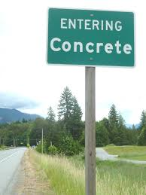
Agenda
Introduction
Air Entraining Agents
Water reducers
Retarders
Accelerators
Strength Enhancers
Corrosion Inhibitors
Lubricants

Slide 3
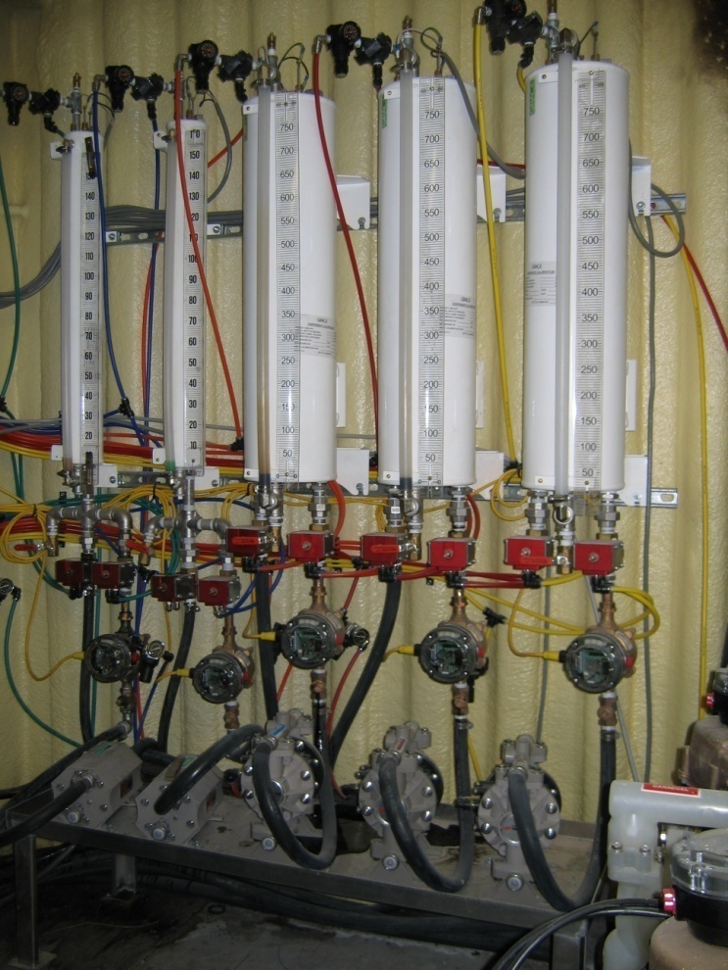
Admixtures for Concrete
Modify and improve many of the properties of concrete.
Make higher performance (engineered) concrete routinely possible.
Admixtures make concrete more user friendly and a better value for both the owner and contractor.
Notes:
5
Admixtures, when used properly, modify, enhance, and improve many of the properties of concrete.
Admixtures make higher performance/engineered concretes routinely possible.
Now that we see why admixtures are important, let’s look at them in more detail.....

Slide 4

Admixtures What Are They?
Chemical Admixture - a liquid, or dispersible powder, used as an ingredient in a cementitious mixture to improve its economy and/or properties in the plastic and/or hardened state.
(ACI 212)
Notes:
Key slide.
Highlight of the benefits of using admixtures
Productivity gains. Materials savings. Process improvements.

Slide 5
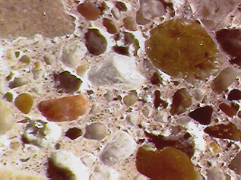
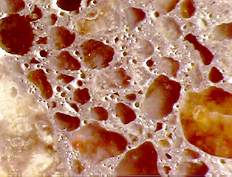
Air Void Systems
Discovered in the 1930’s and is still considered one of the most significant improvements in concrete technology.
Most standard specifications require that concrete be air entrained if exposed to freeze thaw cycles.
Uses air entraining admixtures to create a network of small disconnected air voids distributed through out the concrete.

Slide 6


Air Void Systems
Standards
AASHTO
  M 154 Standard Specification
ASTM
  C 260 Standard Specification
  C 233 Standard Test Methods
Notes:
10

Slide 7

Air Void Systems
Absolutely necessary for F/T durability
Other benefits
  improved workability
  reduced segregation and bleeding
  reduced permeability
  improved finishing with harsh mixtures
  Increased yield
Notes:
10

Slide 8
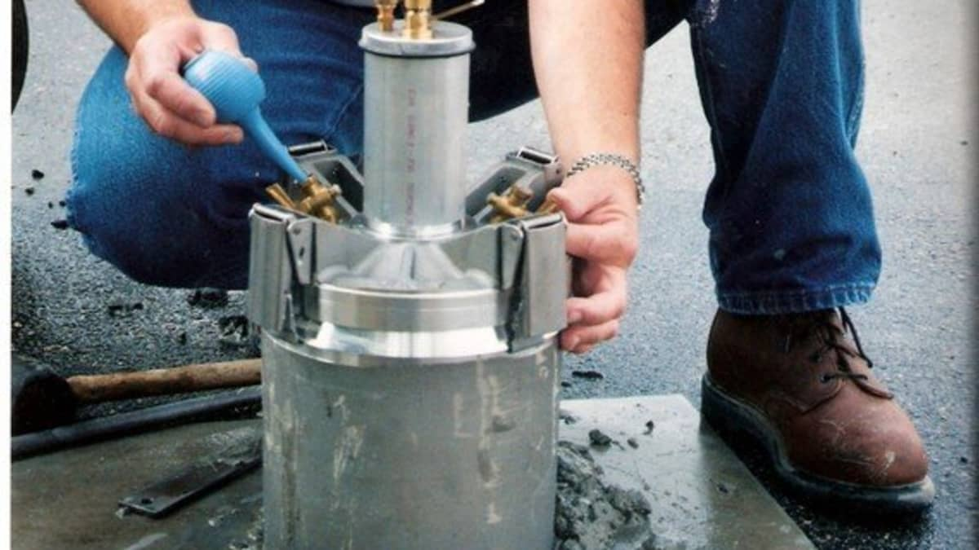
Air Void Systems
Challenges….
Getting the right amount
Dealing with variability
Reduced strength
“Sticky” mixtures
Lower abrasion resistance
Reduces bleeding time

Slide 9
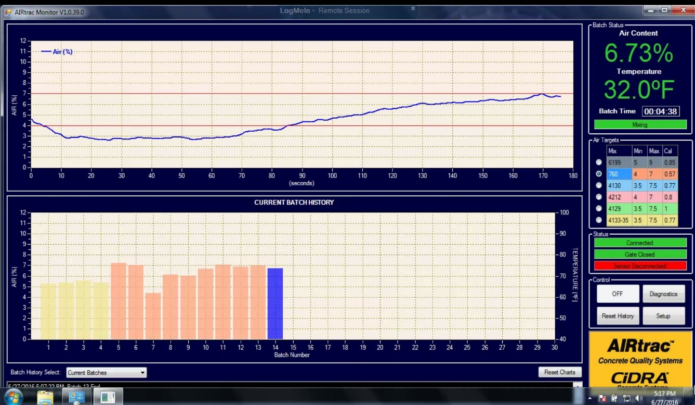
Air Void Systems
What impacts the Air Void System
Amount & Type of OPC
Amount & Type of SCM
Aggregates
Water Content
Concrete & Ambient Temperature
Other Admixtures
Mixing Variation
Placing procedure
Consolidation process…
…and so on, and so on…

Slide 10
Water Reducers and High Range Water Reducers
(HRWR = Super Plasticizers)
Notes:
WRDA and Supers are of many differing chemistries and compositions and understanding how they work is important to concrete production.

Slide 11

ASTM C 494 / AASHTO M 194*
Standard Specification for Chemical Admixtures for Concrete
  Type A - Water Reducing
  Type B - Retarding
  Type C - Accelerating
  Type D - Water Reducing & Retarding
  Type E - Water Reducing & Accelerating
  Type F - High Range Water Reducing
  Type G - HRWR & Retarding
  Type S – Specific Performance Admixture
AASHTO M 194 includes a requirement for 56-day strength
Notes:
26
Most other admixtures fall under ASTM C 494, the Standard Specification of Chemical Admixtures. We will not review the specifications in detail; however, the important aspects of the specification relates to set time and strength at various ages. Anyone interested in reviewing these specifications in greater detail should refer to ASTM Standards volume 04.02.
All commercially available admixtures from Grace meet the appropriate standards and compliance data is available on request.
Since there are several different types of water-reducers - high range, retarding, etc.. let’s begin here.....

Slide 12

Water Reducing Admixtures: What Are They?
  Admixtures that either increase the slump of freshly-mixed mortar or concrete without increasing water content OR
  maintain slump with a reduced amount of water, the effect being due to factors other than air entrainment.
ACI - 212

Slide 13
Water Reducing Admixtures
Overview
  Can be used to reduce water content, improve slump or both
  Three groups: Type A, Mid range, and High range
How they work
  Reduces flocculation and improves hydration efficiency
Effects on concrete
  Increased strength
  Increased slump and workability
Notes:
Keeps particles separated creating less friction between the particles and superior cement hydration. 5% - 12% for low range, high range reducer provide as much as 30% reduction in water. Mid range, while not recognized by ASTM C494 provide water reduction in the area between low and high range reducers. . Added benefit is a slight retarding affect, which can enhance workability time as well as result in increased 28 day strengths.

Slide 14
Water Reducing Admixtures
Water reduction/increased workability normally requires three processes:
DIFFUSION:
Water
miscibility
ADSORPTION:
Attraction to
cement surface
REPULSION:
Imparts a force that overcomes attractive forces between adjacent hydrating cement grains (dispersing ability)

Slide 15
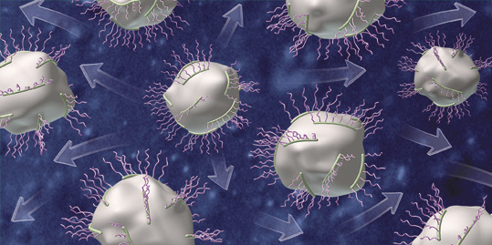
Dispersant Mechanisms
Electrostatic Repulsion
  Adsorbed charged molecules and polymers cause particle dispersion through repelling force of like charges on the surfaces of adjacent cement grains
  Overdose can cause massive bleeding and segregation
Steric Repulsion
  Physical force produced when two adsorbed polymers try to occupy same space in the pore water.
  Overdose usually will not cause segregation in well designed concrete mixtures
CEMENT
CEMENT

Slide 16
Dispersant Mechanisms
High Early Strength (Long Teeth)
z
y
Increased slump life
Teeth Density
Understanding Polymer Structure vs. Concrete Performance critical to leverage value of PC Technology
Increased DR and Thixotropy
Teeth Length
Slump Retention (Dense Teeth)
Backbone Length
Moderate DR and Slump Retention
x

Slide 17
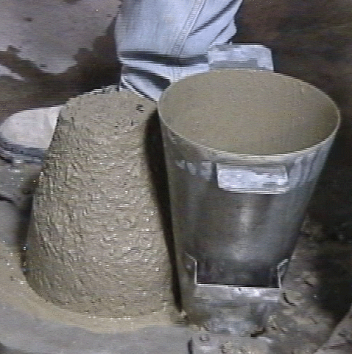
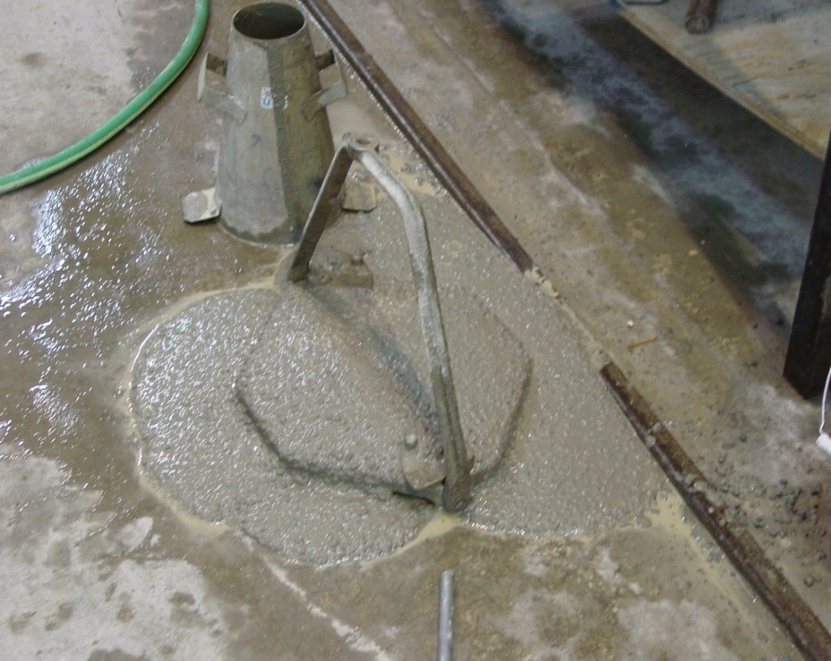
Dispersant Mechanisms
No Admixture
Admixture

Slide 18
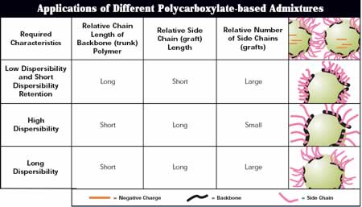
PC Structure and Application
Ready Mix
PC/PS
Slump Retention

Slide 19
Water Reducing Admixtures
Product Type | Class | Water Reduction | Typical Dosage | Strength Gain
Water Reducer | Low | 4-7% | 2-4 oz/cwt | ~ 10%
Mid-Range | Mid | 5-12% | 6-12 oz/cwt | ~ 15%+
HRWR (NSFC) | High | 12-25% | 10-18 oz/cwt | ~ 20%+
HRWR (PC) | High | 12-35% | 3-8 oz/cwt | ~ 20%+
Notes:
The water reducer acts as a floc buster and separates the cement particles. Trapped water is released increases the workability and slump of concrete.

Slide 20
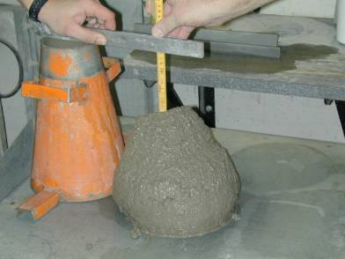
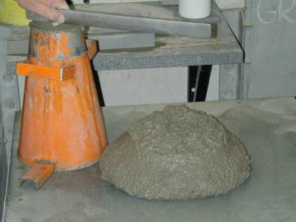
Effects of HRWR on Properties of Fresh Concrete
Increases workability
Improves flow
Improves placeability
Improves finishability
Improves formed surfaces (Swipe)
Can have an effect on air content and setting
Notes:
Setting times can be extended, workability times can be extended, and air entrainment admixture dosage generally has to be recalibrated.

Slide 21
Effects of HRWR on Properties of Hardened Concrete
Improved Strength
Improved Durability
  Chloride resistance increases
  Frost resistance improves
  Increases sulfate resistance
  Increases resistance to abrasion
Notes:
In nut shell by creating lesser void areas, lesser chance for outside elements creating problems. Lower w/c translate to higher strength. However, additional cost, modification with air entraining, less responsive with some cements.
Features above are due to lower w/c

Slide 22
Set Retarding Admixtures
Retarders / Hydration Stabilizers

Slide 23

Why Use Set Retarding Admixtures?
Hot Weather:
  Increase water demand
  Faster set times
  Hasten evaporation rate
  Increase potential for plastic cracking
  Accelerate workability loss
Use of retarders is not a substitute for adequate hot weather concreting procedures
Notes:
59
Hot weather brings different problems for concrete. Slump loss and difficulty in placement are minimized by the use of set retarding admixtures. The effect is similar to that seen with Accelerating admixtures
In addition to slowing down set under hot conditions:
Retarding admixtures can also be used to cause large placements/slabs to set up uniformly. Higher additions of retarders at the beginning of a placement with decreasing dosage rates as the placement continues can allow the entire concrete placement to set uniformly. Clearly, this requires some pretesting to determine optimal dosage rates.
Concretes with high cement factors tend to generate significant heat during the hydration process. Much like with hot weather condition, retarding admixtures can be used to minimize this effect.
Finally, most retarders also have water-reducing properties and impart some improvements in workability to a concrete mixture.

Slide 24
Set Retarding and/or Hydration Stabilizing Admixtures
How they work
  Decreases the rate of cement hydration (C3S)
  Admixture absorbs onto cement grains and temporarily inhibits crystal growth
Effects on Concrete
  Delays Initial set
  Extends workability time
Differences between Retarder and HS
  Range of control over the variety of hydration processes at the surface of the cement grain
    Retarders can slow, HS can stop
Notes:
Two types; Type B retarder and Type D water reducer and retarding also provide a retarding effect. Both types offset unwanted effects of high temperatures / high cement contents. Like acceleration of set and reduction of 28 day strengths.

Slide 25
Set Accelerating Admixtures
Accelerators

Slide 26
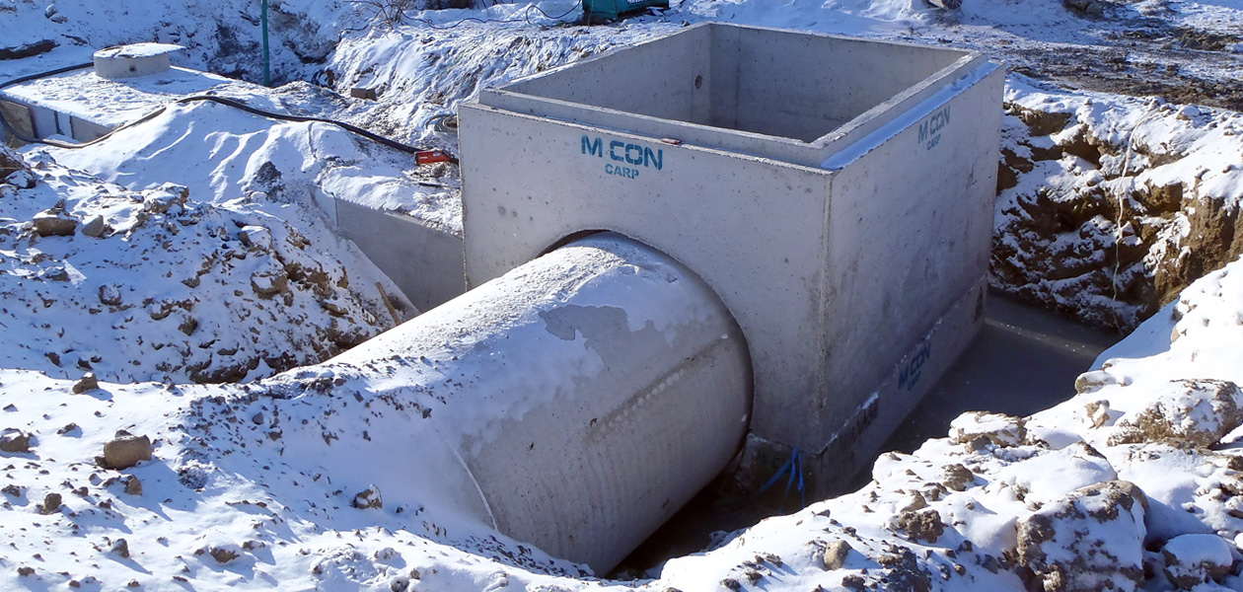
Accelerators
Some common names:
  Calcium, CC, NCA, non chloride & accelerator
Allows concrete to be “used” faster

Slide 27

Accelerators
Speed up both initial and final time of set
Speed up strength development
General Categories: Chlorides and Non-Chloride
Notes:
Calcium Chloride is not recommended for use in reinforced concrete due increased corrosion of the reinforcement in its presence.
27

Slide 28
Accelerators
How they work
  Increases rate of cement hydration
Why accelerate concrete?
  Shorten the setting time
  Reduced curing time
  Quicker early strength
  Reduce bleeding
  Earlier finishing
  Improved initial protection against freezing
  Reduction of protection time to achieve a given quality
They are NOT anti-freeze agents
Notes:
The admixture stimulates the calcium compounds in the cement. Accelerators are not anti-freezing agents, therefore concrete must be protected in freezing weather. Other types of accelerators would be silicates, alkali hydroxide, nitrates, and bromides.
Some accelerators are used to reduce set time only w/o increase in early strength, others are used specifically to increase early strength.
Be sure to verify if accelerator contains chloride or not

Slide 29
Calcium Chloride
Very effective & economical accelerator
Cautions when using chloride-bearing admixture
  DO NOT use in ANY reinforced concrete
  high potential to cause corrosion
  calcium chloride should not exceed 2% in non reinforced concrete
  calcium chloride should not exceed 1% when concrete contains uncoated aluminum conduit
  can cause discoloration issues (dark and light gray spots, especially on hard trowled finishes)
Although often the most effective, non-liquid CC (pellets/flake) is not recommended
Notes:
Should not be used where sulfate resistance is required. Should be dissolved in a portion of mixing water before batching (reduce lumps that may disfigure concrete later). Should be dispensed separately in the mix from air entraining admixtures.
Be sure local specs allow this type of accelerator
29

Slide 30

Non-Chloride Accelerators (NCA)
Non – corrosive
Linear dosage
NOT Anti-freeze
Notes:
Should not be used where sulfate resistance is required. Should be dissolved in a portion of mixing water before batching (reduce lumps that may disfigure concrete later). Should be dispensed separately in the mix from air entraining admixtures.
Be sure local specs allow this type of accelerator
30

Slide 31
Strength Enhancing Admixtures
Sustainable Solutions

Slide 32
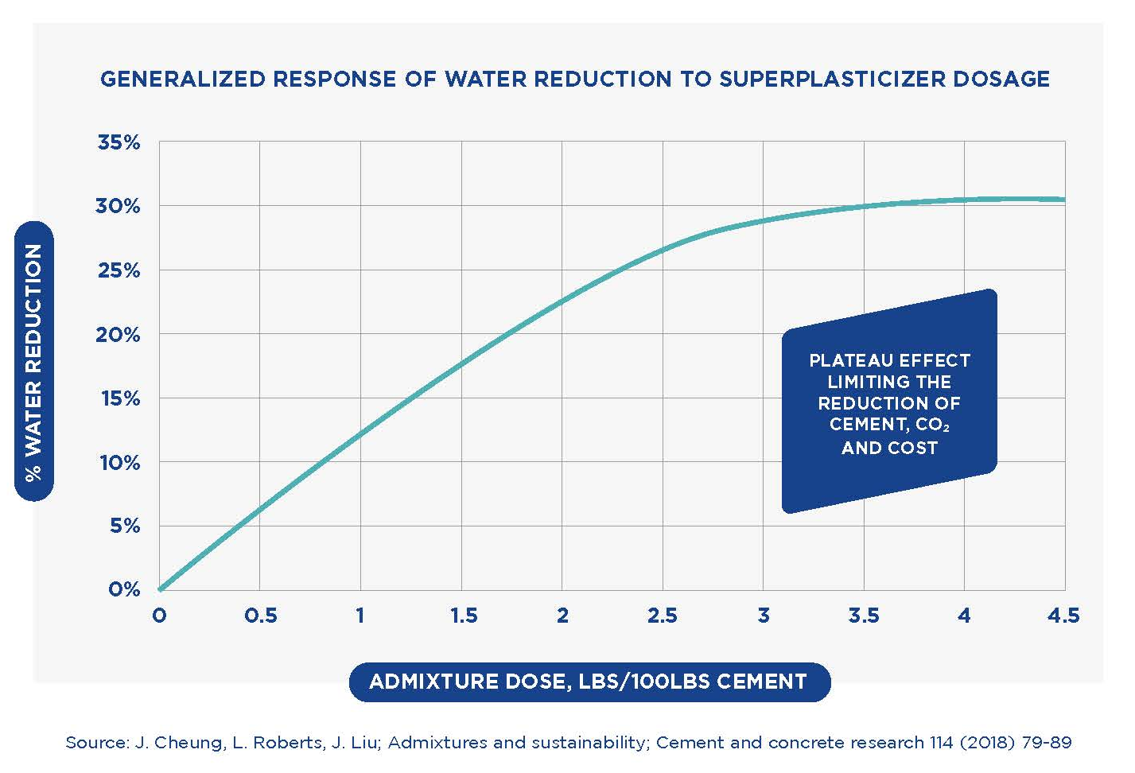
STRENGTH ENHANCERS
THE CHALLENGE:
While water reducers are a powerful solution to reduce Cement Factor, their use can reach limits. Admixture researched solutions have been developed to further reduce the cement content without impacting concrete performance.
LESS CEMENT
LESS COST
LESS CO₂
in excess of 10% STRENGTH INCREASE

Slide 33
Enviromix SE
Product Features – Case Studies
  Accelerates the hydration of cement and supplementary cementitious materials
    Including Type I/II, Type IL, Fly-Ash
  Enhances early and late age strengths
  Allows to reduce the cement factor by up to 10%, while maintaining desired concrete quality and performance
  Range of formulations to meet the specific requirements of concrete producers
  Simple to use: no impact on fresh concrete properties; compatible with WRA admixtures
  Case Study 1 (Southeast US)
  Initial CF = 750 lbs./cu.yd.
  Cement reduction of 50 lbs (32 lbs CO₂/cu.yd.)
  Comparable strength at 1 and 28 day
with
with
  Case Study 2 (South US)
  Initial CF = 550 lbs./cu.yd. and 850 lbs./cu.yd.
  Cement reduction of 40-85 lbs (25-50 lbs CO₂/cu.yd.)
  Same strengths at 28 days
Str. Enhancer
Str. Enhancer

Slide 34
Corrosion Inhibitors

Slide 35
Corrosion Inhibitors
How they work
  Passive film enhances the protection of reinforcing steel from corrosion in the concrete
  Generally, corrosion inhibitors are not needed to protect steel reinforcing, due to the passivating effect of the high pH in the concrete.
Effects on Concrete
  May accelerate initial set
  May improve early age strength
Notes:
Typically concrete pH is around 12 to 13 during the initial hydration phase. These admixtures are added to concrete during batching and they protect embedded reinforcement by delaying the onset of corrosion and also reducing the rate of corrosion after initiation.

Slide 36
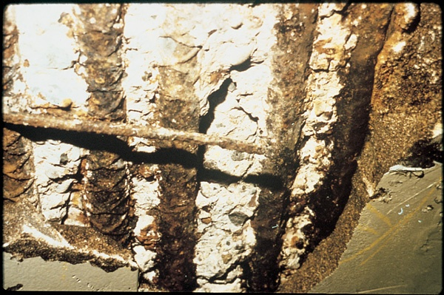
Corrosion Inhibitors
Control Corrosion of Steel Reinforcement
Dosage dependent on anticipated chloride loading
Notes:
Chlorides introduced from deicing salts or seawater lead to corrosion of embedded steel in concrete. (Insert): The damage to this concrete parking structure resulted from chloride-induced corrosion of steel reinforcement. (50051).
Not uncommon to use gallons of corrosion inhibitor – depends upon anticipated chloride exposure and resulting corrosion.

Slide 37
Lubricants and Surfactants

Slide 38
Lubricants & Surfactants (Drycast)
How they work
  Decreases surface friction and therefore aids in stripping forms
  Increased reaction to vibration
  Improved moisture retention
  Improved production efficiency
Effects on Concrete
  Can improve appearance
  Improved water tolerance
  Increase in surface paste

Slide 39
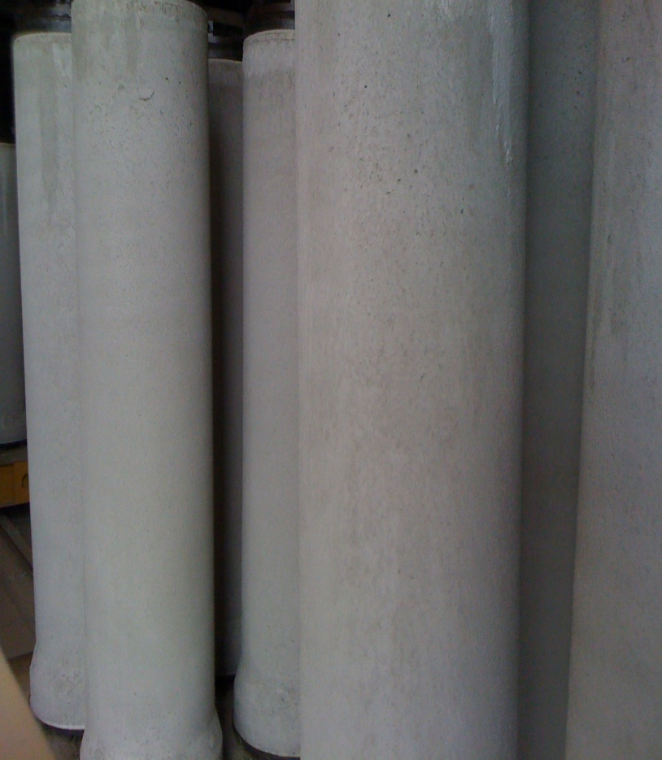
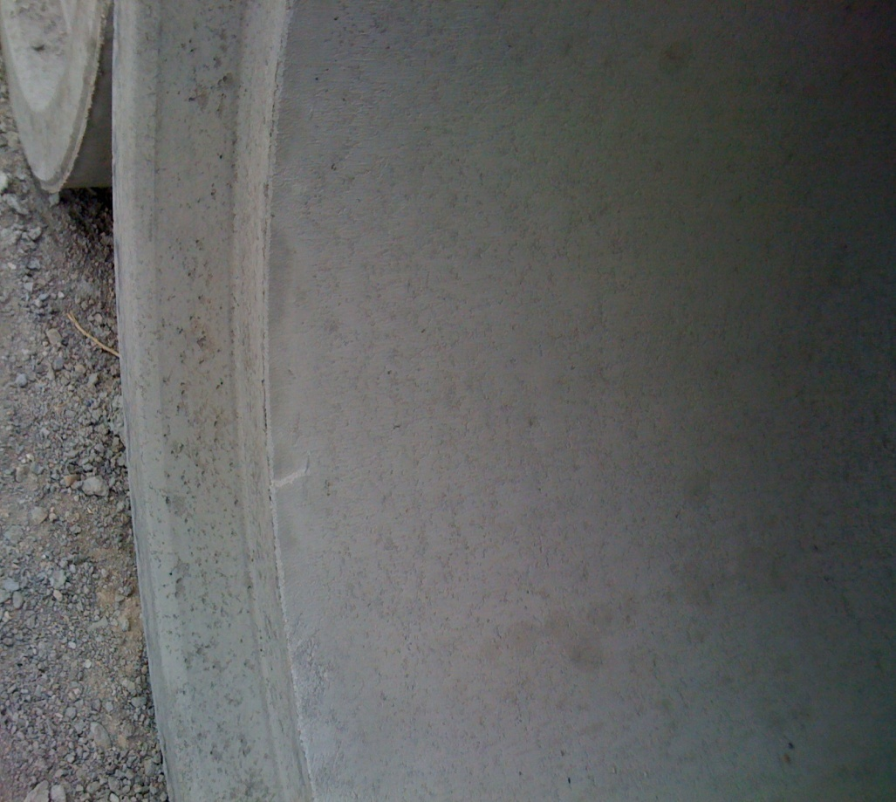
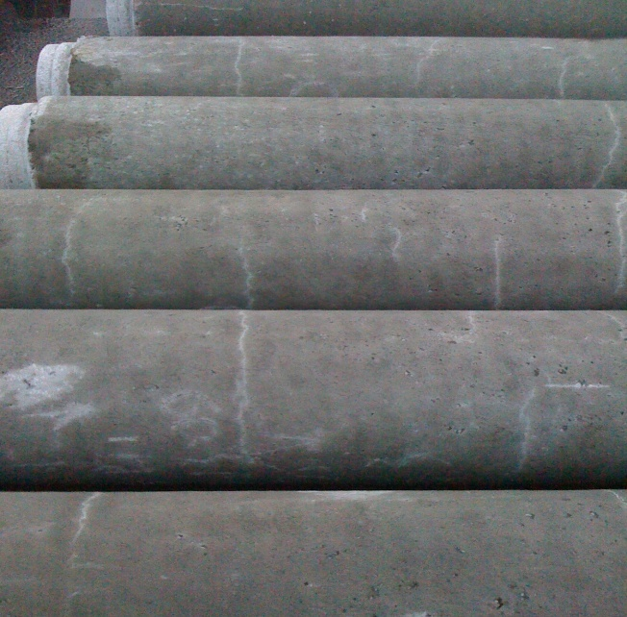
Dry Cast Admixtures
  Reduction in Cracking
  Improved surface swipe
  Sharper joints
  Reduced repair
Notes:
Rheology modifiers (mix lubricants) can enhance the mechanical consolidation of concrete mixes, speeding production and reducing the stickiness of the mixes. They can also improve the hydration characteristics of low water content mixes and reduce moisture loss due to evaporation. Improved surface finishes and leak proof joints can be a benefit of using these types of products.

Slide 40
Current Admixture Standards
ASTM C 494 ASTM C 260 ASTM D 98 ASTM C 869 ASTM C 1141 ASTM C 1017 ASTM C 937 ASTM C 979 | Chemical Admixtures Air-entraining Admixtures Calcium Chloride Foaming Agents Admixture for Shotcrete Flowing Concrete Grout Fluidifier Pigments
Notes:
Summary of ASTM standards for concrete admixtures. Within some of specs are many sub-specs, such as ASTM C494 has Type A-G categories.

Slide 41
Admixtures can be used to modify various fresh and hardened concrete properties:
Fresh state | Hardened state
decrease water content increase workability reduce segregation reduce the rate of slump loss improve pumpability improve placeability & finishability modify the rate of bleeding retard or accelerate setting time | improve freeze / thaw resistance improve impact & abrasion resistance inhibit expansion due to ASR inhibit corrosion reduce shrinkage cracking reduce permeability produce colored concrete produce cellular concrete
Notes:
Admixtures provide an important component to improving the performance of concrete.

Slide 42
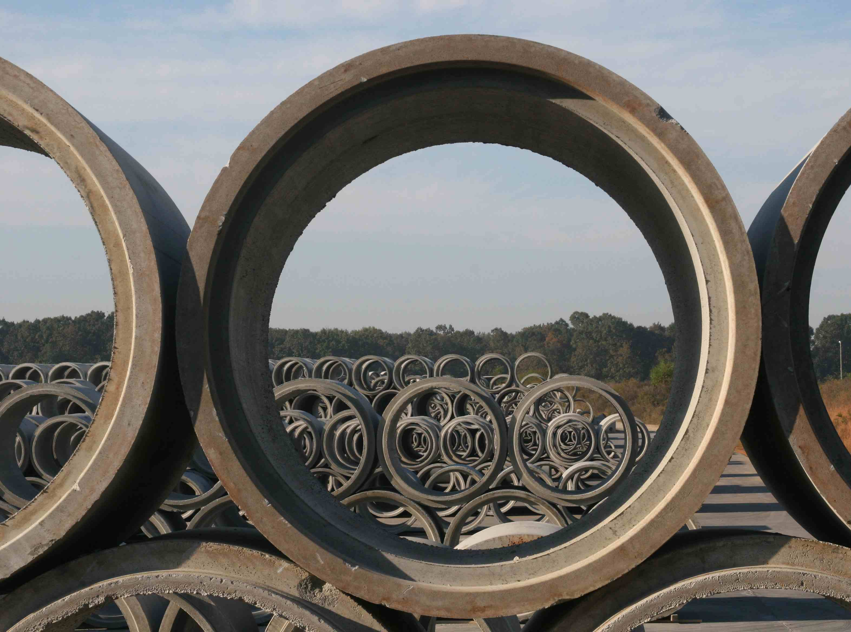
QUESTIONS?

