Slide 1
Aggregates for Use In Concrete

Slide 2
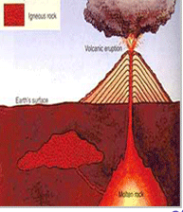
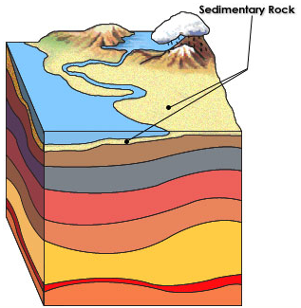
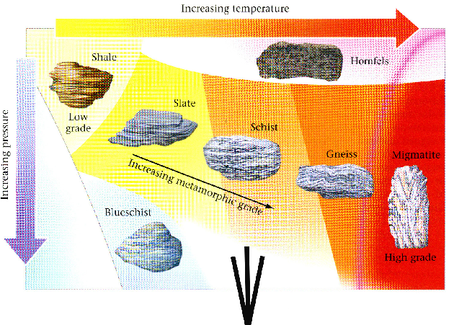
Mineralogy
Igneous (Latin - “Fire”)
  Formed from volcanic processes and the heating and cooling of magma
    Example: granite
Sedimentary (Latin - “Settling”)
  Formed by the layering of sediments due to the action of wind or water
    Example: sandstone
Metamorphic (Greek - “Change”)
  Result from long-term high temperature and pressure on igneous and sedimentary rocks
    Example: marble

Slide 3
Concrete
Composition
Notes:
WHILE OFTEN NEGLECTED OR IGNORED, THE AGGREGATE PORTION OF CONCRETE IS BY FAR THE LARGEST COMPONENT.

Slide 4
Aggregate Types
Natural Aggregates –
  particle sizes from boulder to clay;
  May have poor quality without modification
Manufactured Aggregates –
  produced through crushing, screening, separating, and recombining rock deposits or natural aggregates

Slide 5
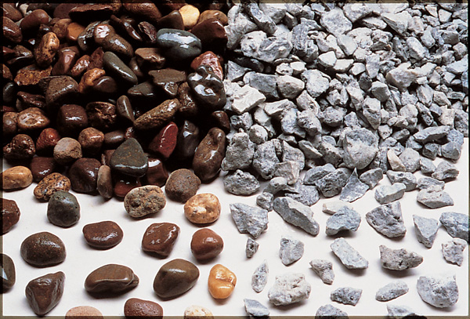
Coarse Aggregate
Gravel and crushed stone
≥ 4.75 mm (0.2 in.), larger than #4 sieve
typically between 9.5 and 37.5 mm (3/8 & 1½ in.)
Notes:
Coarse aggregate. Rounded gravel (left) and crushed stone (right)

Slide 6
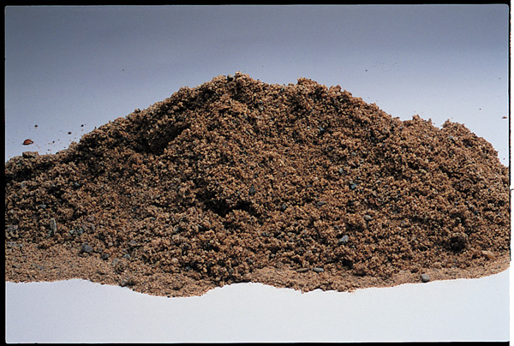
Fine Aggregate
Natural sand, manufactured sand or crushed stone
< 4.75 mm (0.2 in.), will pass #4 sieve
F.A. content usually 35% to 45% by mass or volume of total aggregate
Notes:
Close up of fine aggregate (sand).

Slide 7
Important Aggregate Properties
  Durability, Freeze - Thaw and Chemical Resistance
  Hardness, Toughness, Abrasion
  Texture & Shape
  Strength
  Unit Weight / Density
  Cleanliness

Slide 8
Aggregate Specifications
ASTM C33 - Normal Weight Aggregates
ASTM C330 - Lightweight Aggregates
ASTM C637 - Radiation Shielding Aggregates (Heavyweight)
Notes:
ASTM C637 - Natural mineral aggregates such as barite or hematite. Synthetic aggregates such as iron, steel. And fine aggregate consisting of natural or manufactured sand including high-density minerals.

Slide 10
Aggregate Specifications
ASTM C33 - Normal Weight Aggregates
  Durability requirements

Slide 11
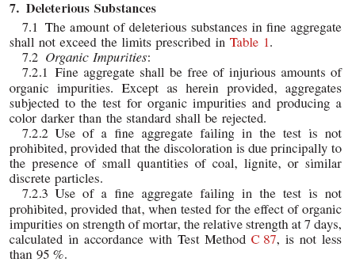

Slide 12
Harmful
Materials in
Aggregates

Slide 13
Item | Mass % of Total Sample
Clay lumps and friable particles | 3.0
Material finer than 75 micron (No. 200) sieve:
Concrete subject to abrasion | 3.0*
All other concrete | 5.0*
Coal and lignite:
Where surface appearance of concrete is of importance | 0.5
All other concrete | 1.0
Deleterious
Substances
Source: Table 1 Limits for Deleterious Substances in Fine Aggregate for Concrete, ASTM C 33.
* In the case of manufactured sand, if the material finer than the 75-micron (No. 200) sieve consists of the dust or fracture, essentially free of clay or shale, these limits are permitted to be increased to 5 and 7%, respectively.
Notes:
Lignite is of poorest quality material

Slide 14
Notes:
ASTM C40 test for organic impurities, i.e. decayed vegatable matter.

Slide 15
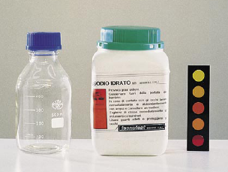
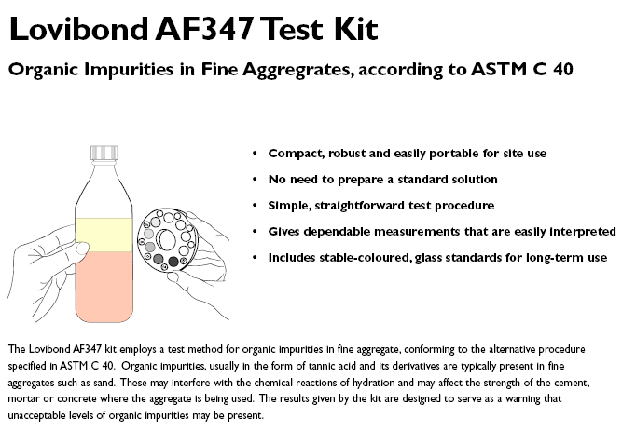
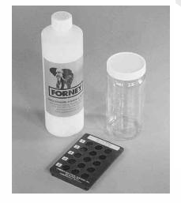
Organic Impurities C40 (fine aggregate)
3.0% Sodium Hydroxide Solution
Two procedures one uses a standard color solution and the other uses a glass color standard, if color is darker possible further testing may be necessary
Notes:
Various Manufactures various Test Kits

Slide 16
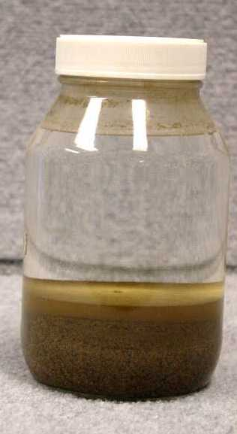
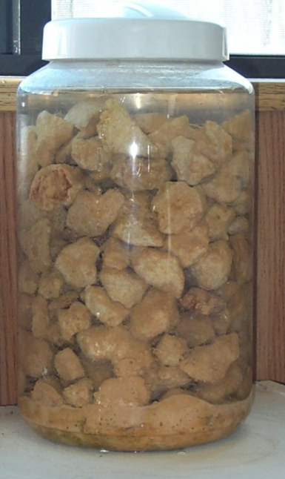
Aggregate Silt Test
Check for silt or clay
Mason jar test is not official test, but only an indication of how much fine material is present
Check ASTM C33 for amount and type of allowable fine material
Use a “Mason jar”
Notes:
Table top test

Slide 17
Aggregate Durability - Soundness
Needed to resist breakdown or disintegration when subjected to wetting/drying and/or freezing/thawing

Slide 18
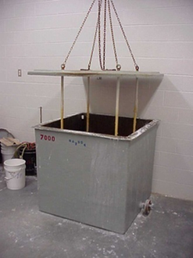
Aggregate Durability - Soundness
Resistance to weathering action
Standard Test
  ASTM C 88, Sodium or Magnesium Sulfate Soundness
  Intended to simulate wet/dry and freezing/thawing conditions
Reproducibility of results is sometimes difficult
Notes:
Key to this test is to determine the how well the aggregate holds up to freeze thaw cycles

Slide 19
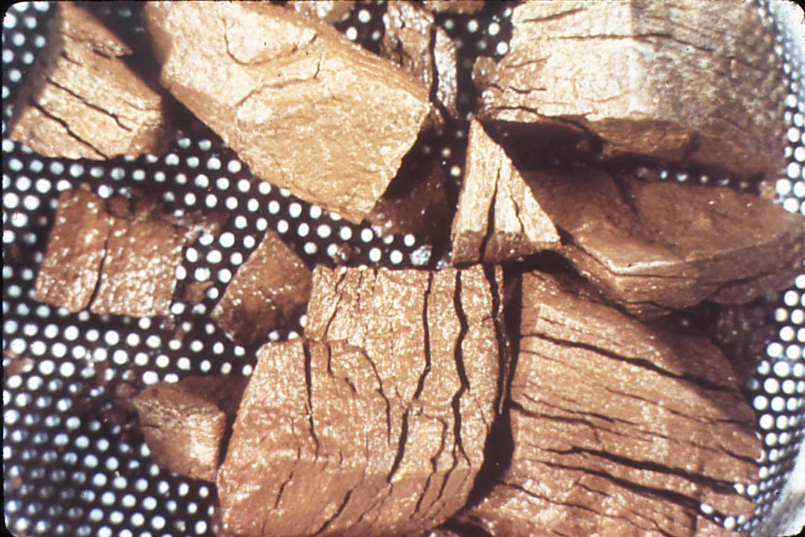
Aggregate Durability - Soundness
Test consists of 5 cycles of soaking in sulfate solution followed by drying. After the 5 cycles any breakdown of the aggregate is removed and the loss in weight calculated.
This value is reported as the “Soundness Loss”
Typical Specification Limits are between 8-18% depending on which salt is used
Magnesium salt gives higher losses than Sodium
Notes:
Soak samples for 16 to 18 hours. Samples are then dried at 230 degrees F until constant weigh is recorded.

Slide 20
Aggregate Durability – Toughness/Abrasion Resistance
Needed to resist crushing, degradation, and disintegration during stockpiling, mix production, construction, and traffic

Slide 21
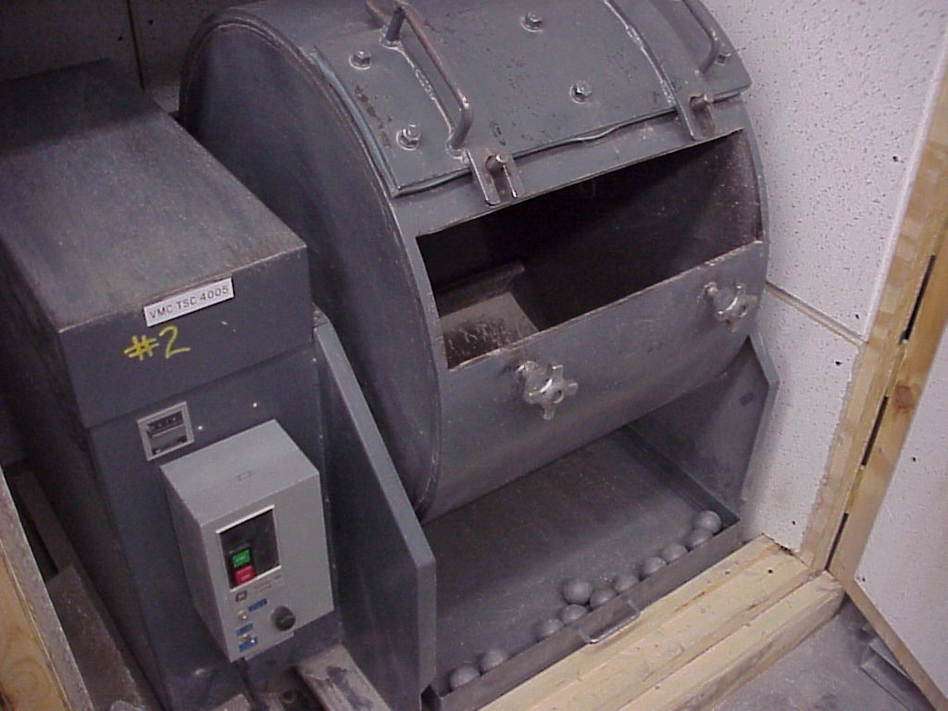
Aggregate Durability – Toughness/Abrasion Resistance
L.A. Abrasion Test
  To evaluate the aggregate’s resistance to degradation during processing, mixing, placing, and later while in service
Standard Test Methods
  ASTM C 131 (aggregates < 1-1/2”)
  ASTM C 535 (larger aggregates)
ASTM C33 50% maximum loss
Notes:
In other words checking to make sure aggregate is not to soft.

Slide 22
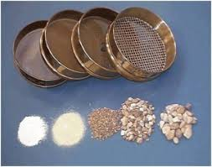
Aggregate Specifications
ASTM C33 - Size and Gradation

Slide 23
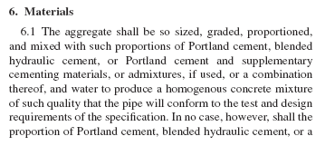
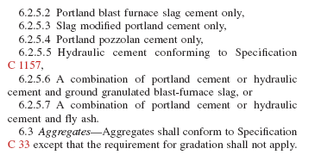
Always read the Materials section of an ASTM

Slide 24
Coarse Aggregate Size
Maximum Size:
  The smallest sieve opening through which the entire amount of aggregate is required to pass
Nominal Maximum Size:
  The smallest sieve opening through which the entire amount of aggregate is permitted to pass
Example: ASTM C33 requires that 100% of a #57 coarse aggregate MUST pass the 1.5” sieve but 95 - 100% MAY pass the 1” sieve, therefore #57 aggregate is considered to have a Maximum size of 1.5” and an Nominal Maximum size of 1”

Slide 25
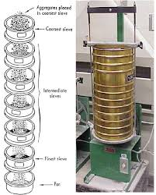
Aggregate Gradation
Also known as “sieve analysis”
It is the distribution of particle sizes
“Well-graded” aggregates:
  particles evenly distributed among sieve sizes
  require less cement and water than “poorly graded” aggregates
Careful choice of aggregates provides for optimization of cement, water and admixtures

Slide 26
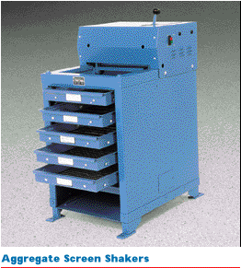
Standard Sieve Sizes
Sieve Size
Metric Size
International
1-1/2”
1”
3/4”
1/2”
3/8”
#4
#8
#16
#30
#50
#100
#200
38 mm
25 mm
20 mm
12.5 mm
10 mm
4.75 mm
2.50 mm
1.12 mm
0.6 mm
0.3 mm
0.15 mm
0.075 mm
37.5 mm
---
19 mm
---
9.5 mm
4.75 mm
2.36 mm
1.18 mm
0.6 mm
0.3 mm
0.15 mm
0.075 mm
Not used in FM Calculation
Notes:
#4 sieve is 4 openings per inch..etc

Slide 27

Sand Stone Well Graded Blend
Notes:
Well graded equals less paste needed to fill voids

Slide 28
Aggregate Gradation Affects:
Workability
Pumpability
Economy
Porosity
Shrinkage
Durability
Notes:
Point: Gradation affects many things, not just one thing

Slide 29
ASTM C 33 Grading for Fine Agg
Fineness Modulus (FM)
Sieve | Percent Passing
3/8 in | 100
No. 4 | 95-100
No. 8 | 80-100
No. 16 | 50-85
No. 30 | 25-60
No. 50 | 5-30
No. 100 | 0-10
A single number system used to express the fineness or coarseness of an aggregate
Sum of cumulative % retained on the standard sieves
Certain sieves are NOT counted (1/2” & pan even if used)
Notes:
2.3 is finer than 3.1
½” and pan not used in FM calculation

Slide 30
Fineness Modulus (FM)
Per ASTM C33, FM of fine aggregate should be between 2.3 and 3.1
Higher FM values indicate coarser grading
Lower FM values indicate finer grading
FM of coarse aggregate can also be calculated and can aid in blending coarse and medium size materials
CONSISTENCY IS THE KEY!
Notes:
gradation of the aggregate = distribution of particle sizes
The Fineness modulus (FM) is an empirical figure obtained by adding the total percentage of the sample of an aggregate retained on each of a specified series of sieves, and dividing the sum by 100. The same value of fineness modulus may therefore be obtained from several different particle size distributions.

Slide 31
Fine Material passing the No. 200 Sieve
Very fine material such as silt, clay, or dust of fracture can increase the water demand in concrete
Fines limit is 3% in ASTM C 33 for concrete subject to abrasion
Manufactured sands 5% and 7%
Coarse aggregate limit is 1% (1.5% for crushed stone)
Notes:
Low FM is generally sandy in texture more water, less strength. High FM lesser water, better strength, but workability not as good.
Note: #200 doesn’t pertain to FM calculation.
Local spec may govern the above requirements
The finer the modulus the more friction you incur when stripping

Slide 32
Gradation and Fineness Modulus - Example
Dry Sample Wt. |  |  | g
Sample:
 |  | Retained
Sieve Size, (mm) | Sieve Size, (US) | Mass, (g)
150 | 1 1/2"
75 | 1"
37.5 | 3/4"
19 | 1/2"
9.5 | 3/8
4.75 | # 4
2.36 | # 8
1.18 | #16
0.6 | # 30
0.3 | # 50
0.15 | # 100
Pan | Pan
Total
Sieve Loss Check
Notes:
Example work sheet

Slide 33
Gradation and Fineness Modulus - Example
Dry Sample Wt. |  | 1267 | g
Sample:
 |  | Retained
Sieve Size, (mm) | Sieve Size, (US) | Mass, (g)
150 | 1 1/2" | 0
75 | 1" | 0
37.5 | 3/4" | 0
19 | 1/2" | 0
9.5 | 3/8 | 0
4.75 | # 4 | 25
2.36 | # 8 | 163
1.18 | #16 | 228
0.6 | # 30 | 278
0.3 | # 50 | 355
0.15 | # 100 | 177
Pan | Pan | 38
Total |  | 1264
Sieve Loss Check |  | 0.24%
ASTM 136
If the amounts differ
by more than 0.3%,based
on the original dry
sample mass, results should
not be used.
(1267-1264) / 1267 x 100 = 0.24%
Notes:
Differ amounts between beginning and end sample weight due to moisture, material lodged in sieve screen, or carelessness of operator.

Slide 34
Gradation and Fineness Modulus - Example
Dry Sample Wt. |  | 1267 | g
Sample:
 |  | Retained
Sieve Size, (mm) | Sieve Size, (US) | Mass, (g) | Ind. % Retained
150 | 1 1/2" | 0 | 0
75 | 1" | 0 | 0
37.5 | 3/4" | 0 | 0
19 | 1/2" | 0 | 0
9.5 | 3/8 | 0 | 0
4.75 | # 4 | 25 | 2.0
2.36 | # 8 | 163 | 12.9
1.18 | #16 | 228 | 18.0
0.6 | # 30 | 278 | 22.0
0.3 | # 50 | 355 | 28.1
0.15 | # 100 | 177 | 14.0
Pan | Pan | 38 | 3.0
Total |  | 1264 | 100
Sieve Loss Check |  | 0.24%
Use original dry mass
(25 / 1267) x 100 = 2.0
(163 / 1267) x 100 = 12.9

Slide 35
Gradation and Fineness Modulus - Example
Dry Sample Wt. |  | 1267 | g
Sample:
 |  | Retained
Sieve Size, (mm) | Sieve Size, (US) | Mass, (g) | Ind. % Retained | Cum % Retained
150 | 1 1/2" | 0 | 0 | 0
75 | 1" | 0 | 0 | 0
37.5 | 3/4" | 0 | 0 | 0
19 | 1/2" | 0 | 0 | 0
9.5 | 3/8 | 0 | 0 | 0
4.75 | # 4 | 25 | 2.0 | 2.0
2.36 | # 8 | 163 | 12.9 | 14.9
1.18 | #16 | 228 | 18.0 | 32.9
0.6 | # 30 | 278 | 22.0 | 54.9
0.3 | # 50 | 355 | 28.1 | 83.0
0.15 | # 100 | 177 | 14.0 | 97.0
Pan | Pan | 38 | 3.0
Total |  | 1264 | 100 | 2.85 FM
Sieve Loss Check |  | 0.24%
1/2” sieve NOT
used to
calculate FM
Never include
the Pan
when calculating
the FM
∑ Cum%
retained/100

Slide 36
Gradation and Fineness Modulus - Example
Dry Sample Wt. |  | 1267 | g
Sample:
 |  | Retained
Sieve Size, (mm) | Sieve Size, (US) | Mass, (g) | Ind. % Retained | Cum % Retained | % Passing
150 | 1 1/2" | 0 | 0 | 0 | 100
75 | 1" | 0 | 0 | 0 | 100
37.5 | 3/4" | 0 | 0 | 0 | 100
19 | 1/2" | 0 | 0 | 0 | 100
9.5 | 3/8 | 0 | 0 | 0 | 100
4.75 | # 4 | 25 | 2.0 | 2.0 | 98.0
2.36 | # 8 | 163 | 12.9 | 14.9 | 85.1
1.18 | #16 | 228 | 18.0 | 32.9 | 67.1
0.6 | # 30 | 278 | 22.0 | 54.9 | 45.1
0.3 | # 50 | 355 | 28.1 | 83.0 | 17.0
0.15 | # 100 | 177 | 14.0 | 97.0 | 3.0
Pan | Pan | 38 | 3.0
Total |  | 1264 | 100 | 2.85 FM
Sieve Loss Check |  | 0.24%
100 - 2 = 98
100 - 14.9 = 85.1
Notes:
The material that passes through the sieve

Slide 37
Gradation and Fineness Modulus - Example
Dry Sample Wt. |  | 1267 | g
Sample:
 |  | Retained
Sieve Size, (mm) | Sieve Size, (US) | Mass, (g) | Ind. % Retained | Cum % Retained | % Passing | ASTM C33 6.1 Fine Aggregate
 |  |  |  |  |  | Min | Max
150 | 1 1/2" | 0 | 0 | 0 | 100 | 100 | 100
75 | 1" | 0 | 0 | 0 | 100 | 100 | 100
37.5 | 3/4" | 0 | 0 | 0 | 100 | 100 | 100
19 | 1/2" | 0 | 0 | 0 | 100 | 100 | 100
9.5 | 3/8 | 0 | 0 | 0 | 100 | 100 | 100
4.75 | # 4 | 25 | 2.0 | 2.0 | 98.0 | 95 | 100
2.36 | # 8 | 163 | 12.9 | 14.9 | 85.1 | 80 | 100
1.18 | #16 | 228 | 18.0 | 32.9 | 67.1 | 50 | 85
0.6 | # 30 | 278 | 22.0 | 54.9 | 45.1 | 25 | 60
0.3 | # 50 | 355 | 28.1 | 83.0 | 17.0 | 5 | 30
0.15 | # 100 | 177 | 14.0 | 97.0 | 3.0 | 0 | 10
Pan | Pan | 38 | 3.0
Total |  | 1264 | 100 | 2.85 FM |  | FM 2.3 | FM 3.1
Sieve Loss Check |  | 0.24%
Can you use this SAND to manufacture Pipe under C76?
Notes:
Last 2 columns list min and max specification tolerances for % passing.

Slide 38
Notes:
Graph illustrates a test sample compared to min and max % passing specification.

Slide 40
Gradation and High Fineness Modulus - Example
Dry Sample Wt. |  | 1091 | g
Sample:
 |  | Retained
Sieve Size, (mm) | Sieve Size, (US) | Mass, (g) | Ind. % Retained | Cum % Retained | % Passing | ASTM C33 6.1 Fine Aggregate
 |  |  |  |  |  | Min | Max
150 | 1 1/2" | 0 | 0 | 0 | 100 | 100 | 100
75 | 1" | 0 | 0 | 0 | 100 | 100 | 100
37.5 | 3/4" | 0 | 0 | 0 | 100 | 100 | 100
19 | 1/2" | 0 | 0 | 0 | 100 | 100 | 100
9.5 | 3/8 | 0 | 0 | 0 | 100 | 100 | 100
4.75 | # 4 | 90 | 8.3 | 8.3 | 91.7 | 95 | 100
2.36 | # 8 | 251 | 23.1 | 31.4 | 68.6 | 80 | 100
1.18 | #16 | 230 | 21.1 | 52.5 | 47.5 | 50 | 85
0.6 | # 30 | 190 | 17.5 | 70.0 | 30 | 25 | 60
0.3 | # 50 | 240 | 22.1 | 92.1 | 7.9 | 5 | 30
0.15 | # 100 | 77 | 7.1 | 99.2 | 0.8 | 0 | 10
Pan | Pan | 10 | 0.9
Total |  | 1088 | 100 | 3.54 |  | FM 2.3 | FM 3.1
Sieve Loss Check |  | 0.275%
Notes:
Example of high FM

Slide 41
Can you use this SAND to manufacture Pipe under C76?
Design and Control of Concrete Mixtures, 14th Edition, Portland Cement Association.
Notes:
Graph illustrates a test sample compared to min and max % passing specification.
Remind students: Per C76, gradation has been deleted, and therefore pipe production does not have to fall within C33 gradation. Therefore, answer is yes to the above.

Slide 42
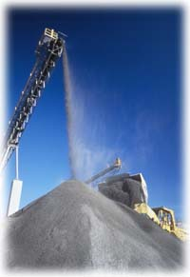
Fine Aggregates: Greatest affect on water demand
Fine aggregates can have 40 times more surface area than coarse aggregates of same weight and volume

Slide 43
2 Units
1 Unit
Volume =
2 X 2 X 2 = 8
Volume =
8 X (1 X 1 X 1) = 8
Surface Area =
6 X (2 X 2) = 24
Surface Area =
8 X (6 X 1) = 48
Small boxes have equal volume,
but twice the surface area.
Notes:
Volume –Length x width x height
Surface area-length x width x # of surface areas

Slide 44
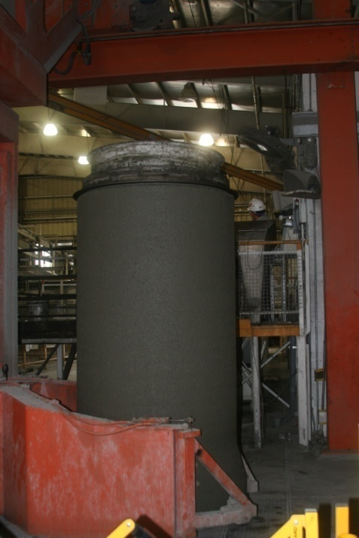
Aggregates critical to water demand
Aggregates take up the largest amount of volume in concrete
Aggregate particle size, distribution, shape, and texture affect the amount of water needed in concrete
Therefore, more than any other material, aggregates have the greatest affect on the water needed for a given concrete workability

Slide 45

Absorption and moisture content
Bone Dry
or
Oven Dry
Air Dry
Absorbed moisture
(absorption)
add water
Saturated
and
Surface Dry
SSD (ideal)
Total water content
Free moisture
(moisture content)
subtract water
Moist

Slide 46
Absorption
Aggregate particles are not solid...they contain pores that absorb water
Concrete mixes are designed based on aggregates being in the saturated surface-dry (SSD) condition
Aggregate in the SSD condition is in a state of equilibrium...it will neither absorb water from nor give up water to a concrete mix
In reality, this state is not achievable in production concrete

Slide 47
Aggregate Moisture Calculations
Total Moisture = Free moisture + Aggregate absorbed moisture
% Total Moisture Content = (Wet Wt - Dry Wt)
X 100
Dry Wt
Example:
Wet Wt = 1000 g
Dry Wt = 980 g
1000 - 980
X 100 = 2.04%
980
Never include the weight of the pan!
%Free Moisture = Total Moisture - Absorbed Moisture

Slide 48
How do we measure moisture in aggregates
Cook out method
  Stove top or microwave
Chapman Flask
“Speedy” moisture meter
Moisture Probes
Total moisture
Free water
Total or free moisture
Total Moisture = Free moisture + Aggregate absorbed moisture
Notes:
Cook out method – ASTM C566 is the most accurate

Slide 49
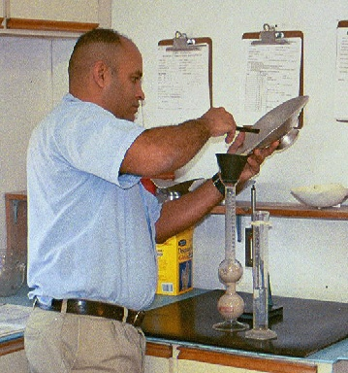
Chapman Flask Method
Fill Chapman flask to 200 ml mark with water
500.0 gram sample of damp aggregate
Add aggregate sample to flask
Agitate flask with sample to remove entrapped air
obtain reading from flask
Using SSD specific gravity of sand look up free moisture on chart

Slide 50
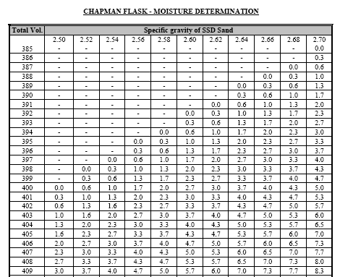

Slide 51
Moisture Probes
Used in batching
Installed per manufactures recommendations
Must be calibrated
There is a difference between a mixer probe and a bin probe
  Mixer probe measures the moisture of the material in your mixer and controls the water to optimize the moisture
  Bin probes measure the moisture of fine aggregates and crushed stone in bin

Slide 52
Moisture Compensation Example
Concrete Mix designs are most often based on SSD conditions for the aggregates, these conditions seldom exist in reality. A mix design containing 1400 pounds of sand with a free moisture of 5% will carry 70 pounds of addition water in to the mix. This water must be adjusted out of the design water
Mix design calls for:
Sand (SSD) 1400 lb.
Water 300 lb.
Design Weights
Batch Weights
SAND:
1400 lb X 5% (free) = 70.00 pounds of water
Batch out (1400 + 70) = 1470
!
WATER:
300 - 70 = 230 net water
All aggregates must be adjusted
Notes:
52

Slide 53
Materials | Pounds of Material | S.G. | Abs Volume | SSD | Moisture Adjustment | Batch Weight
Cement | 400 | 3.15 | 2.04 | 400 |  | 400
Type F Ash | 100 | 2.48 | 0.65 | 100 |  | 100
Miller Stone | 1873 | 2.85 | 10.53 | 1873 | 37 | 1910
Evert Sand | 1247 | 2.62 | 7.63 | 1247 | 50 | 1297
Water | 300 | 1.00 | 4.81 | 300 | 87 | 213
Air | 5% |  | 1.35 | 5%
Total | 3920 |  | 27.00 |  |  | 3920
Density | 145.2 |  |  |  |  | 145.2
Materials | Total Moisture % |  | Absorption % |  | Free % | Moisture Adjustment
Miller Stone | 3.00 |  | 1.00 |  | 2.00 | 37
Evert Sand | 5.50 |  | 1.50 |  | 4.00 | 50
Total moisture = Free moisture + Aggregate absorption
Notes:
Always make sure you adjust your mix for moisture.

Slide 54
Aggregate Texture and Shape
Affect the properties of fresh concrete:
  rough textured, angular, elongated particles have greater surface area and require more cement paste than do smooth rounded particles
  angular and poorly graded aggregates are harder to finish
Generally:
  rounded gravel makes stronger and more finishable lean mixes
  angular crushed stone is better suited for high strength, richer cement paste mixes

Slide 55

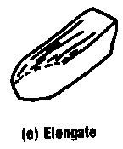
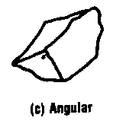
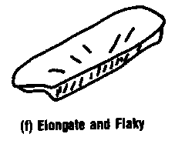
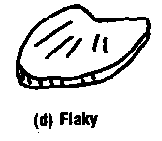
Aggregate Texture and Shape

Slide 56
Review – Concrete Properties Influenced by Aggregates
Strength
  Mineralogy
  Compressive or Flexural strength
  Surface texture and cleanliness
  Particle shape, max size, and gradation
  Compatibility
Finishability
  In general, the more rounded (especially in sand) the particle shape = better finishability
Water Requirements
  Grading, particle shape, mineralogy, and absorption

Slide 57
Review – Concrete Properties Influenced by Aggregates
Workability
  Gradation
    Particle size and distribution
    Affects economy of mix design
    Should be graded up to the largest size practical for job conditions
    Affects workability and placeability
  Nature of particles
    Shape, porosity, surface texture

Slide 58
Review – Concrete Properties Influenced by Aggregates
Durability
  Freeze-thaw resistance, potential for cracking, abrasion, wet/dry, heat/cool, ASR
  Air entrainment will not protect against concrete made with non-durable aggregates
Shrinkage
  Larger the volume fraction of aggregate, the lower the drying shrinkage of concrete
  Use largest nominal max size of coarse aggregate to reduce potential of drying shrinkage

Slide 59
Review – Concrete Properties Influenced by Aggregates
Coarse sand or under-sanded mixes:
  hard to pump
  hard to consolidate
  bleed excessively
  segregate
  hard to get accurate slump
Fine sand or over-sanded mixes:
  increase water demand
  sticky, hard to finish surface
  reduced strength
  blister
  bugholes
  scaling

Slide 60
Specific Gravity
Water: Specific Gravity = 1.00
Stone: Specific Gravity = 2.70
Same Volume, but 2.70 Times More Mass
Notes:
When you dealing with specific gravity you are using it to calculate absolute volumes …..Do not confuse with Bulk Volumes (An Example (1) Cement bulk volume 94 lbs / cubic foot (2) Cement absolute volume 196.56 lbs / cubic foot (3.15 x 62.4). Everything in mix designs is absolute. Absolute volume accounts for all void spaces being filled.

Slide 61
Specific Gravity
The ratio of a material’s weight to the weight of an equal volume of water
Also, the relative density of a material compared to water
Bulk specific gravity (SSD)
  Used to determine the “solid volume” (absolute volume) of a material going into concrete
Ensures proper yield
SG of normal weight aggregates vary from 2.40 to 2.80

Slide 62
Sampling Aggregate for testing
Obtain truly representative sample
  Critical to any standardized testing of concrete materials.
Every time aggregate is moved, handled or stored they tend to segregate.
  As particles tend to segregate (fines vs. coarse) samples obtained may not represent the pile

Slide 63
Collecting and Reducing Field Samples
ASTM D75 Collecting Sample from Stockpile
ASTM C702 Reducing Samples of Aggregate to Testing Size
Sample Splitter Method
  Each sample must be representative of total product ( i.e., sampled correctly)
  Sample Splitter
    Must have equal width chutes
    Must have two receptacles
  Place sample in hopper
  Distribute Evenly
  Allow to Freely Flow
  Repeat as many times as necessary.

Slide 64
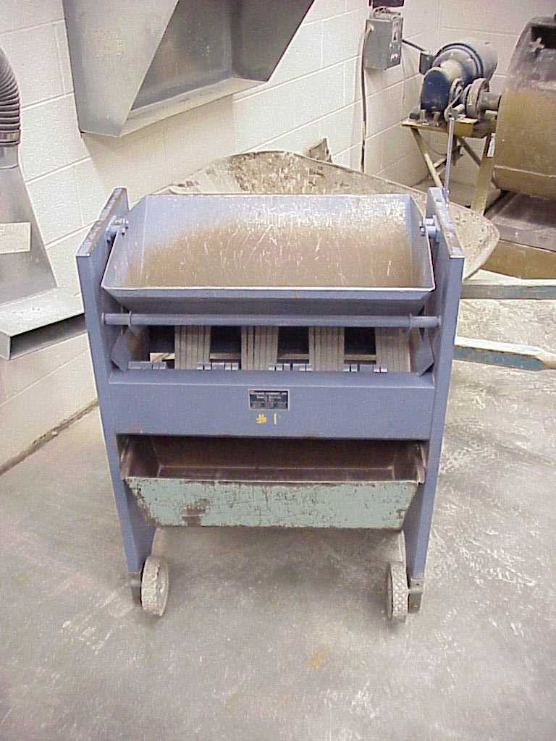
Reducing Field Samples
Sample Splitter Method
  Each sample must be representative of total product ( i.e., sampled correctly)
  Sample Splitter
    Must have equal width chutes
    Must have two receptacles
  Place sample in hopper
  Distribute Evenly
  Allow to Freely Flow
  Repeat as many times as necessary.

Slide 65
Reducing Field Samples
Stockpile Method
  Mix Sample
  Place in Single Pile
  Divide Into Equal Quarters
  Collect Opposite Quarters
Notes:
C702
65

Slide 66
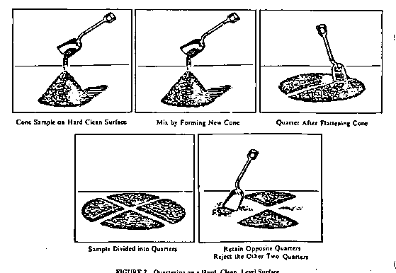
Reducing
Field
Samples
Cone sample on hard, clean surface
Mix by forming new cone
Quarter after flattening cone
Sample divided into quarters
Retain opposite corners, reject other two corners
Quartering on a Hard, Clean Surface

Slide 67
QC/QA Program
Ensures aggregates are sampled and tested correctly
Critical to obtain predictable and consistent concrete properties

Slide 68
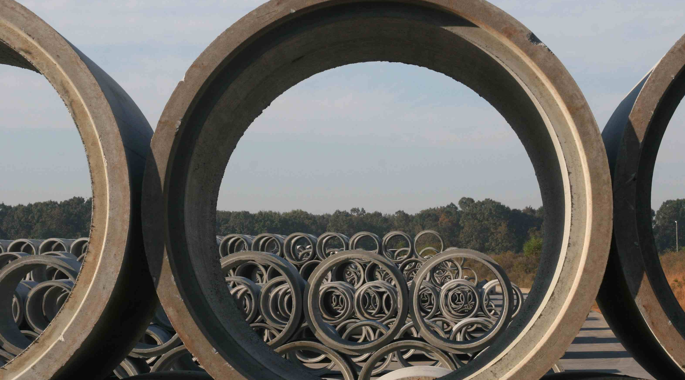
Thank You

