Slide 1
Cement and SCM

Slide 2
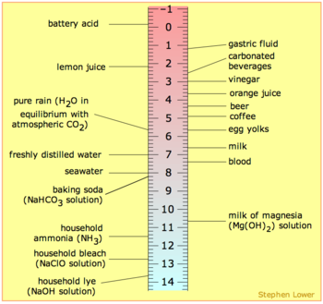
Safety First!
Always wear proper personal protective equipment (PPE) when working with cement and concrete
  Gloves
    Cover all exposed skin that may come in contact with the cement or concrete
  Eye protection
  Respirator
  Hearing protection
  Safety shoes
Portland Cement & Concrete

Slide 3
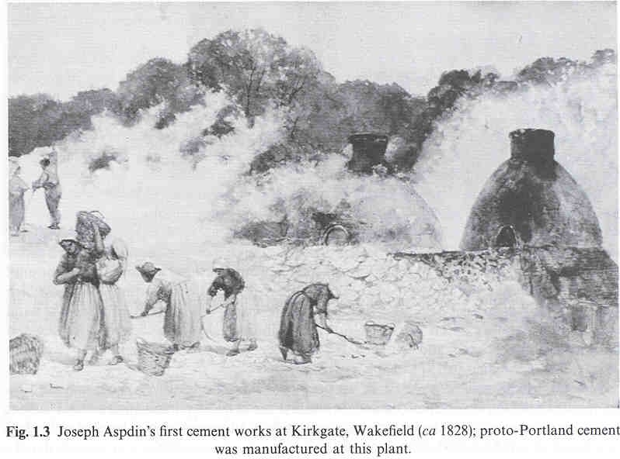
Joseph Aspdin 1824
Early Cement Works
Aspdin’s early cement was nothing more than hydraulic lime, but in 1824 his patent gave him the use of the term Portland cement
Lea’s Chemistry of Cement
Notes:
3
Aspin’s early cement was nothing more than hydraulic lime, but this 1824 paten gave him the priority for the use of the term Portland Cement even though his product was not the Portland Cement that we know today.
The name “Portland” came from the color of the limestone on the Isle of Portland.
Lime- various chemical and physical forms of quicklime, hydrated lime, and hydraulic lime.
Quicklime- calcined limestone; major part calcium oxide , or calcium oxide with magnesium oxide.
Hydratd lime- produced when quicklime and H2O are mixed
Proto-cement: little evidence of Silica - Lime reaction

Slide 4
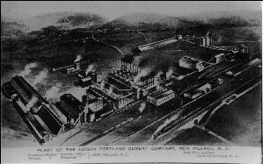
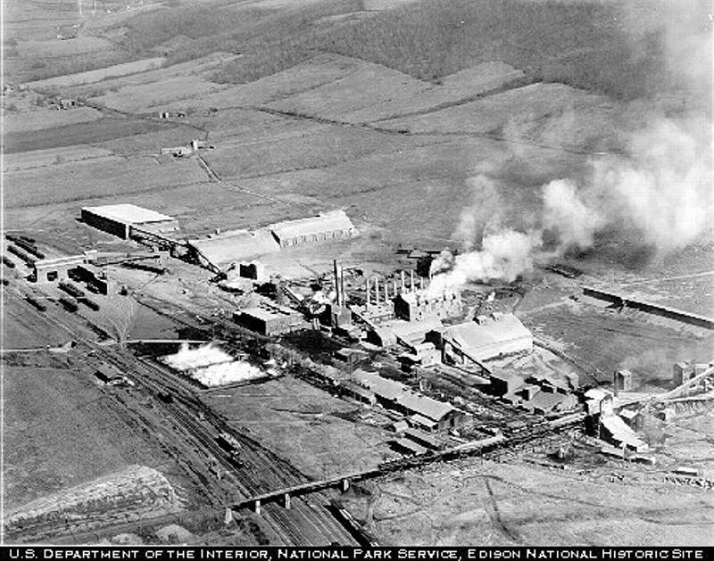
1885 England
Frederick Ransome patented a rotary kiln (18 inch X 15 ft)
1900 - Thomas Edison takes advantage of the horizontal rotary kiln. Cement manufacturing changed from a batch process to a continuous process
Notes:
4
Continuous process always adding material in and always producing product at the other end. Know today as the 24/7 process

Slide 5
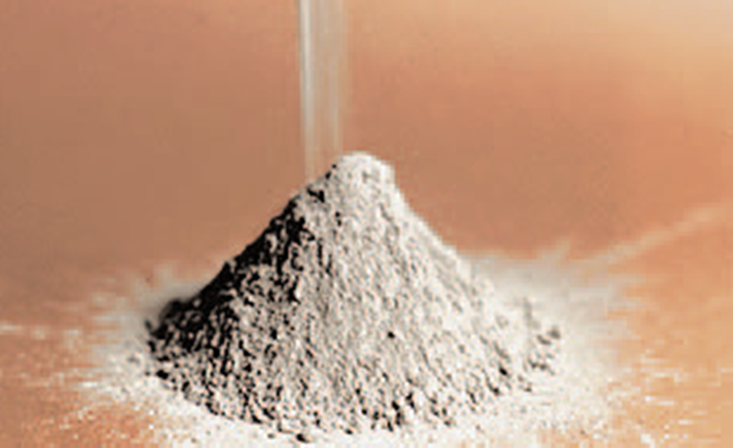
Portland Cement - Definition
Simple Definition
The gray powder that reacts with water to create a glue-like material that bonds aggregates together to form concrete
Hydraulic Cement

Slide 6
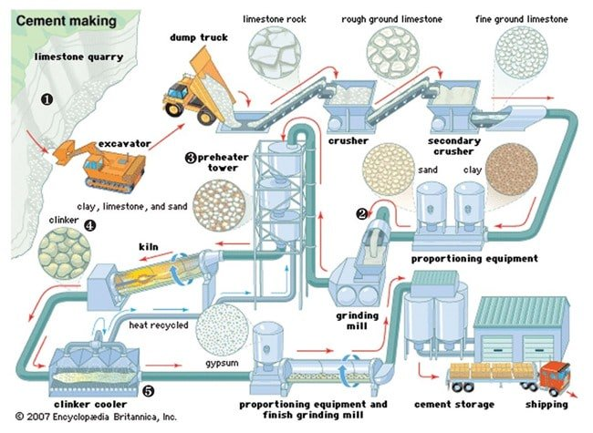

Slide 7
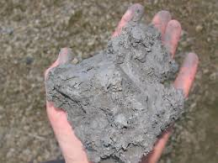
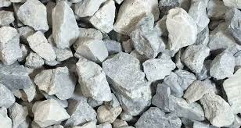
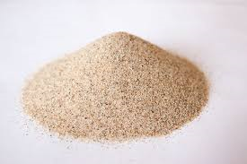
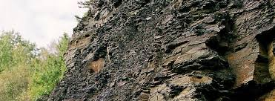
Raw Material Components
Calcium Silica Aluminum Iron
Silica Sand
Clay
Limestone
Shale

Slide 8
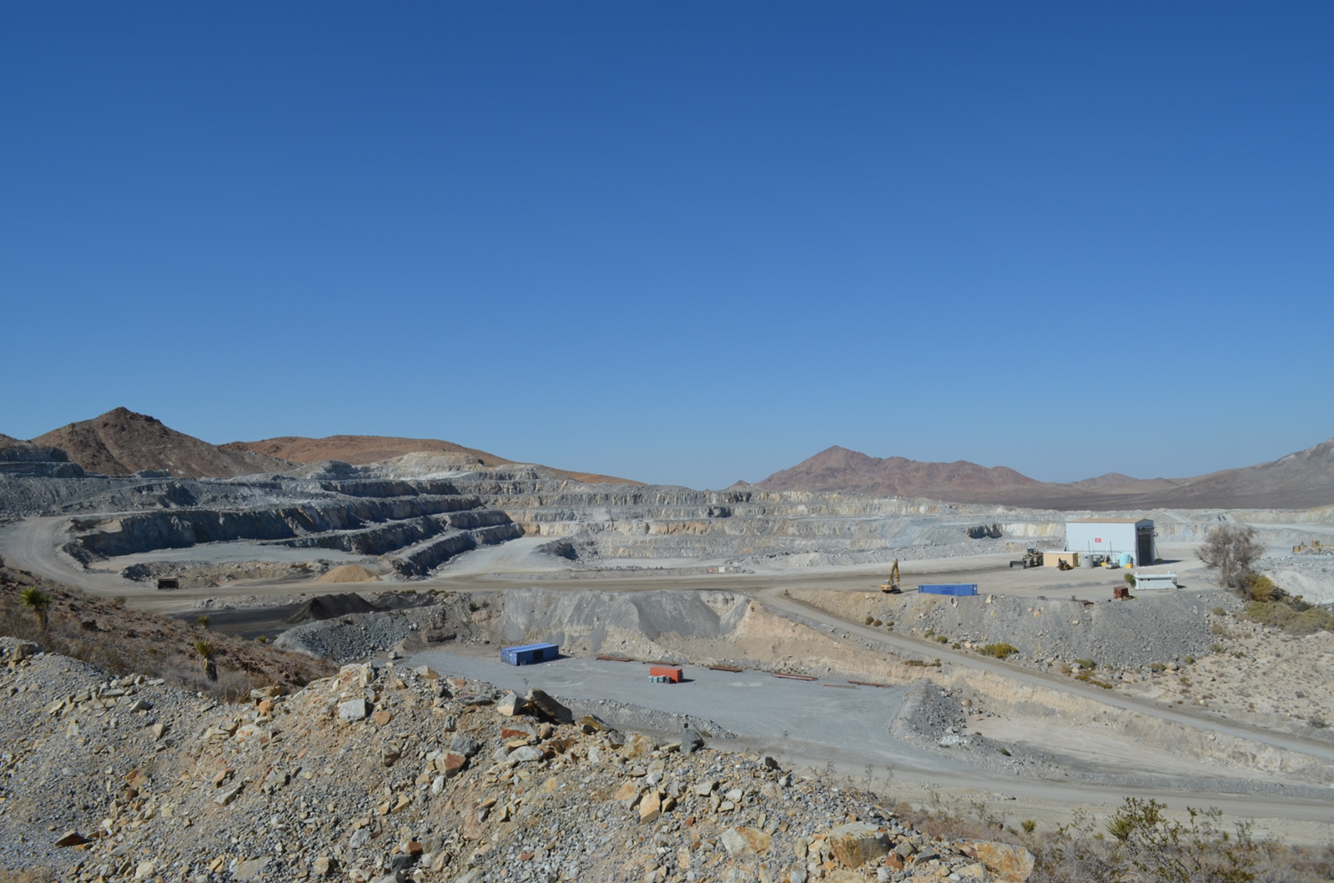
Raw Material Mining & Processing
Notes:
Drilling campaign is conducted to check large areas of raw materials that a plant will use for the next 5 to 10 years. From this campaign you will choose specific areas you will immediately use for mining. Then after blasting the material is rechecked to ensure quality is the same as determined during the drilling campiagn.

Slide 9
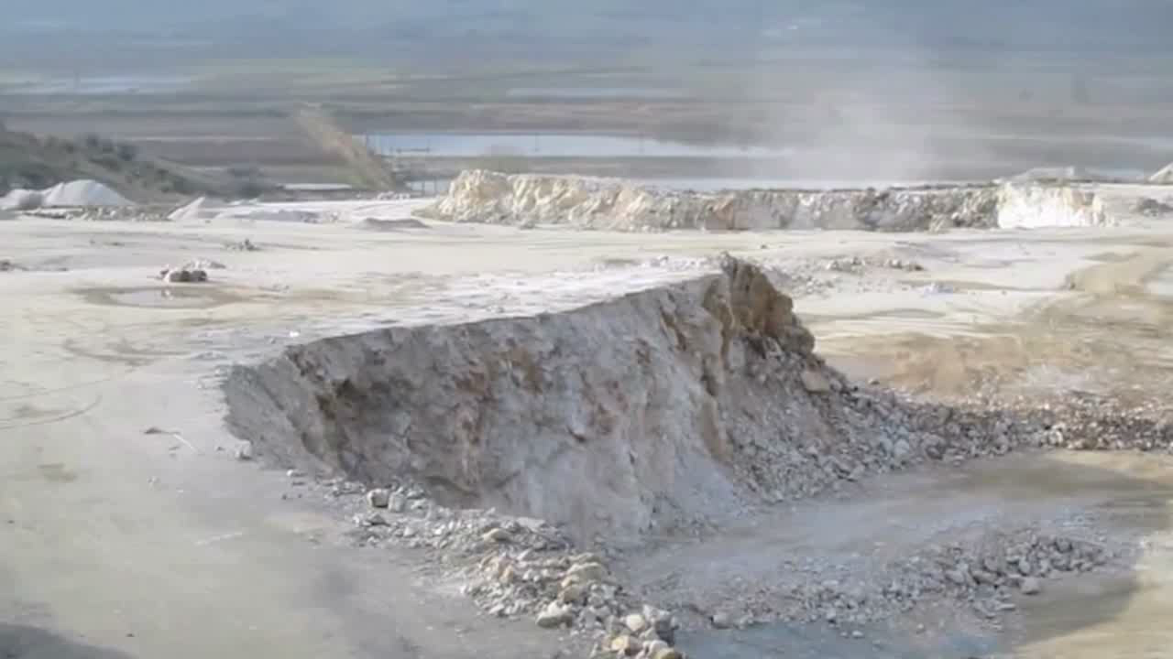

Slide 10
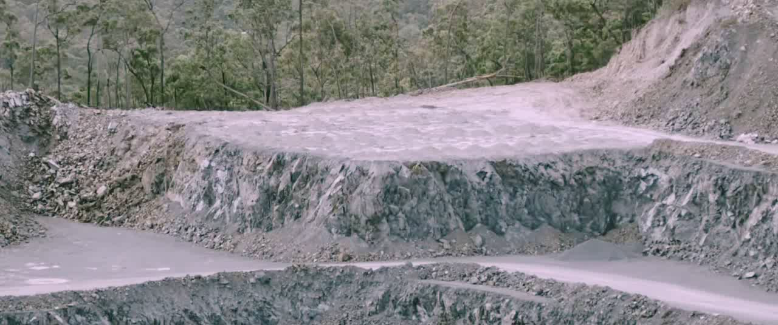

Slide 11
Raw Material Proportioning and Blending
C A F S
Dust
Collector
To
Preheater
or Kiln
Grinding
Mill
Iron
Ore
  Shale
Sand
Raw
Meal
Pump
Limestone
Blending and
Storage Silos
Raw materials are homogenized by crushing, grinding and blending so that approximately 80% of the raw material pass a No.200 sieve
Notes:
The raw materials are now proportioned and set to the grinding mill where at this time samples are taken for yet a third analysis. This lets you totally fine tune your raw materials. At blending we ensure the materials uniform.
This is the start of the clinker production.

Slide 12
Two Types of Cement Kilns
Wet Process
Kiln Mix is a Slurry (30%-40% water)
  Advantages
    more uniform
    raw material may already contain moisture
  Disadvantage
    higher energy use
Dry Process
Kiln Mix is a Dry Powder
  Advantages
    preheating done outside the kiln
    efficiency
    shorter kiln length
  Disadvantage
    alkalies, sulfur, chlorides
    tall, sophisticated
Notes:
Major point is that there is a Wet and Dry process.
Two types of dry plants, pre calciner and dry process. Dry process is just like a wet process except material is not in a slurry material comes direct from bleeding silo. In a pre calciner the material is calciened in pre heater towers to breakdown the calcium carbonate into free lime (CaO) and gas (C02). Kiln length of pre calciner is about half as long as a old fashion dry process plant. A wet process plant kiln averages 400 to 500 feet, where as a pre heater kiln averages half as long. These sizes are dependent upon the capacity of the plant production.

Slide 13
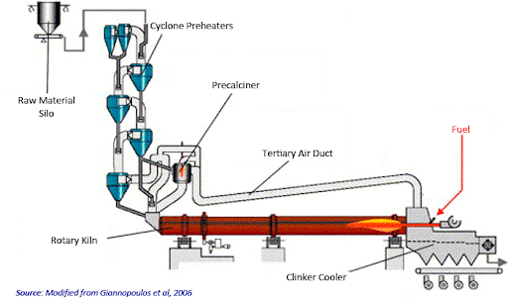
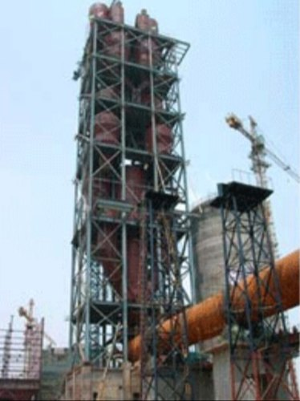
Dry Process Kilns

Slide 14
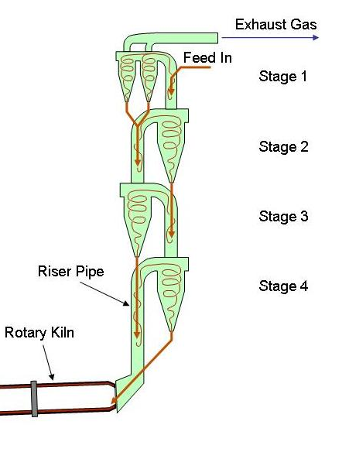
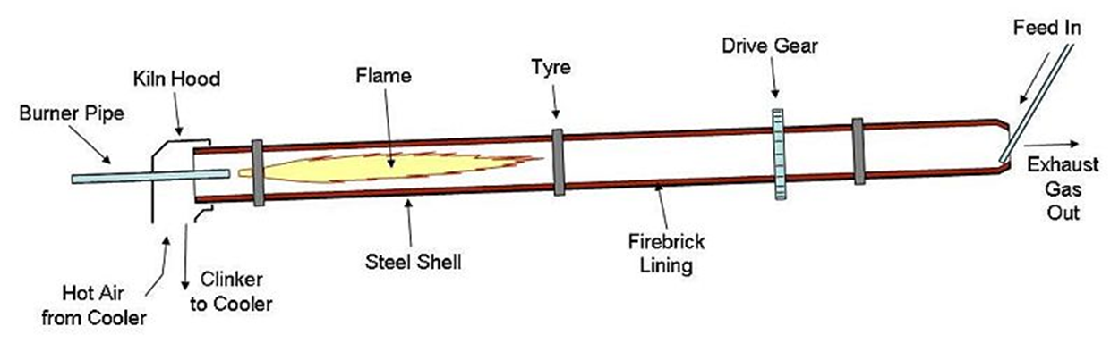
Dry Process Kilns
Cement kilns are heated to about 2700ºF
Final pre heater stage of a pre calciner kiln is ~1600 *F
Mixture is fed into kiln & burned in a dry state
This process provides considerable savings in fuel consumption and water usage.

Slide 15
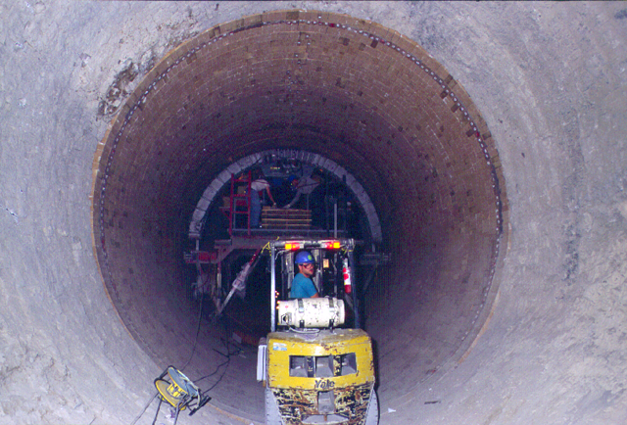
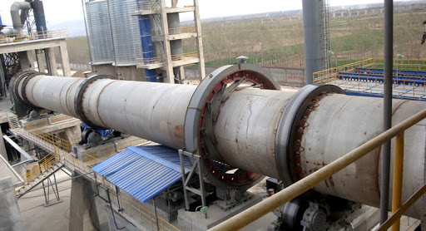
The Kiln
Notes:
Inside the kiln... Perspective Diameters can range from 12 to 24 feet.

Slide 16

Heat Zones
Inside the Kiln
Low red -- dark red 875-1200 F
bright red -- orange 1500-1650 F
orange -- yellow 1650-2000 F
light yellow - white 2400-2800 F
Notes:
Location of flame and distance of the burning zone are important factors in the formation of the clinker crystalline structure.

Slide 17
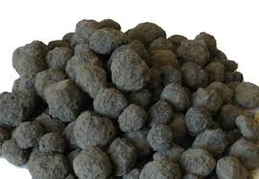
Clinker

Slide 18
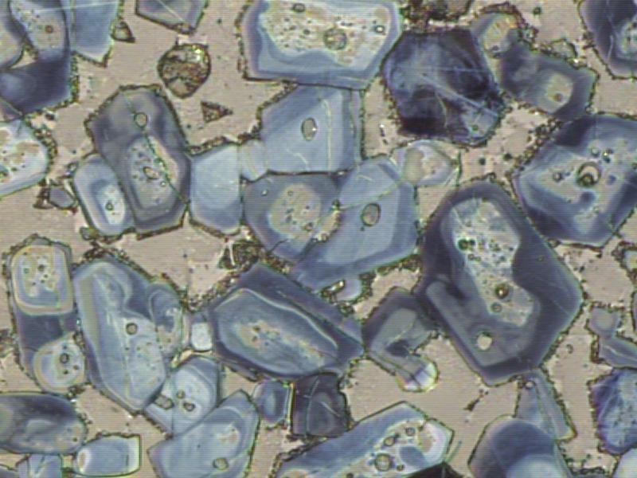
Clinker (Cement) Compounds
C₃S (alite)
C₂S (belite)
C₄AF
C₃A
Notes:
Just like a multivitamin, different compounds affect different things
Eg. Vitamin A – Vision, Immune System, Vitamin B – Energy, Brain Function

Slide 19
Clinker (Cement) Compounds
C₂S (belite)
C₃S (alite)
Alite - C₃S (Tricalcium Silicate)
  Lots of Heat Production and Early Age Strength
  Controls Initial and Final Setting
Belite - C₂S (Dicalcium Silicate)
  Later Age Strength and Less Heat Production
Aluminate - C₃A (Tricalcium Aluminate)
  Lots of Heat Production
  Contributes to very early Age Strength
  Controls Sulfate Attack Resistance
Ferrite - C₄AF (Tetracalcium Aluminoferrite)
  Some Heat Generation but Contributes Little Strength
  Responsible for Grey Color
  Lowers clinkering temperature
C₃A
C₄AF
Notes:
Just like a multivitamin, different compounds affect different things
Eg. Vitamin A – Vision, Immune System, Vitamin B – Energy, Brain Function

Slide 20
Turning Clinker into Cement
Dust
Collector
Clinker
  Gypsum
Storage Silos
Kiln
Clinker
Cooler
Grinding
Mill
Bagging
Facility
Cement
Pump
Bulk
Loading
Notes:
The only product you have to add to the clinker is Gypsum to control set time. Nowadays there are other products added such as limestone and slag to lower greenhouse gases.

Slide 21
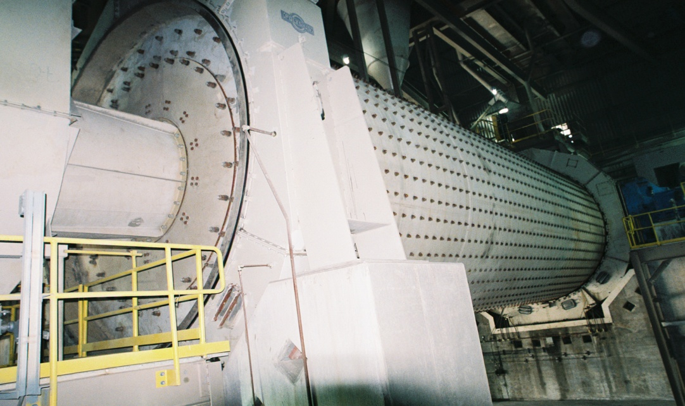
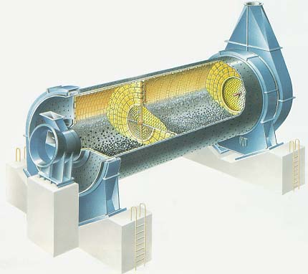
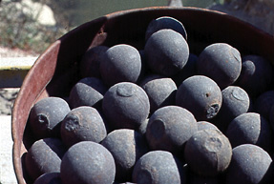
Notes:
Ball mill, two compartments, first contains large steel balls up to 4 1/2 inch diameter and second compartment contains balls down to ¾” the larger balls crush and the smaller ones grind finer.

Slide 22
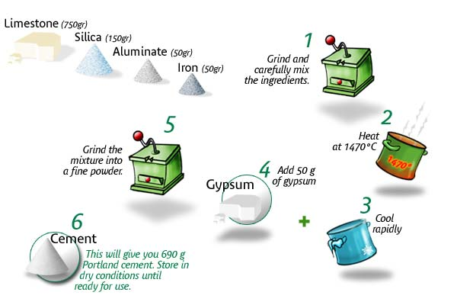
THE RECIPE
Notes:
Basically it takes 1.5 to 1.7 tons of raw material to make 1 ton of cement.
1 ton of cement produces 1 ton of C02 from both raw materials and fuels
The 0.5-0.7 is waste made up of moisture and oxides

Slide 23
Cement Types
Type I – General Use Cement
Type II – Moderate Sulfide Resistance
Type III – High Early Strength
Type IV – Low Heat of Hydration
  (No longer available)
Type V – High Sulfide Resistance
No Type I/II

Slide 24
Type of portland cement | Potential Compound Composition,% |  |  |  | Blaine fineness m²/kg
 | C₃S | C₂S | C₃A | C₄AF
I | 54 | 18 | 10 | 8 | 369
II | 55 | 19 | 6(max8) | 11 | 377
III | 55 | 17 | 9(max15) | 8 | 548
IV | 42 | 32 | 4 | 15 | 340
V | 54 | 22 | 4(max5) | 13 | 373
White | 63 | 18 | 10 | 1 | 482
NO LONGER AVAILABLE
Notes:
24
Type III is basically a Type I cement ground finer. The finer the grind, the faster the reaction with water thus the high early strength.
Type I/II meets the requirements for both Type I and Type II cements. C₃A is limited to 8% max in both Type I/II and Type II.

Slide 25
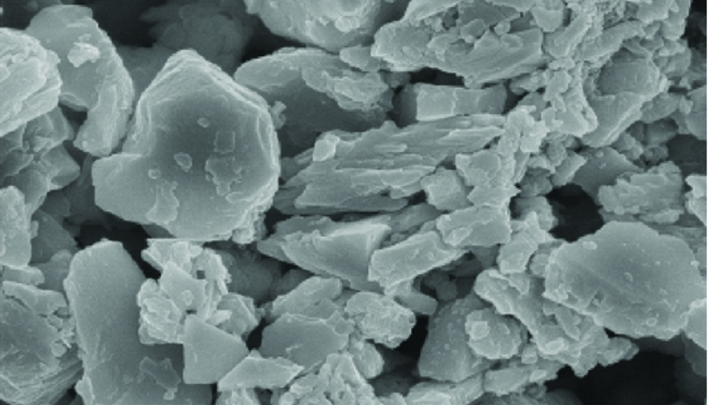
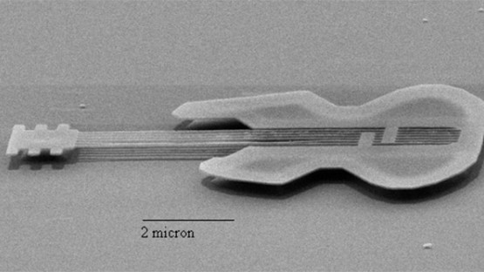
Cement Characteristics
Specific Gravity: 3.15
Amount Passing #325 Sieve (45 micron): ~95%
Surface Area (Blaine):
390-410 m²/kg
Median Particle Size:
10 microns

Slide 26
Hydraulic
Cement
ASTM C150
“Portland Cement”
ASTM C595
“Blended Cement”
ASTM C1157
“Performance Cement”
Cement Standards
No AASHTO equal for C1157
AASHTO
American Association of State Highway &
Transportation Officials
M85 / M240
State cement
Requirements
CalTrans, Section 90-1.02B (2)
(2010)
AASHTO & ASTM are equal or similar specifications
Notes:
C1157 are currently not permitted for use in C76

Slide 27
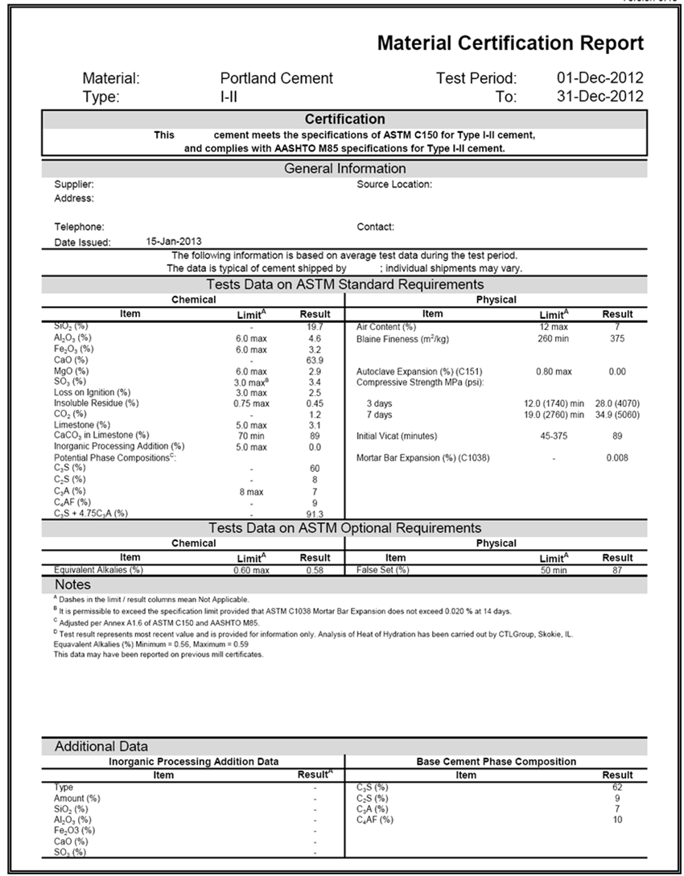
Material
Certification
Report
Notes:
Shows that the manufacture conforms to particular specs including limits and results
Mill Certs represents a composite of tests done by the manufacture for a particular prior time period.
Spec does no define a time frame for mill certs, but industry norm is 1 month.

Slide 28
Cement Hydration
C₃S + C₂S + C₃A + H₂O
Glue
CS Hydrates (CSH)
+ CA Hydrates (CAH)
+ Ca(OH)₂ (CH)
+ heat
CSH gel is the glue that holds concrete together

Slide 29
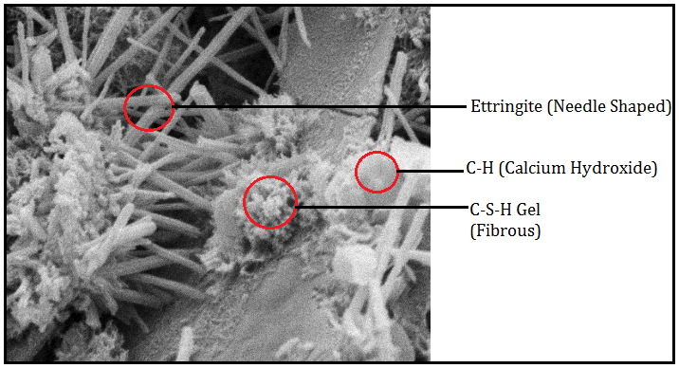
Hydrated Cement Paste - Depending on the time of hydration and the Portland cement composition, several crystalline pictures can be observed in hydrated cement paste. A typical one contains CSH, calcium hydroxide and ettringite as shown in this picture.

Slide 30
Primary cement reaction (fast):
C₃S (and C₂S) + water = C-S-H gel
Byproduct from hydration = Calcium Hydroxide
Pozzolanic reaction (slow):
Fly Ash + Calcium Hydroxide = C-S-H gel

Slide 31
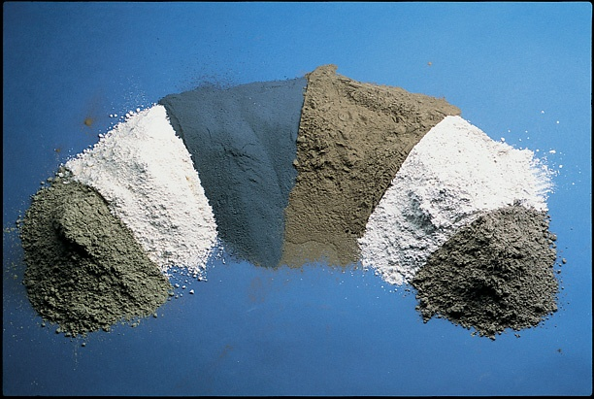
Supplementary Cementitious Materials (SCMs)
From left to right:
Fly ash (Class C)
Metakaolin (calcined clay)
Silica fume
Fly ash (Class F)
Slag Cement
Calcined shale
Notes:
Fig. 3-1. Supplementary cementitious materials. From left to right, fly ash (Class C), metakaolin (calcined clay), silica fume, fly ash (Class F), slag, and calcined shale.

Slide 32
What is a Supplementary Cementitious Material?
Supplementary Cementitious Material (SCM) - a material that, when used in conjunction with Portland Cement or Blended Cement, contributes to the properties of the hardened concrete through hydraulic activity, pozzolanic activity, or both.
Hydraulic Cementitious Material - a material that sets and hardens by a chemical reaction with water.
Pozzolanic Material - a siliceous or siliceous and aluminous material, which in itself possesses little or no cementitious value but will, in finely divided form and in the presence of moisture, chemically react with calcium hydroxide at ordinary temperatures to form compounds possessing cementitious properties.

Slide 33
Slag Cement
Byproduct from the iron manufacturing process
ASTM C 989 Standard Specification for Slag Cement for Use in Concrete and Mortars (classified by Strength Activity Index compared to a reference Portland Cement)
  Grade 80 (SAI @ 28days = 75%)
  Grade 100 (SAI @ 7days = 75% & 28days = 95%)
  Grade 120 (SAI @ 7days = 95% & 28days = 115%)
Slag Cement is a hydraulic cement
Notes:
33
Explain Strength Activity index
C76 and C1433 specifies Grade 100 or 120 only

Slide 34
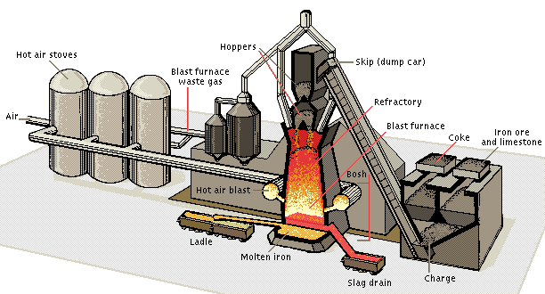
Blast
Furnace
Notes:
Iron ore is heated in a blast furnace to about 2700 – 3000 degrees F. Limestone and coke are added to the iron ore as a flux material. As the iron melts, the furnace is tapped and the iron is released into a channel. Impurities that were in the iron ore, the limestone, and the coke float on top of the dense iron. The impurities in this molten state are called slag. The slag and iron are separated by mechanical means (usually by a gate that drops over the channel of flowing iron and slag). The separated slag is diverted into its own channel where it flows to the granulator. Flux- In the process of smelting, inorganic chlorides, fluorides (see fluorite), limestone and other materials are designated as "fluxes" when added to the contents of a smelting furnace or a cupola for the purpose of purging the metal of chemical impurities such as phosphorus, and of rendering slag more liquid at the smelting temperature.

Slide 35
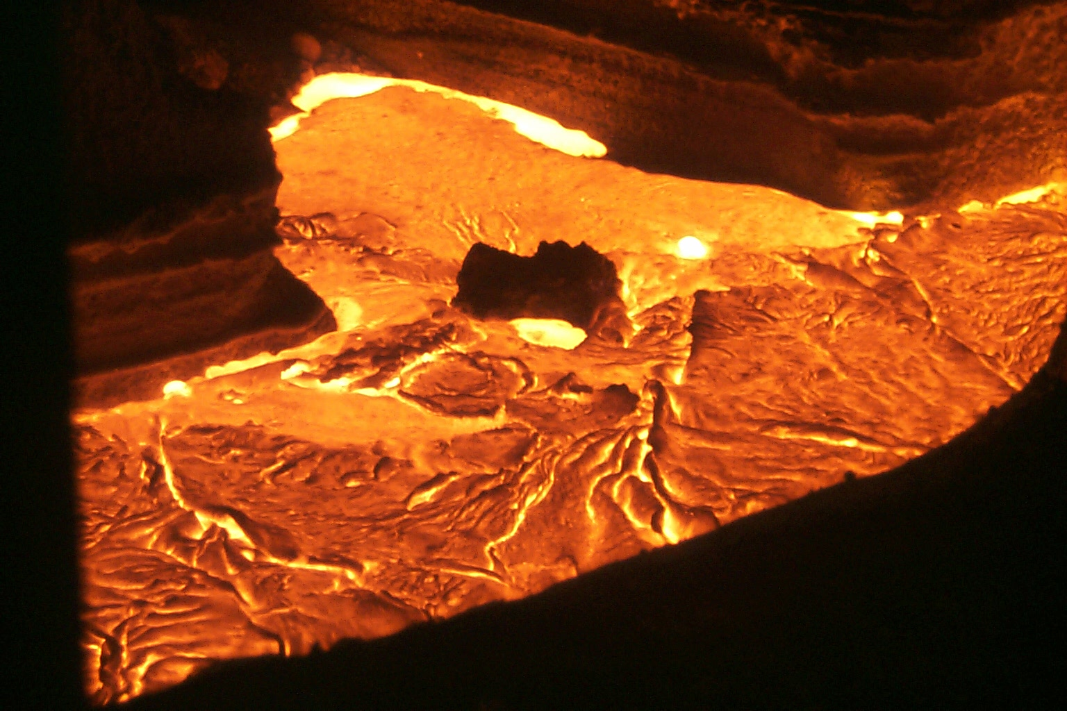
Molten
Iron & Slag
The slag is not as dense as the molten iron and floats on the top. It is separated by mechanical means and then granulated
Notes:
35
Blast Furnace Slag is formed when iron ore or iron pellets, coke (a fuel with few impurities and a high carbon content) and a flux (either limestone or dolomite) are melted together in a blast furnace. When the metallurgical smelting process is complete, the lime in the flux has been chemically combined with the aluminates and silicates of the ore and coke ash to form a non-metallic product called blast furnace slag. During the period of cooling and hardening from its molten state, BF slag can be cooled in several ways to form any of several types of BF slag products.
Quality control at an iron plant is based off the slag component of the mix.

Slide 36
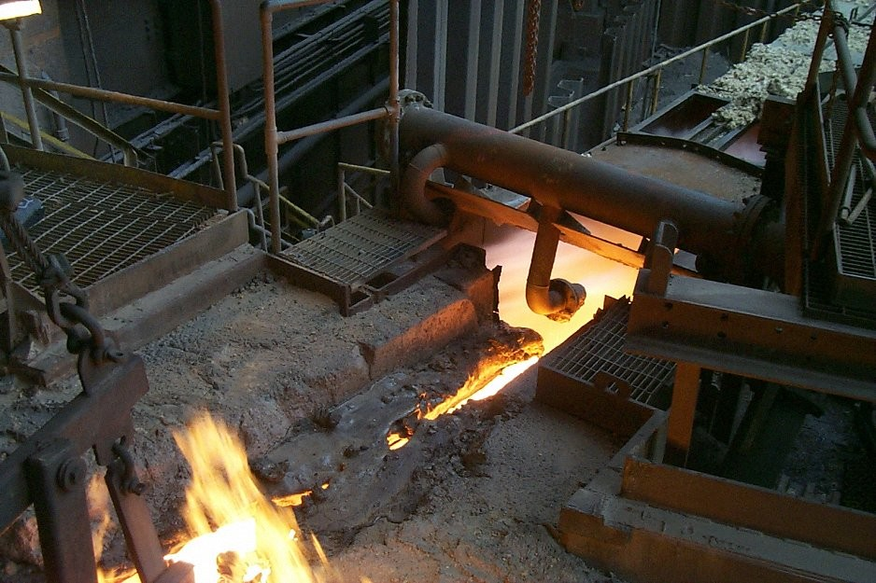
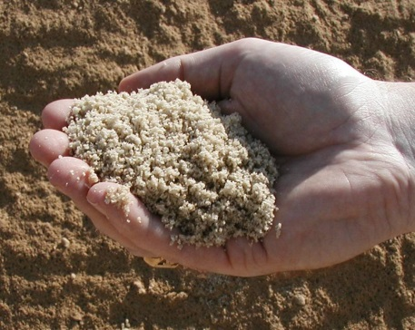
Granulation
The Blow Box
Slag Runner
Rapid quenching with water at a ratio of 10:1 changes the hot slag to glassy, non-metallic silicates and aluminosilicates of calcium, known as granulated blast furnace slag
Notes:
If the slag was air cooled then it would not have cementitious properties and would be more of an aggregate type material.
Water added at blow box.

Slide 37
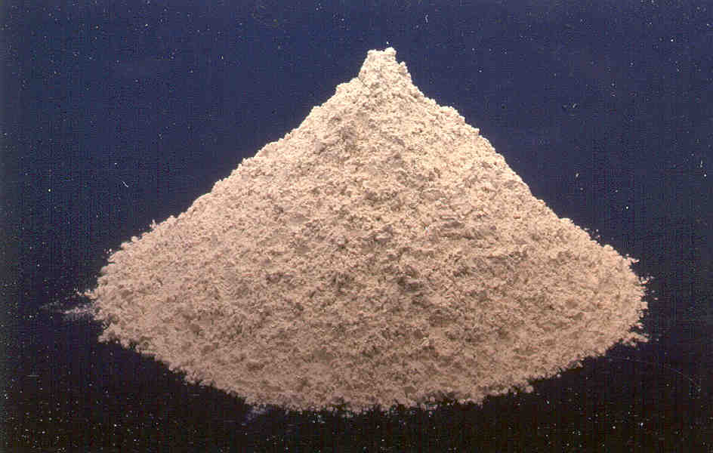
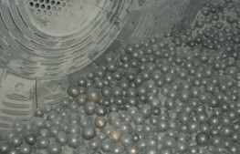
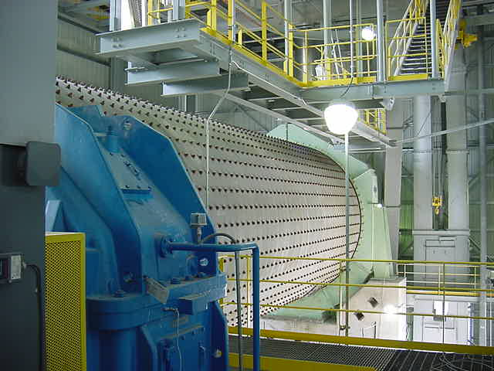
Grinding
Notes:
Just like cement you grind it like cement
Spec used to be GGBFS, but is now Slag Cement since it is the final product.
37

Slide 38
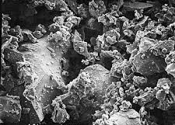
Slag Characteristics
Specific Gravity: 2.6 - 2.9
Amount Passing #325 Sieve (45 micron): ~95%
Surface Area (Blaine):
400 m²/kg
Median Particle Size:
10 microns

Slide 39
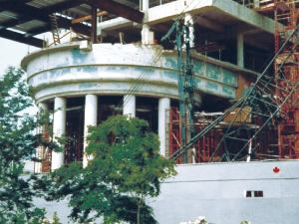
Slag Cement
Cautions
As levels of unoxidized sulfide sulfur increase, a temporary greening of the hardened concrete may occur
Benefits for Hardened Concrete
  Later age strength
  Increased flexural strength
  Lighter, brighter color
  Reduced permeability and increased durability
  Increased resistance to alkali silica reaction
  Increased sulfate resistance (low alumina slag)
Notes:
Most U.S. slag IS low alumina slag
39

Slide 40

Pozzolans (For example Fly Ash & Silica Fume)
ASTM C618 Standard Definition
  “pozzolan, n.
  a siliceous or siliceous and aluminous material which in itself possesses little or no cementitious value but which will, in finely divided form and in the presence of moisture, chemically react with calcium hydroxide to form compounds possessing cementitious properties”
Notes:
The broad definition of a pozzolan imparts no bearing on the origin of the material, only on its capability of reacting with calcium hydroxide and water, That means that it “sets up” when mixed with a source of calcium and water
Siliceous – sedimentary rocks that have silica (SiO₂) as the principal constituent
Aluminous - of or pertaining to alumina

Slide 41
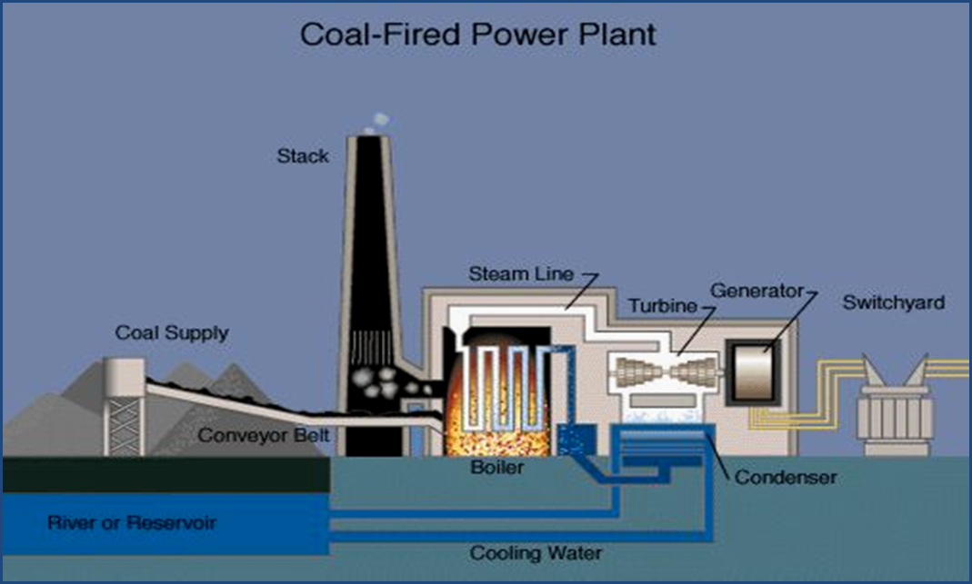
Fly Ash Production
Coal/Source
Coal Pulverizer
Boiler
Electrostatic Precipitation
Fly Ash Silo
Customers
Notes:
41

Slide 42
Fly Ash
Class F
  Produced from burning anthracite or bituminous coal
  CaO content < 10%
  Pozzolanic (no hydraulic properties, reacts to cement hydration byproducts only)
Class C
  Produced from burning of lignite or subbituminous coal
  CaO content > 20%
  Hydraulic and pozzolanic properties

Slide 43
Fly Ash Characteristics
Specific Gravity: 2.1 – 2.9
.Amount Passing #325 Sieve
(45 micron): 85% - 98%
Surface Area (Blaine):
420 m²/kg
.Median Particle Size:
Class C = 5 microns
Class F = 15 microns
Notes:
Based on local fly ashes in KY and IN
Maimi 7, 8
Mill Creek
Zimmer

Slide 44
Fly Ash
Benefits for Hardened Concrete
  Improve workability
  Lower mix cost
  Reduce heat
  Lower permeability
  Improve durability
  Mitigates ASR and DEF (Class F only)
Cautions
  Low early-age strength
  Increase set time
  Affects air entrainment (Class F)
Notes:
44
Since Fly ash particles are finer than cement particles, they fill the empty voids and create a denser paste. Denser paste means less capillary voids and lower permeability and increased durability.
The spherical shape of fly ash particles improves the workability of concrete at low water contents.
Fly Ash typically replaces a percentage of cement thus reducing the overall heat generation and early strength gain.
Class F fly ash is excellent for mitigating ASR and DEF.

Slide 45
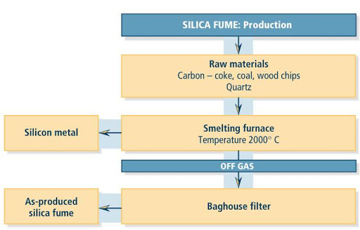
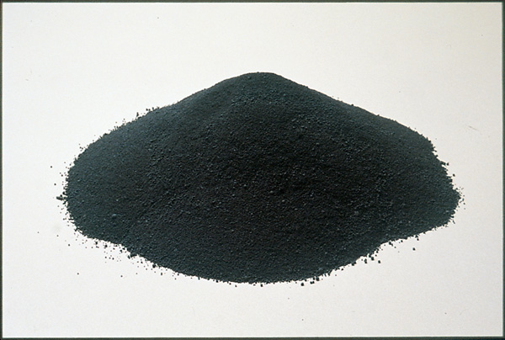
Silica Fume Production
Notes:
Silica fume is a byproduct in the carbothermic reduction of high-purity quartz with carbonaceous materials like coal, coke, wood-chips, in electric arc furnaces in the production of silicon and ferrosilicon alloys
Particle size is finer than cigarette smoke, so imagine what happens when you breathe this? One micron is 1/1000 mm (1/25,000 of an inch).
Amorphous silica - Amorphous silica (SiO2) is an inorganic material commonly used in semiconductor circuits to isolate different conducting regions. Due to its mechanical resistance, high dielectric strength, and selectivity for chemical modification, amorphous silica has also become a key material in microelectronics and chromatography. Because of its unique properties, silica is quintessential for a broad range of applications: chips, optical fibers, and telescope glasses are manufacture on silica. Furthermore, molecular biologists employ silica in resins and optical beads to study the biomacromolecules.

Slide 46
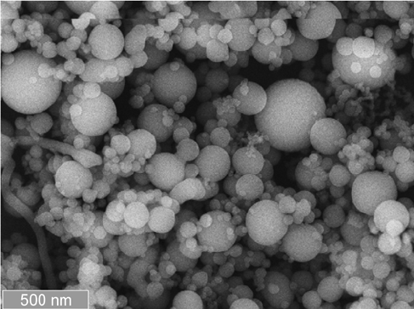

Silica Fume Characteristics
Specific Gravity: 2.2 – 2.3
Amount Passing #325 Sieve
(45 micron): 100%
Surface Area (Blaine):
20,000 m²/kg
Median Particle Size:
0.15 microns
Tobacco smoke has a surface area of 10,000 m²/kg

Slide 47
Silica Fume Use
First used in concrete in 1950’s. Modern usage started in the 1980s.
Works on two mechanisms:
  Purely pozzolanic because of the high silica content
  Ultra fine filler material that fills the spaces between cement grains
Very effective for very high strength / low permeability
Typically used at 5-10% (by mass) replacement of cement
Available in raw, densified, pelletized and slurry form

Slide 48
Silica Fume
Benefits for Hardened Concrete
Significant strength gain
Reduces permeability
Improves bonds strength to steel
Reduces steel corrosion
Improves freeze/thaw durability
Excellent resistance to sulfate attack
Significantly reduces Alkali-Silica reactivity
Cautions
Concrete is more sticky
Water demand of concrete will increase
Affects Air Entrainment dosage
Potential for plastic shrinkage cracking
Notes:
48
One of the most beneficial uses for silica fume is in concrete. When silica fume is added to fresh concrete it chemically reacts with the CH to produces additional CSH. Additionally, Because silica fume is 100 to 150 times smaller than a cement particle it can fill the voids created by free water in the matrix, thus creating a much denser pore structure.
At higher concentrations of Silica require more care in curing moisture

Slide 49
General Reactivity Comparison
Portland Cement
Reactivity
Slag
Class C Fly Ash
Class F Fly Ash
% CaO
Silica Fume
Pozzolanic Hydraulic

Slide 50
Conclusions
Portland cement is a complex material that is manufactured from natural materials
Pozzolans and Slags are by-products of manufacturing processes
The use of SCM’s can benefit concrete by improving the desired engineering properties
SCM’s also provides an environmental benefit

Slide 51
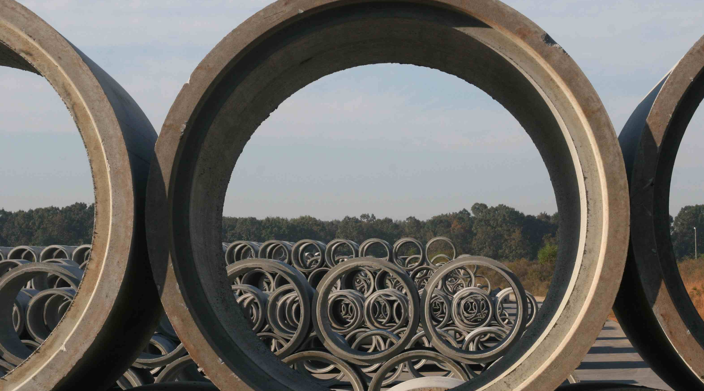
Thank You

