Slide 1
MIX DESIGN

Slide 2
Concrete Mix Design
Wet Cast (Slump)

Slide 3
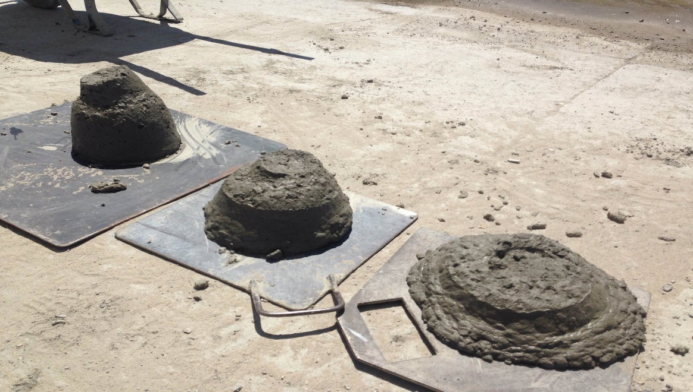
Concrete Mix Design
Wet Cast (Slump)

Slide 4
Concrete Mix Design
Dry Cast (no Slump)

Slide 5
Concrete Mix Design
Dry Cast (no Slump)

Slide 6
Concrete Mix Design
Combination of Art and Science…

Slide 7
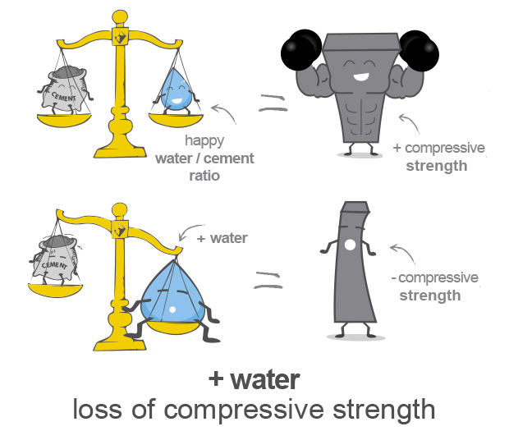
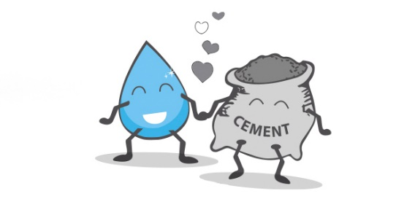
Water, Cement, & Aggregate
As the water to cement ratio increases, the strength of a concrete mix decreases.

Slide 8
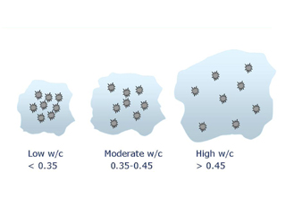
Water, Cement, & Aggregate
As the water to cement ratio increases, the strength of a concrete mix decreases.

Slide 9
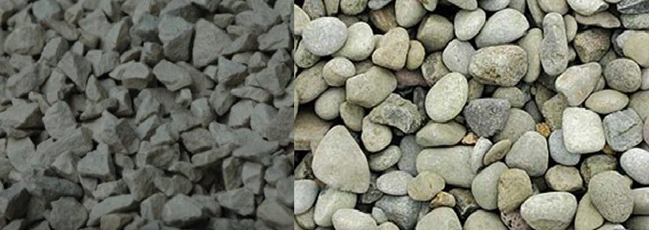
Water, Cement, & Aggregate
As the surface area of the aggregate increases more water will be needed to maintain a given slump.
Coarser Surface Texture
Particle Shape

Slide 10
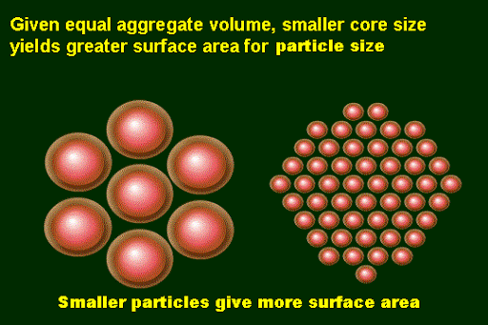
Water, Cement, & Aggregate
As the surface area of the aggregate increases more water will be needed to maintain a given slump.
Particle Size Distribution

Slide 11
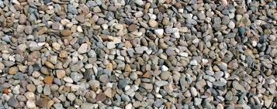
Water, Cement, & Aggregate
As the surface area of the aggregate increases more water will be needed to maintain a given slump.
Particle Size Distribution

Slide 12
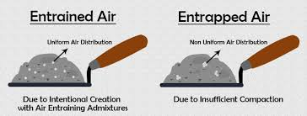
Water, Cement, & Aggregate
As the air content increases, the strength of the concrete decreases.

Slide 13
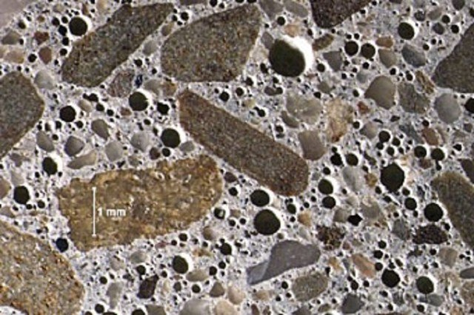
Water, Cement, & Aggregate
As the air content increases, the strength of the concrete decreases.

Slide 14
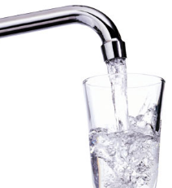
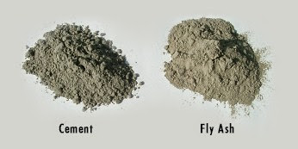
Water/Cement Ratio
It’s a calculation:
w/c ~ lbs. of water / lbs. of cement
45 lbs of water
=
Water cement ratio
= 45 lbs ÷ 100 lbs
100 lbs of cement
= 0.45 expressed as decimal

Slide 15
Water/Cementitious Ratio
It’s a calculation:
w/c_{m} ~ lbs. of water / lbs. of cementitious
45 lbs of water
+
=
Water cementitious ratio
= 45 lbs ÷ (80lbs + 20 lbs)
80 lbs of cement
20 lbs of Flyash
= 0.45 expressed as decimal

Slide 16
Water/Cementitious Ratio
Often when w/c is discussed its really w/c_{m} that is intended as the reference
Water/
Cementitious
Water/Cement

Slide 17
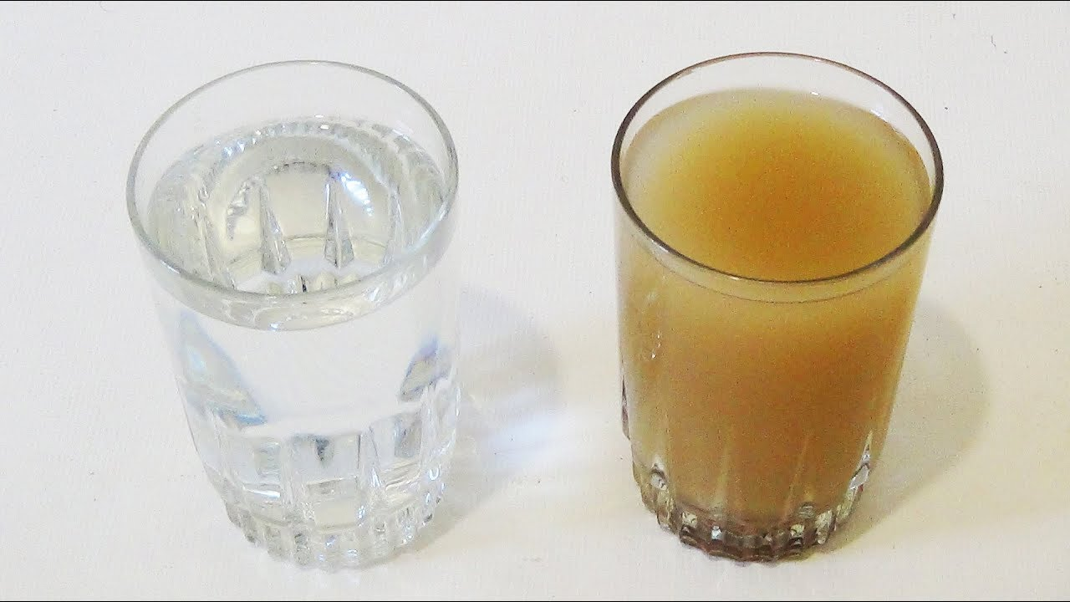
Water/Cementitious Ratio
Water needs to be drinkable or meet ASTM 1602

Slide 18
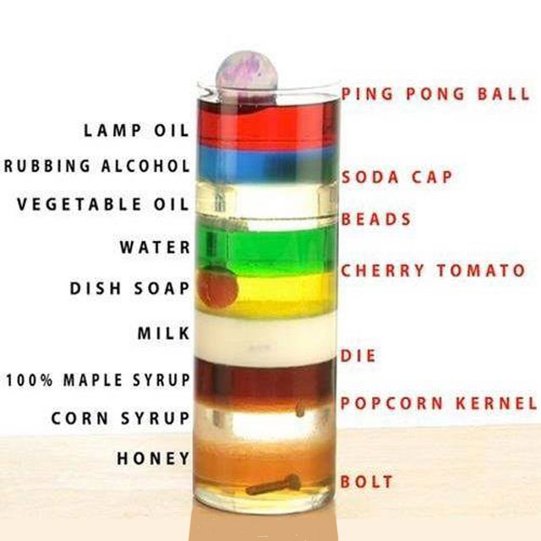
Terminology
Specific Gravity
The relative density of a material compared to water
The ratio of a material’s weight to the weight of an equal volume of water
Notes:
18

Slide 19
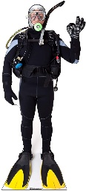
Specific Gravity
What about you?
Notes:
19
Ratio of same volume to compare mass.
As if the stone was a solid block, not individual stones
Human specific gravity is very close to 1. If you float in water, it would be < 1

Slide 20
Specific Gravity
Water: Specific Gravity = 1.00
Stone: Specific Gravity = 2.70
Same Volume, but 2.70 Times More Mass
Cement – 3.15
Steel – 7.85
You - ???
Notes:
20
Ratio of same volume to compare mass.
As if the stone was a solid block, not individual stones
Human specific gravity is very close to 1. If you float in water, it would be < 1

Slide 21
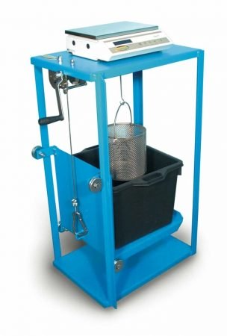
Terminology
Bulk Specific Gravity (SSD):
Used to determine the “solid volume” (absolute volume) of a material going into concrete
It is determined by submerging the material in water for 24 hours in order to fill any permeable voids
Notes:
21

Slide 22
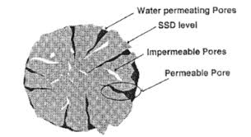
Calculations for SSD Bulk Specific Gravity
Coarse Aggregate Using Basket Suspended in water:
B / (B - C) = SSD Bulk Specific Gravity
where:
B = weight of SSD sample in air
C = weight of SSD sample in water
Notes:
22

Slide 23
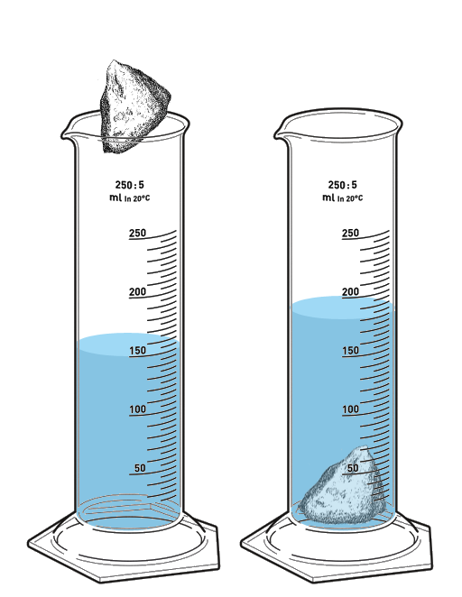
Calculations for SSD Bulk Specific Gravity
Field Calculation of SSD Bulk Specific Gravity:
Weight of Aggregate @ SSD
=
Specific Gravity
Weight of equal volume of water displaced
1245g of SSD aggregate
=
2.65
469.81g of water displaced
Notes:
23

Slide 24
Concrete Mix Design
It’s always about volume!
What is absolute volume?
Notes:
24

Slide 25
What is Absolute Volume?
Relationship of Materials to Volume
specific gravity of Type I Cement = 3.15
specific gravity of water = 1.0
1 gallon of water weights 8.33 pounds
water weights 62.4 pounds / cubic foot
Pounds of Material
= Absolute Volume
S.G. X 62.4

Slide 26
Basic Concrete Mix Design

Slide 27
Basic Concrete Mix Design
667
3.15 X 62.4
1590
2.60 X 62.4
1242
2.65 X 62.4

Slide 28
Basic Concrete Mix Design
Lbs Material
= Absolute Volume
S.G. x 62.4
S.G. x 62.4 x Abs. Volume
= Lbs. of Material

Slide 29
Basic Concrete Mix Design
300
1.0 X 62.4
0.055 X 27

Slide 30
Basic Concrete Mix Design
36 gal
1.0 X 62.4
36 Gal

Slide 31
Basic Concrete Mix Design
36 gal x 8.33 lbs/gal
1.0 X 62.4
36 Gal

Slide 32
Water/Cement Ratio = W/C
Water / Cement
300
667
Weight (mass)
Notes:
32

Slide 33
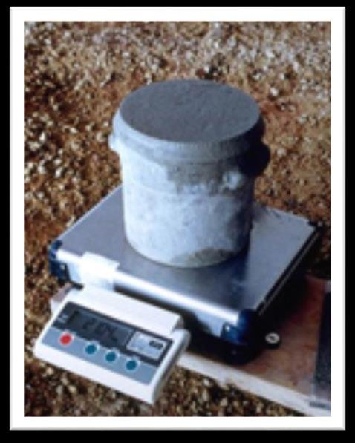
Density (Unit Weight)
Design (unit weight)
3799
27.0
@ 1.5% air, unit weight (density) = 147.26
Notes:
33
The unit weight shown with 1.5% air is based on adjustments of the rest of the materials to maintain 27 cubic feet.

Slide 34
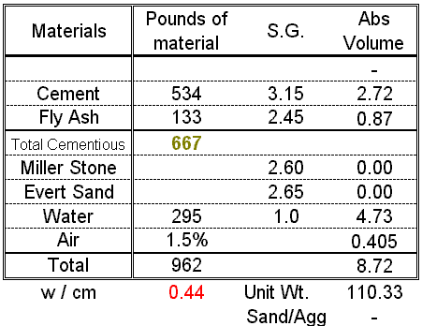
Mix Design with Cement & Fly Ash
133 lbs. fly ash
667 Total lbs. Cm
= 20% ash
It’s about volume!
Notes:
20% fly ash is based on 20% by weight not volume.
The “Note” is usually true, but not always. Also note the change in w/cm ratio due to lower water demand.
34

Slide 35
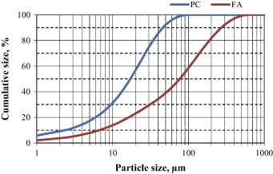
Mix Design with Cement & Fly Ash
Note: lower water
demand due to fly ash
- for same slump
It’s about volume!
Notes:
20% fly ash is based on 20% by weight not volume.
The “Note” is usually true, but not always. Also note the change in w/cm ratio due to lower water demand.
35

Slide 36
Mix Design with Cement & Fly Ash
Proportion the mix to
yield 27 ft³ … but how
much sand, stone …
what ratio?
Sand / Aggregate
ratio is by volume
It’s about volume!

Slide 37
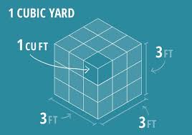
Mix Design with Cement & Fly Ash
Volume without
aggregate = 8.72
27.00 - 8.72 =
18.28 ft³ required
It’s about volume!

Slide 38
Mix Design with Cement & Fly Ash
Left for aggregates
18.28 ft³
Already used
27 ft³
8.72 ft³
18.28 ft³ + 8.72 ft³ = 27 ft³
It’s about volume!

Slide 39
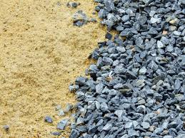
Sand to Aggregate Ratio
Volume of Sand
=
Rules of thumb ?
Volume of Total Aggregate
Manufactured Concrete Pipe
60-80% Packerhead Mix
45-65% Dry Cast
Notes:
Chart is a blended gradation curve based on % retained
Percentages shown are a broad start and encompasses percentages for both volume and weight
39

Slide 40
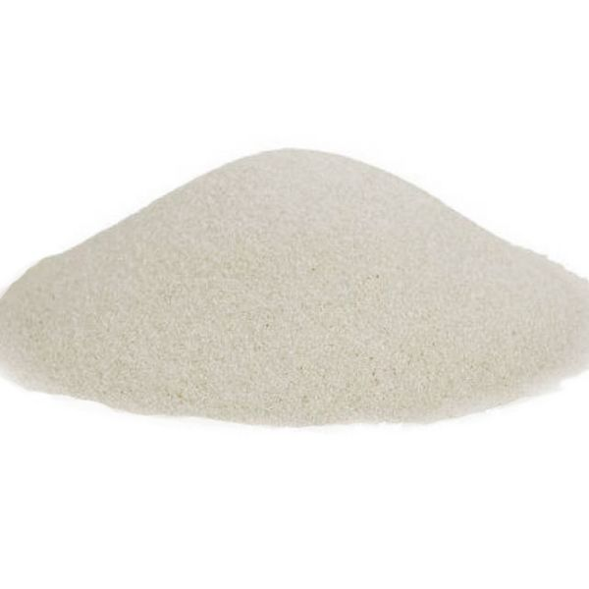
Calculating Sand & Stone to Yield 27ft³ of Concrete
Assume this concrete needs to have Sand / Aggregate ratio of 0.42
Volume of Sand
= 0.42
Total Volume of Aggregate
Volume of Sand
= 0.42
18.28
Volume of Sand = 7.68 ft³

Slide 41
Calculating Pounds of Sand
Pounds of Material
= Absolute Volume
S.G. X 62.4
Pounds of Material (Sand)
= 7.68 ft³
2.65 x 62.4
Sand = 1270 lbs
Evert Sand S.G. = 2.65

Slide 42
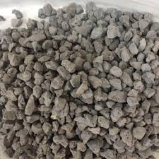
Calculating Volume of Stone
Total Aggregate Volume
Total Volume Left for Stone
18.78
- 7.68
= 10.60 ft³
Sand Volume
Notes:
42

Slide 43
Calculating Pounds of Stone
Pounds of Material
= Absolute Volume
S.G. X 62.4
Pounds of Material (stone)
=10.60 ft³
2.60 x 62.4
Stone = 1720 lbs
Miller Stone S.G. = 2.60
Notes:
43

Slide 44
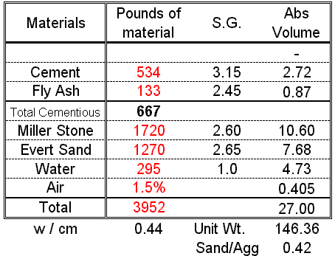
SSD Mix Design

Slide 45
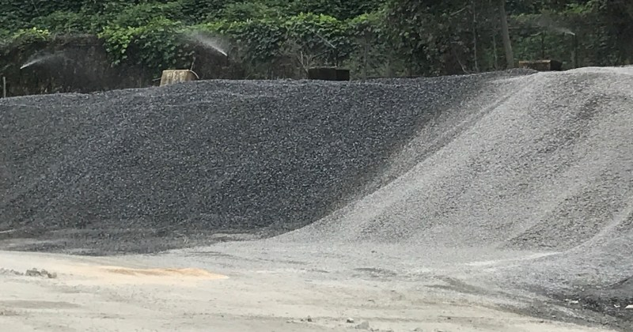
Aggregate Moisture
Notes:
45

Slide 46
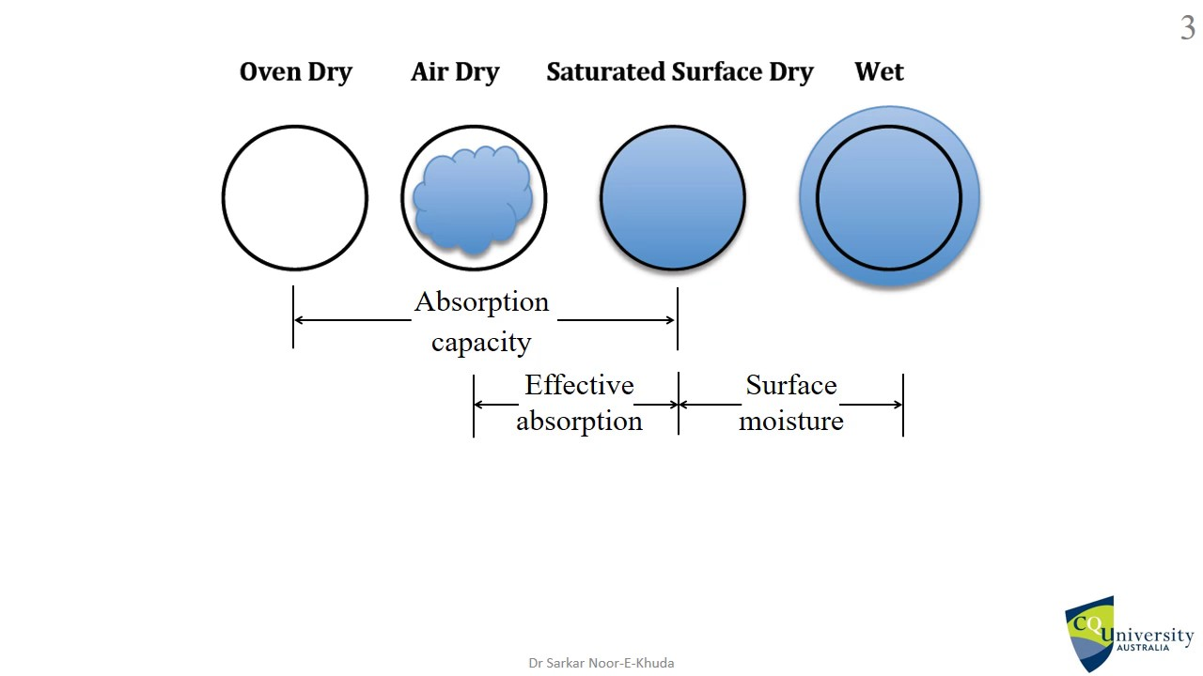
Aggregate Moisture
Absorbed moisture
(absorption)
SSD (ideal)
Free moisture
(moisture content)
Add Water
Subtract
Water
Notes:
46

Slide 47
Moisture Adjustments
Moisture Management is Critical (How much free water)
Total aggregate moisture = Aggregate absorption + Free water
Notes:
Convert 26 & 59 Lbs into gallons for clarity to students
47

Slide 48
Moisture Adjustments
Moisture Management is Critical (How much free water)
Aggregate Absorption = Total aggregate moisture - Free water
Notes:
Convert 26 & 59 Lbs into gallons for clarity to students
48

Slide 49
Moisture Adjustments
Moisture Management is Critical (How much free water)
Free Water = Total aggregate moisture - Aggregate absorption
Notes:
Convert 26 & 59 Lbs into gallons for clarity to students
49

Slide 50
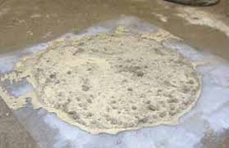
Moisture Adjustments
What if we do not make moisture corrections
Notes:
Convert 26 & 59 Lbs into gallons for clarity to students
50

Slide 51
Moisture Adjustments
Moisture Management is Critical (How much free water)
Total aggregate moisture = aggregate absorption + free water
Stone
3.0% = 1.5% + free water,
(% free water = 1.5%)
0.015 X 1720 =
26 pounds of free water on the Stone
Sand
5.5% = 0.85% + free water,
(% free water = 4.65%)
0.0465 X 1270 =
59 pounds of free water on the Sand
Notes:
Convert 26 & 59 Lbs into gallons for clarity to students
51

Slide 52
Moisture Adjustments
Moisture Management is Critical (How much free water)
Total aggregate moisture = aggregate absorption + free water
Notes:
Convert 26 & 59 Lbs into gallons for clarity to students
52

Slide 53
Water Adjustment
If 26 + 59 pounds of water rides in on the aggregates
you must take that amount of water out of the BATCH water.
Design water
295
Water on aggregates
-85
Batch water
210
Notes:
53

Slide 54
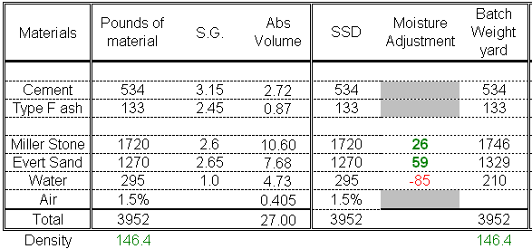
Moisture Adjustment
Total moisture = Free moisture + Aggregate absorption
SSD & batch totals
will be the same
Notes:
Circled numbers above should be the same because of the moisture adjustment.
Note that Batch Weights have been increased from the SDD Aggregates
54

Slide 55
Where Can I Get This?
Portland Cement Association (PCA)
5420 Old Orchard Road
Skokie, IL 60077-1083
847 966-6700 PH
847 966-8389 FX
Info @ cement.org

