Slide 1
Concrete Production

Slide 2
Concrete Production
ASTM C94 - why?
Specifications for ready mix most closely align with our product mix and production concepts
Good starting point for specifications rather than inventing new ones
Notes:
C94 if for ready mix concrete. May not apply to dri-cast mixes. Check your local agencies for any specific tolerances

Slide 3
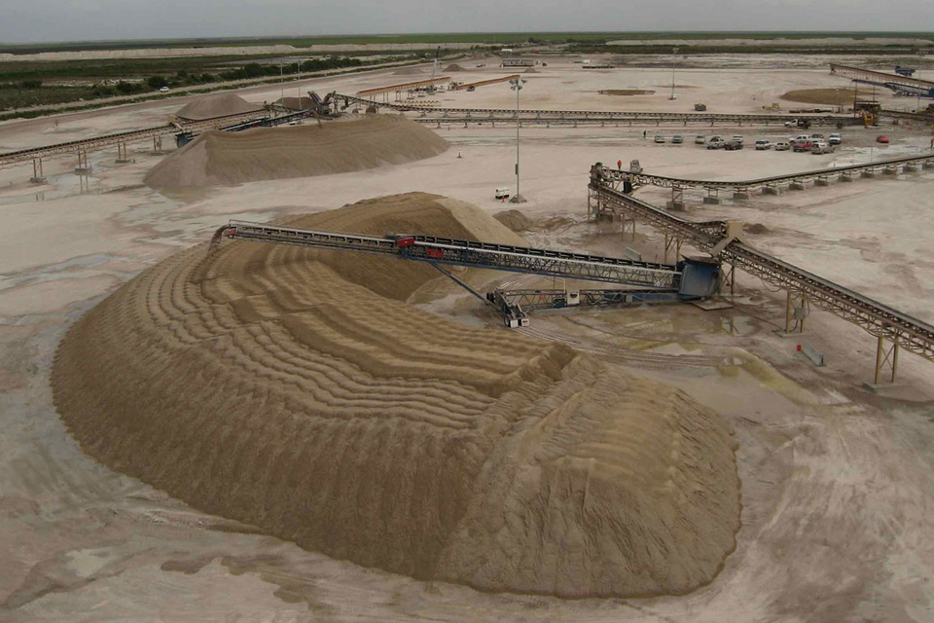
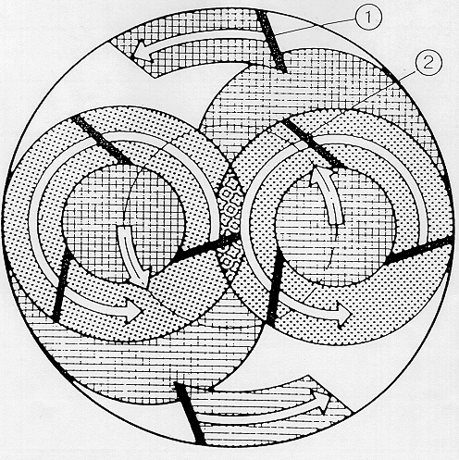
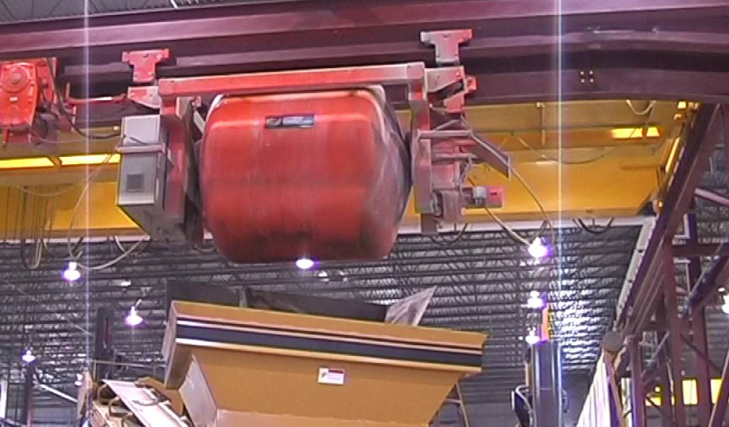
Redi-mix Requirements
Consistent Aggregates
Aggregates Stored Properly
Accurate Mix Proportions
Consistently Mixed
Transported to the forms

Slide 4
Concrete Production Topics
Material Handling
Batching
Mixing
Transporting

Slide 5
Material Storage
And
Handling

Slide 6
Proper Aggregate Storage
Minimize Segregation
Do not store in conical piles
Store in horizontal layers
Prevent Contamination
Store on slabs or planking
Have storage bins separated by walls
Keep gradations within specified limits
Reference ACI 304, “Guide for Measuring and Placing Concrete”
Notes:
Horizontal layers = bunker storage as seen in the following slide
If stored on ground, loader may dig into dirt contaminating the aggregate

Slide 7
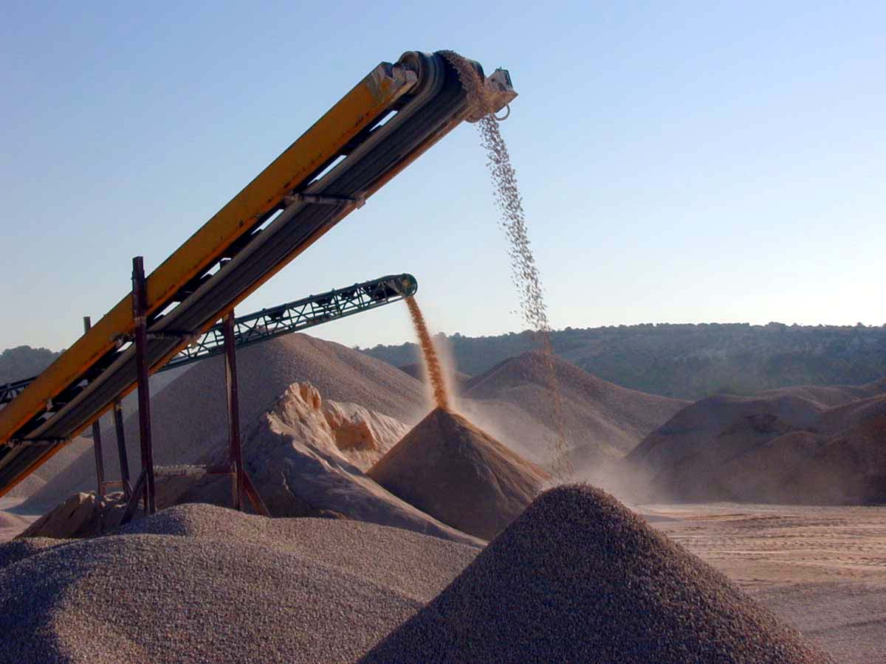
Notes:
Picture shows a lot very fine material. Conical piles good practice?

Slide 8
Stockpiles that stack traditionally can segregate, with coarser material falling to the bottom/outside, and finer material remaining in the center and top. Degradation can occur if loaders or dozers drive onto the stockpile, or if material is falling from a great height — potentially splitting or crushing the gradated material. Equipment driving on stockpiles can also cause contamination,
as it tracks dirt or loose material onto the stockpile.
Notes:
Tell how barges are loaded and how the larger rock falls to the far side

Slide 9
WOW!

Slide 10
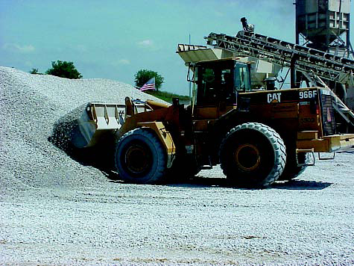
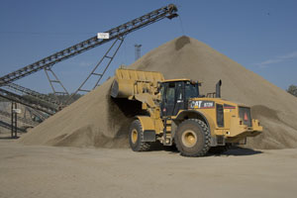
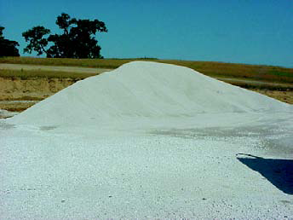
Correct loading techniques gathers a blend and does not hurt the pile
Flat Stacks

Slide 11
Notes:
Caution:
Scooping water
Walls high enough to not cross contaminate

Slide 12
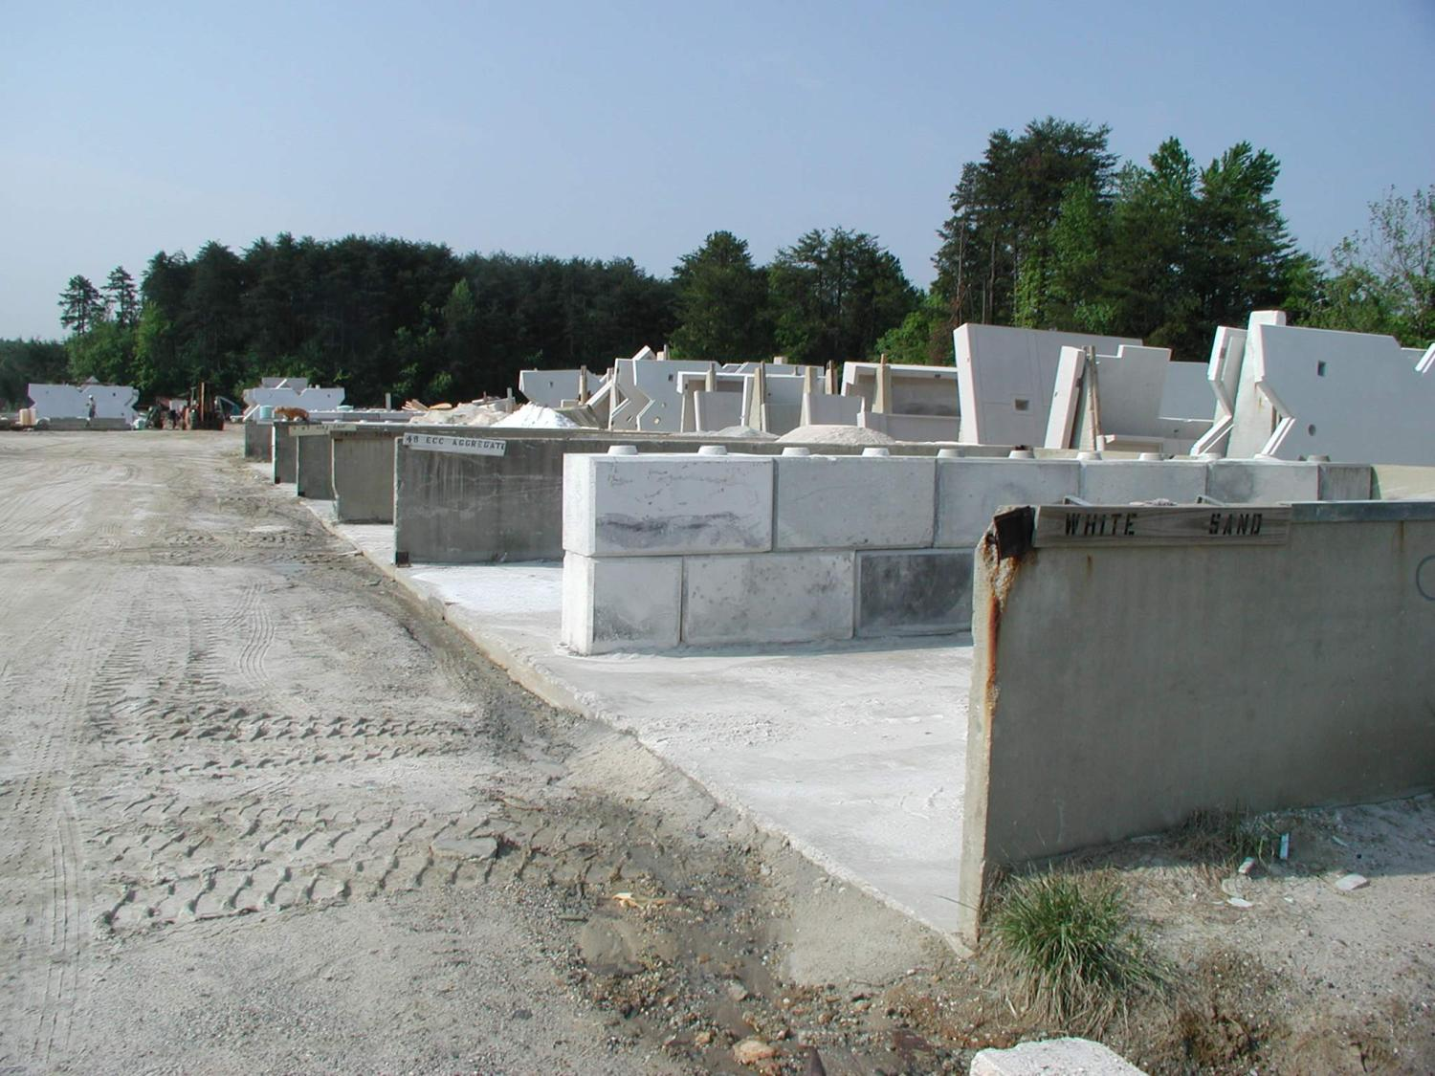

Slide 13
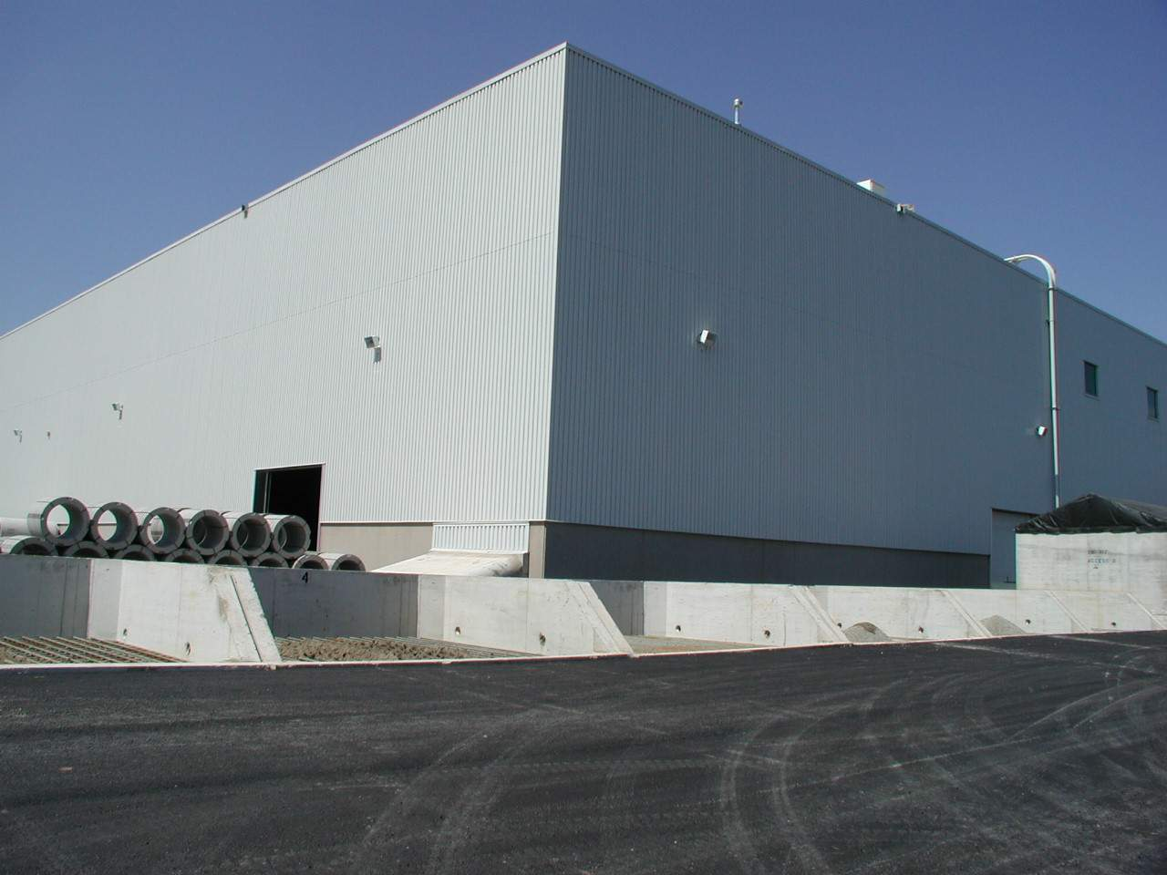

Slide 14
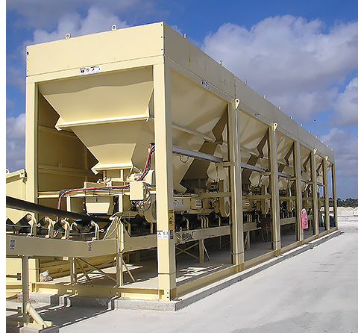
Under the individual grizzlies will be a system similar to this. The storage bins are directly under the truck dump areas and feed into individual weigh hoppers or onto a cumulative weigh belt that leads to the mixer

Slide 15
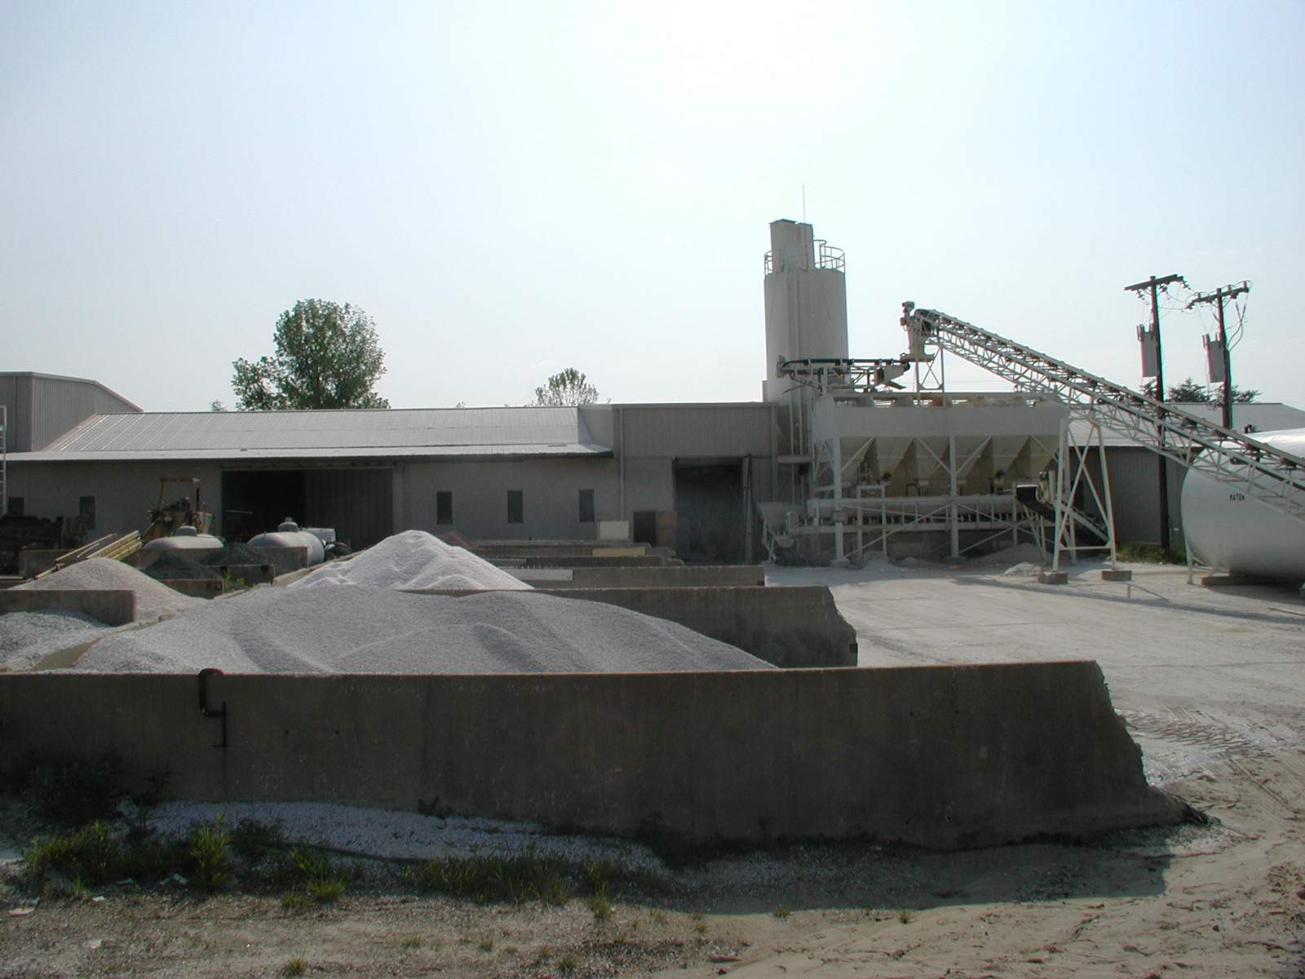

Slide 16
Filling Aggregate Bins
Correct
Incorrect
Notes:
Material can segregate in agg bins

Slide 17
Batching

Slide 18
Batching
Accuracy of weighing
Compensating for moisture in Aggregates
Sequencing

Slide 19
Typical Batching Tolerances (C94)
Cementitious +/- 1%
(for batches less than 1cy not less than required, up to 4% over)
Water +/- 1%
Fine Aggregates +/- 2%
Coarse Aggregates +/- 2%
Cum. Aggregates +/- 1%
Admixes +/- 3%
(or minimum recommended dosage per 100 weight or which ever is greater)
Notes:
C94 is for Ready mix concrete. May not apply to dry cast mixes. Check your local specs

Slide 20
Accuracy
Scales must hang free
Scales (gates or valves) must not leak
Scales must empty completely after each batch
Zero on scales should be checked on a regular basis
Calibrate scales annually
Notes:
Mention venting of cement and fly ash

Slide 21
Why Compensate for Moisture in Aggregates?
Batch Consistency
Predictable strengths
Production efficiency

Slide 22
Free Moisture
The free moisture must be accounted for when batching our concrete to help control mix costs and to improve its quality and consistency
Notes:
Probes are used for 2 reasons:
in aggregate bin, compensates for weight of the aggregate
in mixer, compensates for the weight of the water

Slide 23
Free Moisture Example
Consider the amount of water in 1,854 pounds of sand
(which is a typical amount of sand for a yard of pipe machine concrete)
that has 4% total moisture in it and has an absorption of 1%
This gives us free moisture of 3% (4%-1%)
Notes:
Probes are used for 2 reasons:
in aggregate bin, compensates for weight of the aggregate
in mixer, compensates for the weight of the water

Slide 24
Free Moisture Example
At 3% moisture:
The 1,854 pounds of sand that we weighed up is 1800 pounds of SSD sand and 54 pounds of water
Fifty-four pounds of water is 6 ½ gallons (54pounds/8.33 pounds per gallon) of water
We are 54 pounds short of sand and we have 54 extra pounds of water
If we do not compensate properly for this difference, it will significantly affect the cost and quality of the concrete that we are producing
Notes:
Probes are used for 2 reasons:
in aggregate bin, compensates for weight of the aggregate
in mixer, compensates for the weight of the water

Slide 25
Compensating for Moisture in Aggregates
The old fashioned way
Water Valve (hose)
No compensation for lost (yield) aggregate
Inconsistent mixes (slump)
Inconsistent strengths due to varying batch proportions and W/Cm ratio
Notes:
Emphasize moisture control is necessary for consistent mixes

Slide 26
Compensating for Moisture in Aggregates without Probes
Daily burn offs of aggregate samples
Compensation for moisture in aggregates remains constant as long as moisture does not change between burn offs
Can improve batch consistency (slump)
Can improve strength consistency

Slide 27
Compensating for Moisture in Aggregates
Moisture Probes
Good batch consistency (Slump)
Automatic compensation for Aggregates
More consistent strengths
Probes need to be calibrated and calibration must be checked on a routine basis based on requirements from your local agencies.
Notes:
Probes must be calibrated
Probes should be used in at least the sand and if possible in the coarse aggregate. If not in coarse ag, then it must be oven dried.
Probes measure total moisture, not free moisture

Slide 28
Microwave Bin Probe Calibration Plots
Typical Sand Microwave Bin Probe Plot

Slide 29
Microwave Bin Probe Calibration Plots
Typical Rock Microwave Bin Probe Plot

Slide 30
Microwave Bin Probe Calibration Plots
Shifts in Probe Calibrations

Slide 31
Sequencing (per manufacturer’s recommendation)
Aggregates
Cementitious
Water
Admixtures (per admix manufacturer recommendation)
Aggregates
Water
Cementitious
Admixtures (per admix manufacturer recommendation)
OR

Slide 32
Sequencing Cement
Depends on Mixing system
Generally cement should be discharged when all aggregates and water are in mixer
If cement balling occurs cement should be discharged sooner or later depending on your mixer
Ask your mixing manufacturer for a recommended sequence and timing schedule

Slide 33
Why does the Sequencing of Admixtures matter?
Mix Consistency
Reducing the amount of additive added (cost)
How it affects the probe readings

Slide 34
Air Entrainment Sequencing
Air entraining should be added with the mix water or aggregates
Air entraining should be mixed with aggregates for a few seconds before adding cement

Slide 35
Lubricant/Surfactant Sequencing (Dry Cast)
Should be added with the aggregates and water

Slide 36
Water Reducer Sequencing
Water Reducers should be added with the mix water after the air entraining is done

Slide 37
High Range Water Reducer (Super/Superplasticizer) Sequencing
High Range Water Reducers should be added at the end of the batch after all ingredients are thoroughly mixed

Slide 38
Admixture Sequencing
Always work with your admixture supplier when you have batching sequence questions or issues

Slide 40
It is important to understand the effect of time on your concrete. The workability and quality of the concrete will deteriorate particularly in hot weather

Slide 42
Mixers

Slide 43
Mixer Output
Quantity of concrete needed per day
Quantity of concrete needed per hour

Slide 44
Mixer Output
Output is measured in:
ft³
yd³
m³
Typically 2/3 of rated capacity!!!
Notes:
It’s 2/3rds because the raw ingredients take more room than the mixed result. Some mixers will mix the rated capacity (ie…Skako)
Have them ask what the min and max output capacity

Slide 45
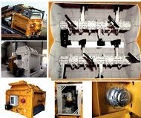
Common Types of Mixers
Paddle Mixers
Ribbon/Spiral Blade Mixers
Pan Mixers
Counter-Current
Rotating Pan
Stationary Pan
Twin-Shaft Mixers

Slide 46
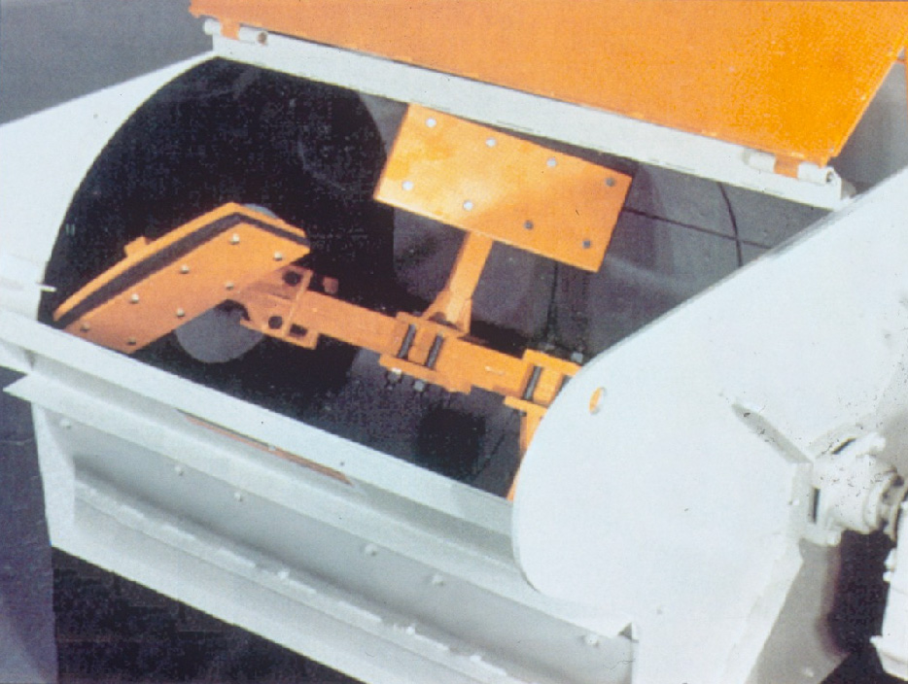
PADDLE MIXER
Notes:
Paddle mixer
If you are going to use a lab mixer for trial batching, you would probably use this type of mixer.

Slide 47
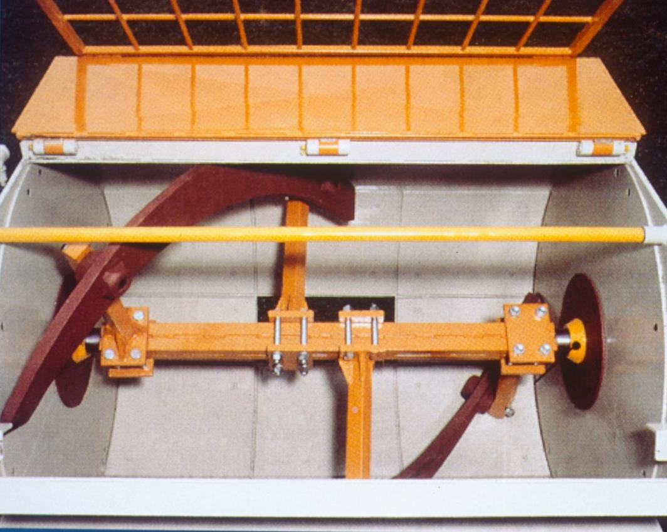
RIBBON MIXER
Notes:
Spiral blade or ribbon mixer

Slide 48
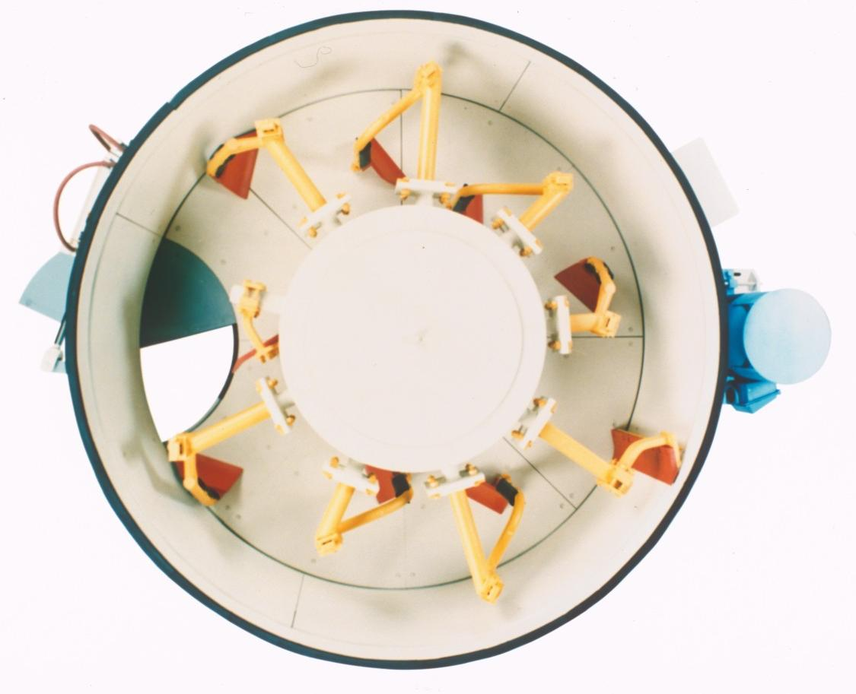
TURBINE MIXER
Notes:
Turbine pan mixer

Slide 49
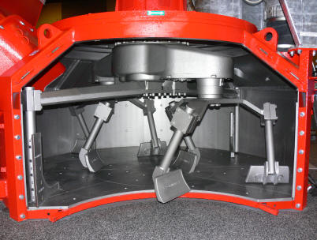
COUNTER CURRENT MIXER
Notes:
Counter current mixer

Slide 50
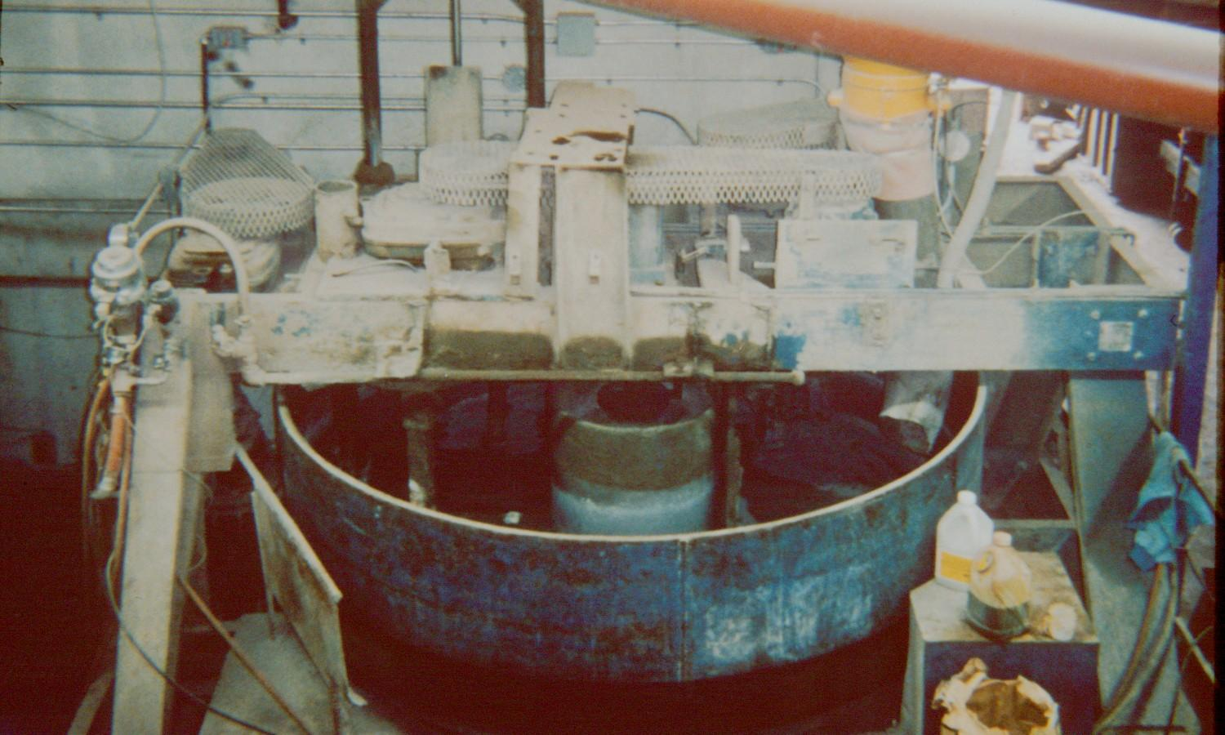
PAN MIXER

Slide 51
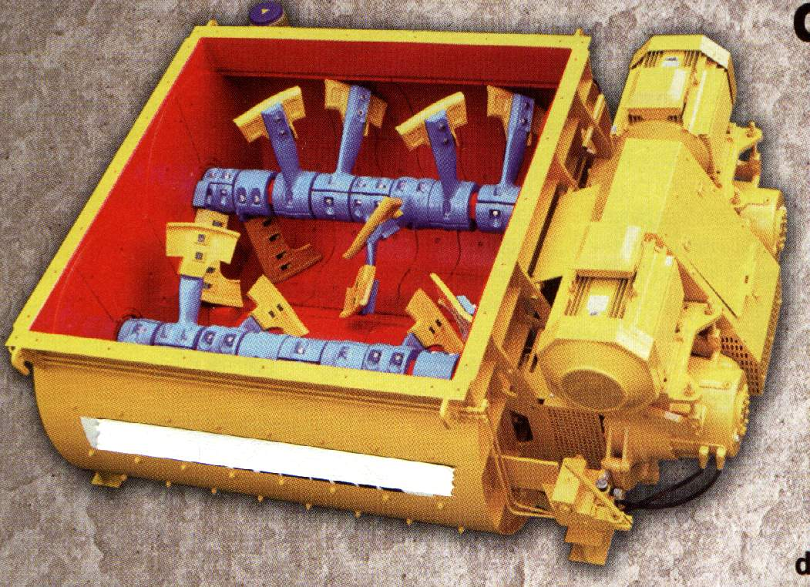
TWIN SHAFT MIXER
Notes:
Twin Shaft

Slide 52
Concrete Transport

Slide 54
Concrete Discharge from Mixer
Discharge into center of bucket or hopper
Incorrect
Correct

Slide 55
Handling Concrete
Avoid
Segregation
Loss Of Mortar
Loss of Slump

Slide 56
Segregation
Most common cause of damage occurs:
if concrete is not discharged vertically
at free-fall distances more than 6 feet
when jarring or shaking during transportation
Open chutes
more than 20’ Long
chutes that are too steep (slide not tumble)
Notes:
6-10’ is acceptable due to the fact that producers are pouring 8’ lengths, but the closest possible is best

Slide 57
Pouring Concrete
Place concrete in the form near its final location
Keep free-fall to a minimum
Use flat forms
Begin pour at corner or edge
Pour in equal lifts
Vertical Forms
Pour in horizontal layers
For large blockouts, pour on one side - allow concrete to flow underneath
Notes:
Blockouts: pour from one side to avoid trapping air by pouring from both sides.

Slide 58
Questions?
Tom Umek
Tom.Umek@cam-hp.com

