Slide 1
Curing

Slide 2
Curing
Hardening of concrete
Hydration→ CSH gel
Accelerated curing
The rate of hydration increases as the ambient temperature increases
Maintaining moisture in the concrete is critical
Notes:
Curing is more than the hardening of concrete
Hydration is not a “drying out” of concrete but rather a chemical reaction

Slide 3
Proper Curing is Essential
Reduces permeability
Essential for structure watertightness
Improves durability
Optimal strength achieved

Slide 4
Essentials for Proper Curing
Maintain moisture
Maintain temperature

Slide 5
Notes:
What’s wrong here: product covered, but there is a rip in the plastic. No moisture added, and therefore being cured in a dry atmosphere which can’t be done with exposed concrete.

Slide 6
Concrete Strength
vs
Moisture Condition
Proper moisture and temperature result in increased concrete strength
Notes:
If moist cured (water bath), you will get 100% design strength at 28 days. (Note: the difference in moist and air cured is generally not as severe as show in this graph, but it should be explained that there is some loss of strength)
Explain that if they put a piece on the plant floor and throw a tarp over, they will notice water on the inside of the tarp…therefore if not covered, that water is just escaping…Suggest at least covering product

Slide 7
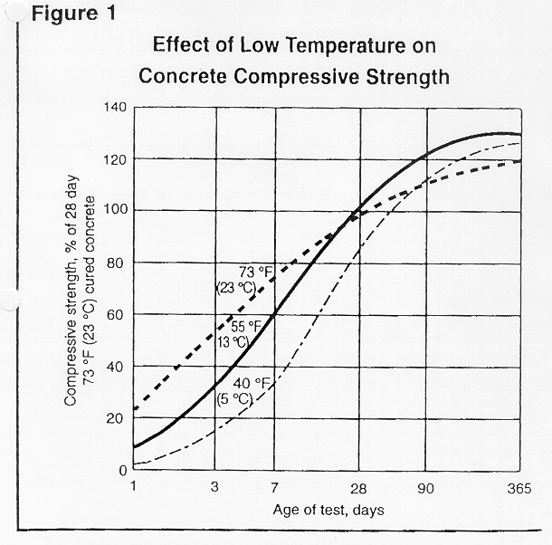
Low Temperature
vs
Strength
Compressive Strength
% of 28 day
73°F(23°C) concrete
Notes:
Show the lower temps = lower strengths…most pipe producers are curing at 120 degrees. The 120 degree line would show a higher early strength, but lower final strength.

Slide 8
Curing Methods
Maintaining moisture by wetting
Prevent moisture loss by sealing
Accelerated curing

Slide 9
Maintaining Moisture by Wetting
Wet burlap
Spraying/Misting
Fogging
Notes:
Recommended by Mel to fog during the day while hot
Mention: If burlap is not kept wet, it will wick away moisture and hurt you more than helping

Slide 10
Spraying/Misting
Cold or hot
Very fine droplets
Air pressure
Effective for higher cement content and warmer climates
Notes:
Caution: If using a Jay Bird, they must be high enough to avoid air movement that will crack the pipe.
Water should also be proper temperature to avoid cracking the pipe if the water is too cold.

Slide 11
Prevent Moisture Loss by Membrane Sealing
Forms
Tarps / Polyethylene
Curing Compounds
Caution:
If w/c <0.5
With pozzolanic mixes
Notes:
If wet casting at least cover the ends
If a curing compound is NOT membrane forming, there is a potential for moisture loss
Ask Mel about the Caution on pozzolanic mixes

Slide 12
Accelerated Curing
Dry Heat
Use with caution: difference between accelerated curing and maintaining heat
Heated beds (hollow core)
Electric or gas heaters – convection heat
Infrared heating – radiant heat
Low pressure steam
Boilers
Steam generators
Admixtures
Note: Raise concrete temperature while maintaining high humidity
Notes:
Admixes accelerate the set or strength gain, but are not a substitute for proper curing environments

Slide 13
Accelerating Admixtures
2 Classes of Admixtures:
Set Accelerator
Strength Accelerator (Early Age)
Calcium Chloride is the most common in Ready mix, but BEWARE should not be used in precast reinforced concrete
Several non-chloride, non-corrosive accelerators, but generally most are not as effective as calcium chloride
Notes:
Calcium Chloride is not recommended for use in reinforced concrete due increased corrosion of the reinforcement in its presence.

Slide 14
Considerations for Accelerated Curing
As a rule of thumb, a temperature increase of 18°F doubles rate of hydration
High temperatures with low humidity can crack the product
The lower the curing temperature, the longer the product must be cured to achieve comparable early strengths

Slide 15
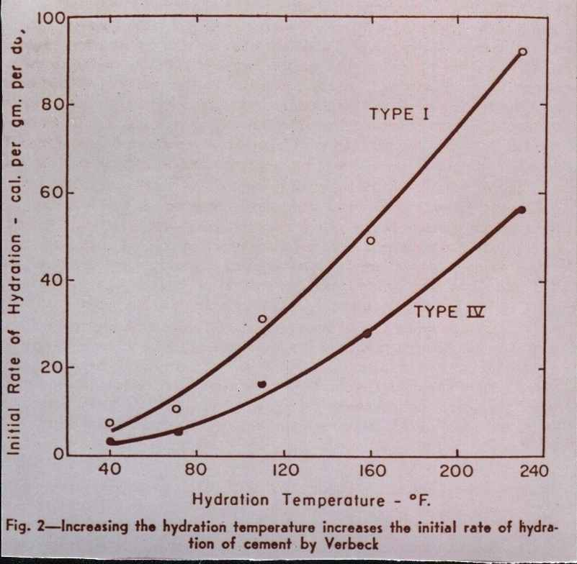
Notes:
Higher the temp = higher the rate of hydration
Note: Type IV is not commercially available

Slide 16
Notes:
Example of poor curing because no moisture is being maintained or added.

Slide 17
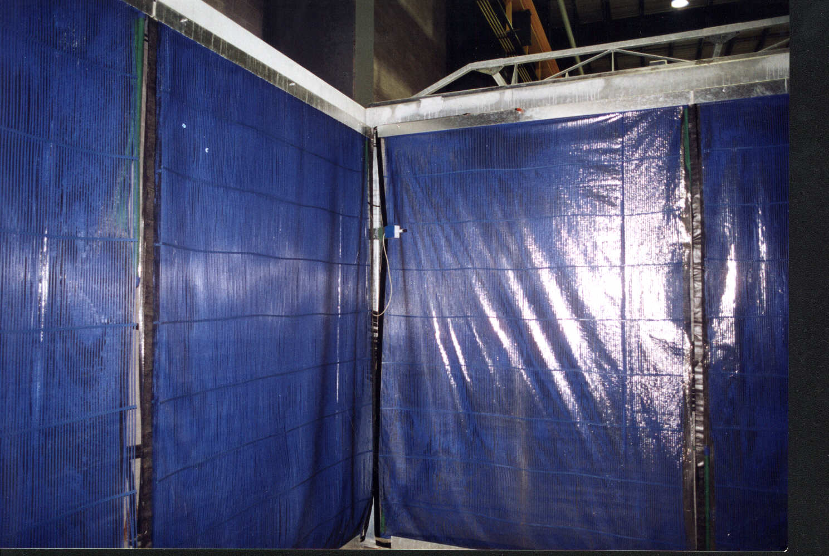
Notes:
One method to use radiant heat while maintaining moist curing environment…Just an example, but is expensive

Slide 18
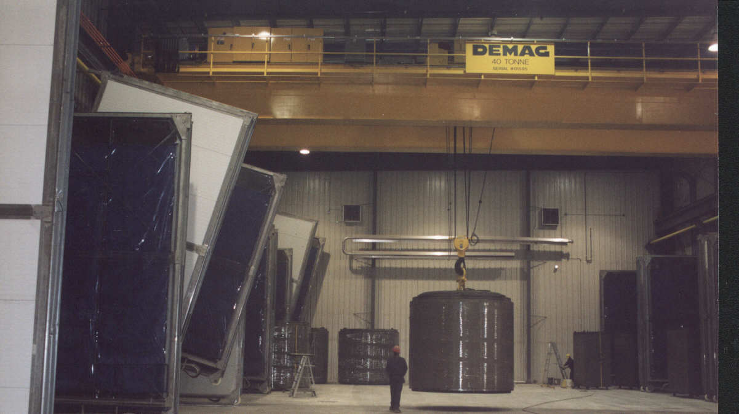

Slide 19
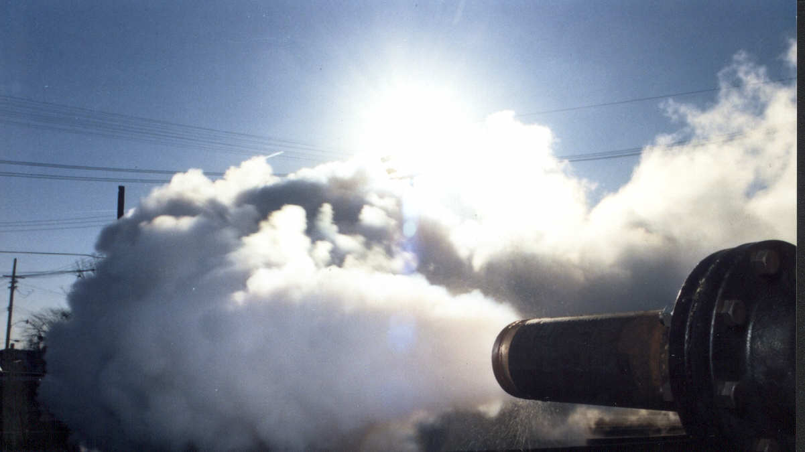
Notes:
Live steam is most common providing both the heat and the humidity

Slide 20
Low Pressure Steam Curing
Provides both heat and humidity
Product is heated by the warmer steam condensing on it
Moisture evaporation is minimized

Slide 21
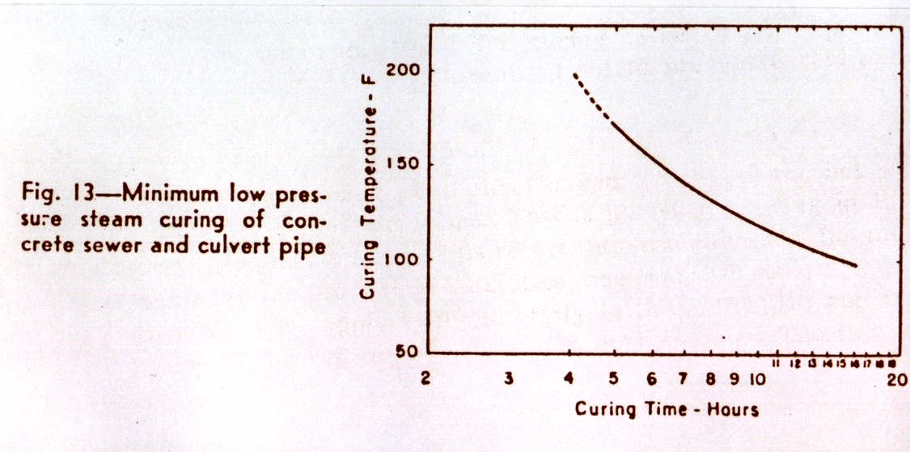
Notes:
Curing showing a relative strength for a given amount of time and temperature. i.e. Higher the temp, faster the curing for the same strength.
Caution students to not cure above 160 degrees per ASTM

Slide 22
Typical Accelerated Steam Curing Cycle
Preset (< 90 degrees) – at least one hour
Ramp (Temperature Rise) – at 20F to 40F per hour
Hold / Soak (at target temperature) – varies with the product
Cool Down
Notes:
Mel uses the I-button at this time to show one way to monitor curing temps.
Determining preset times for dry cast is very difficult. Preset could be 5 hours, but note that at least 1 hour…The longer the preset, the better the product will be. Historically, a preset of 1 hour has proven to be effective for products cured in kilns.
Must test product to know how long to “hold” product to be most efficient

Slide 23
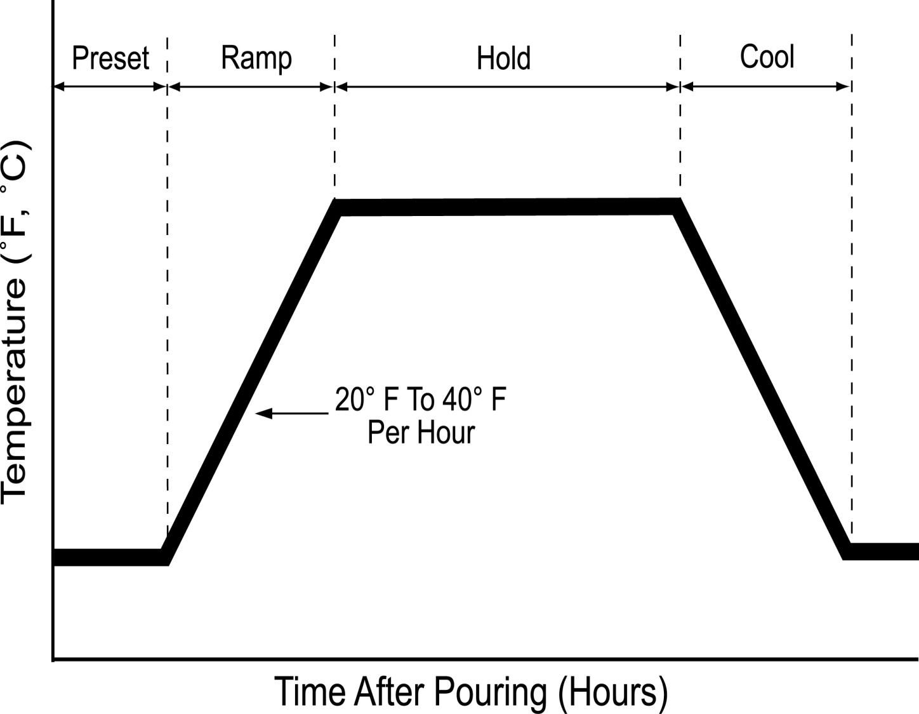
Idealized Accelerated
Steam Curing Cycle
1) Preseting
2) Ramping
3) Holding
4) Cooling

Slide 24
Target or Equilibrium Temperature
Concrete product temperature = Kiln air temperature
Concrete product no longer gains weight from the moisture condensing on its surface
Concrete begins to lose weight to the kiln atmosphere
Generally, the equilibrium temperature is higher for less dense production

Slide 25
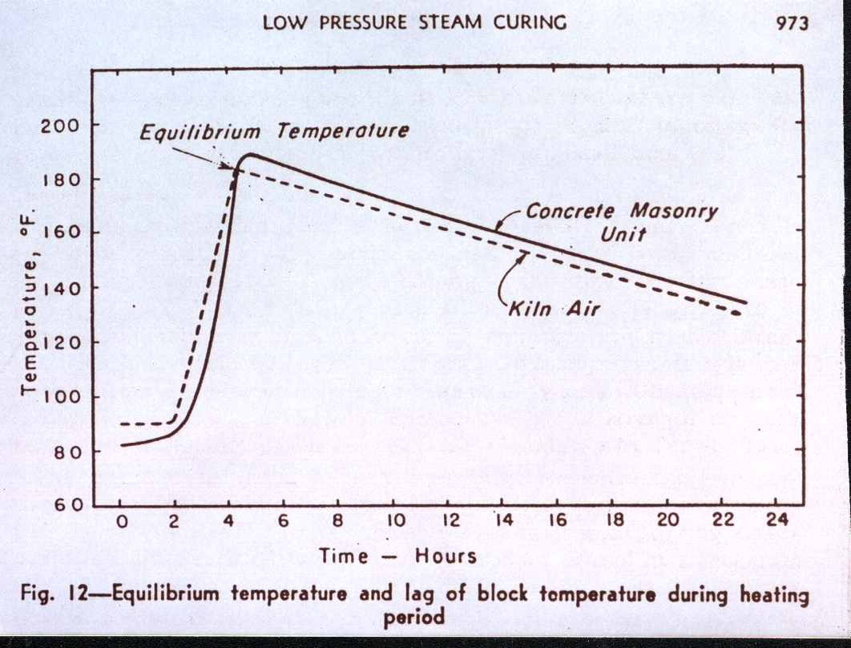
Notes:
Equilibrium Temp = temp where it no longer gains or loses moisture
DEF problems occur when concrete temp shoots up above the curing cell temp

Slide 26
Concrete Target Temperatures
Concrete Pipe (Typical for Accelerated)
120° F to 140° F (50º C to 60º C)
4 to 6 hours
Precast (including Pipe)/Prestress limits (ACI)
160° F (71° C) in Canada
160° F (71° C) in USA
8 to 12 Hours
Notes:
Note: these are concrete temps, not air temps

Slide 27
Wet Cast Products
Leave forms on as long as possible
Check with supplier when using accelerated admixtures

Slide 28
Dry Cast Products
Require 90 to 100% humidity
Must protect from drafts

Slide 29
Special Conditions
Hot weather curing
Shade, sprinkle coarse aggregates
Add ice to mix water or use water chiller
Shelter product from direct sunlight
Notes:
Chillers are great, but if using a low w/c, there isn’t much water to cool.
When using ice, use crushed if possible

Slide 30
Special Conditions
Cold weather curing
Keep fresh concrete temperature > 50°F
Heat aggregates
Heat water
Notes:
If you need (by using chart) to heat the water over 160 degrees, heat aggregate as well.

Slide 31
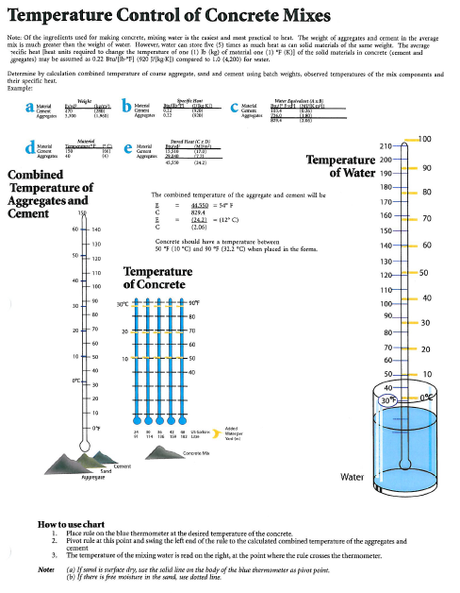
Notes:
If you need (by using chart) to heat the water over 160 degrees, heat aggregate as well.

Slide 32
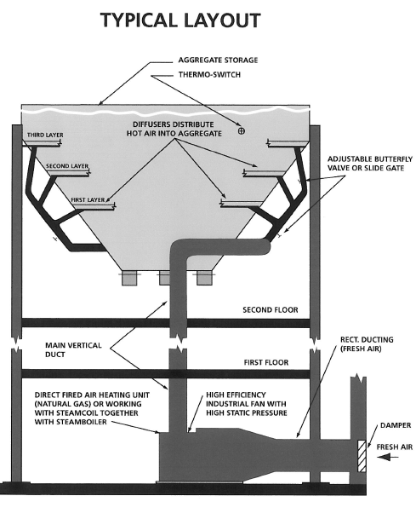

Slide 33
Reducing Energy Costs
Determine actual curing cost
Review curing cycle
Preset, ramp, hold
Curing chambers
Insulation, partitions, canopies
Prevent flueing
Direct steam flow out curing cell bottom only
No steam leakage along the sides or through the top
Notes:
Qcast REQUIRES that you monitor what happens in the curing cell

Slide 34
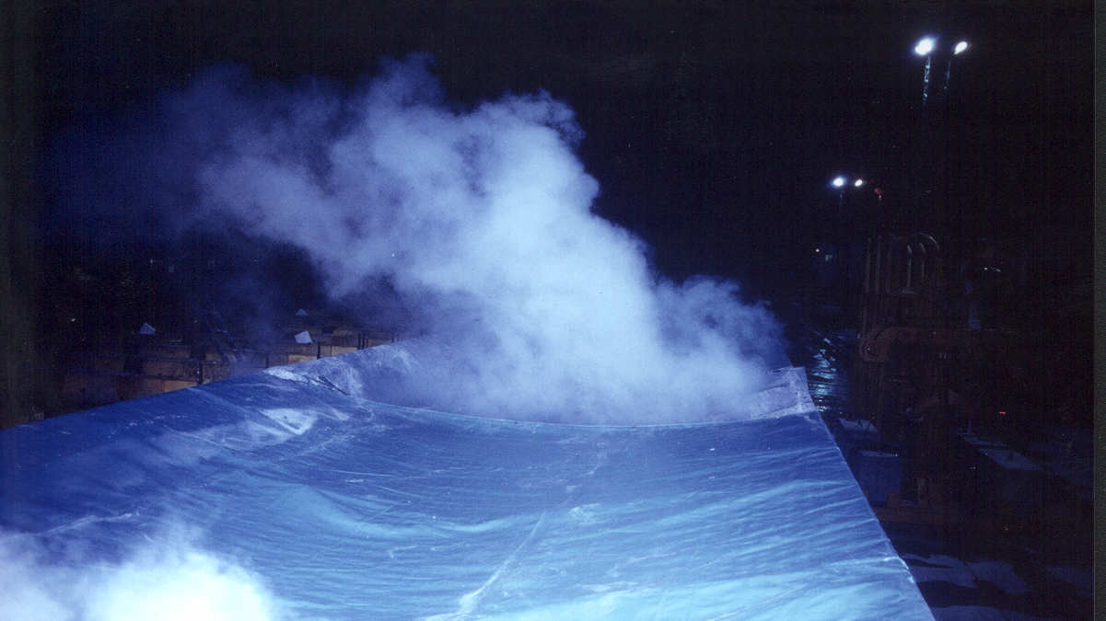
Notes:
Pic showing a plant who couldn’t get temp…this shows the problem of energy and stem being released out the top.

Slide 35
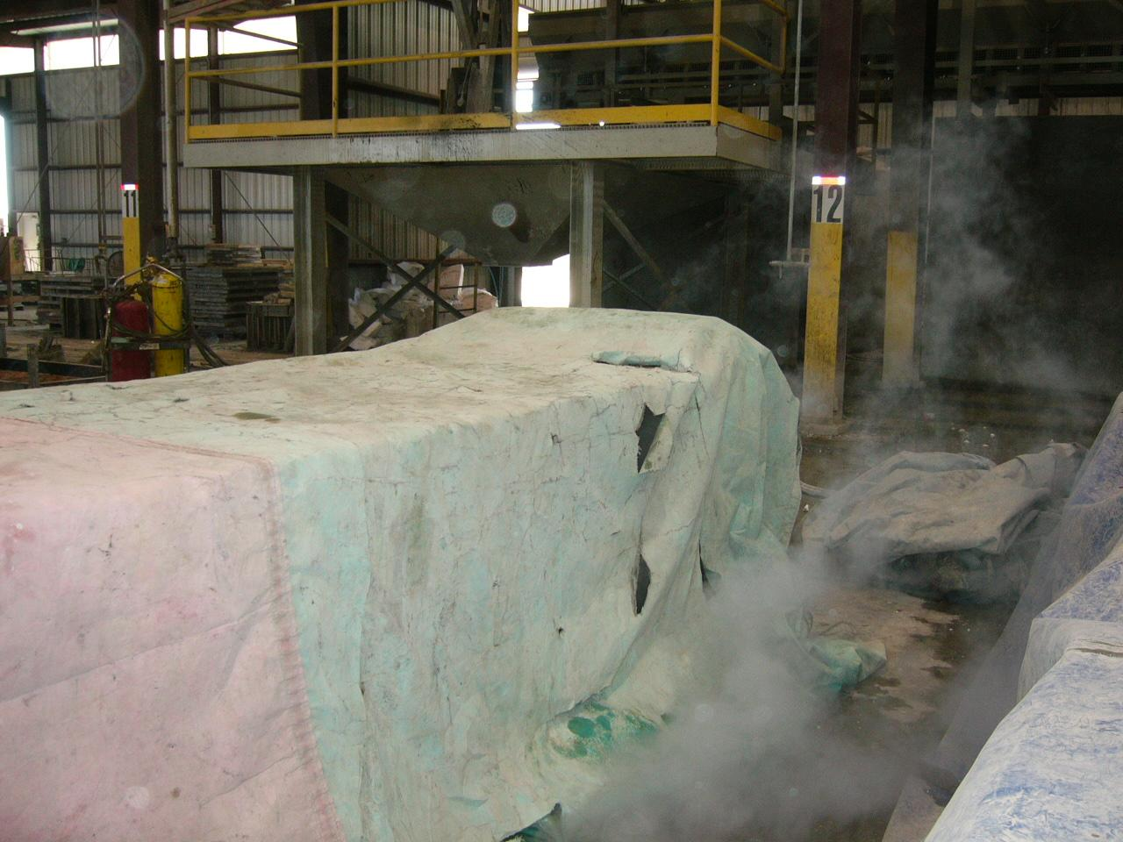
Notes:
Should only see stem coming out the bottom. If they are having problems, put hand over any holes to see if heat is escaping. Or put a match or cigarette or match under tarp…If smoke goes up, then there is flueing problems.

Slide 36
Conclusion: Want smoke flowing out of cell

Slide 37
Additional checks for Flueing
Light a match
Flame flows in if Flueing
If the floor of the cell is cold and dry
Cold air pulled into the cell
Flueing.
If the floor is warm and wet
Steam flowing out of the kiln bottom
Not flueing

Slide 38
www.maxim-ic.com ---- iButton
800-336-6933
DS1921K - starter kit
DS19216 – extra button

Slide 39
Questions?
Mel Marshall
Mel@mcmconultants.ca

