Slide 1
INTRODUCTION TO SELF-CONSOLIDATING CONCRETE

Slide 2
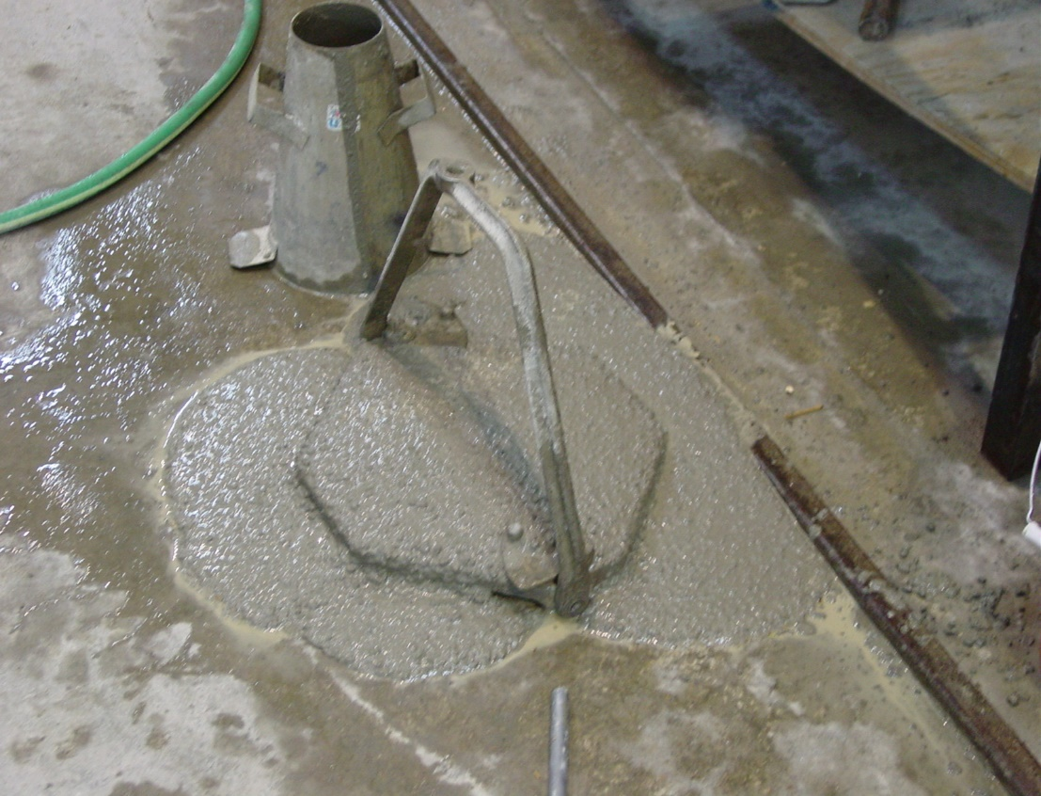
Agenda
What is SCC
Terminology
Applications for SCC
How are SCC mixes developed
Testing methods

Slide 3
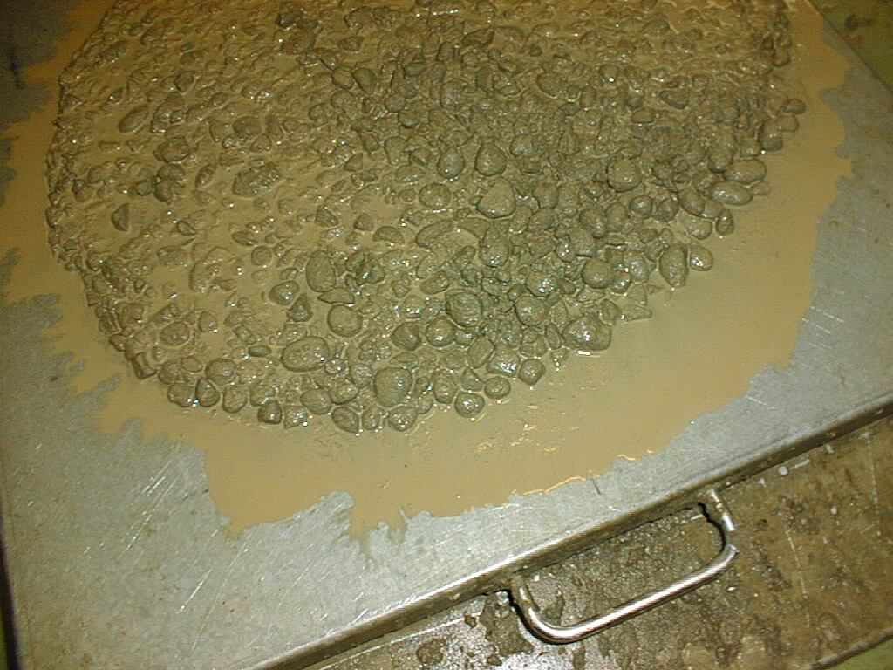
What is SCC?
20” Slump (490mm)
SCC is more than flowable concrete
  it is a highly engineered fluid with unique Rheological properties
24” (590 mm) Slump/Spread
This is not SCC. You cannot just add water or admix and get SCC!
Notes:
With conventional concrete mix design it is almost impossible to acheive true SCC (24 inch slump flow), because the viscosity is insufficient to suspend the aggregates in the mix, and segregation will occur.
A quick study of the rheology of conventional flowable concrete, and SCC tells us why and gives guidance on how to redesign mixes for SCC concrete.

Slide 4
What is it?
Self Consolidating Concrete is a highly flowable, non-segregating concrete that can flow into place, fill the formwork, and encapsulate the reinforcement without any mechanical consolidation.
ACI 237
Notes:
Plastic properties define SCC, but the mix design and the production practices define the benefits to the producer and the quality of the hardened product.

Slide 5

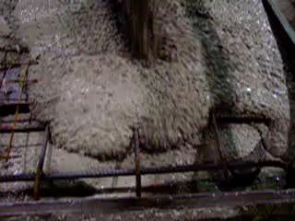
What this means is that SCC is much more than flowable concrete
SCC fills the formwork without vibration and with a significant reduction in labor.
Notes:
What this means is that SCC is much more than flowable concrete. Note how the concrete encapsulates the reinforcement without any external vibration or consolidation. The aggregates are moving along with the paste – no mix separation. The concrete completely fills the form, the reinforcement does not stop the concrete flow, and there is no past bleeding or aggregate separation.

Slide 6
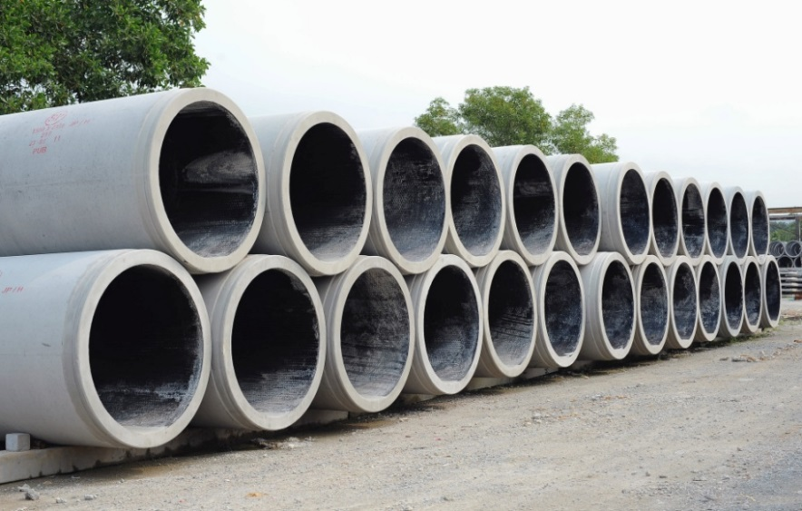
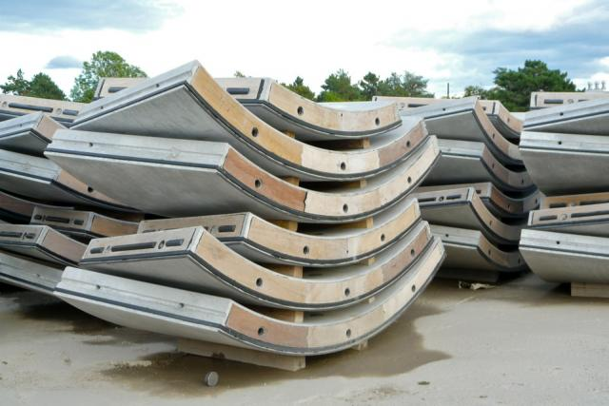
Where Can SCC be used?
Notes:
What this means is that SCC is much more than flowable concrete. Note how the concrete encapsulates the reinforcement without any external vibration or consolidation. The aggregates are moving along with the paste – no mix separation. The concrete completely fills the form, the reinforcement does not stop the concrete flow, and there is no past bleeding or aggregate separation.

Slide 7
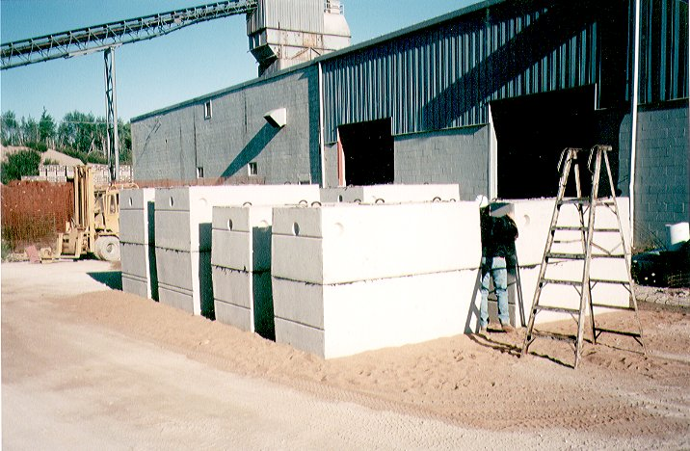
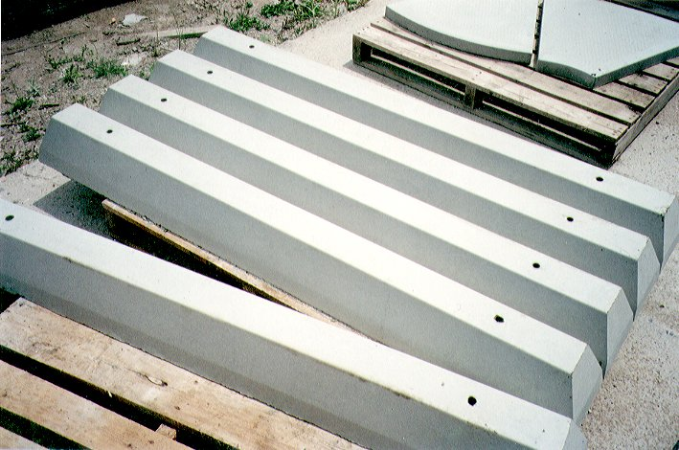
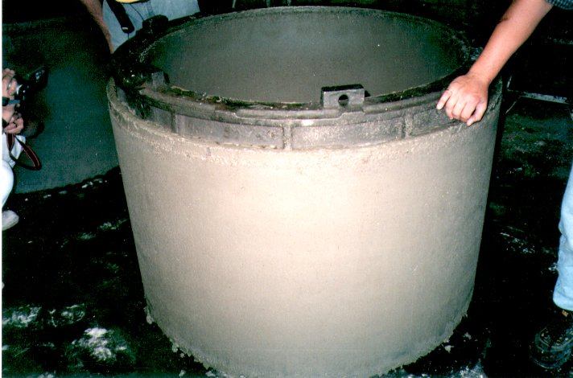
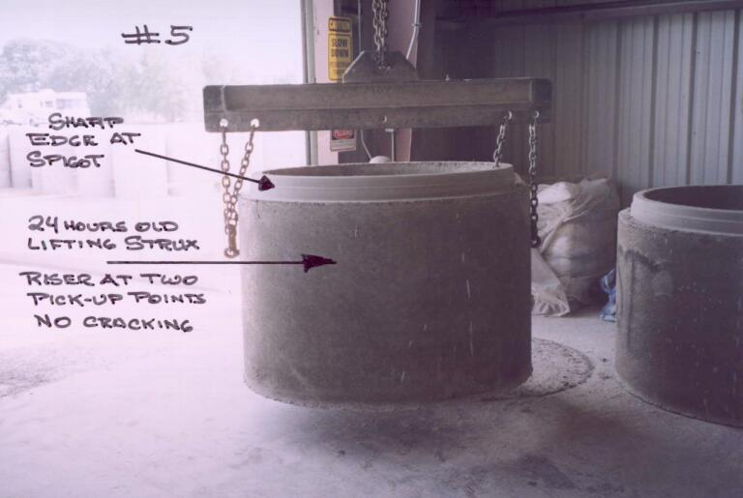
Where Can SCC be used?

Slide 8
SCC Terminology
Rheology, Viscosity, Thixotropy and more…

Slide 9
Rheology
The science dealing with flow of materials, including studies of deformation of hardened concrete, the handling and placing of freshly mixed concrete, and the behavior of slurries and pastes.
    Cement and Concrete Terminology, ACI Publication SP-19

Slide 10
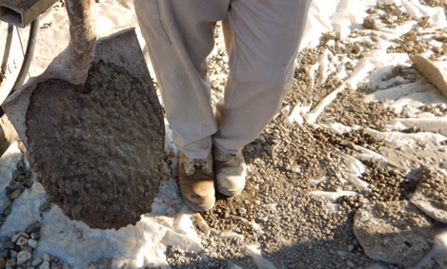
Viscosity
The property of a material which resists change in the shape or arrangement of its elements during flow, and the measure thereof.
    Cement and Concrete Terminology, ACI Publication SP-19

Slide 11
Thixotropy
The tendency of a material to act as a semi-solid (gel) at rest and a fluid while in motion.
A material is said to have thixotropic properties when it exhibits a decrease in viscosity with time when the material is subjected to a constant shearing stress

Slide 12
Concrete Rheology
The rheology of concrete is measured with a concrete rheometer, which determines the resistance of concrete
to shear flow at various shear rates.
Concrete rheology measurements are typically expressed in terms of the Bingham model, which is a function of:
  Yield stress: the minimum stress to initiate or maintain flow (related to slump)
  Plastic viscosity: the resistance to flow once yield stress is exceeded (related to stickiness)
Concrete rheology provides many insights into concrete workability.
  Slump and slump flow are a function of concrete rheology.
Results
Flow Curve
The Bingham Model
Shear Stress, (Pa)
slope = plastic viscosity (μ)
intercept = yield stress (τ₀)
Shear Rate, (1/s)

Slide 13
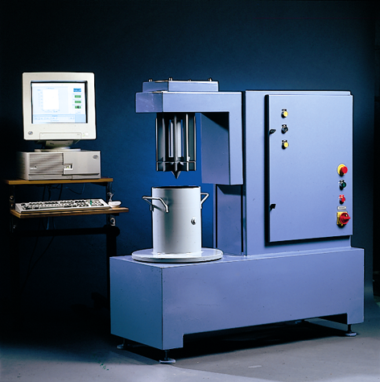
Rheology – Targets for SCC Mixes
Static YIELD STRESS (t₀)
  Low enough such that concrete will flow under own weight
VISCOSITY (m)
  Low enough to allow flow,
  High enough to prevent segregation
BLM Rheometer
Notes:
Very important when designing and evaluating an SCC mix that the critical components of Rheology are evaluated and managed.
Yield Stress
Viscosity

Slide 14
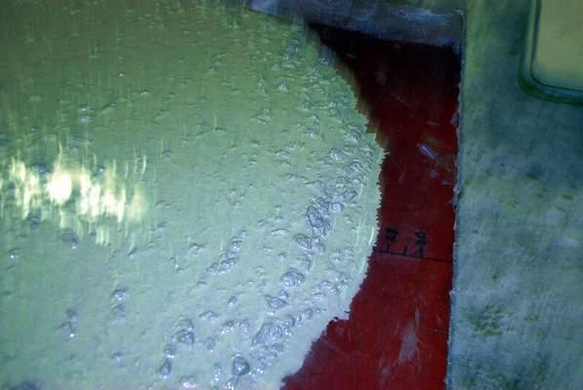
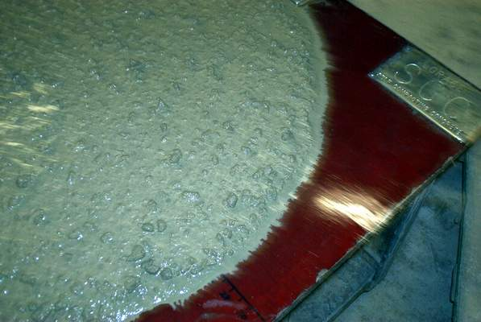
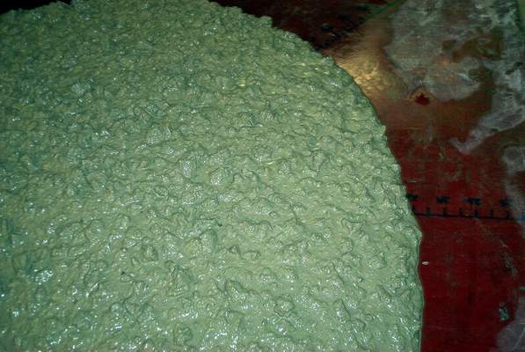
SCC: Rheology and Stability
Low Flow
More Stability
Moisture Tolerance and Stability reflected in concrete rheology
Rheology controlled by:
  admixtures (supers & VMAs)
  mix design (powder content, w/cm, aggregate & gradation)
Yield Stress
High Flow
Less Stability
Plastic Viscosity
Fast Flow
Less Stability
Slow Flow
More Stability
Acceptable…
but on the edge
Superior…
With good moisture tolerance & stability
Unacceptable
Notes:
The Stability of SCC mixes are critical. In the field, these are visually evaluated. When evaluating at the SCC, whether it be in the formwork or during the testing, close attention and evaluation of the concrete and the behavior are an important process as they indicate the Yield Stress and the Plastic Viscosity. Adjustments can be made to the mix design or production process to make / keep the mix within the acceptable range(s).

Slide 15
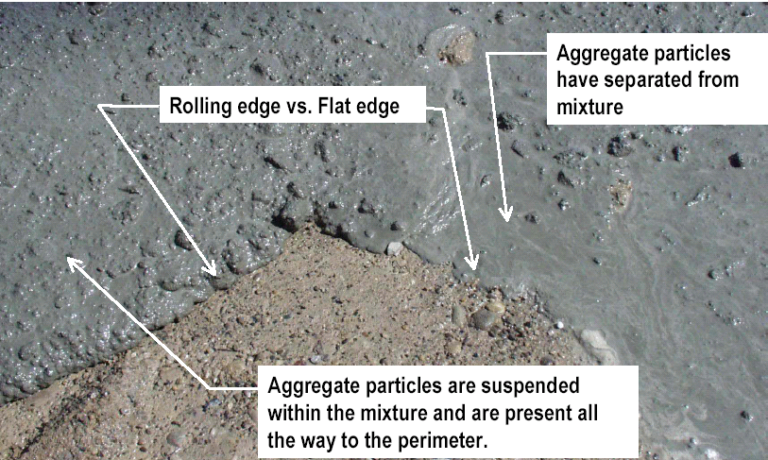
Stable SCC – Visual Difference
Notes:
Visual evaluation of the SCC. Note the location of the aggregates in relation to the cement paste and the suspension of the aggregates within the matrix of the paste. Where the paste goes so goes the aggregates. NO SEPARATION of sand / stone / paste.

Slide 16
SCC Mix Development
Understanding Key Properties

Slide 17
Key Plastic Properties of SCC: Filling Ability
The ability of the concrete to flow freely under its own weight, and to completely fill formwork of any dimension and shape without leaving voids
Filling ability is impacted by:
  Slump Flow
  Viscosity (T20/T500)
  Aggregate Shape
  Aggregate Ratio
  Placing Methods
  Size and configuration of the Forms

Slide 18
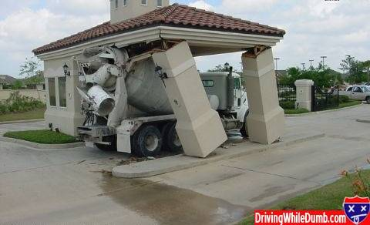
Key Plastic Properties of SCC: Passing Ability
The ability of concrete to flow freely in and around dense reinforcement without blocking

Slide 19
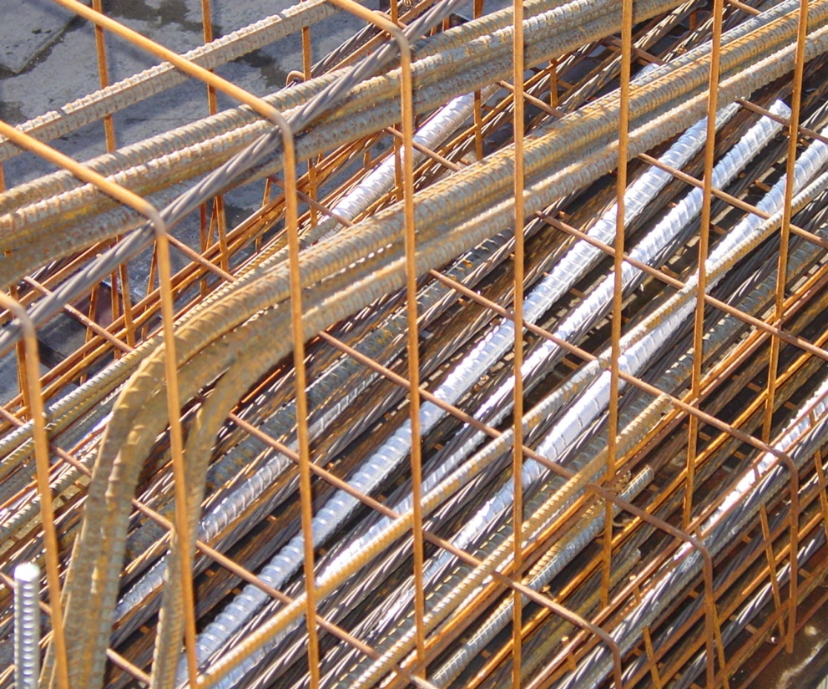
Key Plastic Properties of SCC: Passing Ability
Passing Ability is impacted by:
  Slump Flow
  Viscosity (T20/T500)
  Aggregate
    Shape
    Ratio
    Size
  Placing Methods
  Form or Rebar Spacing
Notes:
T20. Time for the SCC flow to reach a 20” circle on the slump flow board. A field method of evaluating the plastic viscosity. Thicker paste will take longer to reach 20”, thinner paste will quicken the spread flow. The thinner paste is more susceptible to the coarse aggregates falling out of suspension and the mix quality and stability impacted.

Slide 20
Key Properties of SCC
Resistance to Segregation
  During placement and while flowing, the concrete should retain its stability.
  There should be no separation of aggregate from paste or water from solids and no tendency for coarse aggregate to sink downwards through the fresh concrete mass under gravity
  Resistance to segregation is the most difficult to achieve

Slide 21
Key SCC Plastic Properties
Dynamic Stability - The characteristic of fresh concrete that ensures uniform distribution of solid particles and air voids as the concrete is being transported and placed.
Static Stability - The characteristic of fresh concrete that ensures uniform distribution of solid particles and air voids once all the placement operations are complete and until the onset of setting.

Slide 22
Plastic Properties
Stability is Impacted by:
  Slump Flow
  Viscosity (T20/T500)
  Aggregate Size
  Aggregate Ratio
  Aggregate Specific Gravity
  Powder Content
  Air Content
  Paste Content
  Mortar Content
  Transportation and Placing Methods
  Admixture Content
  Water Content

Slide 23

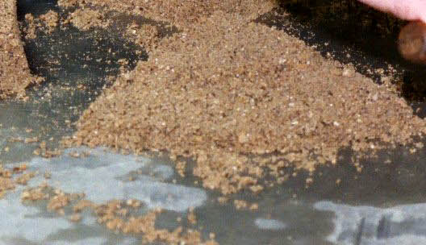
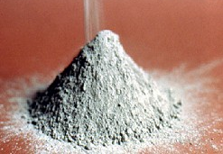
SCC Mixture Proportioning
Developing SCC consists of material combinations and relationships of:
  Cementitious Materials
  Sand / Aggregates
  Admixtures
  Water

Slide 24
SCC mix design approaches
High Powder Content and high-range water-reducing (HRWR) Admixture
Lower Powder Content, HRWR Admixture, and Viscosity Modifying Admixture (VMA)
Moderate Powder Content, HRWR Admixture, w/wo Moderate VMA addition
Powder
(Cmt, Fly ash, GGBFS)
Aggregate
Admix

Slide 25
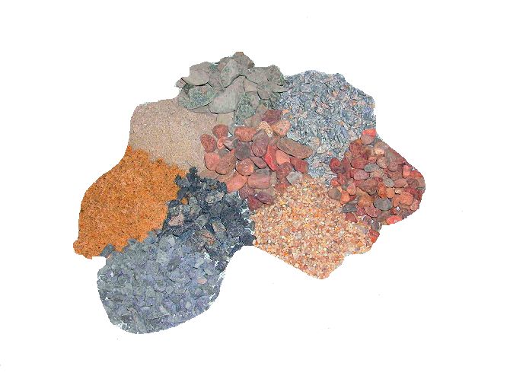
SCC Aggregate Selection
Aggregate Variability
  Size and distribution
  Angularity and aspect ratio
  Water demand
SCC mixture success:
Must use locally available materials
Quality of the ingredients can
vary dramatically
One mix design does not fit all

Slide 26
SCC Proportioning Steps
Determine required slump flow
Select coarse aggregate size
Determine the required air content
Estimate the required powder content
Estimate the required water content
Calculate coarse and fine aggregate amounts after Powder, Water and Air contents are determined
Calculate paste and mortar volume
Adjust coarse and fine aggregate weights based on paste and mortar volumes
Select admixture types and dosage
Batch Trial Mixture – Make adjustments and batch again

Slide 27
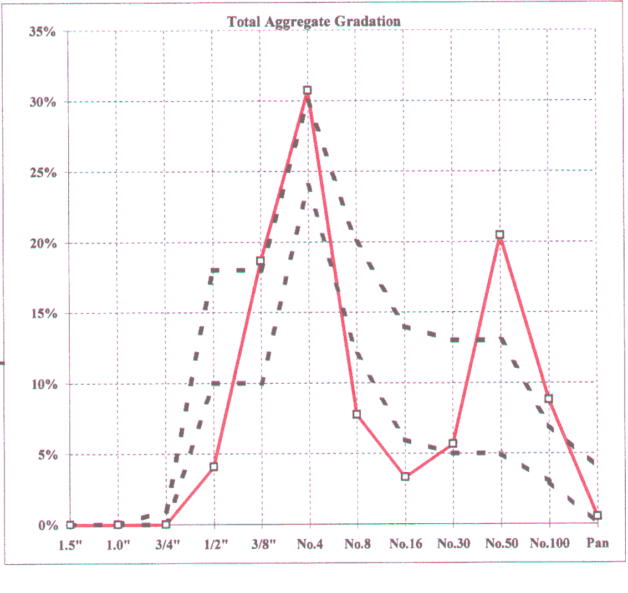
Aggregates
Many coarse aggregates available in North America are Gap Graded, and thus have low volumes of No. 8 and No. 16 sieve size particles
The optimized grading curve for SCC is much tighter than for conventional concrete
Optimizing mix packing density is critical for many SCC mixes, so it is may be necessary to blend aggregate sources

Slide 28
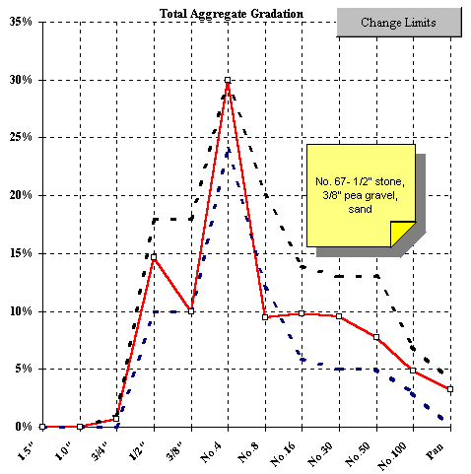
Aggregate Grading
An example of a typical # 57 blend, indicating a Gap Graded Aggregate
An optimized SCC aggregate gradation with blended aggregates

Slide 30
Possible Powder Content
 | Slump Flow (in) <22 | Slump 22-26 (in) 22-26 | Slump Flow (in) >26
Powder Content (pcy) | < 650 | 650 - 750 | 750 +
Absolute volume of coarse aggregate | 28-32% (total mix volume)
Paste Fraction (calculated on volume) | 34-40% (total mix volume)
Mortar Fraction (calculated on volume) | 60-70% (total mix volume)
Typical w/cm | 0.32 – 0.45
Typical cement (powder content) | 650-800 pounds

Slide 31
SCC Admixture Usage
SCC Polycarboxylate Superplasticizers
  Excellent flowability with improved stability compared to superplasticizers for conventional concrete. Increased mix forgiveness.
Viscosity Modifying Agents
  For difficult aggregates and production conditions such as low cementitious and paste volumes. Increases mix forgiveness / water tolerance.
Extended Slump Life Polycarboxylate Superplasticizers
  Excellent flowability with improved stability; formulated for the concrete market for added workability retention
Common admixtures such as AEA, retarders/HS and accelerators also work with SCC

Slide 32
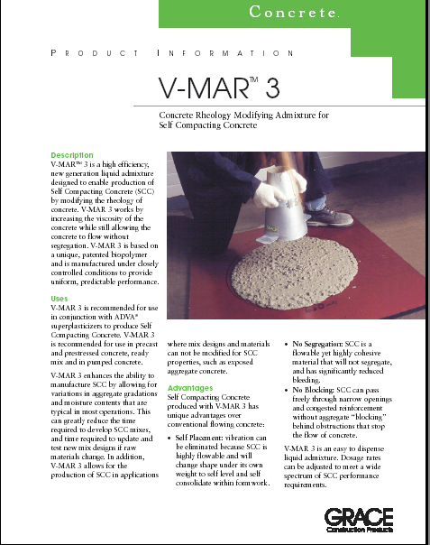
Viscosity Modifiers
Acts as a ‘thickening’ agent
Protects against segregation
Dispense direct into mix
No effect on set times or air content
Provides flexibility of water contents

Slide 33
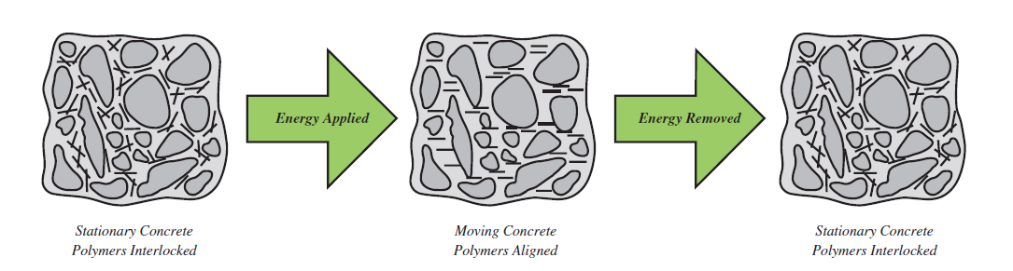
Viscosity Modifiers…what they do
Large polymer structure of VMA align in the direct of the applied energy (flow) and allow paste to lubricate coarse, angular sand particles reducing internal friction.

Slide 34
Viscosity Modifying Admixture Benefits
Drycast products –
Pipe, Manholes, etc
Hollowcore
SCC mixtures to
reduce bug holes
High cementitious
content mixes; making
it easier to discharge without sticking to
the drum
Notes:
One thing to note is that neither Viscosity Modifiers or Rheology Modifiers have a negative impact on the mix – strength, slump life, etc

Slide 35
VMA Benefits
Performance Attributes | Plastic Concrete Benefits | Hardened Concrete Benefits
Rheology modifier acting as a lubricant: Concrete flows more readily at low shear rates, without vibration (SCC, paving, truck discharge, poorly shaped aggregates) Improve extrusion and surface texture (creamier with more body than V-MAR3) | Mix ‘lubricity’ Cohesive without being ‘sticky’ Less clumping and lumps Improved surface finishes Even flows from the mixer – up the belts – out of the hopper and into the machinery Less sticking in the chutes Wide window of water flexibility No effect on water contents Generates more paste – potentially reduce cement content Able to use less than optimum sand and stone – especially if added cement is used to enable | Moisture retention aids curing Higher strengths through better curing, lower air contents Less cracking due to moisture retention Better surface finish, swipe/webbing More paste on surface, generally less bugholes Crisper edges Pallets and headers remove easier Fewer defects

Slide 36
Effects of HRWR and VMAs on Rheology
Same Mix Design
Different dosages of Superplasticizers and VMAs
140
130
20-21” Slump Flow
120
110
Yield Stress (Pa)
100
23-25” Slump Flow
90
80
70
27” Slump Flow
60
30
40
50
60
70
80
90
Plastic Viscosity (Pa*s)
Mixes made with different admixtures can have similar slump flow yet different rheology
In general, for mixes with the same slump flow, those with higher viscosity are more stable
The edges of the Workability Box are dangerous
    mixes with very low yield and viscosity may segregate
    mixes with very high yield and viscosity may not “self consolidate”

Slide 37
Adjustments to mix

Slide 38

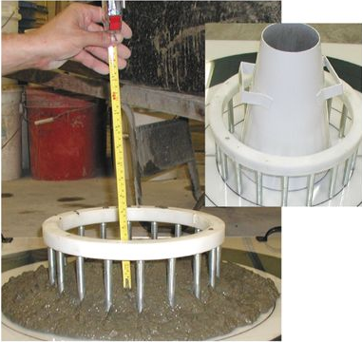
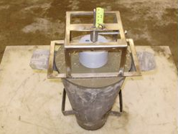
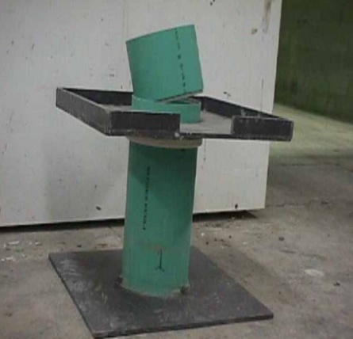
Test Methods to Evaluate SCC in Fresh State
  Workability:
    ASTM C11611 - Standard Test Method for Slump Flow of Self-Consolidating Concrete
  Stability:
    ASTM C1610 Column Segregation Test
      ASTM C1712 Rapid Assessment Test for SCC Segregation
  Passing Ability:
    ASTM C1621 J-Ring

Slide 39
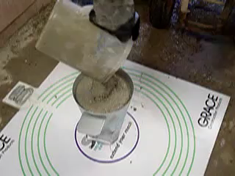
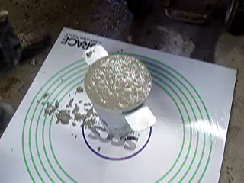
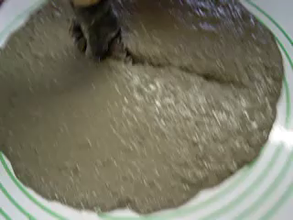
ASTM C1611 – Slump Flow

Slide 40
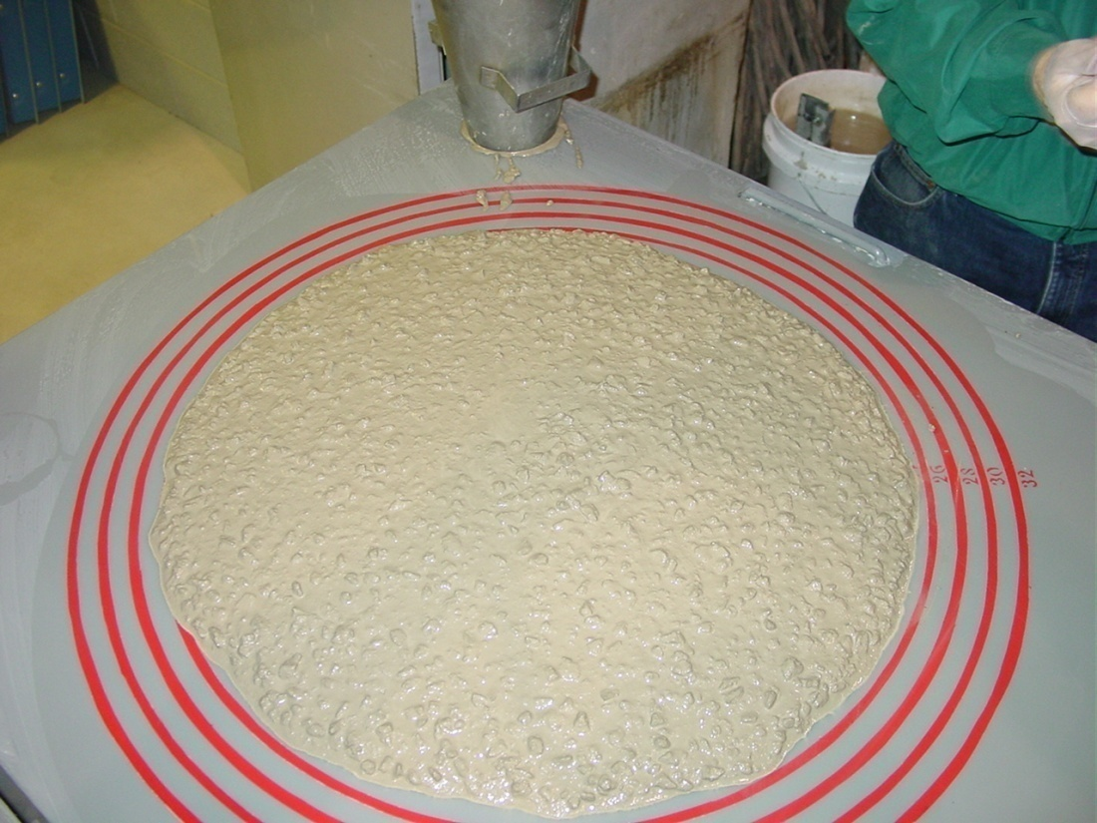
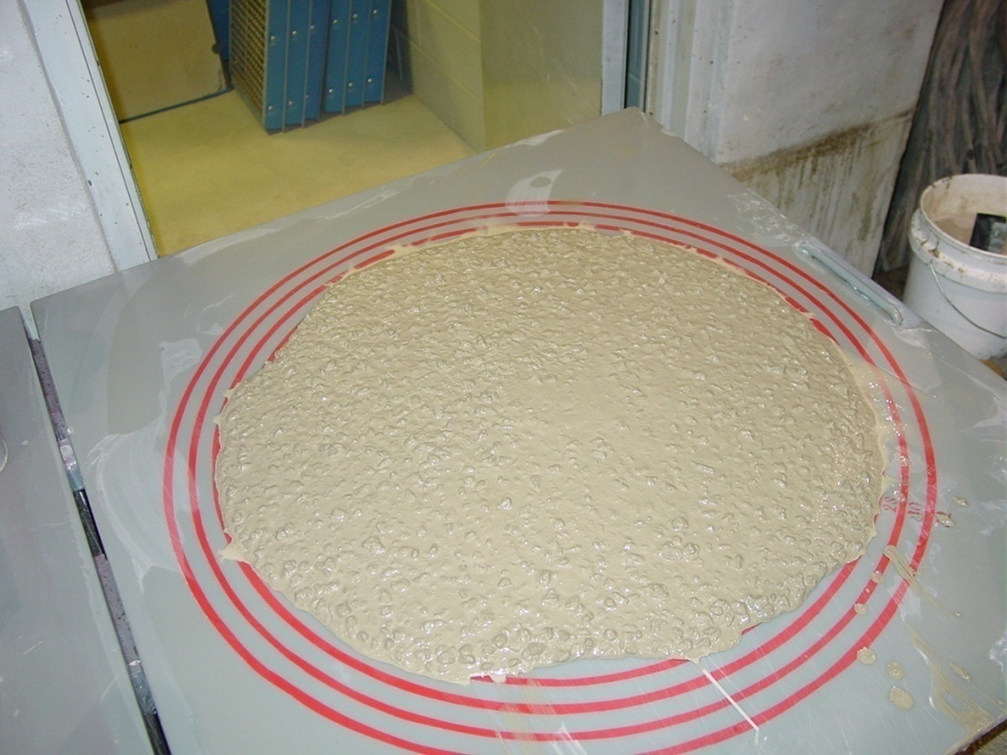
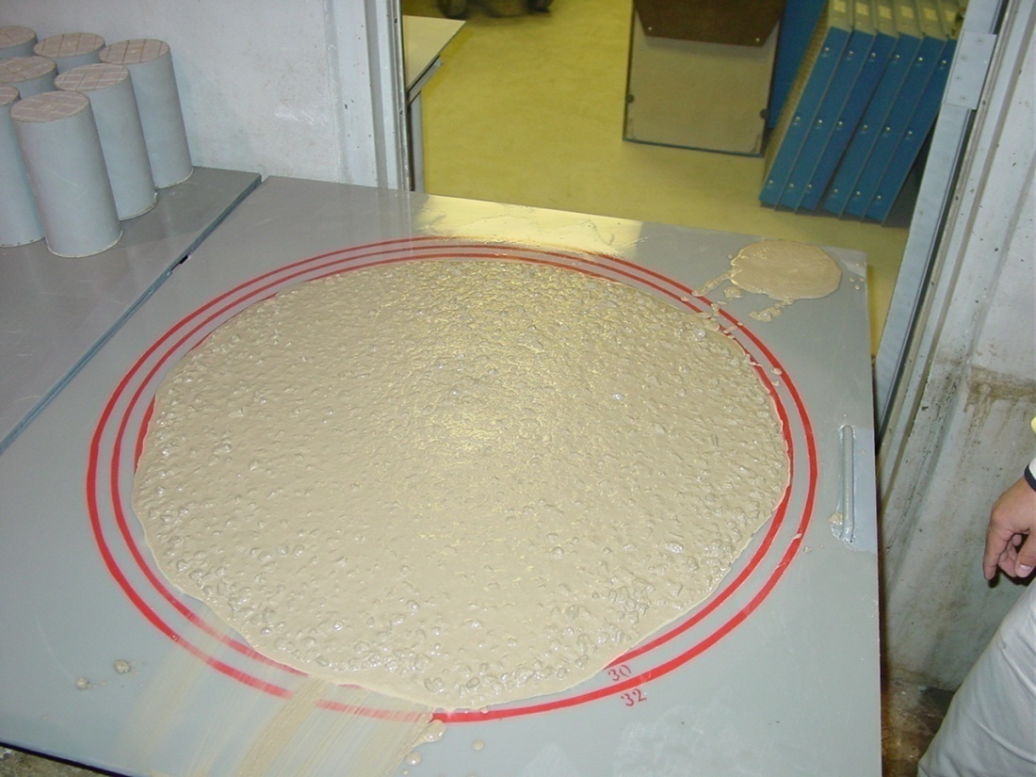
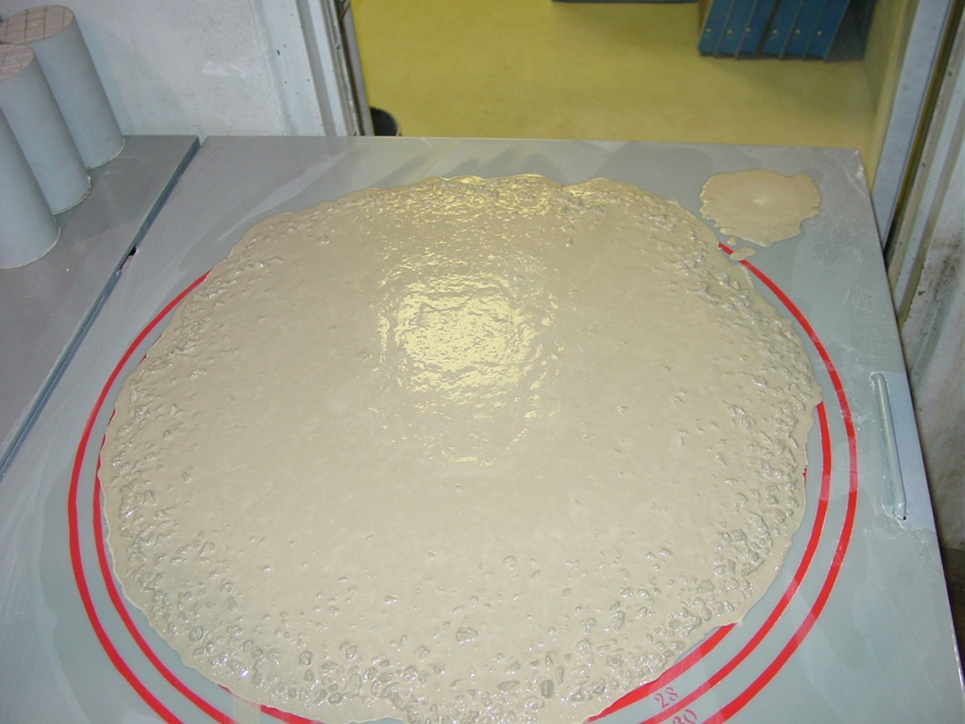
0
1
HIGHLY STABLE
STABLE
VISUAL STABILITY INDEX
2
3
UNSTABLE
HIGHLY UNSTABLE
Notes:
Visual Stability Index
Visual examination of the SCC by Production and QC departments as a means of assessing the acceptability of the mixture.
Upper Left #1 - high quality SCC with no indication of segregation or separation. Very good aggregate distribution and materials carried to the outer edge of the slump flow.
Upper Right #2 - high quality SCC, mix is starting to exhibit somewhat of a mortar halo and possibly some bleed water separation. This is an acceptable SCC mixture. Good aggregate distribution, although a little more mortar is present at the outer edges of the slump flow.
Lower Left #3 - Mix is exhibiting more mix separation, a more pronounced mortar halo, and uneven distribution of aggregate. Qualified QC personnel should evaluate this mix further before acceptance or rejections. Retest from another sample. Evaluate the application as to whether this mix should be used. VSI of #3 would indicate Marginal or borderline quality. Take corrective action on batches that follow to correct this situation.
Lower Right #4 - SCC mix showing all the signs of segregation, separation, bleeding, and instability. Reject this mix. Take corrective action immediately on following batch.

Slide 41
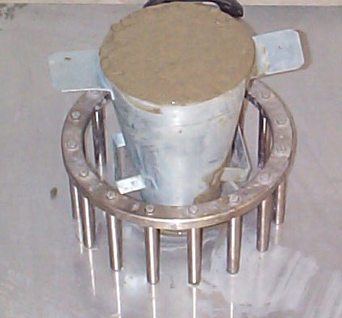
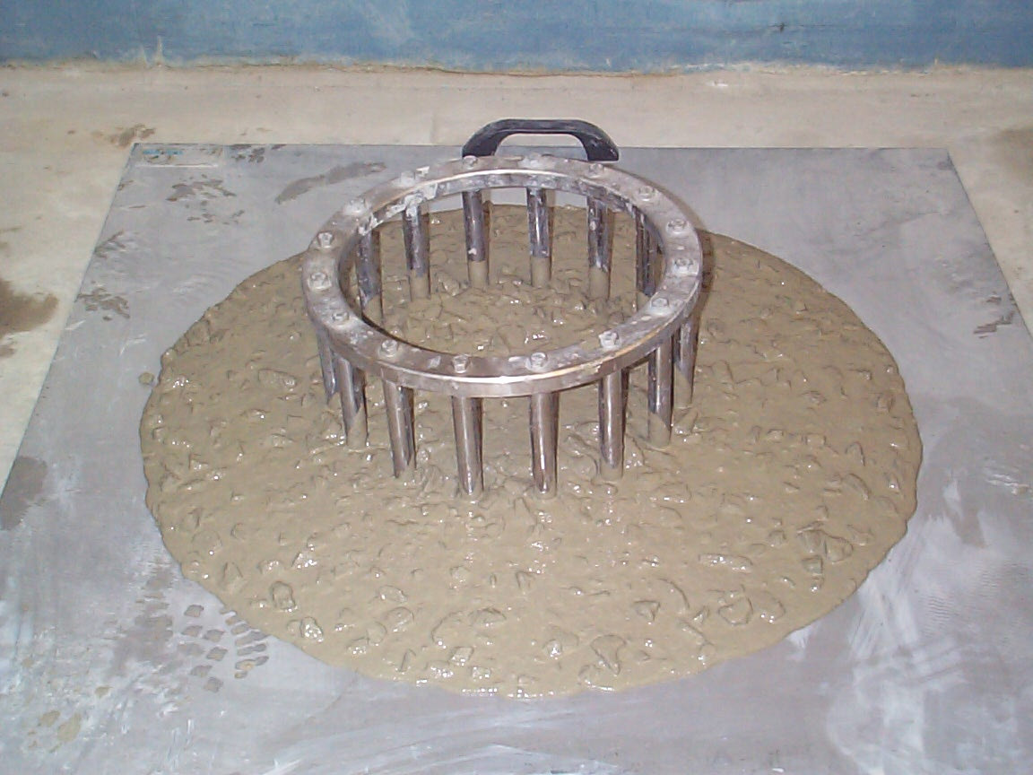
SCC Flow Characteristics ASTM C1621
J-Ring test (passing ability)
Comparison of J-Ring flow and Slump flow tests

Slide 42
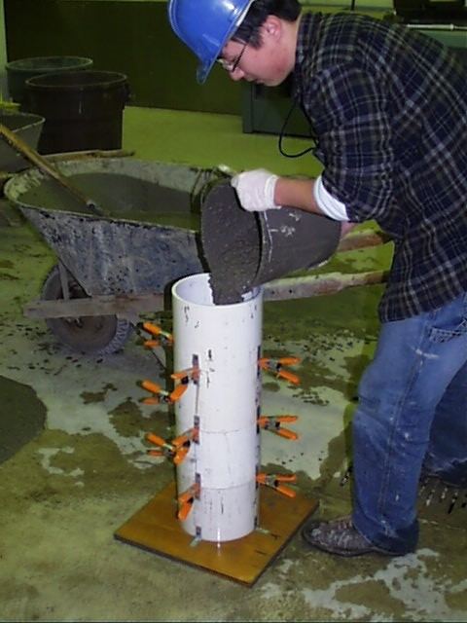
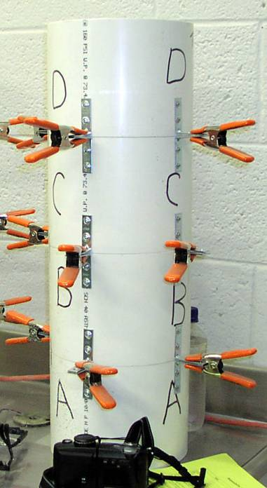
Column Segregation Test – ASTM C1610

Slide 43
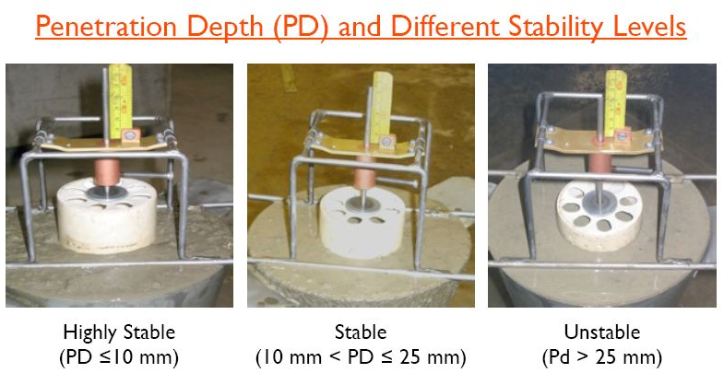
ASTM C1712 Rapid Assessment Method for SCC Segregation

Slide 44
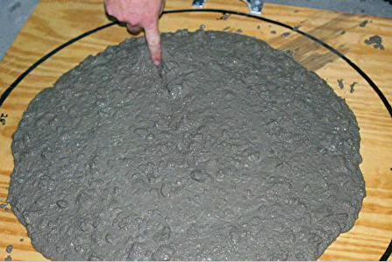
‘Unofficial’ Finger test

Slide 45
L Box Test
Test for passing ability indicated by the difference in concrete height between H1 and H2
Gate
Concrete
Fill Level
Rebar
Blocking ratio = H2/H1
BR = 1.0 is Excellent
BR = 0.9 Acceptable
H1
H2
Measurement
Notes:
The L Box test is typically used as a development tool for SCC mixes in the lab, to measure flow, segregation resistance and blocking.
A visual check confirms that the mix has flowed through the rebar once the gate is lifted, and that no aggregates have backed up behind the rebar.
The ratio of H1 to H2 indicates how level the concrete is after flowing through the rebar, and therefore resistance to blocking.

Slide 46
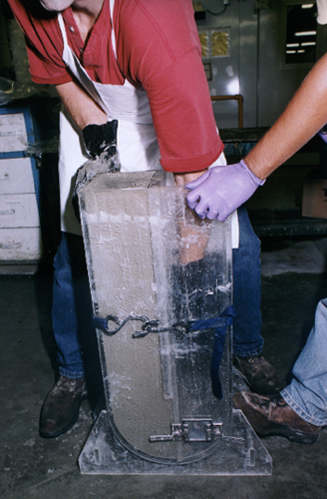
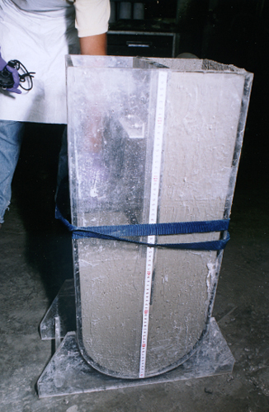
U Box Test
Concrete must reach at least 30 cm height after passing through rebar

Slide 47
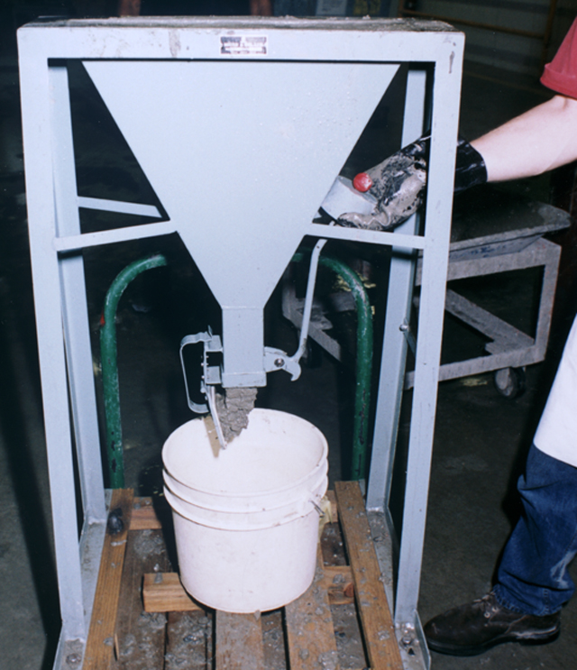
V Funnel Test

Slide 48
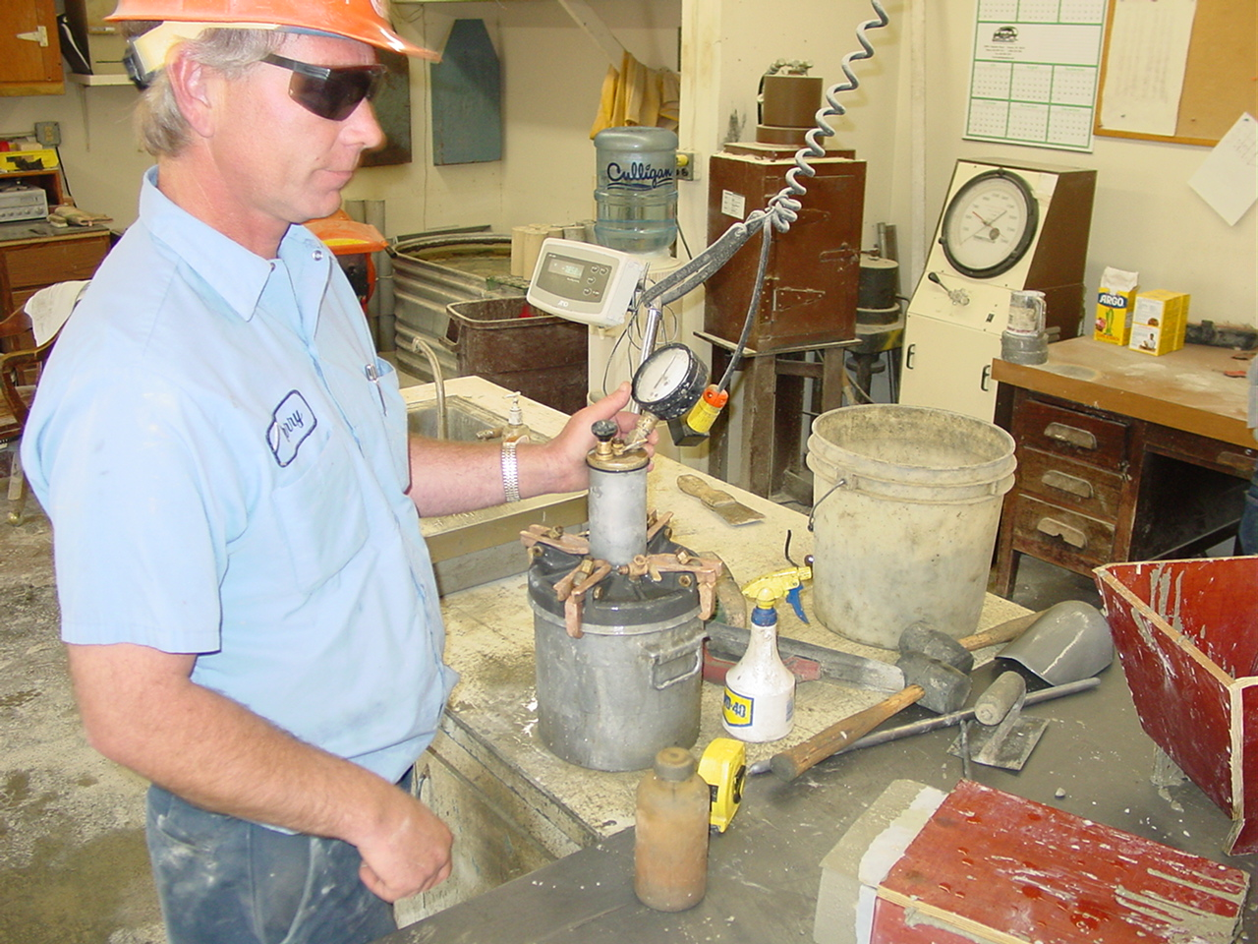
Modified Standard Tests for SCC

Slide 49
SCC Sources of Information
ACI
  Committee 237 – Self Consolidating Concrete
  Committee 211H; Proportioning
PCI
  Guidelines for SCC
ASTM
  Test methods
Other Resources
  European, French, Japanese Guidelines
  PCA Bibliography for SCC
  NRMCA
  RILEM Proceedings (International SCC conferences)
  ACBM Proceedings (1st North American SCC Conference)
Your friendly, local Admixture Field Sales Rep

Slide 50

Thank You

