Slide 1
ACPA QCAST PLANT
CERTIFICATION
MADE EASY

Slide 2
Learning Objectives
Recognize the benefit of obtaining the ACPA QCast Certification
Recall the product options for QCast Certification
Recall the components of the certification program
Recall the qualification requirements for the QC person on-site
State the scoring requirements for passing for overall and for critical items
Recall the minimum documentation requirements for initial certification of first time plants

Slide 3
Outline
Understand how to become QCast certified
Introduction to plant certification requirements
Provide suggestions to organize paperwork
How to avoid common deficiencies

Slide 4
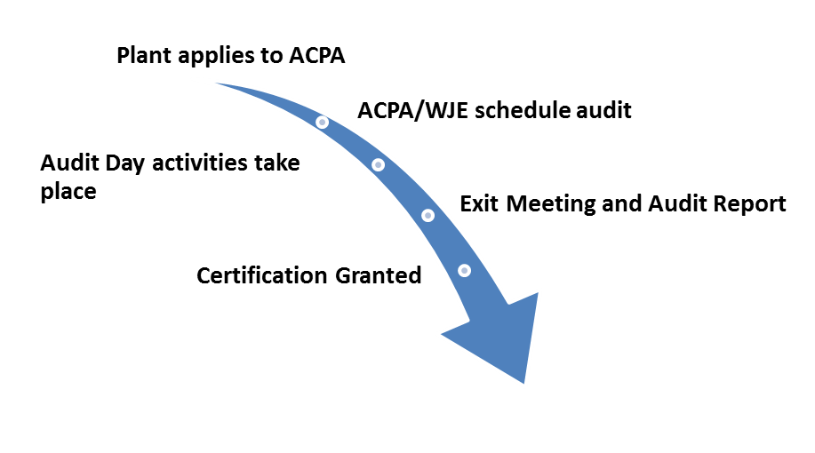


Slide 5
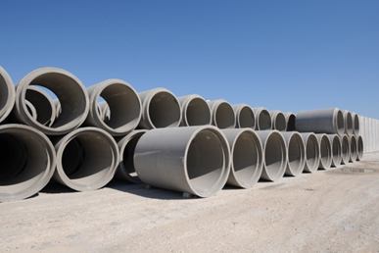
Product Certification Options
Storm sewer pipe
Sanitary pipe
Box culverts
Manholes
Sanitary manholes
Engineered precast [2024 – any single manhole item can be certified under precast]
Gasket Manufacturers
Notes:
Do not need to have all products you produce certified but if certified all such products produced at the plant must fall under program. No “commercial” units.

Slide 6
QCast Plant Certification Process
Submit Application
Submit Copy of Plant Quality Control Manual
Have All Elements Available for Inspection
Receipt of a Satisfactory Audit (announced)
ACPA QCAST Certification Manual
  Application Process (voluntary)
  QCast Manual Provides All Requirements
  Re-certification Process (annually)
    If add Box, Sanitary Pipe or MH, or Storm pipe to existing certification – announced reaudit

Slide 7
Scoring Requirements
In order to be awarded certificate plants must:
Receive a minimum overall score of 80 out of 100
Receive a score greater than 75 on identified critical audit elements: reinforcing inspection, concrete testing, TEB, and Sanitary tests (if applicable)
Plants that fail Combined Storm and Sanitary Sewer Pipe may still gain Storm Sewer Certification or conditional certification if the plant passes all Storm items with an 80, and a score greater than 75 on critical items
Appeal Process

Slide 8
Certification process can seem overwhelming.
Understand the QCast Manual Requirements.
Break the program down into many smaller parts.

Slide 9

Documentation
- Why?
- What.
- How.
- How Long?
1.5 Q.C. Organizational Chart
1.4 Documentation of Special Projects
1.3 ASTM Standards
1.2 ACPA Concrete Pipe,
Manhole and Precast Product
1.1 Plant Quality Control Manual

Slide 10
ACPA QCAST MANUAL
Certification Bylaws
Section I – Common Program Requirements
Section II – Concrete Pipe Requirements
Section III – Manhole Requirements
Section IV – Engineered Precast Requirements
Section V – Box Culvert and Three-sided Structures Requirements
Appendix A: Procedures and Sample forms
Appendix B: Audit Expectations
*Visit ACPA website QCast Tools

Slide 11
ACPA QCast Manual Technical Subsections
1.0 Quality Control Documents
2.0 Raw Materials
2.1 Drawn wire
3.0 Calibration
4.0 Mix Designs
5.0 Joint Design Drawings and Testing
6.0 Forms and Joint Forming Equipment
7.0 Reinforcing
8.0 Pre-Pour Inspection
9.0 Concrete Testing
10.0 Curing
11.0 Post-Pour Inspection and Repairs
12.0 Product Marking
13.0 Product Testing
14.0 Storage, Handling, Shipping and Final Inspection

Slide 12
All documentation files should contain program information for the previous 3 years plus year-to-date.
For new applicants, files should contain all documentation generated since you adopted the Certification Program plus any previously accumulated information.
A minimum of two months of documentation is required.
Documentation is important as can be legal record that products meet specifications and used to improve quality processes.

Slide 13
ACPA QCAST MANUAL
SECTION 1 - COMMON PROGRAM REQUIREMENTS
1.0 Quality Control Documents
2.0 Raw Materials
3.0 Calibration
4.0 Mix Designs
9.0 Concrete Testing
10.0 Curing
12.0 Product Marking
14.0 Storage, Handling, Shipping and Final Inspection

Slide 14

1.0 Quality Control Documentation, Specifications, and
Information
Company/Plant Quality Control Manual
Current ACPA Qcast Plant Certification Manual
Current Applicable ASTM Standards
Documentation of Special Project Specifications
Management Structure & Quality Control Coordinator
Quality Authority/Hold Production Policy
QC Personnel Training
Quality Audits

Slide 15
1.1 PLANT QUALITY MANUAL
A description or reference to standard industry procedures which constitute the plant’s working quality system.
All necessary technical information for carrying out the plants quality systems or must make clear where the relevant information is to be found.
A document control system (version numbers).
Provide a copy of the plant’s Manual prior to the initial audit.

Slide 16
1.2 ACPA QCAST CERTIFICATION MANUAL
What goes in here?
Current version of ACPA Concrete Pipe, Manhole and Precast Products Plant Certification Manual
Where do I get it?
American Concrete Pipe Association
Web: www.concrete-pipe.org
Phone: (972) 506-7216 with questions
Notes:
Electronic is okay.

Slide 17
1.3 CURRENT APPLICABLE ASTM STANDARDS
What goes in here?
ASTM Standards. A list of required standards can be found in ACPA QCast manual.
Check and update each year.
Where do I get them?
On-line subscription service is most common method. Individual ASTM Standards can be purchased from ASTM (www.astm.org)
Notes:
ASTM C76 – 22a

Slide 18
1.4 DOCUMENTATION OF SPECIAL PROJECTS
What goes in here?
Any special projects specifications that exceed minimum ACPA requirements or have different test methods or criteria.
Note: if no special projects exist, it may be of value to insert a sheet of paper dated to the current year that says “No special project specifications for the 20XX year-to-date”.
Where do I get it?
From your Project Specifications, Standard Specs, and Local Agencies.

Slide 19
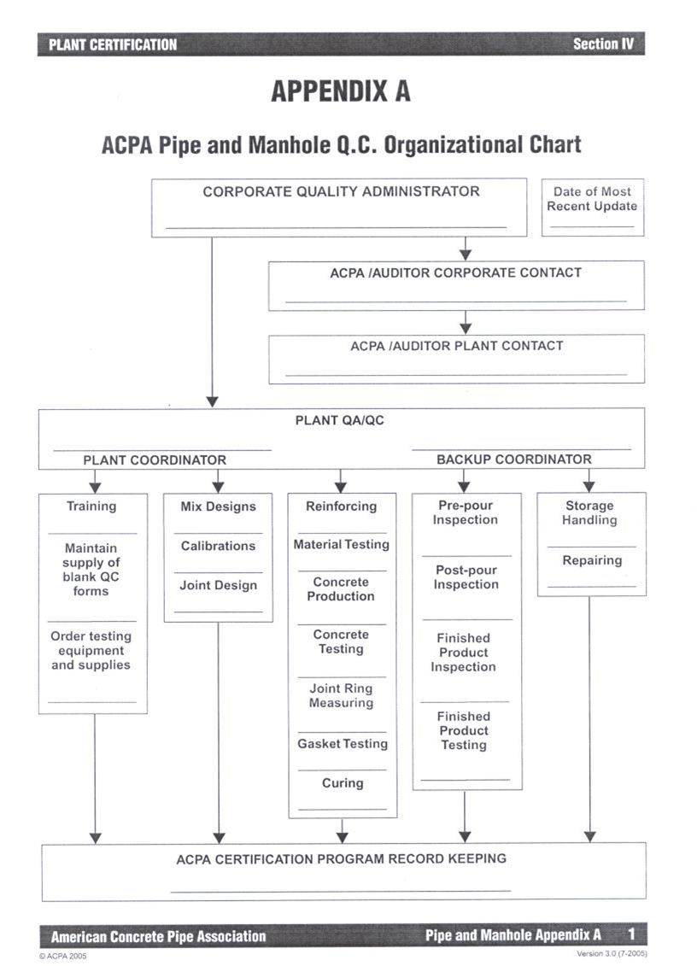
1.5 MANAGEMENT STRUCTURE AND QUALITY CONTROL COORDINATOR
QC Coordinator and Back-Up
Full authority to correct and stop production when quality issue arise and to reject products.
  [notify ACPA within 20 days of changes in primary QC staff]
Organization Chart - Key personnel involved with production, quality and the Certification Program to assign responsibilities
Primary QC Inspectors should not report to Production Managers
Update annually and whenever changes in staff responsibilities occur

Slide 20
1.6 QUALITY AUTHORITY/HOLD PRODUCTION POLICY
A statement describing the authority of personnel to correct and/stop production when quality issues arise and to reject products not meeting requirements.
Policy should be written by plant/company quality director and approved by the company president.
Once policy is written it should be shared with the entire plant.
Hint: make sure its signed and distribute or include in meetings

Slide 21
1.7 Q.C. MEETINGS
Hold meetings that include production, quality and management staff a minimum of once every six months to discuss Quality topics and performance.
- Document Attendance and Quality Topics.

Slide 22
1.8 Q.C. PERSONNEL TRAINING RECORDS
- Primary QC Coordinator and Backup QC Coordinator must complete and be accredited in ACPA Quality School, or ACI Concrete Field Testing Technician Grade 1, ACI Concrete Laboratory Testing Technician Level 1 or equivalent (such as DOT-certified training)
One of these trained individuals must be on staff during all production hours
Keep training files on QC Staff up-to-date
Hint: include any related training, in-house, DOT etc.

Slide 23
1.9 QUALITY AUDITS
Plant Manager or designee shall review QC documentation at least once every 30 days.
  Highlight/circle values that are out of specification tolerances
Perform internal audits of the plant’s quality system annually. This can be done on a rolling basis.
  Maintain internal audit reports and QCast audit reports and corrective actions (3 years minimum)
Maintain records on customer complaints or quality issues and corrective actions.

Slide 24
2.0 MATERIALS
Files should be kept containing the following materials certifications:
Cement – Cement mill certs received from the cement company once/mo. for each type of cement being used.
Fly Ash & Other Cementitious Materials – A test report should be supplied by the supplier once per month.
Aggregate – A Certificate of Compliance (ASTM C33) should be received once/yr. for each material from your aggregate supplier.
Aggregate Gradations – Need gradations for each aggregate quarterly as per Pipe, Manhole and Precast Products and monthly for Box Certification.

Slide 25
2.0 MATERIALS (Cont)
Additives – Certificates by the additive supplier once/yr. for each material.
Reinforcing – Mill certs should be supplied by the supplier once/mo. for each type of product.
Gasket Material/Joint Sealants/Pipe to Manhole Seals – Cert. should be supplied by the manufacturer once per year for each type of gasket, material or seal.

Slide 26
2.1 In-Plant Drawn Wire
In-Plant Drawn Wire
- Incoming certificates for stock per lot
- Drawn Wire Testing (ASTM A1064) per 20,000 lbs. wire drawn.
ASTM A1064:
- Meet required Tensile, Yield, and Reduction of Area
- Meet bend test without cracking
180º for smooth and 90º for deformed
One test for each 10 tons (20,000 lbs or 9000 kg)
- Need to track tonnage drawn

Slide 27
3.0 CALIBRATIONS
Documents showing the following calibrations at specified frequency.
Concrete Batching Equipment 1/yr
Must be properly calibrated and certified by independent agency
[HINT: see ACPA Members Site for Guide document].
Water Meter 1/yr.
In-house calibration using volumetrically calibrated 55 gallon barrel or water weight works well.
Additive Dispensing Equipment 1/yr.
In-house/supplier volumetric calibration using graduated cylinders works well.
Notes:
Get graduated cylinder from supply house such as McMaster-Carr.

Slide 28
3.0 CALIBRATIONS - CONT.
Concrete Compression Tester 1/yr.
Must be calibrated and certified by independent agency.
3-Edge Bearing Tester 1/yr.
Must be calibrated and certified by independent agency
Go-No-Go Gages min. 1/yr
In-house or independent agency calibration with micrometer or calibrated bars.
Laboratory Scales 1/yr.
In-house or independent calibration with certified test weights.
Micrometers and Calipers 1/yr.
In-house or independent calibration with certified micrometer or calibration bars.
Vacuum Test Equipment 1/yr.
In-house or independent calibration with manometer column height using a
liquid with a verified specific gravity or certified test gage.

Slide 29
3.0 CALIBRATIONS - CONT.
Pipe Test Equipment 1/yr.
Hydraulic Rams used for QCast testing (sanitary).
Hydro Test Equipment 1/yr.
In-house calibration with manometer or independent calibration with certified test gage.
Air Content (PCC) Test Equipment min. 1/yr or 1/mo. Wetcast Box
In-house calibration allowed.
Curing Temperature Loggers 1/yr.
In-house calibration allowed.
Concrete Thermometer 1/yr.
In-house calibration allowed.
Durometer (gasket testing) 1/yr.
In-house calibration allowed.

Slide 30
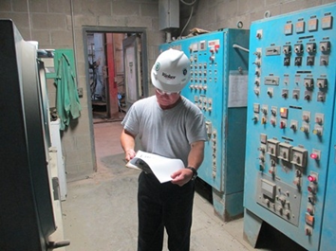
4.0 CONCRETE MIX DESIGNS
What goes in here?
Need a copy of all concrete mix designs used in production (shows sources and target Water/Cementitious (W/Cm) ratio).
Water – either potable or meets ASTM C1602.
Concrete Batch Reports (also for ready-mix if used).
Self-Consolidating Concrete (SCC) requires a QC Plan.
Electronic files ok as long as you can access
them easily.

Slide 31
4.2 WATER/CEMENTIOUS MATERIAL CONFIRMATION
What goes in here?
Confirmation of the W/C ratio for each mix design once per month for each mix design used.
No mix design should have a W/C ratio higher than 0.50 for pipe, manhole and precast and 0.45 for Box and Three-sided structures.
Where do I get it?
Tests should be done at least monthly by QC personnel for each mix used and demonstrated during an audit.
Hint: use W/C spreadsheet from ACPA website QCast.

Slide 32
5.4 GASKET QUALITY
What goes in here?
Maintain Critical Dimensions and Tolerances for Gaskets.
Reports of gasket tests per frequency in QCast Manual – performed in-house or obtained from a QCast-certified supplier:
- Pipe less 36” 1/300
- Pipe 36” and larger 1/100
- Manholes 1/100
- Box Gaskets 1/25
Notes:
Notify ACPA if find any problems with gaskets from QCast cert.

Slide 33
5.4 GASKET QUALITY
Where do I get it?
Check with gasket suppliers for dimensions and tolerances.
Test methods in QCast Manual.
Work with suppliers to file or maintain access to gasket test reports.
HINT: Keep storage area well organized and protected.
What do I do with it?
Post gasket dimensions and tolerances.
Demonstrate easy access to gasket test reports.
If done in-house - Demonstrate gasket QC tests during audit and compare results with acceptable dimensions.
Notify ACPA if find problems with gaskets from QCast certified supplier.
Notes:
Notify ACPA if find any problems with gaskets from QCast cert.

Slide 34
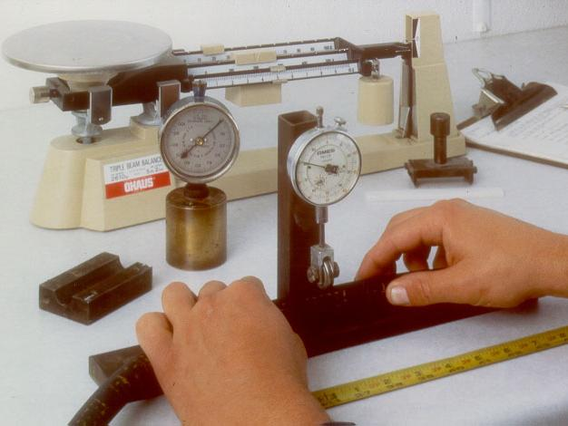
Notes:
Gasket inspection is not difficult

Slide 35
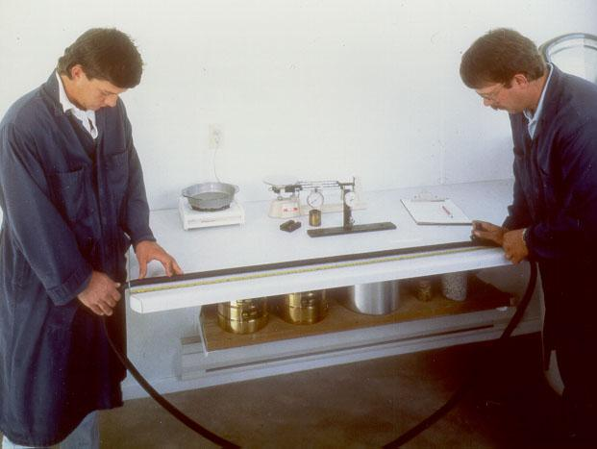

Slide 36
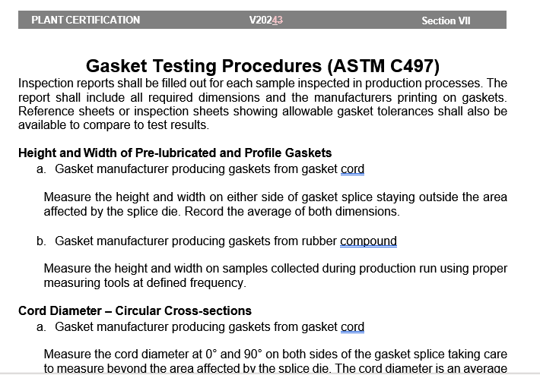
Hint:
Notes:
It okay to read and follow test procedures when demonstrating testing. Know where to look.

Slide 37
9.0 CONCRETE TESTING
What goes in here?
Reports documenting:
Slump (daily) or SCC flow,T20 and VSI (0 or 1) (*first batch and every 4 thereafter for continuous pour (less than one hour – unless documentation exists switching batches does not affect results).
Temperature (wet-cast – beginning of continuous pour / dry-cast with cylinders)
Air content of wet-cast (daily first batch/each new pour/per 50 CY and per specifications)
Unit weight of wet-cast (min. one per week; daily if air-entrained SCC/Flowable or weekly if non-air entrained SCC/Flowable)
Notes:
Change in 2023.
If batching and mixing is interrupted by a batch of concrete (with a different mix design) being mixed between consecutive batches, this is considered a new pour and an air test shall be taken on the first batch following the different batch, unless documentation exists that switching batches does not affect air content beyond specified limits.

Slide 38
9.0 CONCRETE TESTING (cont.)
What goes in here?
Concrete Absorption (Annually on lowest cementitious mix per production process per ASTM C497 A or B), take core samples for dry-cast (or per local specifications).
  Absorption shall not exceed 9% for Method A or 8.5% for Method B, except for sanitary sewer pipe and sanitary sewer manholes which shall not exceed 7.5% for Method A and 7% for Method B.
Need to demonstrate concrete testing procedures during audit.
Test first batches of each shift. Have a plan to reject failed concrete.
Hint: Make sure to maintain backup test equipment or parts.
Notes:
* Change in 2023.

Slide 39
9.9 COMPRESSIVE STRENGTH TESTING
What goes in here?
Compressive strength test reports for all mixes used in production. Cast minimum of 5 cylinders per week for pipe tested in TEB otherwise 5 cylinders per day. Must test minimum of two cylinders to determine concrete design strength.
Box culverts min. of 2 additional cylinders per week for stripping strength.
For tests done in-house will need to demonstrate cylinder fabrication and concrete strength testing procedures during audit.
Monitor strengths and ensure strength is adequate at shipping ages per shipping policy.
Hint: Clean and check platens compression machine periodically.

Slide 40
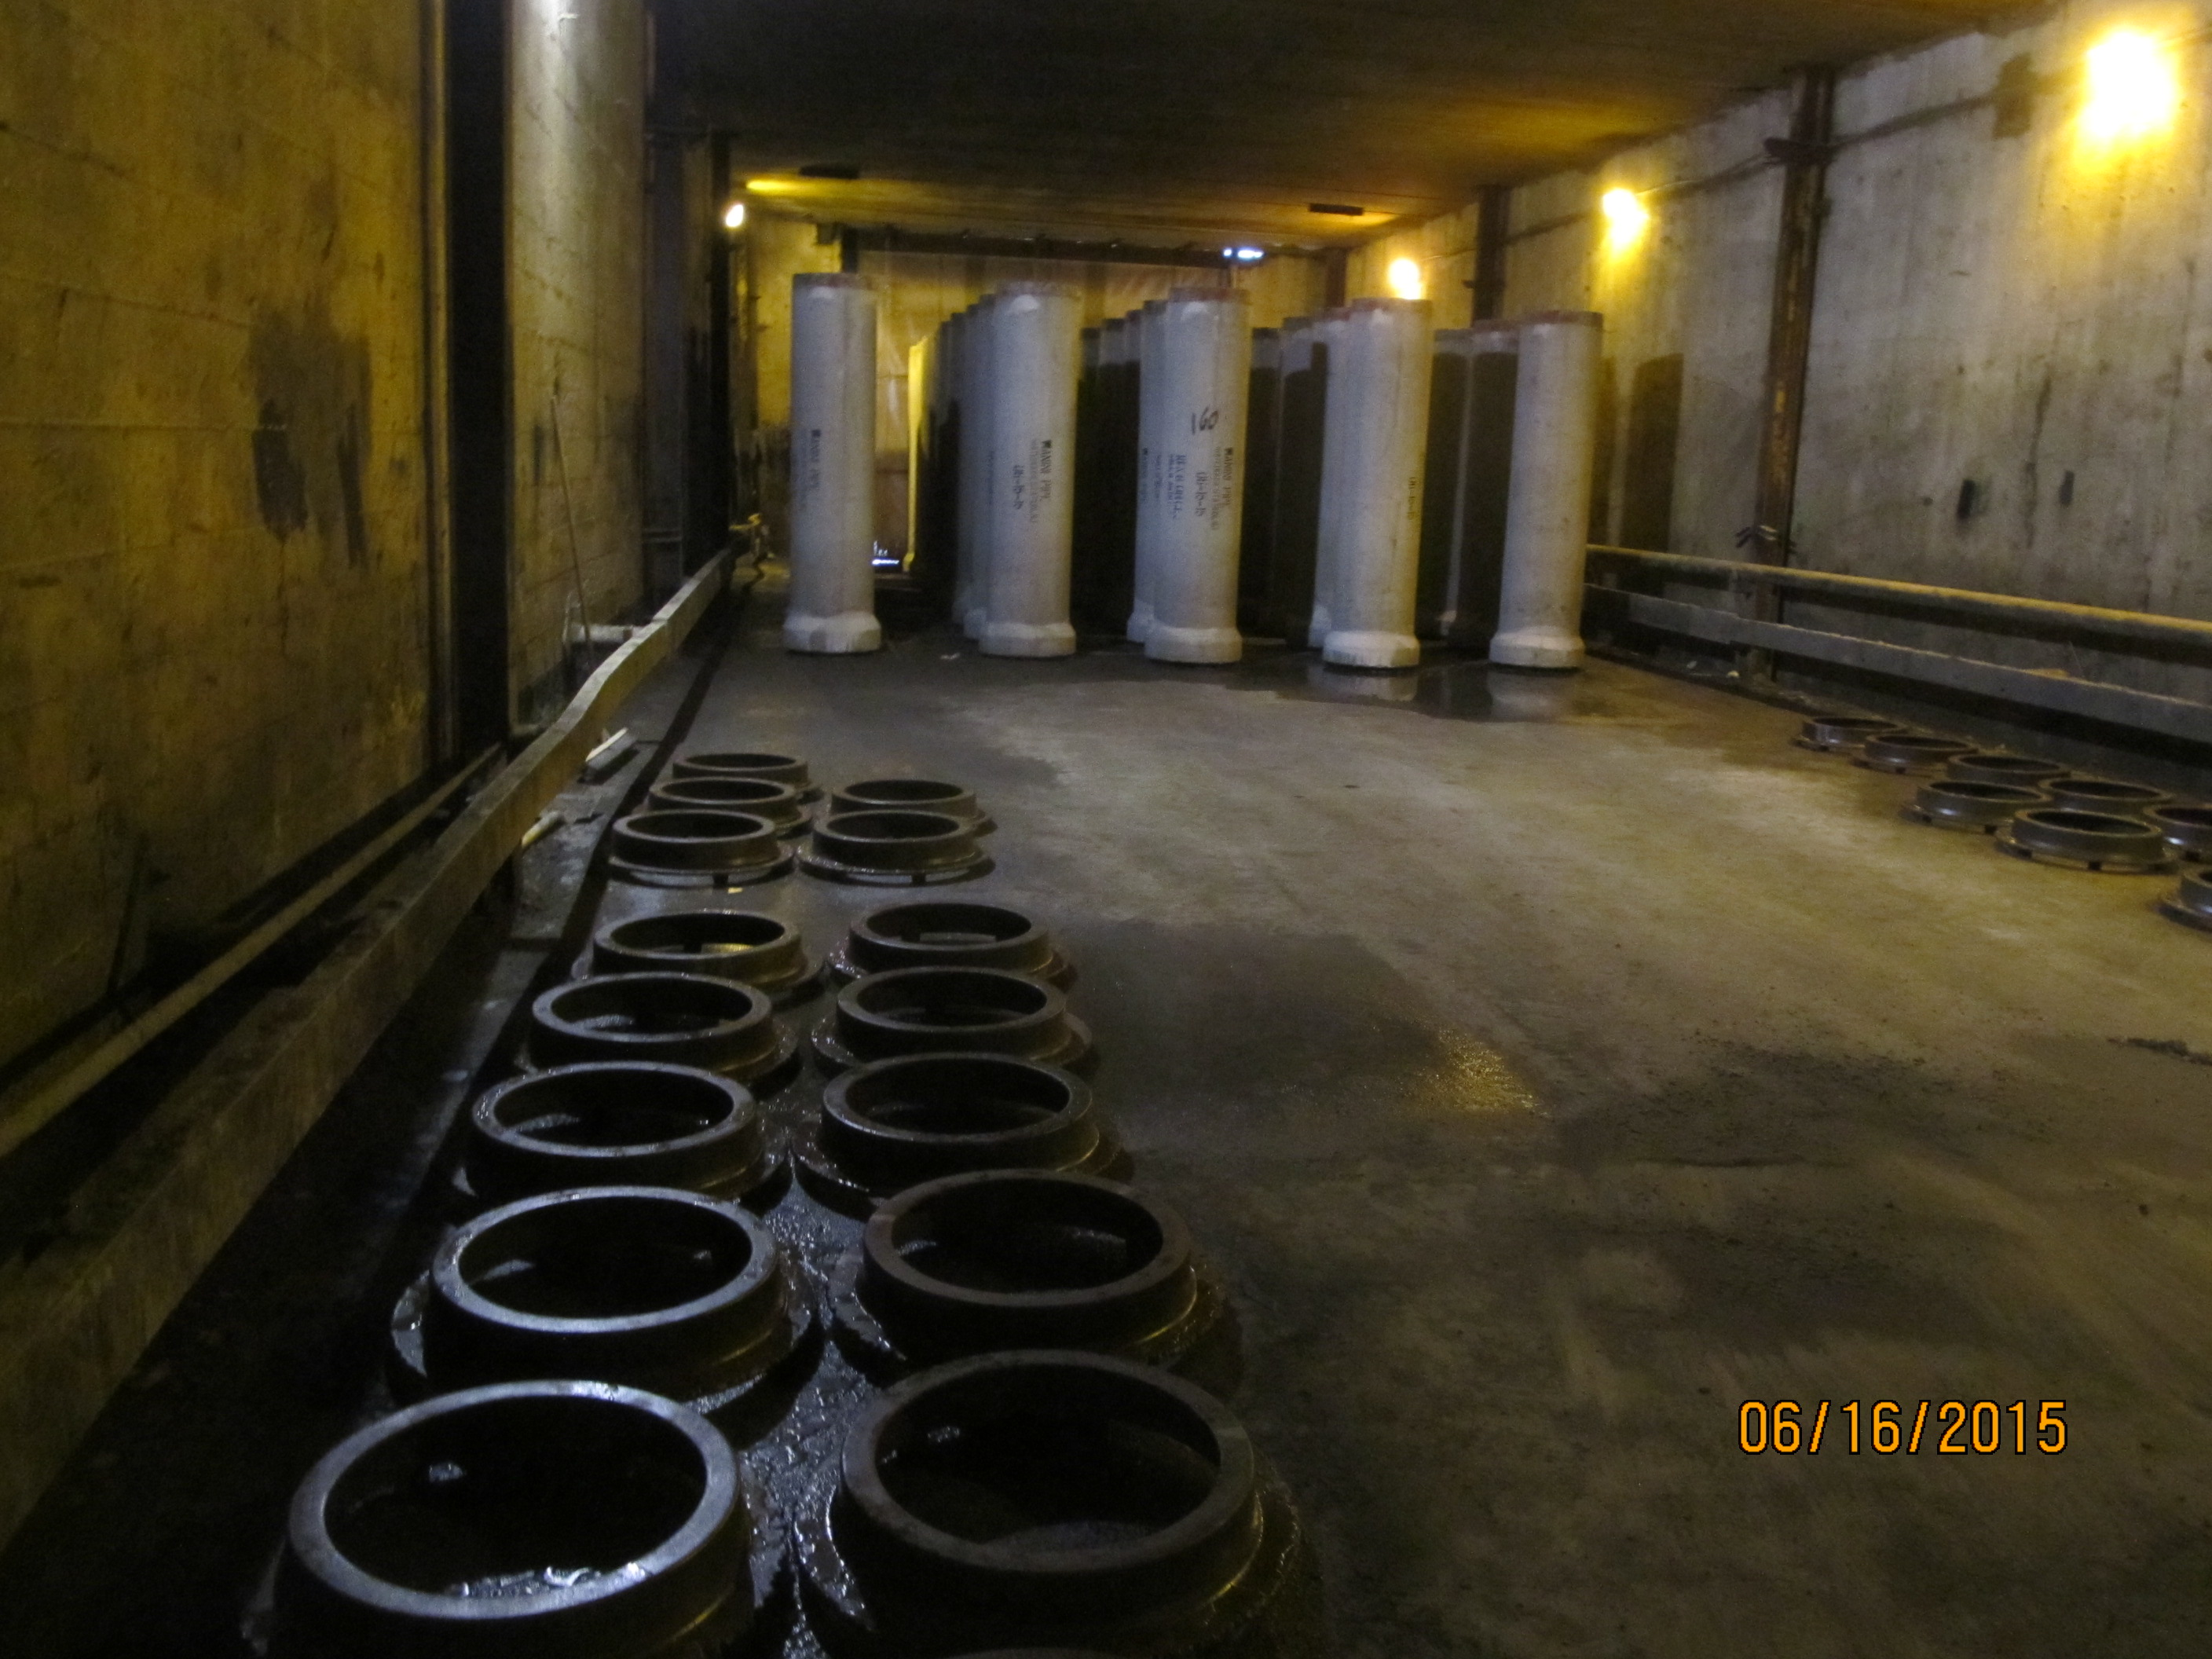
10.0 CURING RECORDS
What goes in here?
Written Curing Procedure with minimum strength for stripping and handling.
Curing must provide a humid (moist) and warm environment.
Reports showing temperature cure cycle of products, minimum one kiln per day/cycle.
Keep maximum temperatures below 160 F (71 C) with max. rise 40 F/hr (25 C/hr).
Plants should have calibrated temperature instruments to measure the cure cycle of products, daily.

Slide 41
12.0 PRODUCT MARKING
No files needed but must understand the minimum requirements of ASTM or local standards for marking your products.
[2024 - Plants producing both certified storm and sanitary products shall have a written procedure for identifying the sanitary products. If a plant is not sanitary certified and they ship certified storm products to a sanitary project, the QCast marking shall be removed or redacted from those products.
Auditor will inspect your products to ensure that they are properly and legibly marked.
Hint: Periodically walk yard - check your products to make sure that they are properly marked and markings are durable.

Slide 42
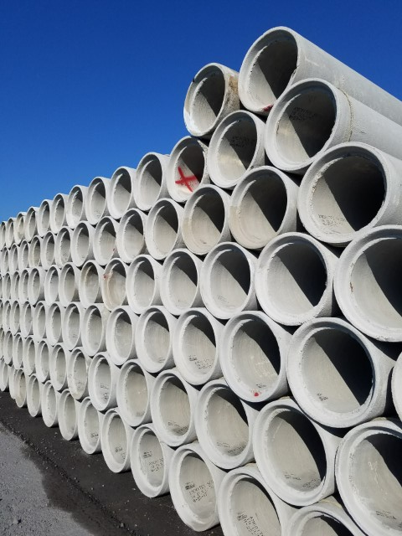
14.1 HANDLING AND STORAGE
What goes in here?
Write a maximum stacking height policy for each class and size of product.
Ensure that all products are handled to prevent damage. All rejected materials must be clearly marked and separated when able.
Hint: Periodically walk yard with can of spray paint - check stack heights and damage.

Slide 43
14.2 SHIPPING POLICY
What goes in here?
Write a Shipping Policy that corresponds with your current shipping practices and how they relate to three-edge bearing and concrete compression test results and inspection criteria.
Correlate age at shipment with strength testing or TEB test results.

Slide 44
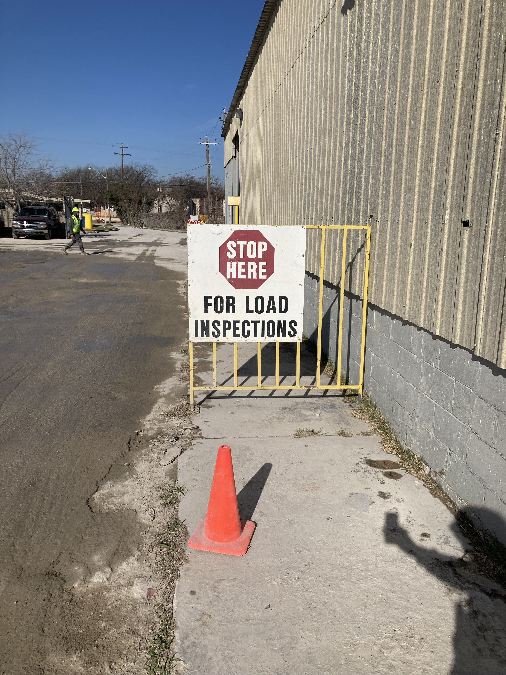
14.3 FINAL INSPECTION
What goes in here?
Write a Final Inspection Policy that corresponds with your actual practices. Identify persons responsible for the final inspection in the policy.
Document final inspections to verify product compliance at the time of shipping.

Slide 45
ACPA QCAST PRODUCT REQUIREMENTS
Section II – Concrete Pipe Requirements
Section III – Manhole Requirements
Section IV – Engineered Precast Products Requirements
Section V – Box Culvert and Three-sided Structures Requirements
Section VI – Gasket Requirements

Slide 46
5.1, 5.2, 5.3 JOINT DESIGN DRAWINGS
What goes in here?
Detailed drawings of joints used for gasketed and non-gasketed pipe, manholes, precast and boxes. Include tolerances.
(See sample form in Appendix)
Sanitary Pipe – include design calculations and Go/No Go gaging system including gasket compression figures.
Where do I get it?
Check with both equipment and gasket suppliers.
Sanitary - Demonstrate proper use of Go/No Go gaging during audit.

Slide 47
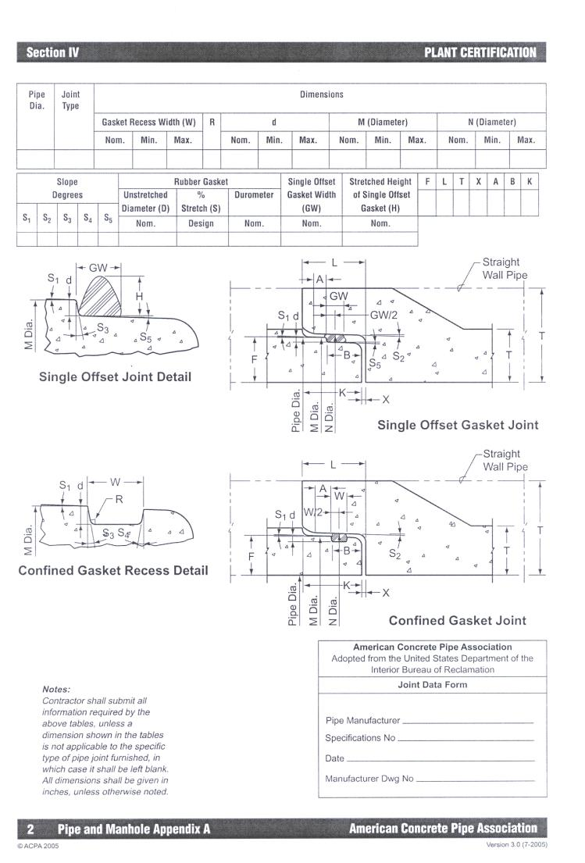

Slide 48
6.0 EQUIPMENT & FORMS
What goes in here?
Inspection reports for all new and repaired equipment to check dimensions and function.
Forms must be kept clean and be inspected after each use.
Inspections for gasketed joint formers can be done with Go-No Go gage.
Where do I get it?
Reports can be done in-house or by equipment supplier. Plants should always verify critical measurements.

Slide 49
6.2 PIPE/MANHOLE HEADER/PALLET/RING INSPECTION
2024 - Joint forming equipment shall be visually inspected for cleanliness and function prior to each use.
What goes in here?
Incoming Inspection Reports for all Headers/Pallets/Truing Rings for gasketed pipe and manholes.
Annual inspection of gasket sealing surfaces for sanitary products.
Sample forms in Appendix A of the Certification Manual.
What do I do with it?
Verify compliance with established tolerance to ensure joint integrity. File for future reference.
HINT: Good idea store your original, detailed Incoming Inspection Reports separately from annual QC data but with easy access.
Sanitary Audit: demonstrate procedures for measuring joint formers.
Notes:
Company who is entering program: Plant should request an inspection that was done from the manufacturer.

Slide 50
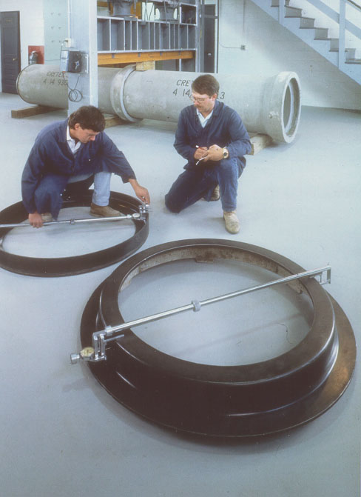
Notes:
New and used rings entering the plant should be inspected

Slide 51
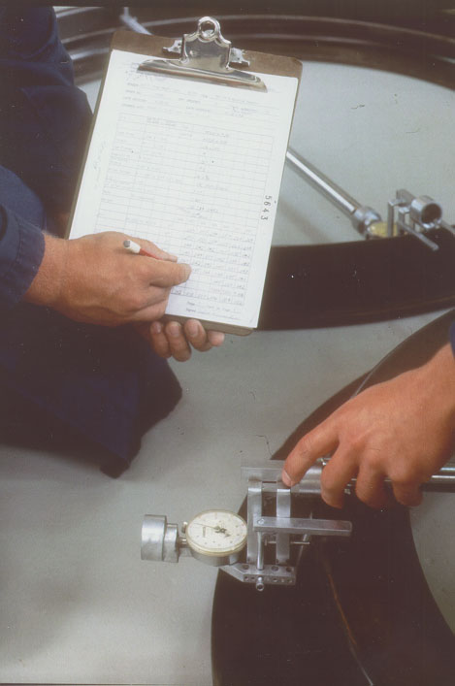

Slide 52
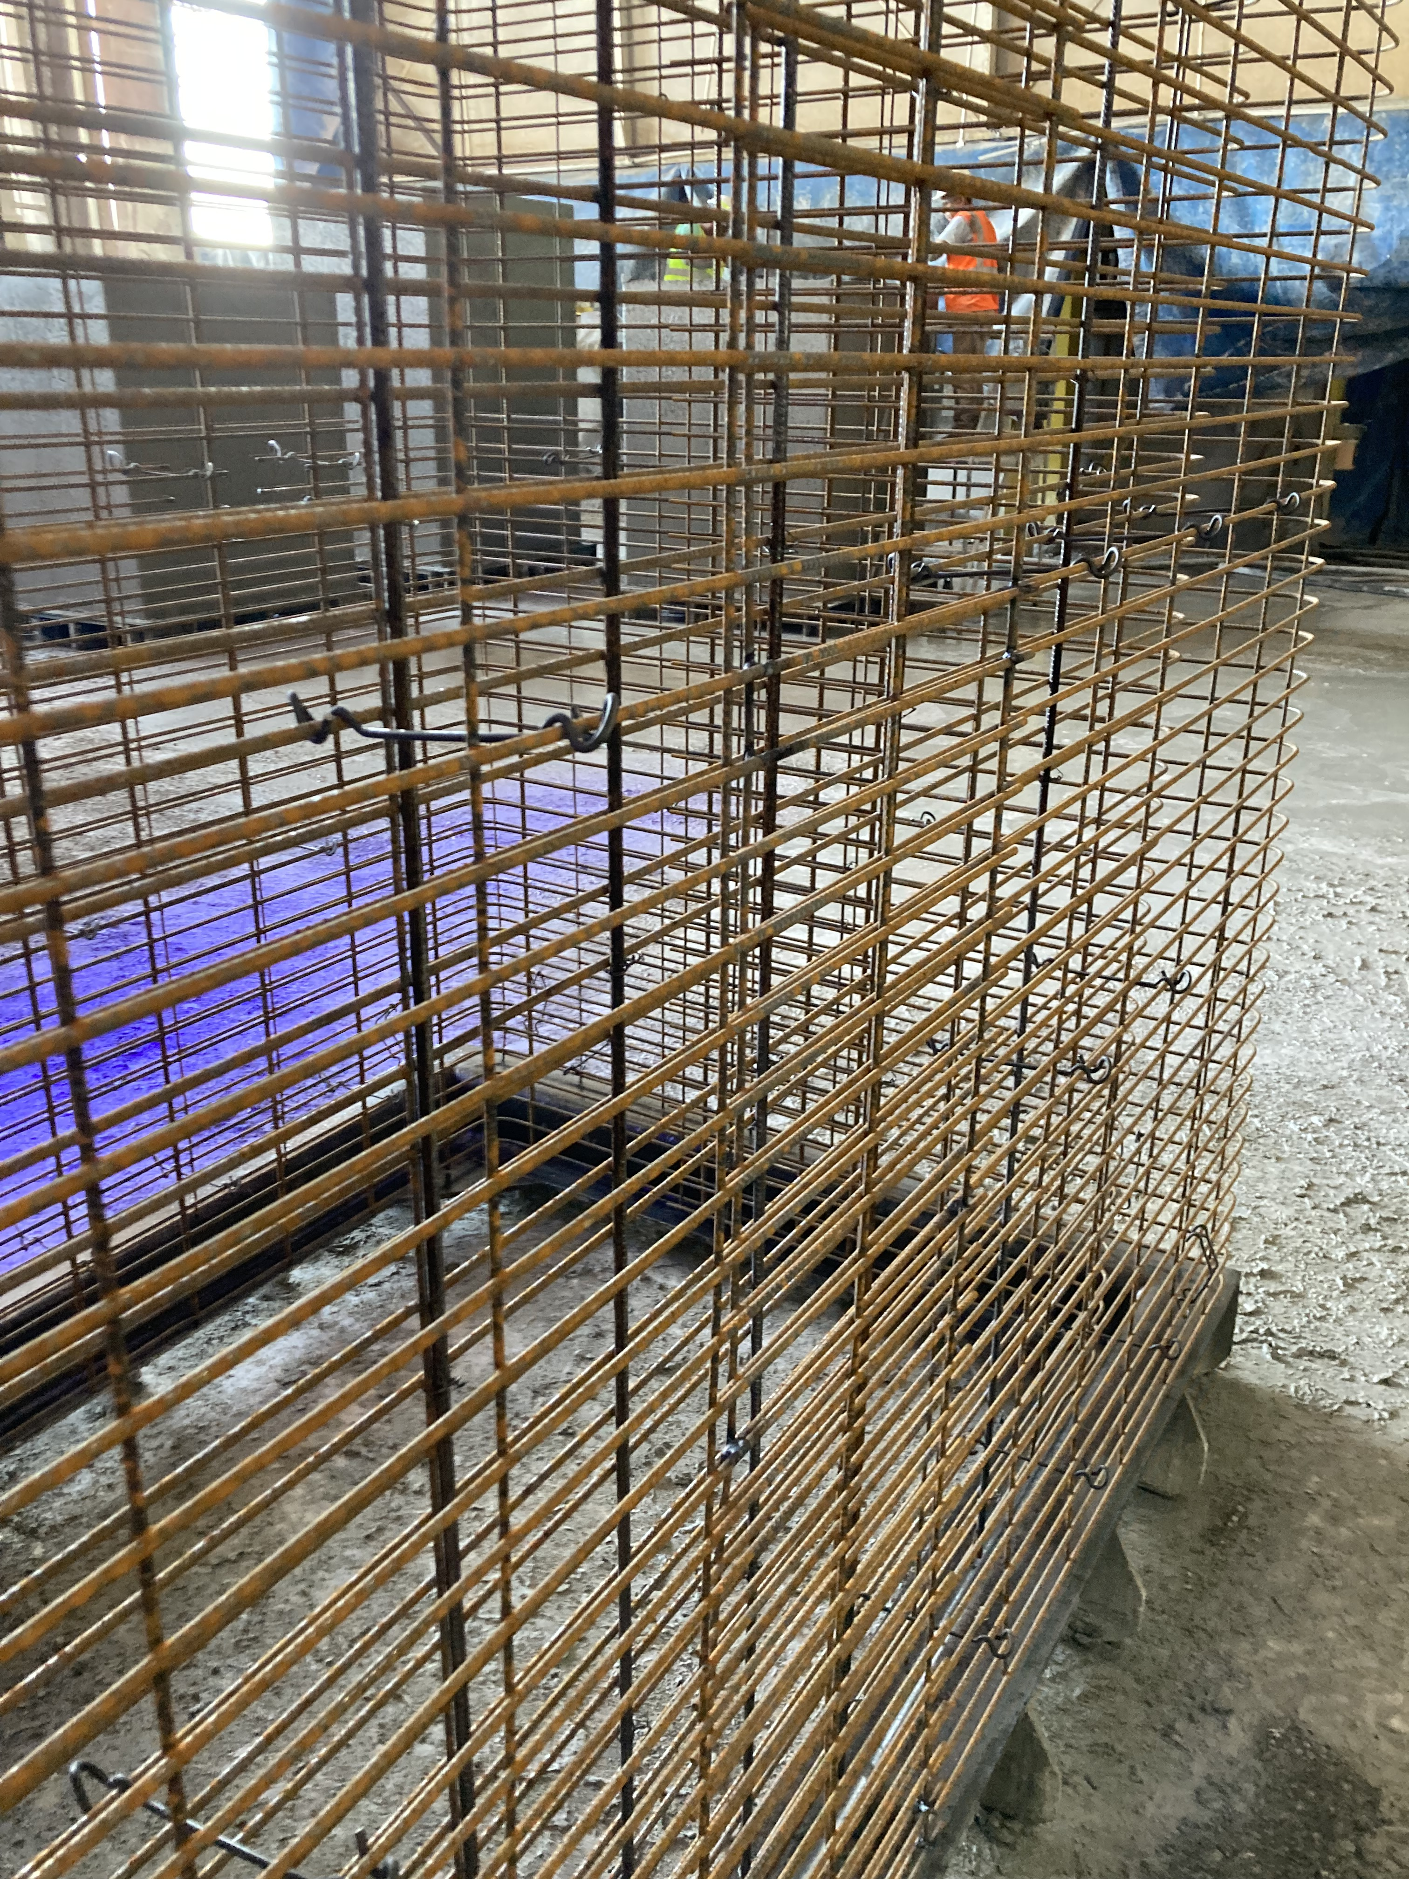
7.0 REINFORCING (critical)
What goes in here?
Reinforcing design information for the production of all Pipe, Manholes, Precast Products, or Boxes.
Where do I get it?
Designs can be done in-house or by a second party. Standard drawings or job specific.
Must have: mesh style, diameter (& tolerances), length, steel area (design & actual), location in wall or minimum cover, lap, bell reinforcing, and shear steel.
What do I do with it?
Retain on file and maintain at production fabrication areas. Cage fabricators must be familiar with reinforcing requirements.
HINT: Periodically check that cage fabricators have current information, are checking cages, and document training.

Slide 53
8.0 PRE-POUR INSPECTIONS
What goes in here?
Reports documenting pre-pour inspections of reinforcing, forms (visual and dimensions) and embedded items.
Measure and document a minimum of one cage at beginning of each shift or any change. (See QCast Manual for sample forms)
Visually inspect each cage and form. (Cleanliness, Form Release, Spacers…)
Measure and initial shop drawings for check of embeds and blockouts.
Where do I get it?
Reports should be completed by Quality Control and other trained plant personnel.
What do I do with it?
Retain on file for future reference.
Demonstrate inspection procedures during audit. HINT: Know tolerances
HINT: Good idea to have location and number of spacers listed.

Slide 54
8.0 PRE-POUR INSPECTIONS (cont.)
At a minimum, measure and document one cage at the start of each production run of product, one cage at the start of each new shift after that, and one cage if any component or setting is changed. Alternatively, for cages that are manufactured in advance of product production, measure and document one cage at the start of each production run of cages and 1/50 cages thereafter. [2024]
Notes:
Blue added 2024

Slide 55
11.0 POST-POUR INSPECTION
What goes in here?
Check a portion of each day’s production before and after finishing/patching.
Perform visual and dimensional checks on both barrel and joints daily. Document 1 piece/size/shift for pipe and manhole and 20% of Box production. Note size and location of embeds.
Sanitary: 100% of joints by Go/No Go gaging. Mark as Sanitary (12.0)
Maintain a written repair procedure and list acceptable repair materials. Check that repairs are properly cured and durable.
Where do I get it?
Sample forms can be found in the QCAST Appendix.
Demonstrate during audit. HINT: Be able to refer to tolerances. Record observations of defects in QC paperwork (exposed steel, cracks, etc.)
Notes:
(low production wetcast 1/100 or every 6 months min.) If auditor sees cracks or exposed steel during audit and none of paperwork shows this – bad thing.

Slide 56
11.0 POST-POUR INSPECTION (cont.)
Engineered Precast [new 2024]
Inspect, document, and verify the size and location of all embedded items and blockouts for each product produced each day. Initialing product shop drawings shall be the minimum documentation.
When using fixed forms, maintain a Post-Pour Dimensional Inspection record of applicable dimensions (including lengths, widths, thicknesses, diameters) on a minimum of one product at the beginning of product run and once per month per form in continuous use.
For adjustable or segmental forms, maintain a Post-Pour Dimensional Inspection Record and applicable dimensions (including lengths, widths, thicknesses, diameters) for each non-standard precast product produced.

Slide 57
13.0 PRODUCT TESTING
Proof of design and ongoing performance tests showing that products are meeting standards for Three-Edge Bearing, Water Tightness (San), and Joint Tests (San. or gasketed).
TEB test frequency must correlate with production quantities.
Joint tests are proof of design tests for Sanitary or Gasketed Storm to be maintain on permanent file.
Water-tightness testing for Sanitary Pipe and Sanitary Manholes 100% for 36” and smaller and 1/100 for 42” and larger (min. 2 per lot)
Manhole Step Tests – every 3 years.
Gasketed Box Culverts – Proof of Design Joint Test per ASTM C1677, *each size.

Slide 58
13.2 3-EDGE BEARING TEST
What goes in here?
Test results at the frequency described in Section 13.2 of the Certification Manual to minimum of 0.01 inch crack.
Annually, test a minimum of one pipe per size and class (60” or smaller) to Ultimate Load.
Where do I get it?
ASTM C 497 and QCAST manual.
What do I do with it?
Keep tracker sheet up to date and Retain test reports on file.
HINT: Production records should be used to verify test frequencies (use Tracker from ACPA website). Pipe can be loaded to the 0.01” test requirement (+15%) without cracking (unless local spec.).

Slide 59
T.E.B. TEST FREQUENCIES (Min.)
Pipe Size | Class | Frequency
12”-15 | Class 5 and below | 1/1000 pcs
18”-36” | Class 4 and below | 1/800 pcs
18”-36” | Class 5 | 1/400 pcs
42”-60” | Class 3 and below | 1/400 pcs
42”-60” 66” and larger | Class 4 and 5 All classes | 1/200 pcs As required by project specs.
NOTE: Arch and elliptical pipe shall be tested as required
by job or local specifications

Slide 60
13.1, 13.3, 13.4 WATER TIGHTNESS and JOINT TESTS: PIPE and MANHOLES
Water Tightness tests of Sanitary Pipe/MH (Sanitary Sewer Only)
36” & smaller 100%, 42” & larger 1/100
Proof-of-Design Joint test results for:
  Off-Center Joint Test (Sanitary Sewer Only)
  Differential Joint Shear Test (Sanitary Sewer Only)
  Storm Sewer/Culvert & Box Gasketed Joint Test
Test methods in the QCAST manual and appendix. HINT: It is only necessary to test the lowest class pipe produced for each size and style.
What do I do with it?
Retain on file to verify design integrity. It is not necessary to run these tests again unless reinforcing designs or joint configuration changes or to meet local requirements.
Demonstrate test procedures during QCAST audit.
Notes:
Sanitary 100% 36” and smaller
42” larger 1/100

Slide 61

13.0 PROOF-OF-DESIGN TESTING OF GASKETED BOX CULVERTS
Gasketed Box Culvert test per ASTM C1677
Hydrostatic Testing– No drips that do not seal
Straight: 5 psi for 10 minutes
Deflected ½“-inch one side: 3 psi for 10 minutes
Off-Center Differential Load: 150 lbs/in. of span, 5 psi for 10 min.
-Test each size of non-segmented join forming equipment.
-If using segmental forms with the same joint design, test one per the following size groupings:

Slide 62
ACPA QCAST MANUAL
Appendix A: Procedures and Sample forms
Appendix B: Audit Expectations.

Slide 63
What happens on Audit Day?
“A periodic onsite-verification by a certification authority to ascertain whether or not a documented quality system is being effectively implemented.”

Slide 64
Audit Day:
Introductions and Schedule
  Initial audit can hold an opening meeting. May be 1, 1.5, or 2 day audit. Plan for setup of any extra tests.
  Goal is work within your (QC) schedule. See testing of concrete, cylinders, TEB, Pre-, Post-Pour Inspections, … (get started early in day).
  May start with tour of plant, introduce auditor to plant supervisors. Explain what is happening today.
Audit Test Methods, Inspection Procedures, and Review Documentation
  Show and clearly explain what you do and know.
Exit Meeting
  Provide immediate feedback. Resolve any questions or concerns.

Slide 65
Quality documentation files
Materials documents/specifications
Calibration documents
Copies of all mix designs
Joints
Equipment
Reinforcing
Pre-pour and Post-pour inspections
Concrete and product testing documentation
Written curing procedures
Handling and storage maximum stack heights
Written shipping policy
Final inspection procedure
HINT: Explain your filing system and review process for QC Documents

Slide 66
Audit Day: Production Verification and Testing (Highlights)
REINFORCING
  Have detailed reinforcing design in the fabrication area.
  Show how cages are measured and how area is calculated or checked.
  Show auditor tolerances and that measured cages are being checked to meet specifications.
CONCRETE BATCHING
  Mix Designs should be current. Batch proportioning must follow mix designs. Show how you verify W/C.
  Show competence in batching meeting ASTM C94 tolerances.
FORMS
  Inspect condition and cleanliness of forms.
HINT: SEE something SAY something

Slide 67
Production Verification and Testing (Highlights)
Plant personnel shall show competency when performing the following tests:
Compressive strength: cylinder preparation, handling, curing and testing.
Slump, Flow (VSI), Temperature, Air content, Unit weight testing.
Concrete absorption testing. (If done in house)
Aggregate gradation testing. (If done in house)

Slide 68
Production Verification and Testing (Highlights)
Plant personnel shall show competency when performing the following inspections:
Gasket Testing (If done in-house)
Drawn Wire Testing (If done in-house)
Sanitary (if done in-house):
  Pallet Inspection
  Header Inspection
  Truing Ring Inspection

Slide 69
Production Verification and Testing (Highlights)
CURING
Plant personnel shall demonstrate curing methods and retrieve results.

Slide 70
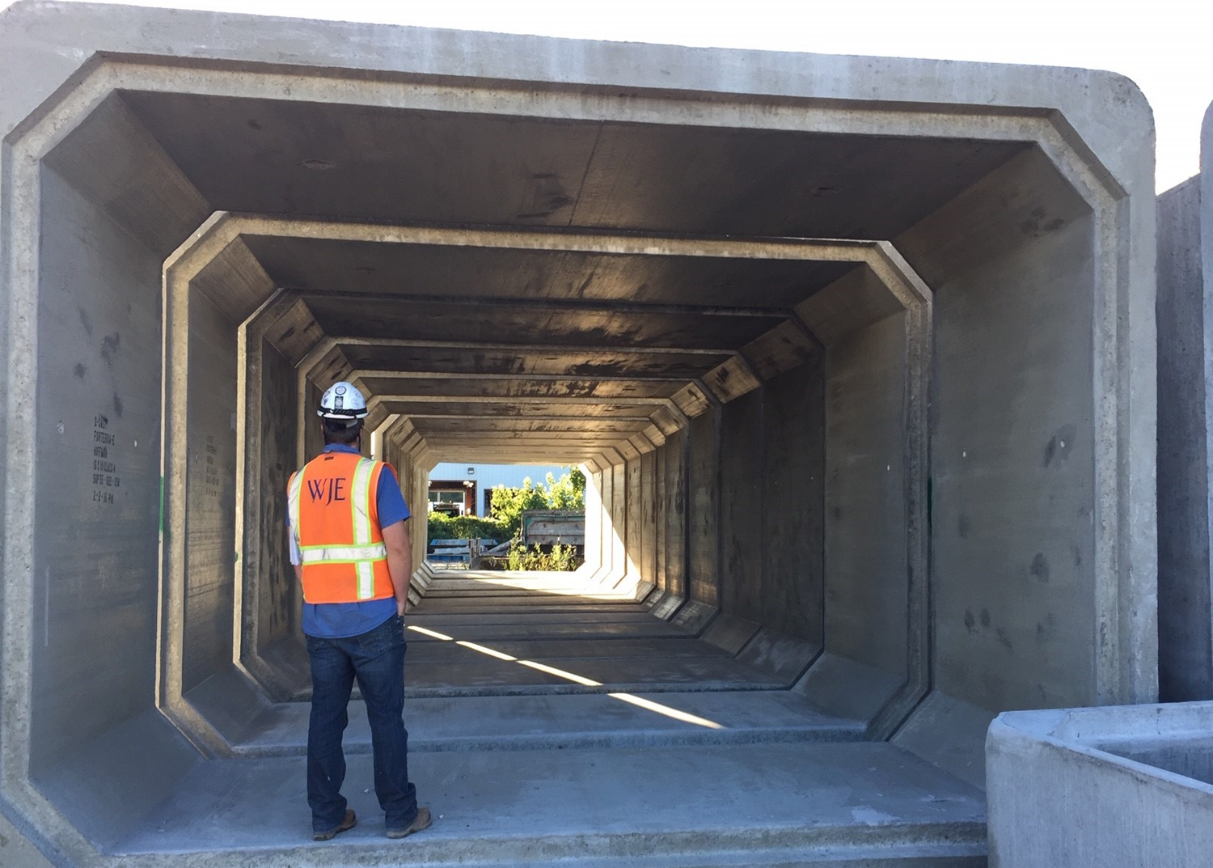
Finished Product Inspection Testing (Highlights)
Inspection and Procedures for Visual Inspection: HINT: Tell the auditor what types of things you look for.
Pipe and MH barrels and joints,
Blockouts/lifters,
Box walls and joints,
Precast appearance

Slide 71
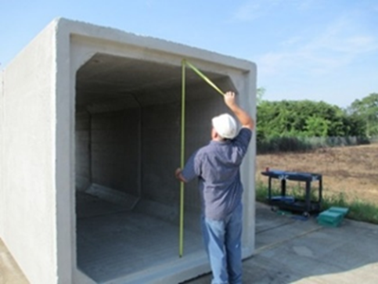
Finished Product Inspection & Testing (Highlights)
The auditor shall witness the following inspections and tests for procedure, equipment and results:
Pipe, MH, Precast, & Box Dimensional Inspections
Pipe/MH/Box Joint Inspection [Box Fit Test of 3 Pieces]
Proof-of-Design Tests: Water tightness; Off-center hydrostatic joint; Differential joint shear tests (sanitary) and Storm Pipe or Box Joint Test (gasketed)
Three-edge bearing tests
  Properly identify 0.01” crack, HINT: Know definition of 0.01” crack (C76), Watch load rate.
Notes:
2 man job should have 2 men doing it on audit day. The auditor wants to see that you know what you are doing, if you are doing it on a day-to day basis.

Slide 72
Audit Day
Finally, the auditor shall verify plant procedures for:
Product marking
Handling and storage
Repairs
Segregating of reject pieces
Final inspection

Slide 74


Slide 75
ACPA QCast Certification
1. Break the Program down into smaller parts.
2. Document well and keep well organized.
3. Ask for help if you need it.
4. Show the auditor what you know.

Slide 76

QUESTIONS?

