Slide 1
PRODUCT TESTING

Slide 2
Learning Objectives
Provide an overview of pipe testing requirements and procedures for ACPA Certification and understand why we need to do the tests.

Slide 3
PIPE TESTS
External load crushing strength test (Three-Edge Bearing test)
Joint shear test
Off-center joint test
Storm sewer and culvert joint test
Water tightness tests
ACPA QCast Plant Certification Manual provides specific detail of testing requirements

Slide 4
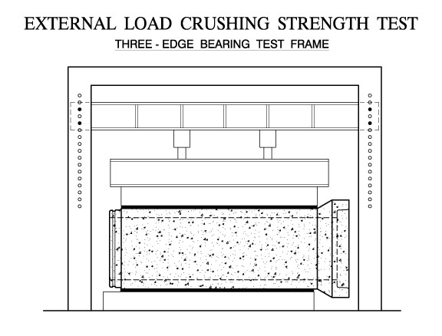
Notes:
calculated based on laying length of the pipe, not the testing board length

Slide 5
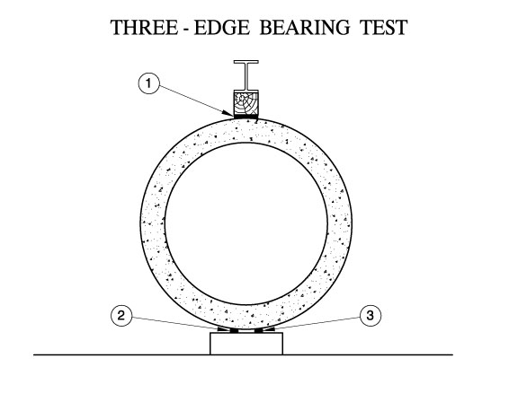

Slide 6
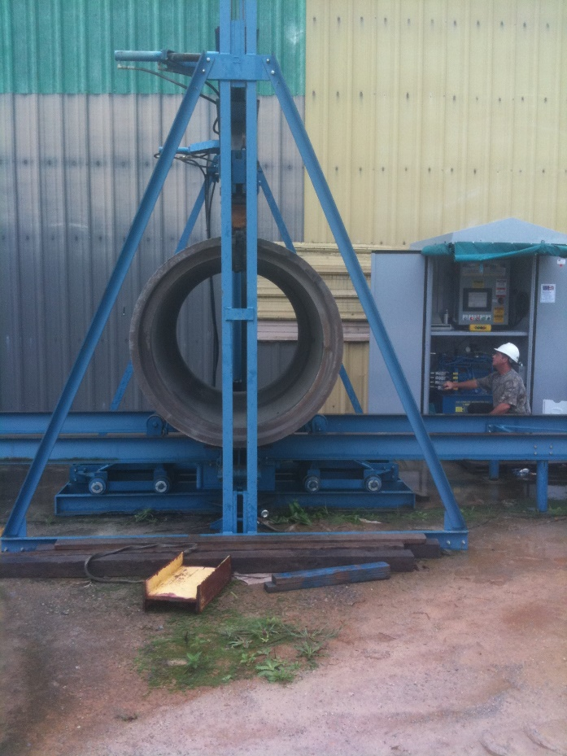
THREE-EDGE BEARING TESTING
Understand what you are doing
Understand why you are doing it

Slide 7
REQUIRED READING:
ASTM C497 - Standard Test Methods For Concrete Pipe, Concrete Box Sections, Manhole Sections, or Tile:
  Section entitled - External load crushing strength test by the three-edge bearing test method
ASTM C76 –Standard Specification for Reinforced Concrete Culvert, Storm Drain, and Sewer Pipe:
  Tables 1-5 provide strength requirements

Slide 8
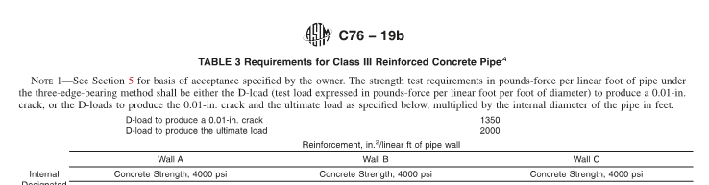
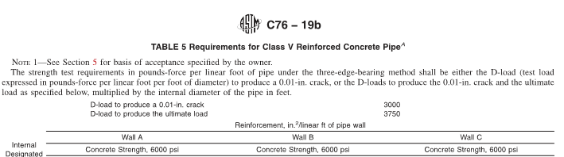
ASTM C76 –Standard Specification for Reinforced Concrete Culvert, Storm Drain, and Sewer Pipe:
Tables 1-5 provide strength requirements

Slide 9
WHY DO WE RUN THE THREE-EDGE BEARING TEST?
To determine the strength of our pipe using two different criteria:
A. The load to produce a crack with a width of 0.01”
B. The ultimate load

Slide 10
D-LOAD
Pounds per foot of length per foot of diameter
For example: ASTM C76 Class III design
D-load to produce a 0.01” crack 1350
D-load to produce the ultimate load 2000

Slide 11
SAMPLE CALCULATIONS FOR
24” DIAMETER x 8’ CLASS III PIPE
0.01” load = 1350 (D-load) x 8 ft (length) x 2 ft(diameter)
= 21,600 lbs.
Ultimate load = 2000 (D-load) x 8 ft. (length) x 2 ft (diameter) = 32,000 lbs.

Slide 12
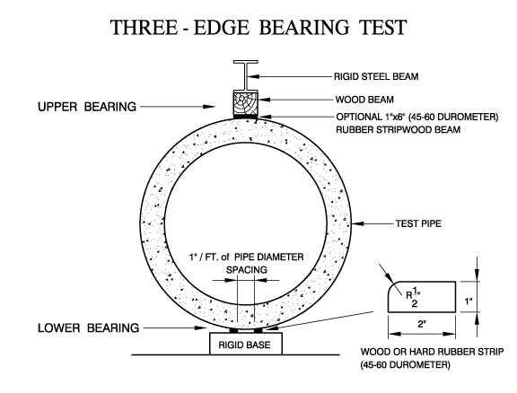
1” – 1 ½”
Notes:
Point out critical elements and that they should be straight and stiff to get a more favorable result
To your advantage to use max spread of bottom edges

Slide 13
Load Rate
ASTM C497
For Reinforced Concrete Pipe, any rate of load application up to a maximum of 7500 lbf/lineal foot of pipe per minute shall be used up to 75% of the specified design strength, at which time the rate of loading shall be reduced to a maximum uniform rate of 1/3 of the specified design strength of the pipe per minute.

Slide 14
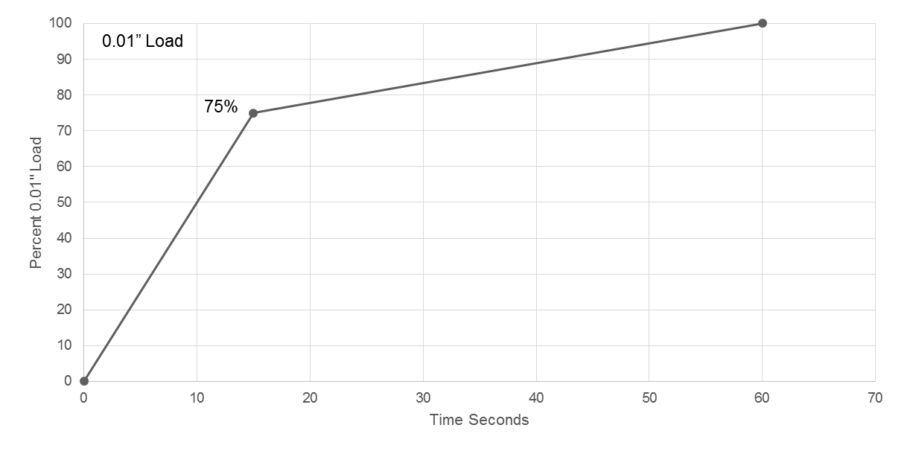
Loading Rate for TEB Testing
1/3 design strength/min
7500 lbf/LF/min

Slide 15
Load Rate Calculation Example
Test Class III, 24 in. pipe, 8’ long
{ASTM C76} 0.01” load = 1350 (D-load) x 8 ft (length) x 2 ft (diameter) = 21,600 lbs
  75% of 21,600 lbs is 16,200 lbs.
Maximum Rate up to 75% is 7500 lbf/lineal foot of pipe (8’) per minute
  7500*8’= 60,000 lbs/minute / (60s/min) = 1,000 lbs/sec
  16,200 lbs / 1,000 lbs/sec = 16 seconds
  Minimum 16 seconds to reach 16,200 lbs.

Slide 16
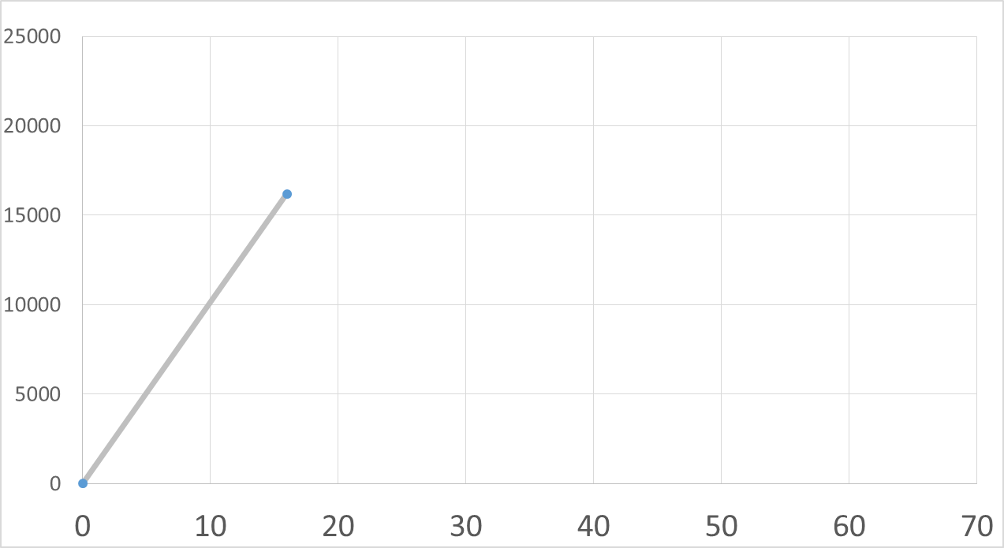
Maximum Loading Rate for TEB
Class III, 24 in. pipe, 8’ long
21,600 lbs
75 %
16,200 lbs in not less than 16 sec.
Seconds

Slide 17
Load Rate Calculation Example (cont.)
Class III, 24 in. pipe, 8’ long
After 75% - reduce rate to 1/3 design strength / minute
  1/3 of 21,600 lbs = 7,200 lbs/minute / (60s/min) = 120 lbs/sec
  Max rate of 120 lbs/sec between 16,200 lbs and 21,600 lbs.
  Time equals 21,600-16,200 [5,400 lbs] / 120 lbs/sec = 45 seconds.
  Total test time equals 16 secs + 45 secs = 61 seconds minimum
  At least one minute but depends on pipe size and class.

Slide 18
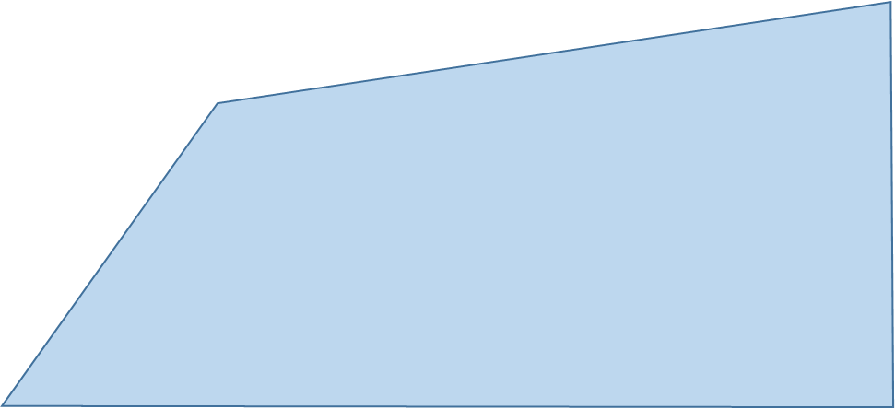
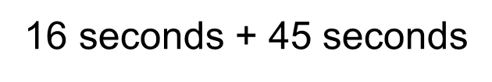
Maximum Loading Rate for TEB
Class III, 24 in. pipe, 8’ long
21,600 lbs
75 %
Seconds

Slide 19
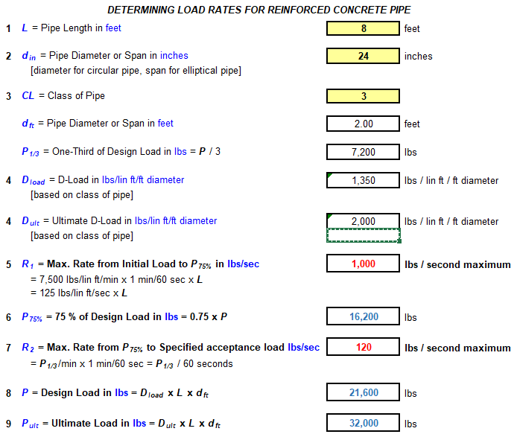
D-Load Rate Calculator
Found On The ACPA Member’s Website:
Q-Cast Tools

Slide 20
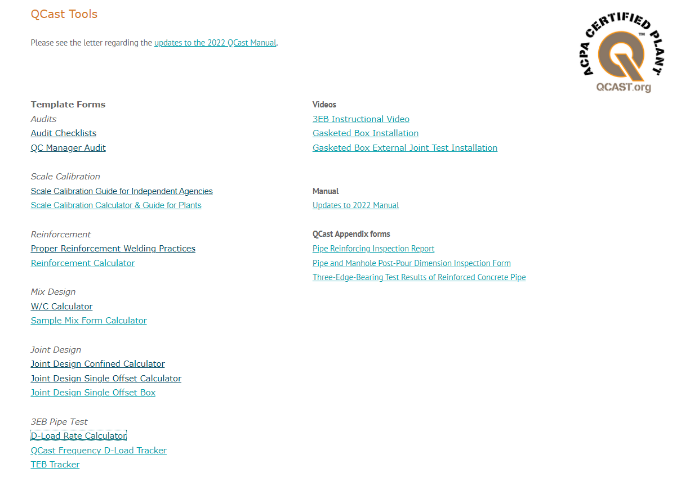
Notes:
ACPA Website has a lot of great tools for you to use

Slide 21
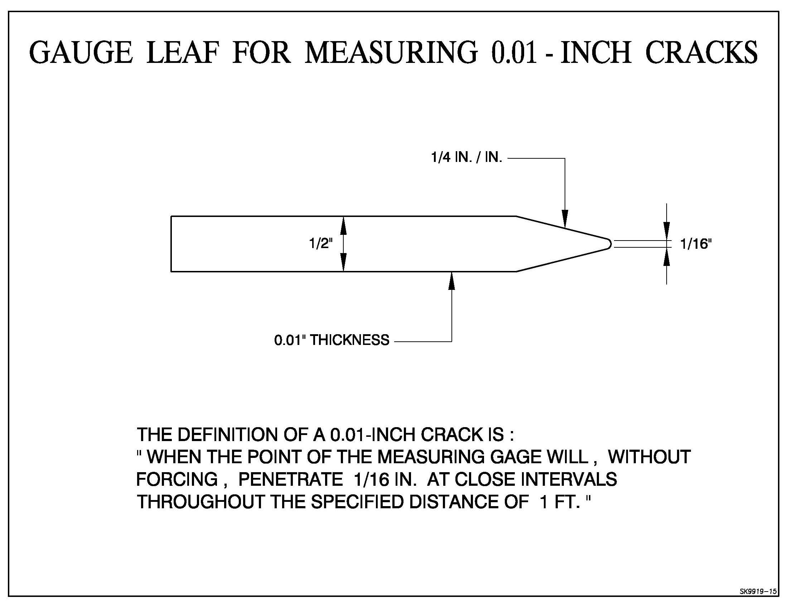
“…when the point of the gage will, without forcing, penetrate 1/16” at 3 in. maximum intervals throughout distance of 1 ft.”

Slide 22
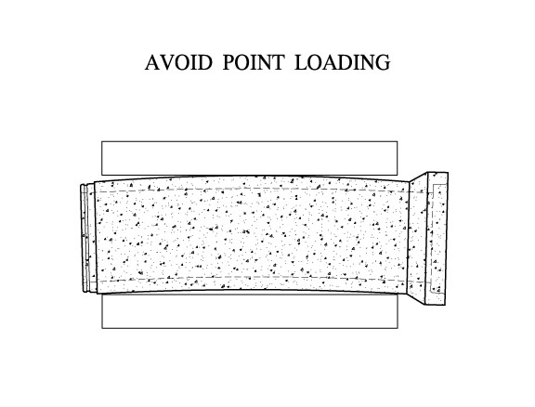
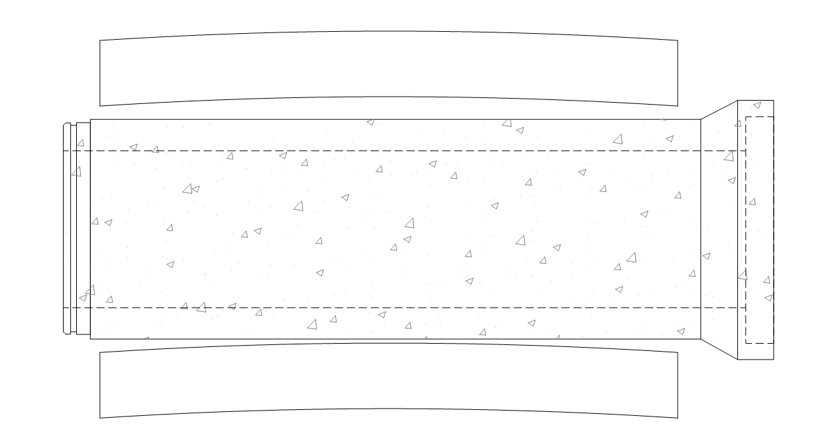

Notes:
It’s 3-edges, not 3 points

Slide 23
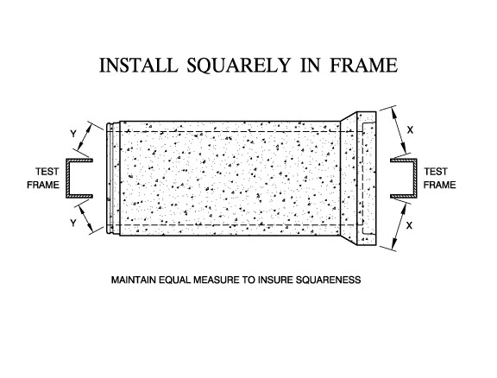
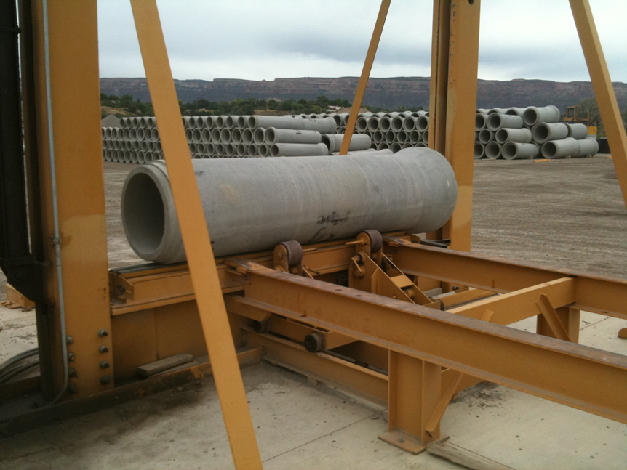
Notes:
Should be tested that pipe is set squarely in the machine

Slide 24
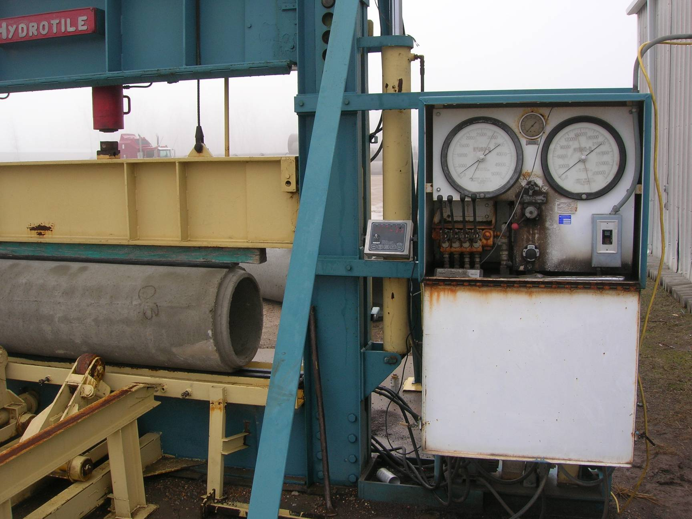

Slide 25
ACPA QCAST MANUAL
T.E.B. TEST FREQUENCIES
PIPE SIZE CLASS FREQUENCY
12”-15” Class 5 and below 1/1000 pcs.
18”-36” Class 4 and below 1/800 pcs.
18”-36” Class 5 1/400 pcs.
42”-60” Class 3 and below 1/400 pcs.
42”-60” Class 4 and 5 1/200 pcs.
66” and All classes As required
larger by project specs.

Slide 26
Pipe shall be tested to the D-load specified in the ASTM tables for the 0.01-inch crack. Pipe meeting these requirements shall be accepted for use.
ACPA requires: one piece, per size and class produced, shall be tested to the Ultimate D-load at least one per year.
ACPA T.E.B. TEST FREQUENCIES

Slide 27
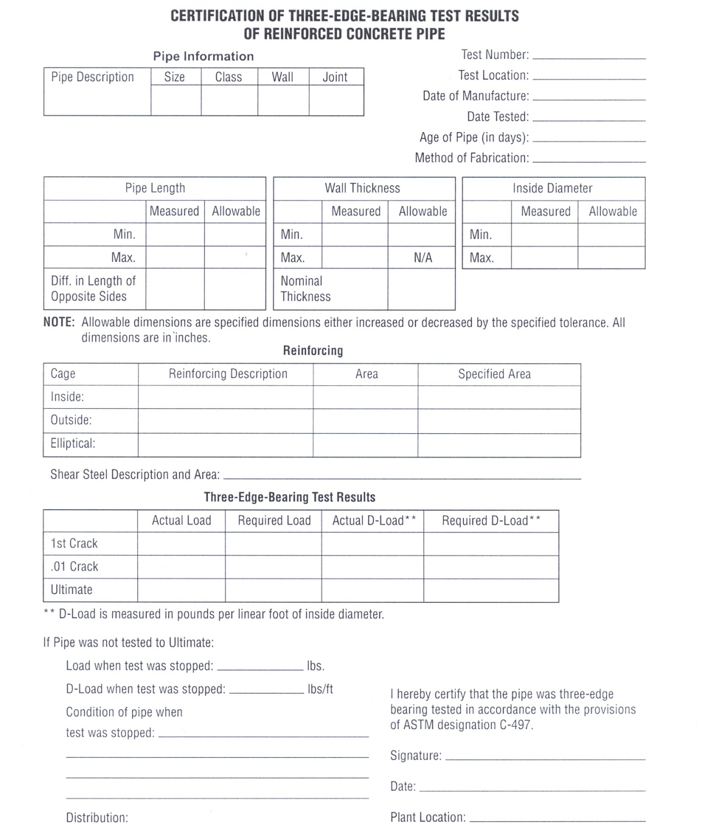

Slide 28
JOINT SHEAR TEST
SPECIFIED IN ASTM C497
SANITARY CERTIFICATION ONLY

Slide 29
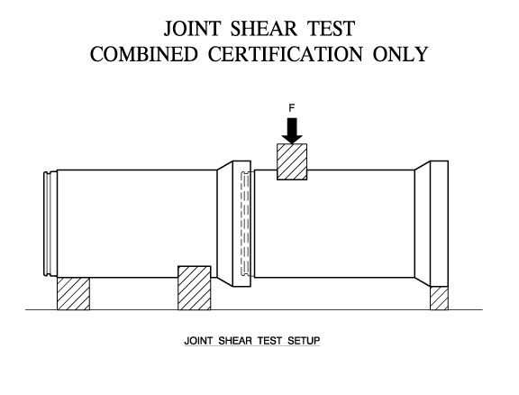
SANITARY

Slide 30
JOINT SHEAR TEST REQUIREMENTS
4000 lbs/ft of pipe diameter (per ASTM C497) including the weight of the pipe.

Slide 31
WHAT IS A PASSING TEST- Joint Shear?
Load Joint to 4000 lbs/ft diameter
Crack Width less than 0.01” after the load is released.

Slide 32
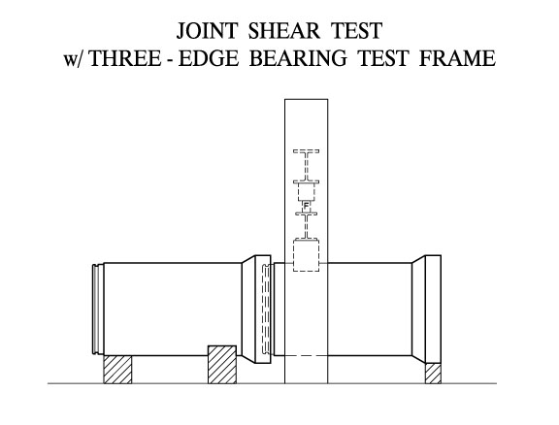
Notes:
Example of 1 method

Slide 33
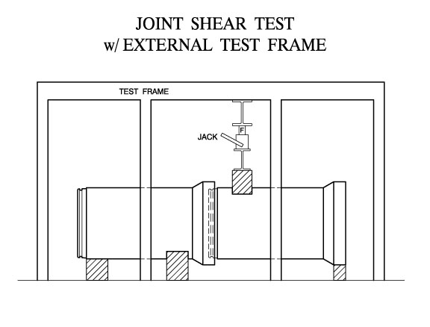

Slide 34
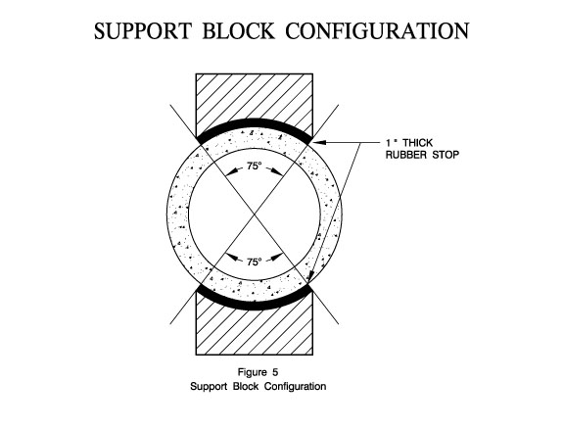

Slide 35
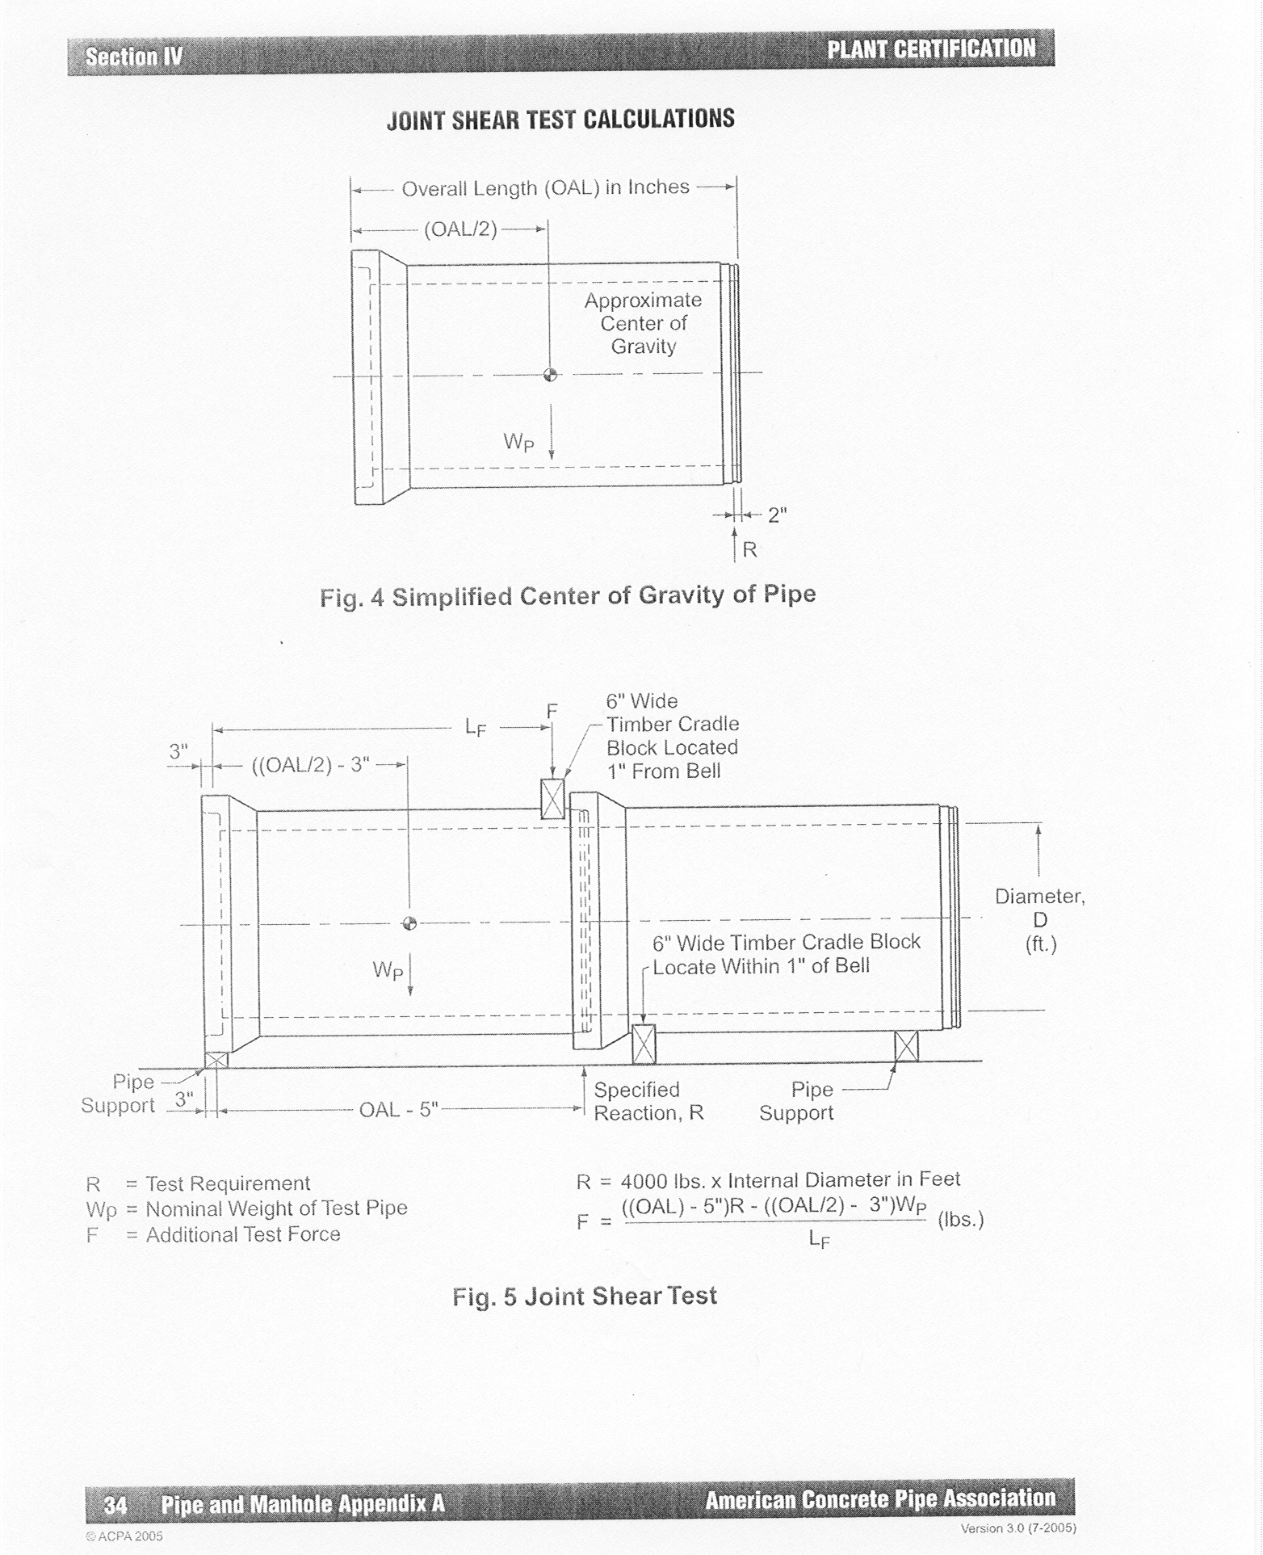

Slide 36
DOCUMENTATION
A proof of design test for the lowest class of each pipe size and joint style should be retained on file as a permanent record.
Expect to run a joint shear test during the audit (sanitary) unless done at another company plant on same design (must be QCast certified).
Notes:
Note the Appendix here that shows Auditor Requirements

Slide 37
OFF CENTER JOINT TEST REQUIREMENTS
VACUUM or HYDROSTATIC
Proof of design test on file. All pipe sizes and joint designs
Sanitary Certification Requirement.

Slide 38
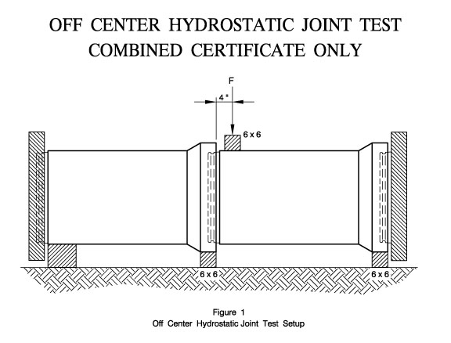
SANITARY

Slide 39
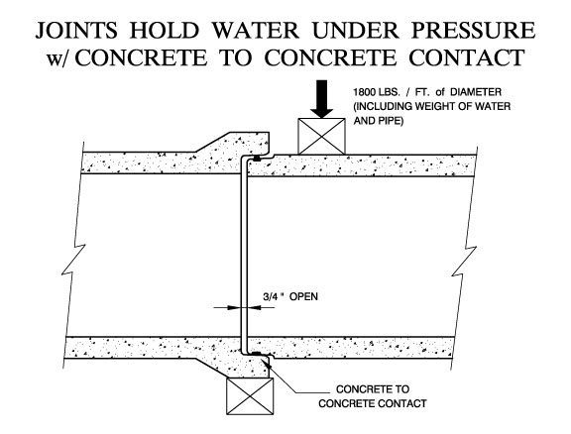

Slide 40
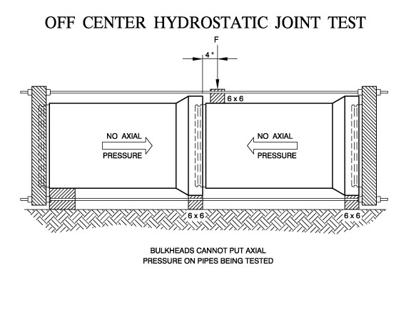

Slide 41
WHAT IS A PASSING TEST – Off-Center?
(QCast)
Vacuum test: Less than 0.108” drop from 7 inches of mercury over set time period
Hydrostatic test: Maintain 13 psi for 2-1/2 minutes with no visible leakage (drips)
  [Can condition the pipes up to 24 hours.]
Test must be run during a (sanitary) audit unless testing performed at another company plant that is QCast certified.

Slide 42
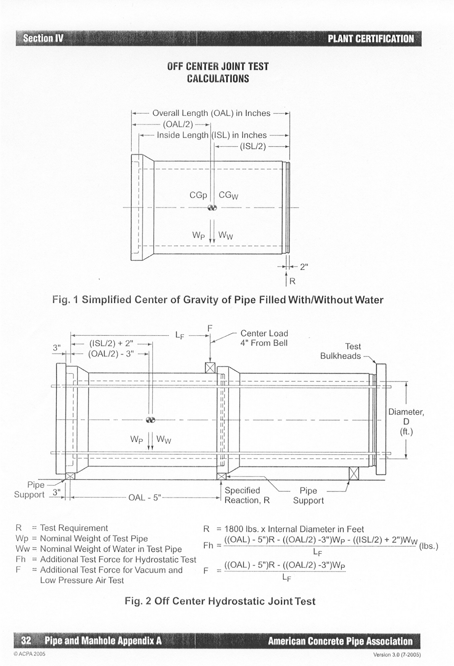

Slide 43
STORM SEWER AND CULVERT JOINT TEST REQUIREMENTS
Gasketed Storm Pipe Joints
VACUUM or HYDROSTATIC
Proof of Design for all Gasketed Pipe Sizes and Joint Designs

Slide 44
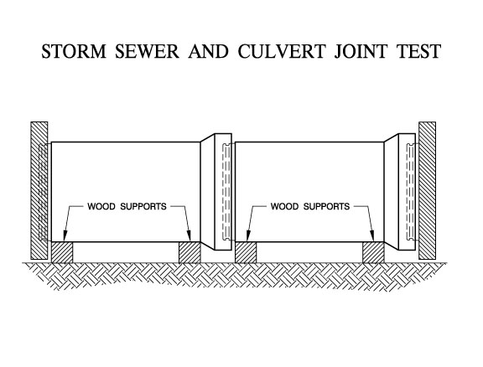

Slide 45
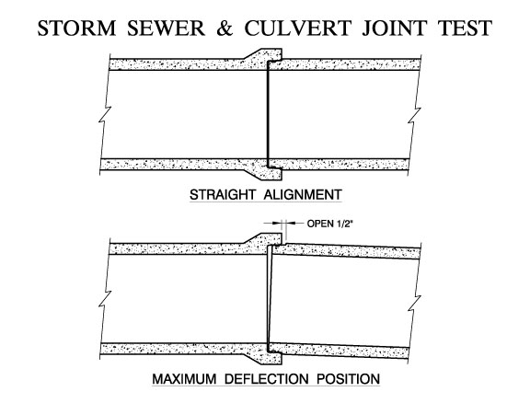
Notes:
Defined in 443

Slide 46
WHAT IS A PASSING TEST –Gasketed Storm Joint Test (QCast)?
Vacuum test: Less than 0.108” drop from 7 inches of mercury over set time period
Hydrostatic test: Maintain 3 psi for 10 minutes with leakage rate less than 200 gallons/inch diameter/mile of pipe/24 hours

Slide 47
WATER TIGHTNESS TESTS
Sanitary Certification Requirement
In-plant quality control tests for pipe barrels
12”-36” pipe Vacuum or Hydrostatic (test 100%)
42” & larger pipe and manhole Vacuum or Hydrostatic
  (1/100, min. of 2 pieces)

Slide 48
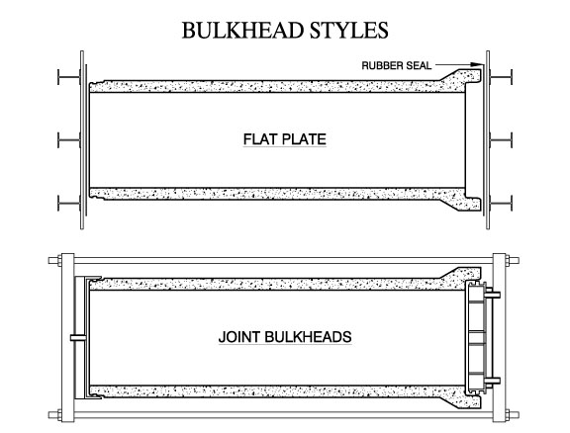

Slide 49
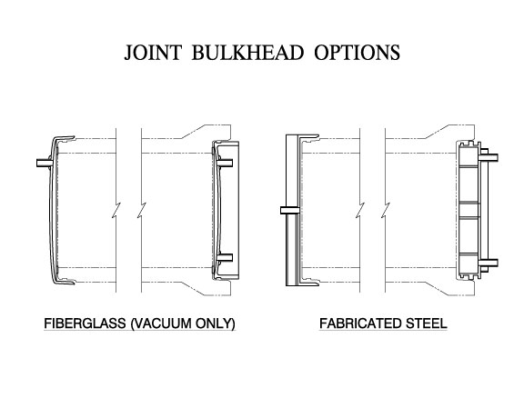

Slide 50
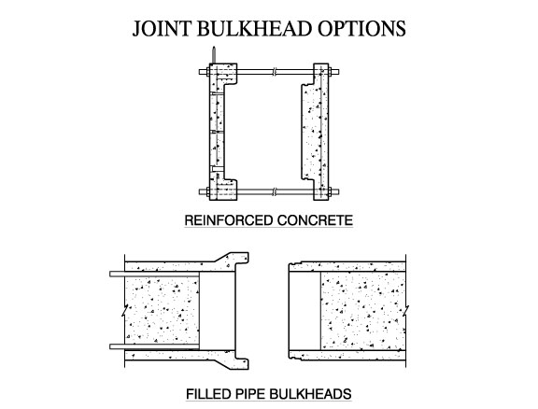

Slide 51
ACPA PIPE PLANT CERTIFICATION
Requires 100% plant testing
12”-36” Sanitary Sewer Pipe
12”-36” Vacuum Test
  Starting vacuum is 7” Hg
12”-36” Hydrostatic Test
  13 psi for 2 1/2 minutes
Found in Appendix A of QCAST Certification Manual

Slide 52
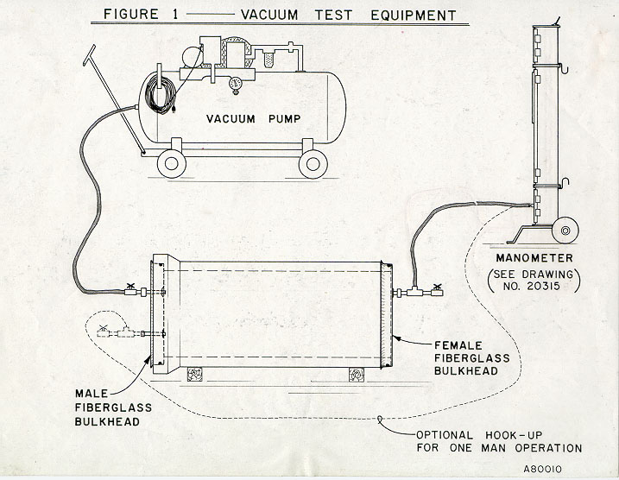

Slide 53
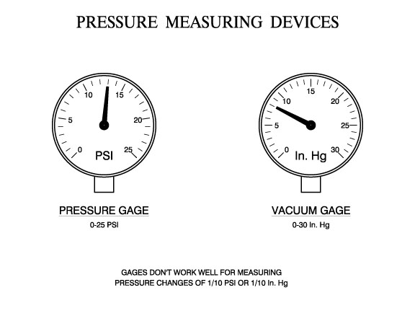
Notes:
X-tech produces digital monometer

Slide 54
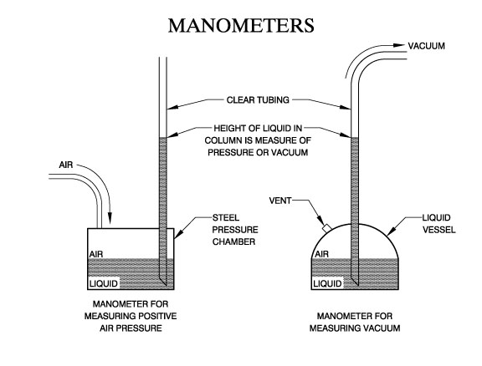

Slide 55
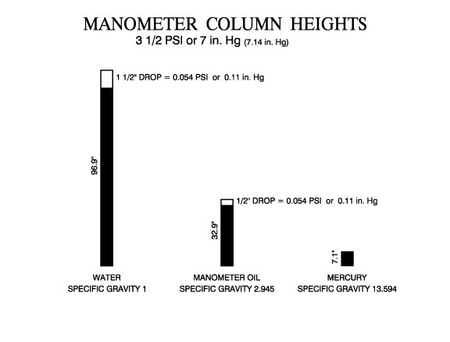

Slide 56
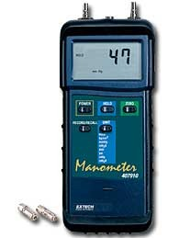

Slide 57
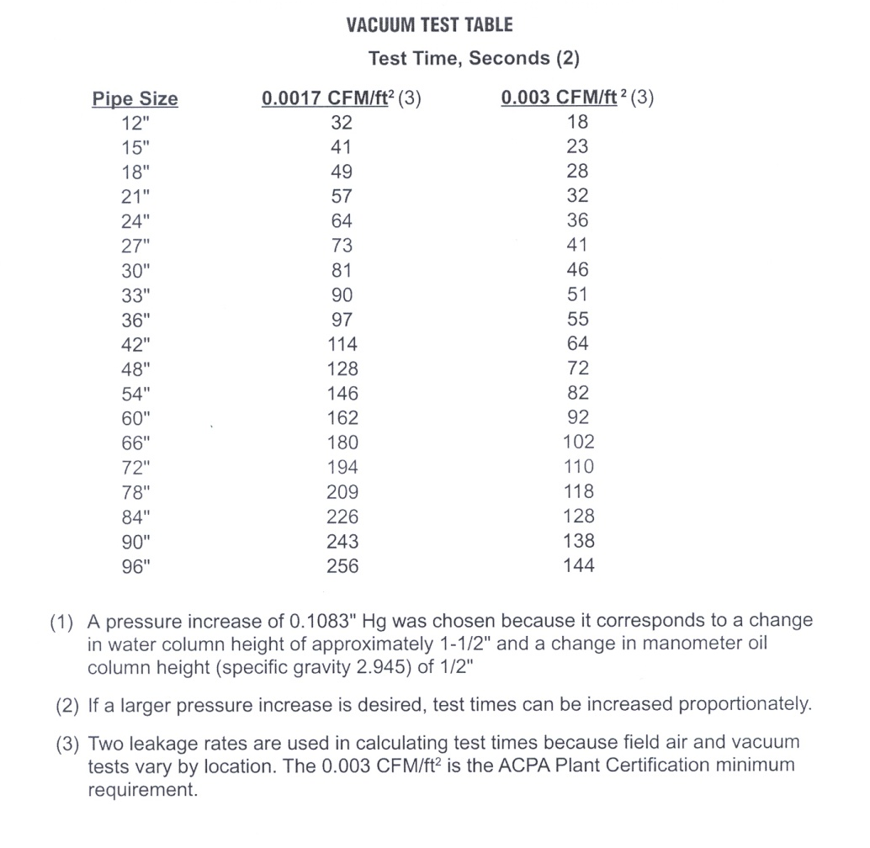

Slide 58
OK to use modified Vacuum Test Pressures and Time,
see QCast Appendix

Slide 59
12” - 36” HYDROSTATIC (Water)
100% OF SANITARY PIPE
13 psi for 2 1/2 minutes
NO VISIBLE LEAKAGE THAT RESULTS IN A DRIP

Slide 60
42” AND LARGER HYDROSTATIC or VACUUM TEST
Hydrostatic test - 13 psi for 2-1/2 minutes with no visible leakage (drip)
Vacuum test per table
1/100 - minimum of two per lot
Notes:
36” must test 100% and 42” only 2, why? Because at some point the wall is thick enough, and ACPA has drawn the line at 42”

Slide 61
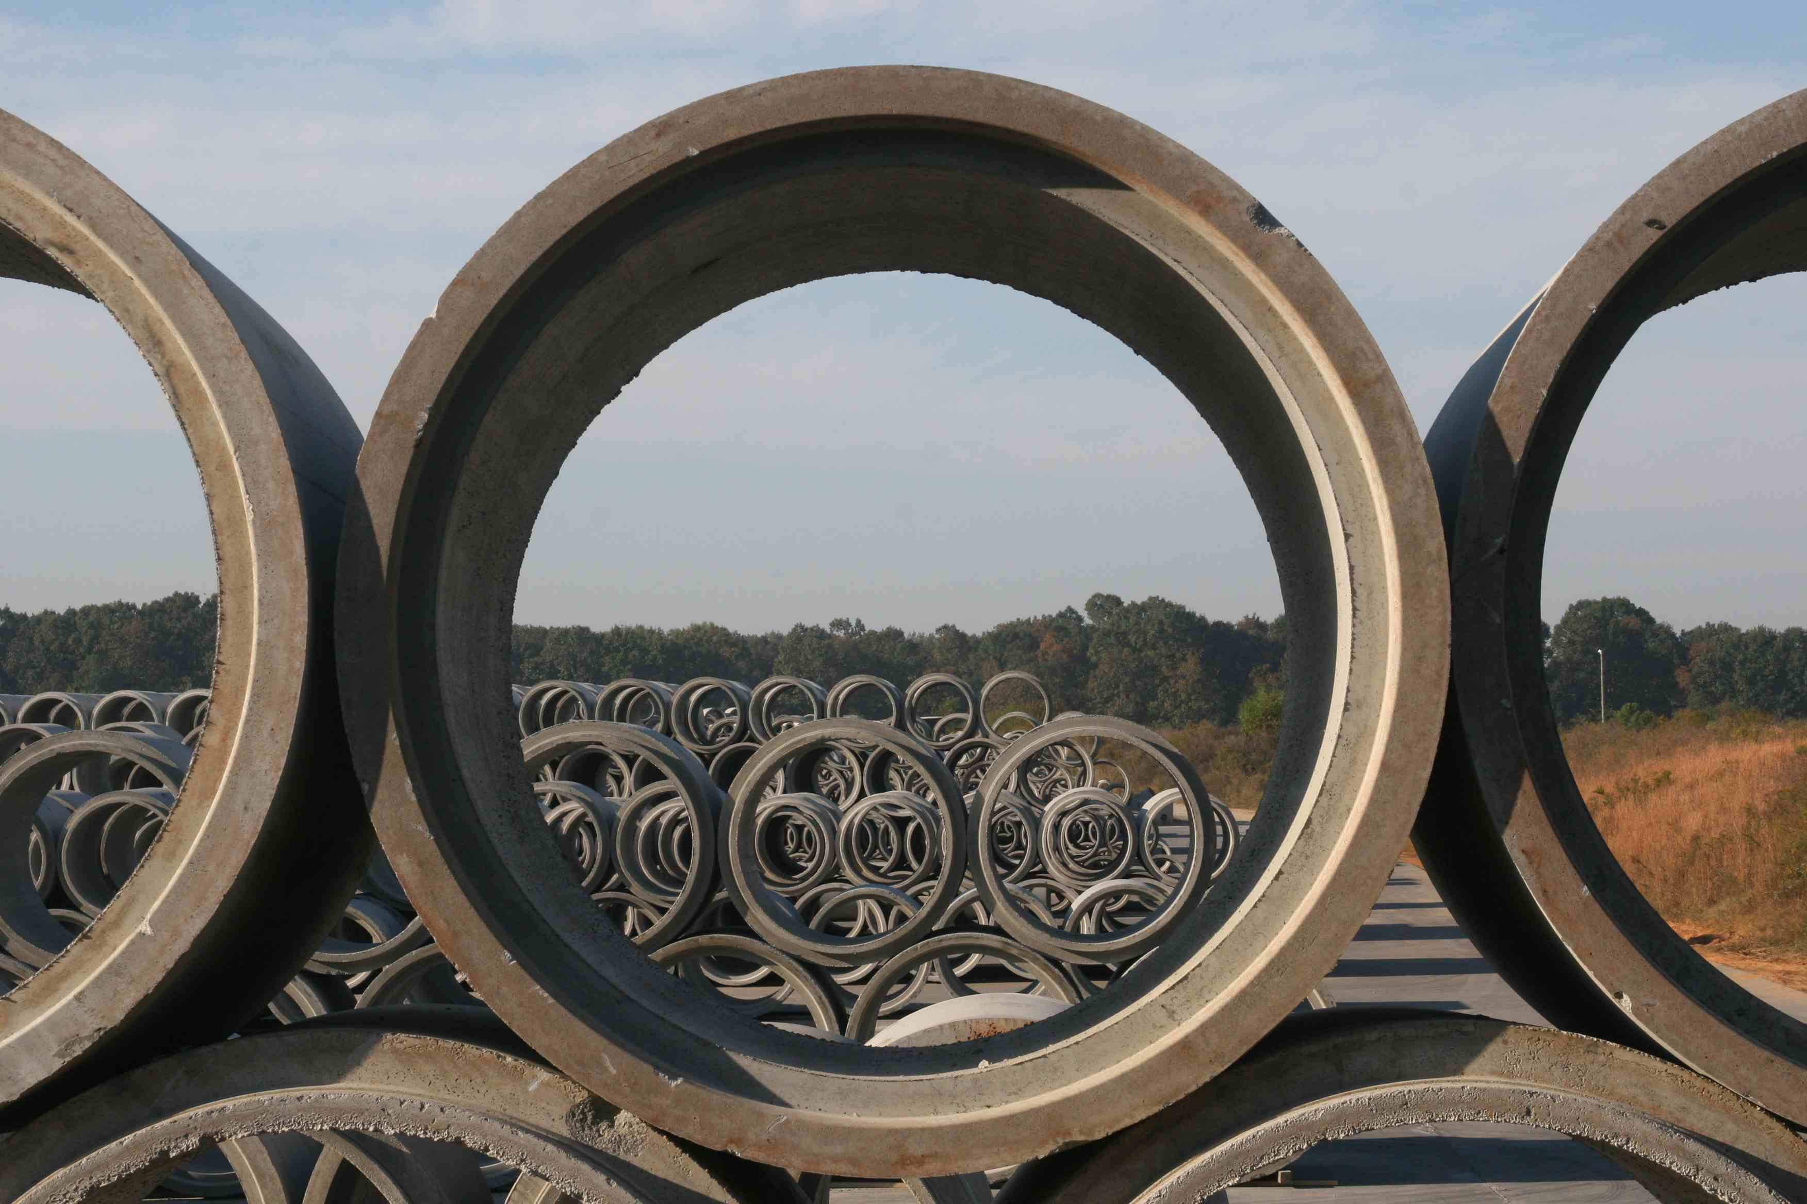
QUESTIONS?

