Slide 1
Reinforcement 1
Jake Jyrkama, P.E.
Rinker Materials

Slide 3
Purpose of Reinforcement
Concrete properties
Strong in compression
Weak in tension
Reinforcement supplies strength to withstand tensile and shear forces experienced by concrete

Slide 4
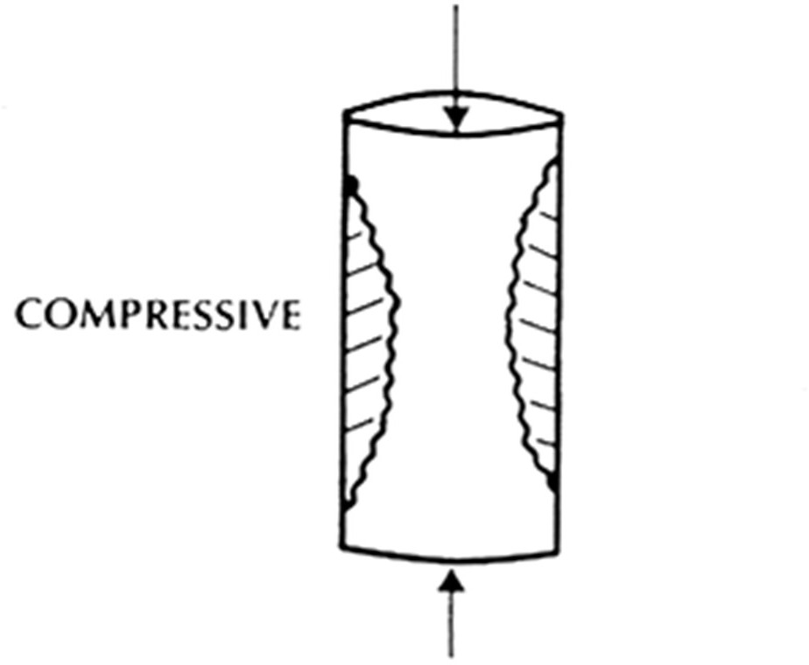
Compressive Forces on Concrete
Concrete can withstand compression

Slide 5
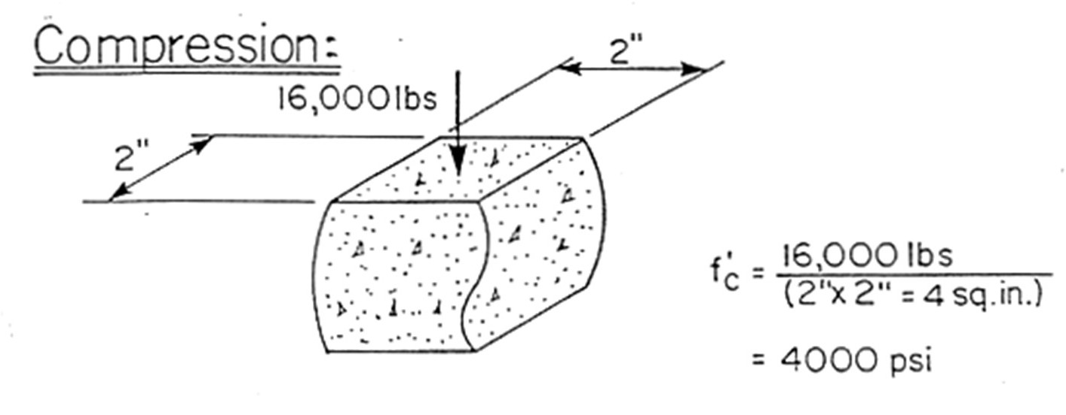
Concrete Under Compression
This 2” X 2” cube of concrete withstands a 4000 psi compressive force

Slide 6
Tensile Forces on Concrete
Without reinforcement, concrete will fail in tension

Slide 7
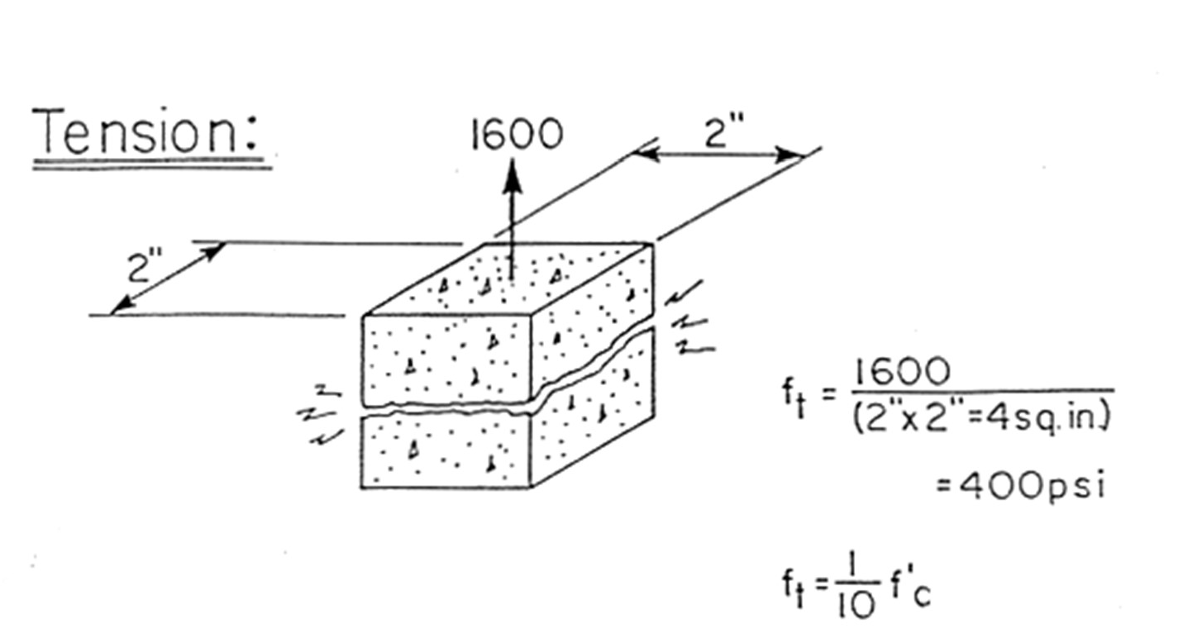
Concrete Under Tension
The same 2” X 2” cube of concrete fails under a 400 psi tensile force

Slide 8
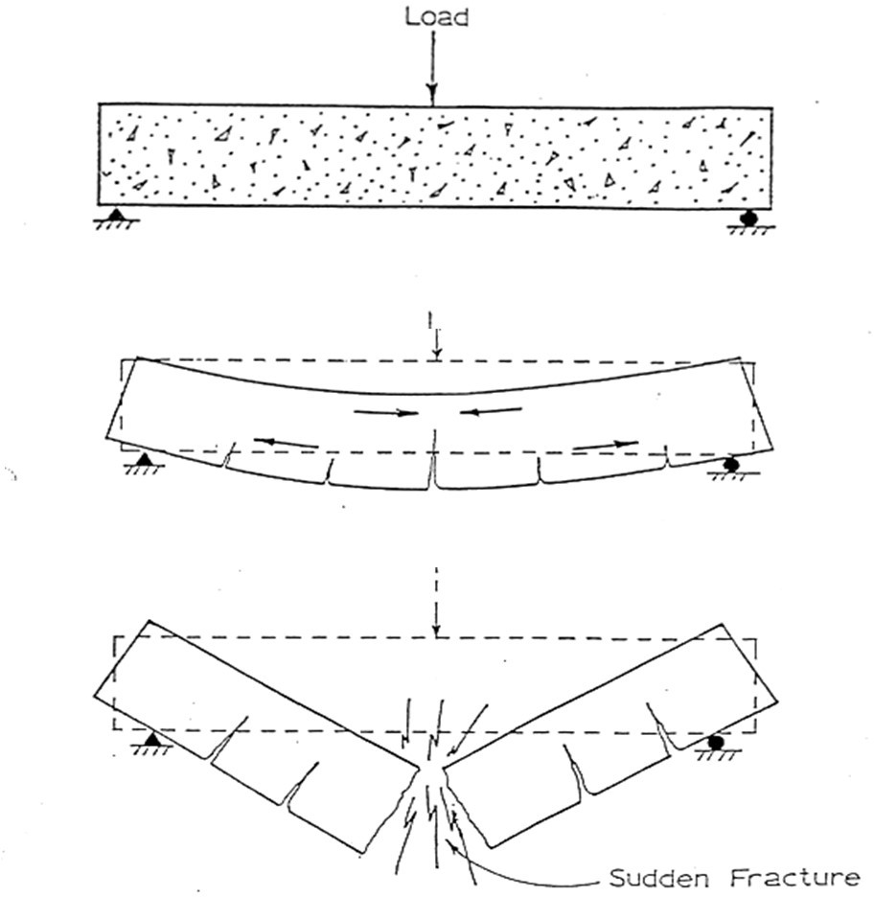
Non-reinforced Concrete Behavior

Slide 9
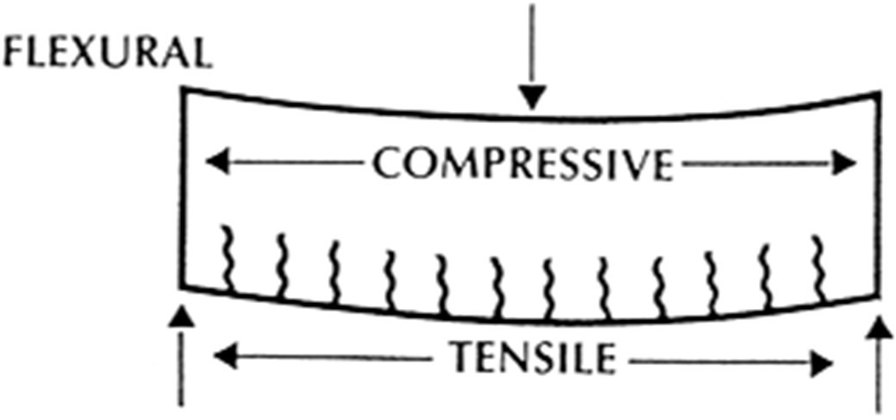
Flexural Forces on Concrete
Without reinforcement, the bottom side will fail in tension

Slide 10
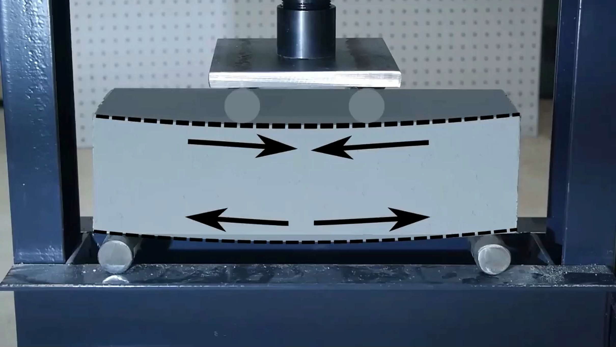

Slide 11
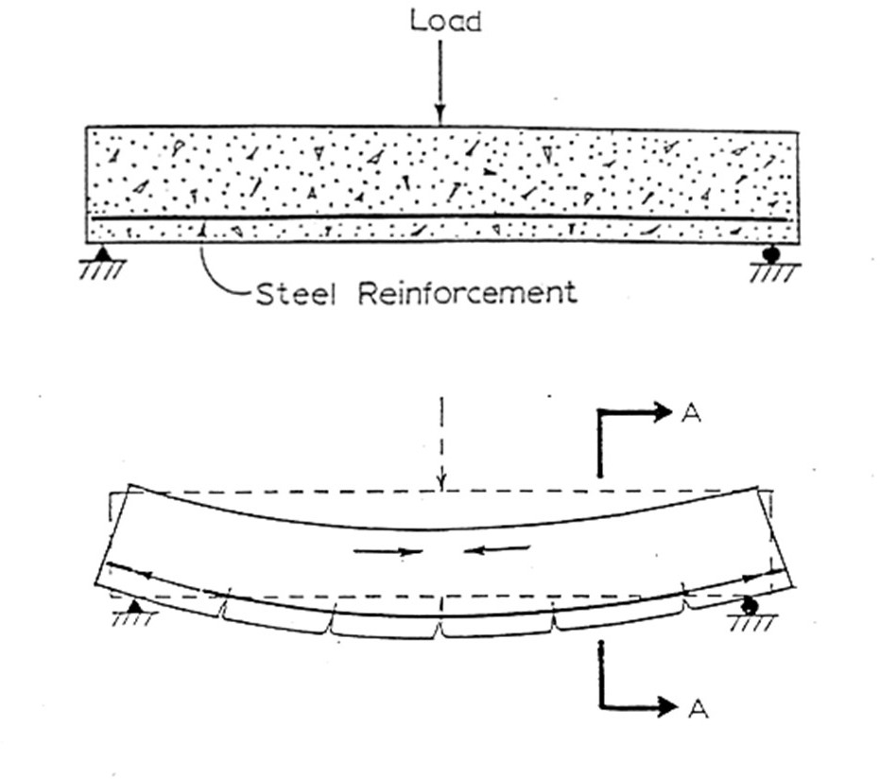
Reinforced Concrete Behavior
CONCRETEPIPE.ORG

Slide 12
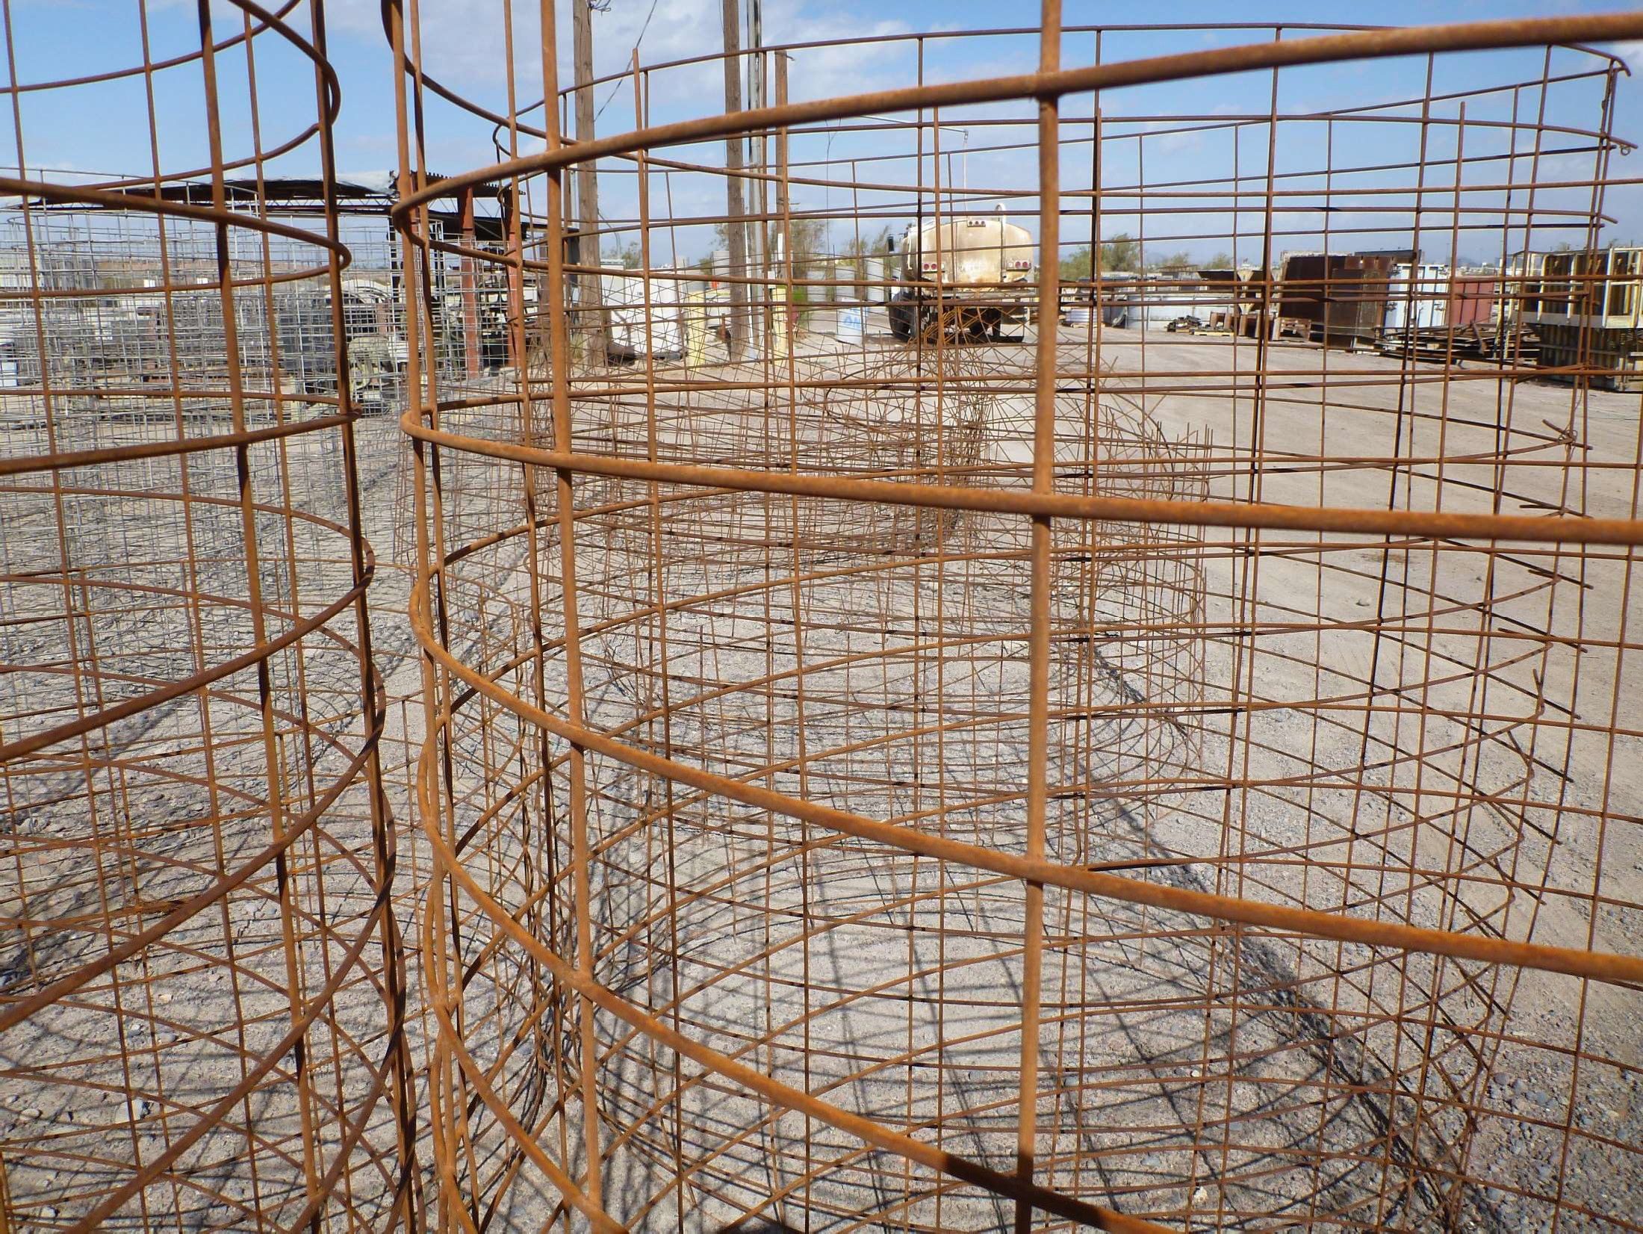

Slide 13
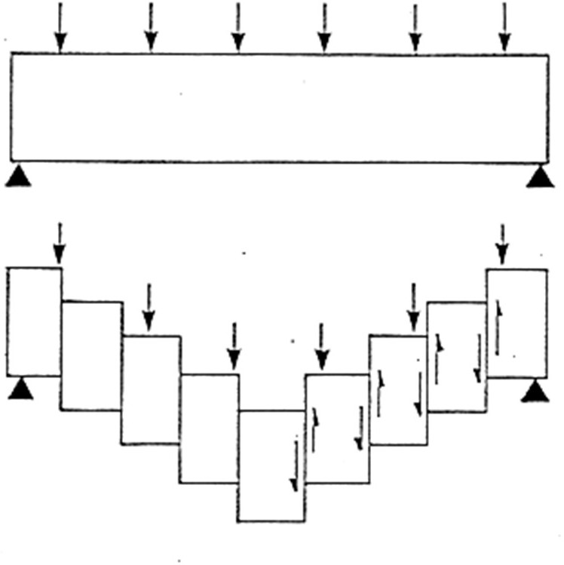
Concrete Behavior Under Shear
Vertical Shear

Slide 14
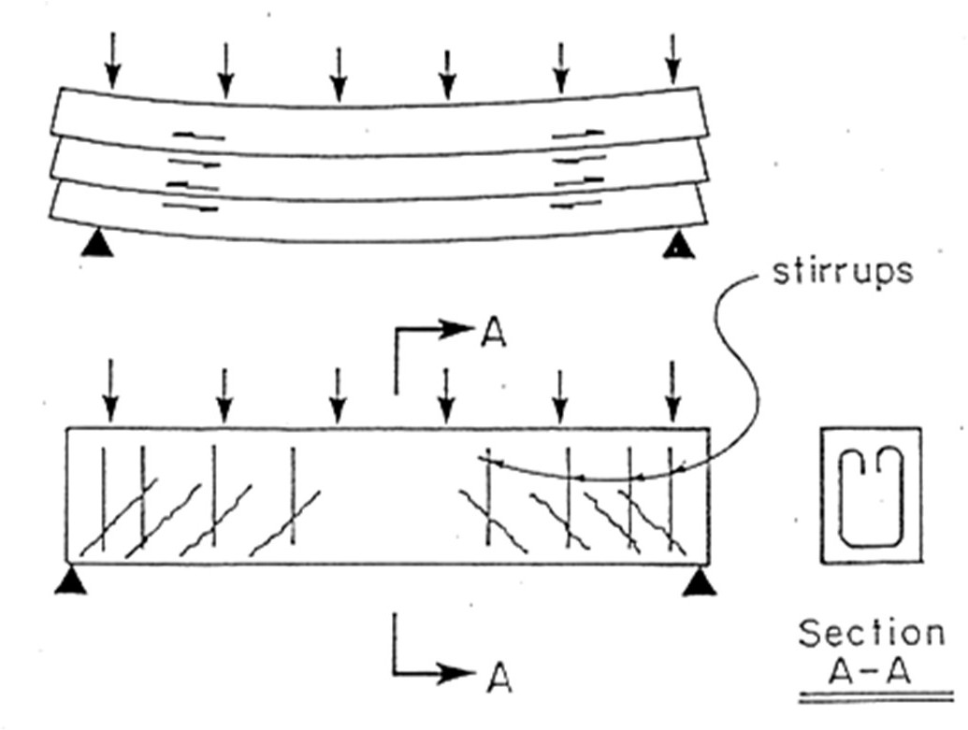
Concrete Behavior Under Shear
Horizontal shear
shear reinforcement

Slide 15
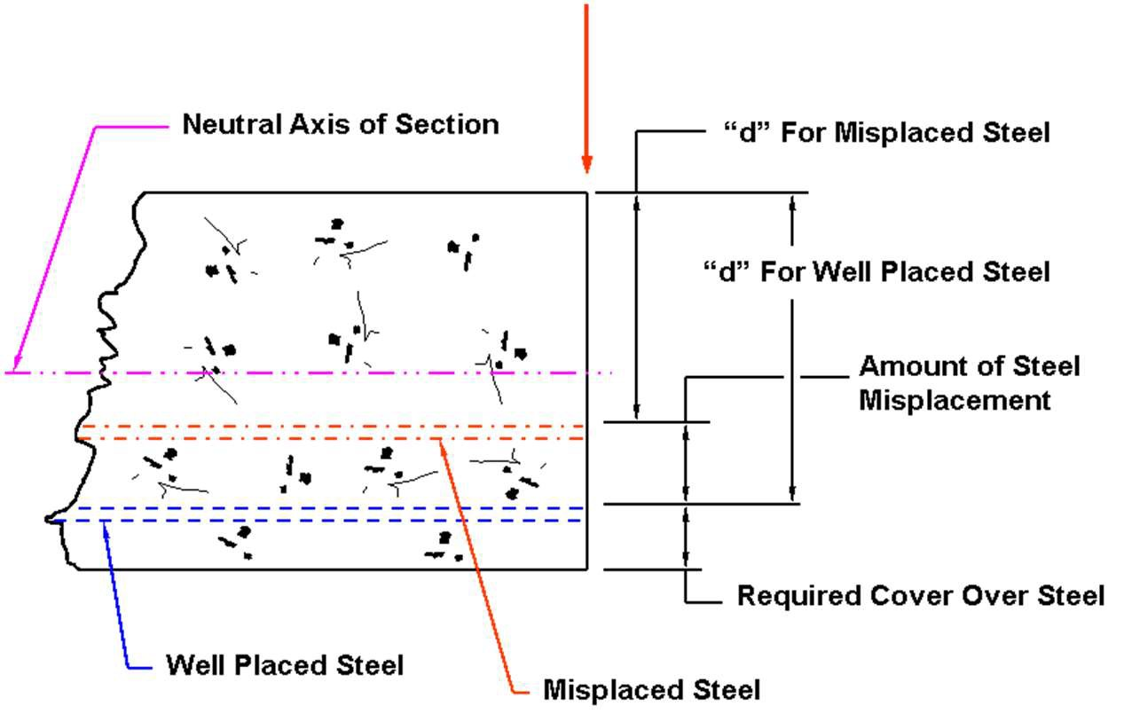
Effectiveness of Placement

Slide 16
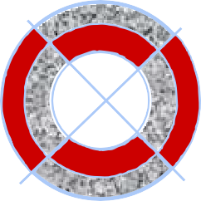
0.01” Crack in Pipe
DEFLECTION UNDER TEST CONDITION
STRESS ZONES UNDER TEST CONDITION
TENSION COMPRESSION

Slide 17
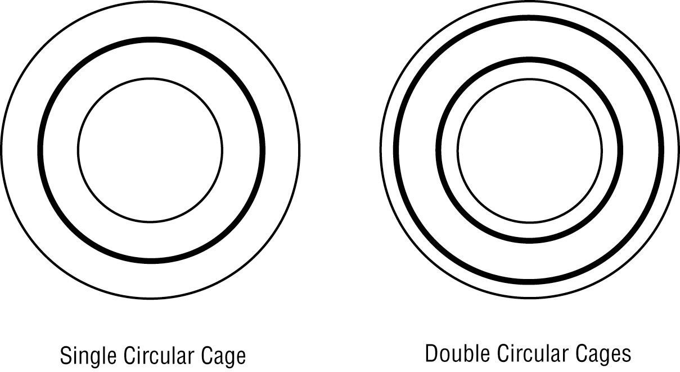
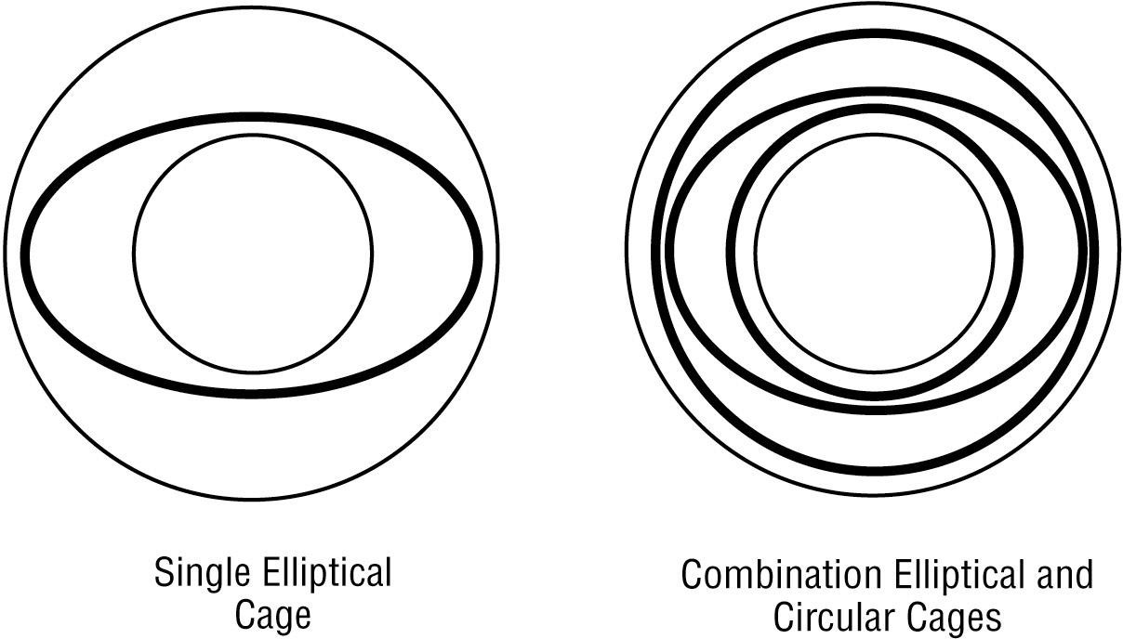

Slide 18
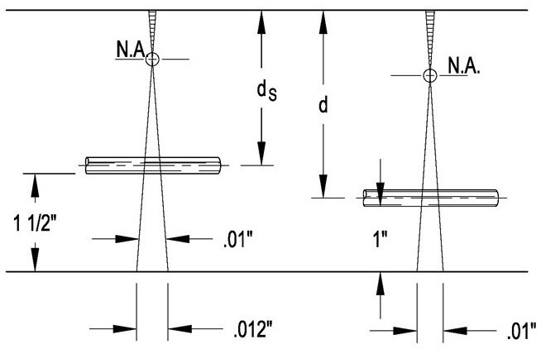
EXAMPLE: Ø36” X 4” WALL
MOVING STEEL INTO WALL TO 1 ½” VS 1” COVER AND DUE TO CRACKING GEOMETRY
INCREASED STEEL BY 47%
DUE TO SHORTER d

Slide 19
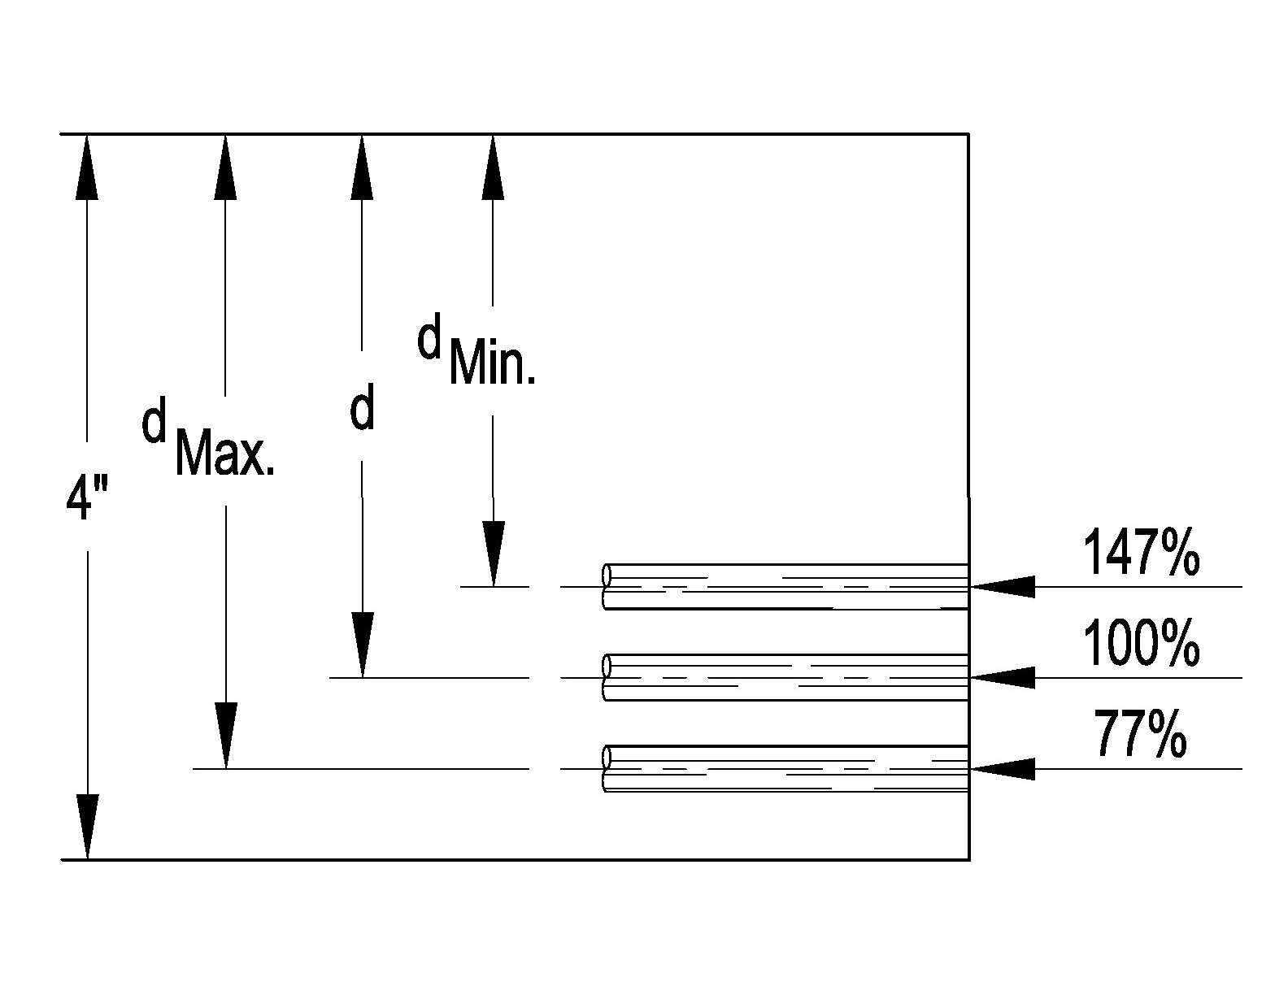
Ø36” X 4” WALL
AS d = RESISTANCE TO CRACK WIDTH
d. MIN. = 147 %
d. NOM. = 100%
d. MAX. = 77%
D- LOAD WOULD VARY BY 34%
IF WE USED THE
ALLOWED CAGE POSITION TOLERANCE FROM C76

Slide 20
Box Culvert

Slide 21
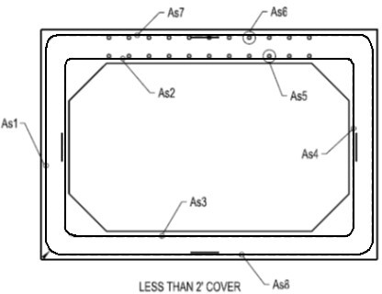
Steel Nomenclature
As₁ = Sidewall outside face As₂ = Top slab inside face As₃ = Bottom slab inside face As₄ = Sidewall inside face
As₅ = Top slab inside distribution steel
As₆ = Top slab outside distribution steel As₇ = Top slab outside face
As₈ = Bottom slab outside face

Slide 22
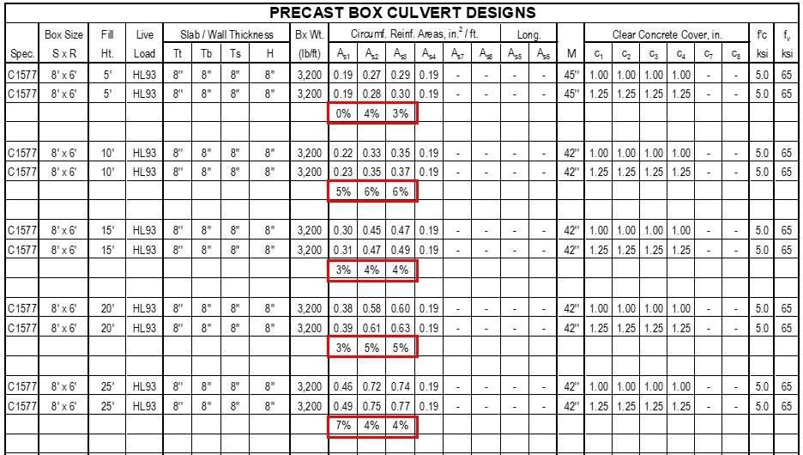
Effectiveness of Placement
1” cover vs. 1-1/4” cover for various fill heights

Slide 23
Effects of Increased Steel Cover
Reduced 0.01” strength
Reduced shear strength
Reduced radial tension strength
Increased cost
Waste of steel

Slide 24
Effectiveness of Placement
It is critical to have correct steel placement for both pipe and box culverts

Slide 25
Reinforcement Type and
Identification

Slide 26
Reinforcement Types
Reinforcing bars
Reinforcing wire
Bar mats and welded wire fabric
Zinc or epoxy coated reinforcement
Prestressing and post tensioning
All types must meet “Buy America” Requirements for federally funded projects

Slide 27
Reinforcing Bars
Conform to specifications
ASTM A615 (New Billet)
ASTM A616 (Rail)
ASTM A617 (Axle)
ASTM A706 (Weldable)
Other bars may be used if permitted by design
Mill certificates required for each shipment

Slide 28
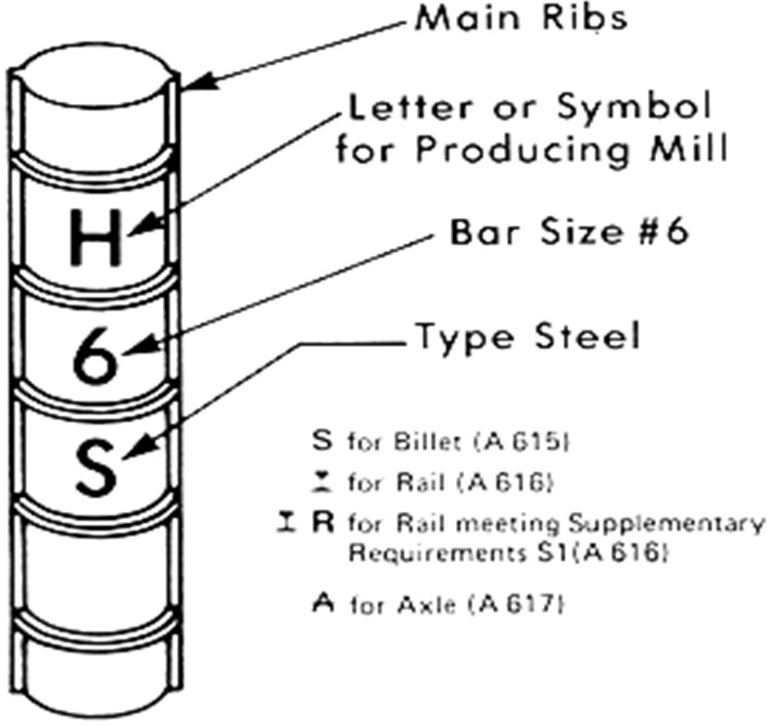
Grade 40 & 50 Rebar

Slide 29
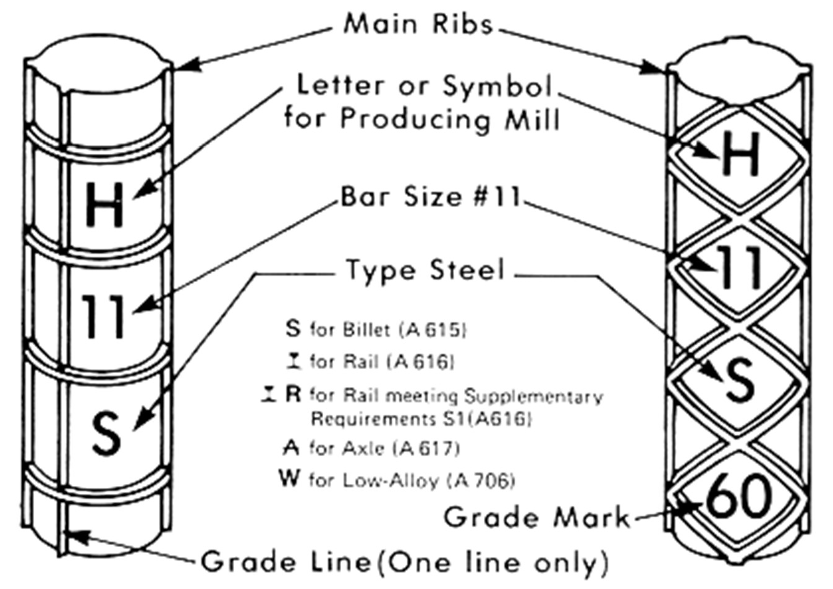
Grade 60 & A706 Rebar
4
4
4

Slide 30
Steel Area Using Different Combinations of Bar Sizes and Spacing
Spacing | #4 | #5 | #6 | #7 | #8 | #9 | #10 | #11
2 in. | 1.20 | 1.86 | 2.64
3 in. | 0.80 | 1.24 | 1.76 | 2.40 | 3.16 | 4.00
4 in. | 0.60 | 0.93 | 1.32 | 1.80 | 2.37 | 3.00 | 3.81 | 4.68
5 in. | 0.48 | 0.74 | 1.06 | 1.44 | 1.90 | 2.40 | 3.05 | 3.74
6 in. | 0.40 | 0.62 | 0.88 | 1.20 | 1.58 | 2.00 | 2.54 | 3.12
7 in. | 0.34 | 0.53 | 0.75 | 1.03 | 1.35 | 1.71 | 2.18 | 2.67
8 in. | 0.30 | 0.47 | 0.66 | 0.90 | 1.19 | 1.50 | 1.91 | 2.34
9 in. | 0.27 | 0.41 | 0.59 | 0.80 | 1.05 | 1.33 | 1.69 | 2.08
10 in. | 0.24 | 0.37 | 0.53 | 0.72 | 0.95 | 1.20 | 1.52 | 1.87
11 in. | 0.22 | 0.34 | 0.48 | 0.65 | 0.86 | 1.09 | 1.39 | 1.70
12 in. | 0.20 | 0.31 | 0.44 | 0.60 | 0.79 | 1.00 | 1.27 | 1.56
13 in. | 0.18 | 0.29 | 0.41 | 0.55 | 0.73 | 0.92 | 1.17 | 1.44
14 in. | 0.17 | 0.27 | 0.38 | 0.51 | 0.68 | 0.86 | 1.09 | 1.34
15 in. | 0.16 | 0.25 | 0.35 | 0.48 | 0.63 | 0.80 | 1.02 | 1.25
16 in. | 0.15 | 0.23 | 0.33 | 0.45 | 0.59 | 0.75 | 0.95 | 1.17
17 in. | 0.14 | 0.22 | 0.31 | 0.42 | 0.56 | 0.71 | 0.90 | 1.10
18 in. | 0.13 | 0.21 | 0.29 | 0.40 | 0.53 | 0.67 | 0.85 | 1.04

Slide 31
Reinforcing Wire (Plain and Deformed)
Conform to (except prestressing wire)
ASTM A1064
Other wire may be used if permitted by design
Mill certificates for each shipment

Slide 32
Bar Mats and WWR (Plain and deformed)
Conform to
ASTM A1064
Mill certificates for each shipment
Applications of rolled vs. straight

Slide 34
Welded Wire Reinforcement

Slide 35
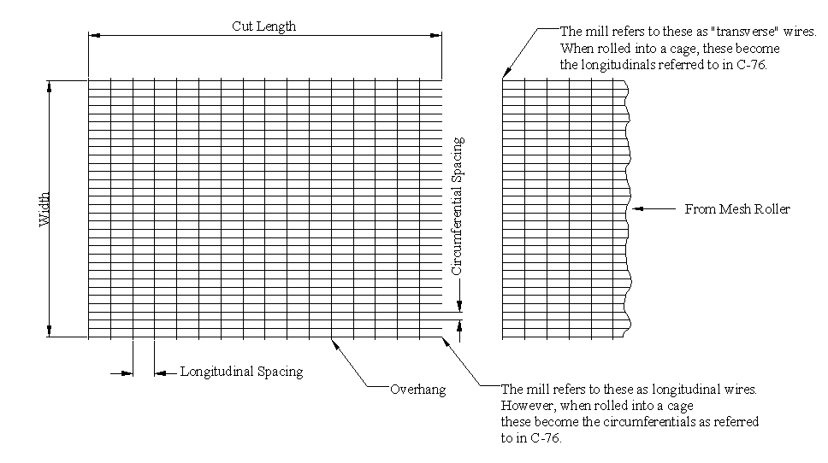
Welded Wire Reinforcement

Slide 36
Cage Basics
Spacing between pipe longitudinals
Area of one circumferen- tial wire (.025 sq. in.)
Length of roll
3x8 W2.5xW2.0 93”x600’ 1/2x1/2
Overhangs
Spacing between pipe Area of one longitud-
circumferentials
inal wire (.02 sq. in.)
Width of mesh – from top to bottom circumferential
W = Plain/Smooth, D = Deformed

Slide 37
Wire Size and Designation
No. = Cross sectional Area in Hundredths of Sq. In.
Thus
W5 = 0.05 Sq. In.
W5.5 = 0.055 Sq. In.
D10 = 0.10 Sq. In.

Slide 38
Cage Basics
Given 3x8 W2.5xW2.0
What is the steel area per foot of pipe?
12
A = 0.025 x
= 0.10 in²/ft
3

Slide 39
Structural Integrity Depends on
Grade of the reinforcing steel
Size of the reinforcing steel
Spacing of the reinforcing steel
Positioning of the reinforcing steel

Slide 40
Thank You
Jake Jyrkama, P.E. Jaakko.Jyrkama@RinkerPipe.com

