Slide 1
Reinforcement 2
Jake Jyrkama, P.E.
Rinker Materials
CONCRETEPIPE.ORG

Slide 2
Concrete Pipe Design
CONCRETEPIPE.ORG

Slide 3
Structural Design
Indirect (D-Load) – (ACPA DD-9)
Designed for concentrated load (3-Edge Bearing Test) that will produce the same bending moments as in the field
Direct Design
Designed for the anticipated soil pressures using typical ultimate strength design methodology
CONCRETEPIPE.ORG

Slide 4
Concrete Pipe Strength (ASTM C76/AASHTO M170)
D-Load
Supporting strength of a pipe loaded under three-edge-bearing test conditions
Expressed in pounds per linear foot per foot of inside diameter or horizontal span
ASTM C 76 Class IV D_{0.01} = 2,000
D_{ULT} = 3,000
CONCRETEPIPE.ORG

Slide 5
ASTM C76
D-Load
0.01”D
Ult. D
Class I | 800 | 1200
Class II | 1000 | 1500
Class III | 1350 | 2000
Class IV | 2000 | 3000
Class V | 3000 | 3750
CONCRETEPIPE.ORG

Slide 6
D-Load Strength Determination
48” Profile Class IV 8’ D_{0.01} = 2000
D_{ULT} = 3000
Total Load Required:
D_{0.01} = (48/12)(8)(2000) = 64,000 lbs D_{ULT} = (48/12)(8)(3000) = 96,000 lbs
CONCRETEPIPE.ORG

Slide 7
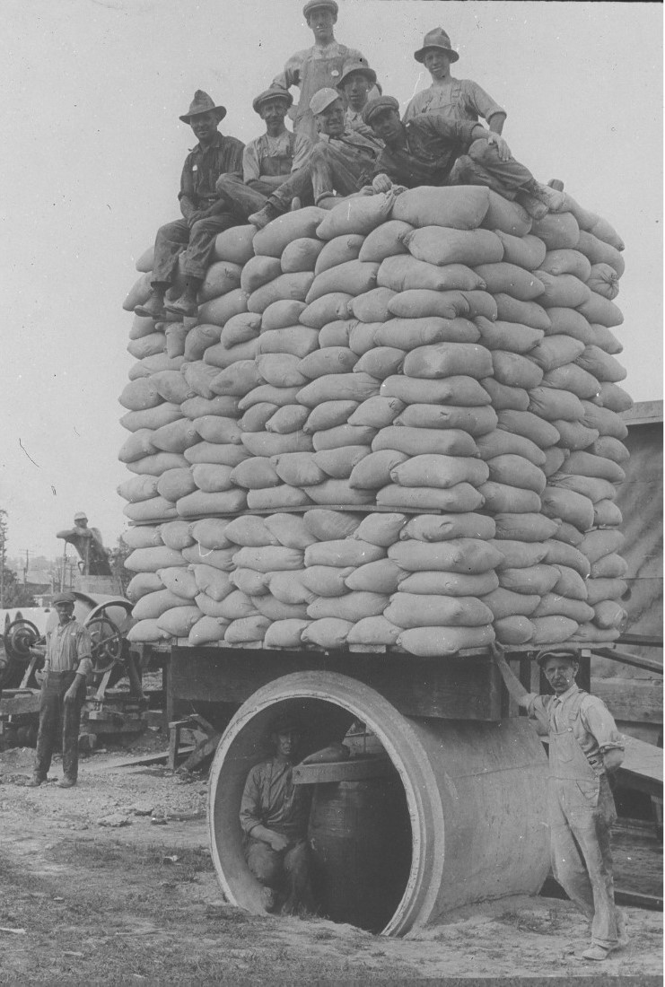

Slide 8
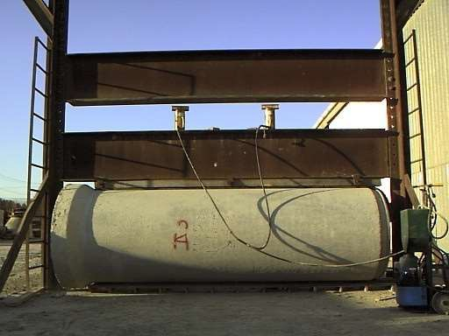

Slide 9
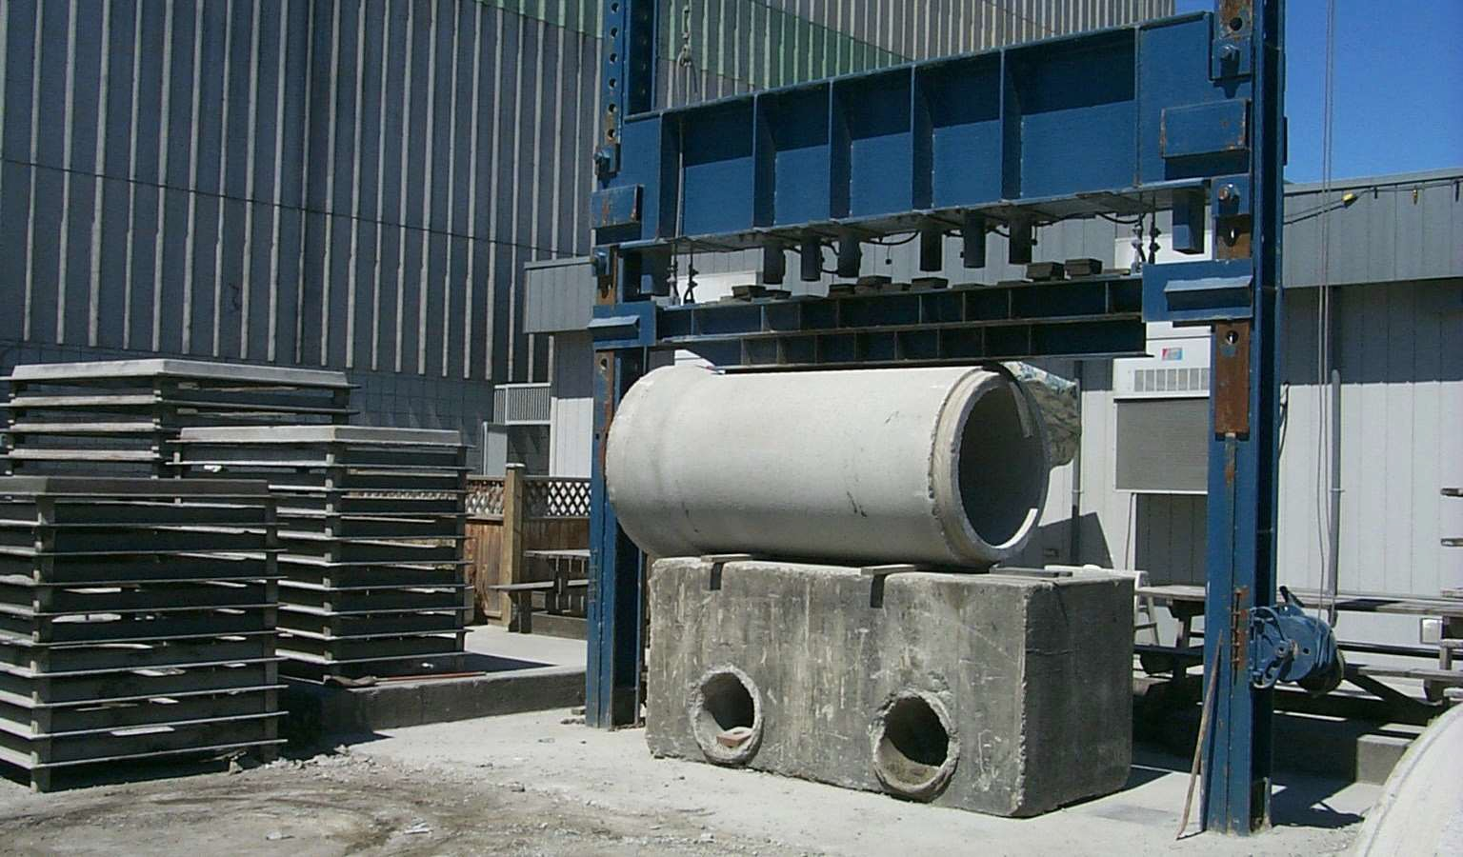

Slide 10
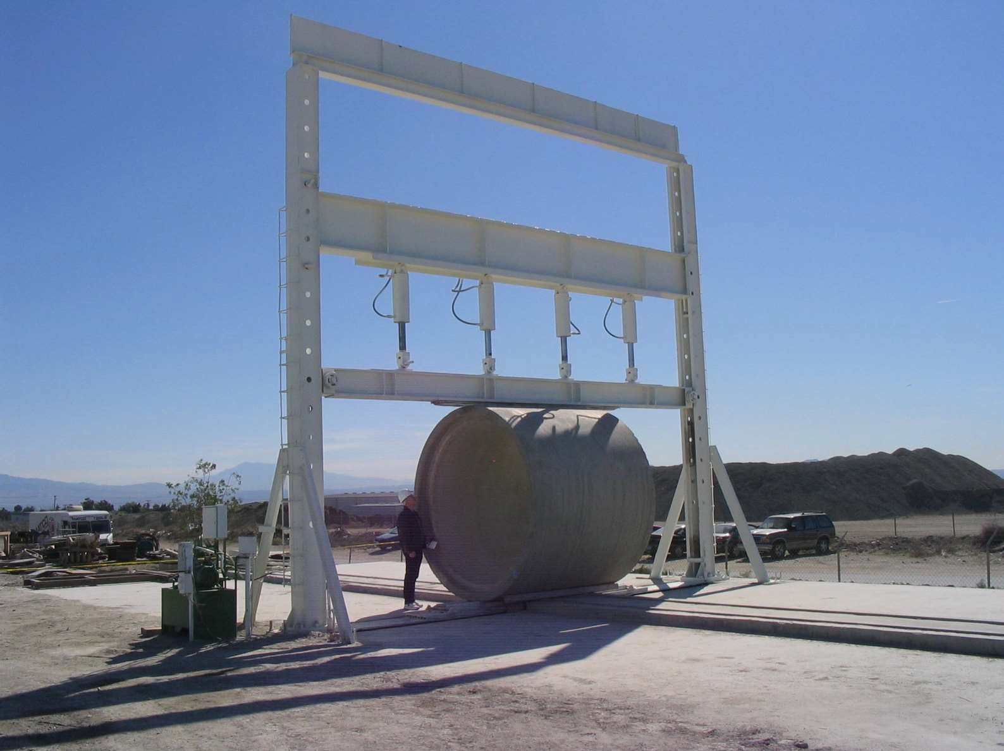

Slide 11
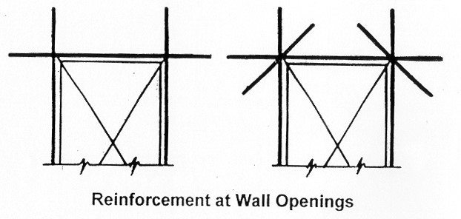
Positioning Reinforcement
CONCRETEPIPE.ORG

Slide 12
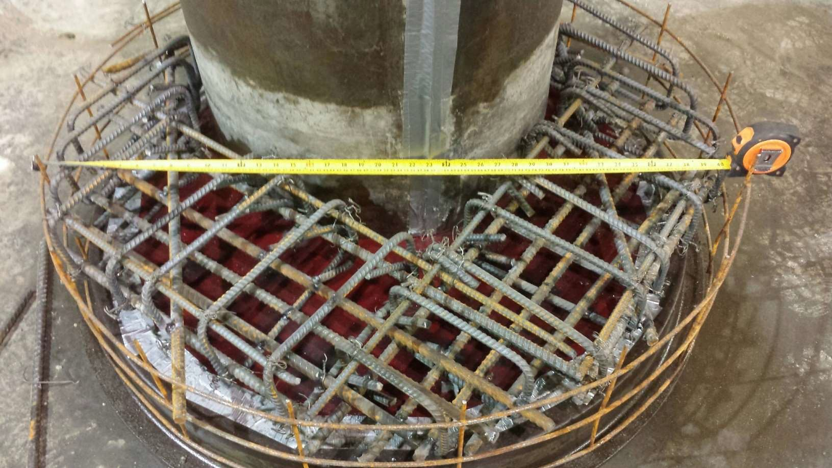
Positioning Reinforcement
CONCRETEPIPE.ORG

Slide 13
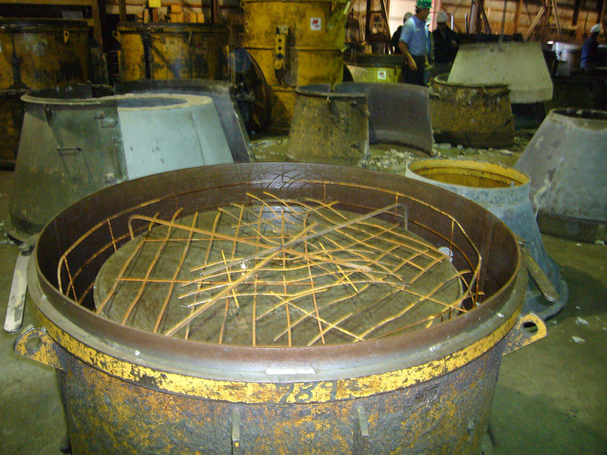

Slide 14
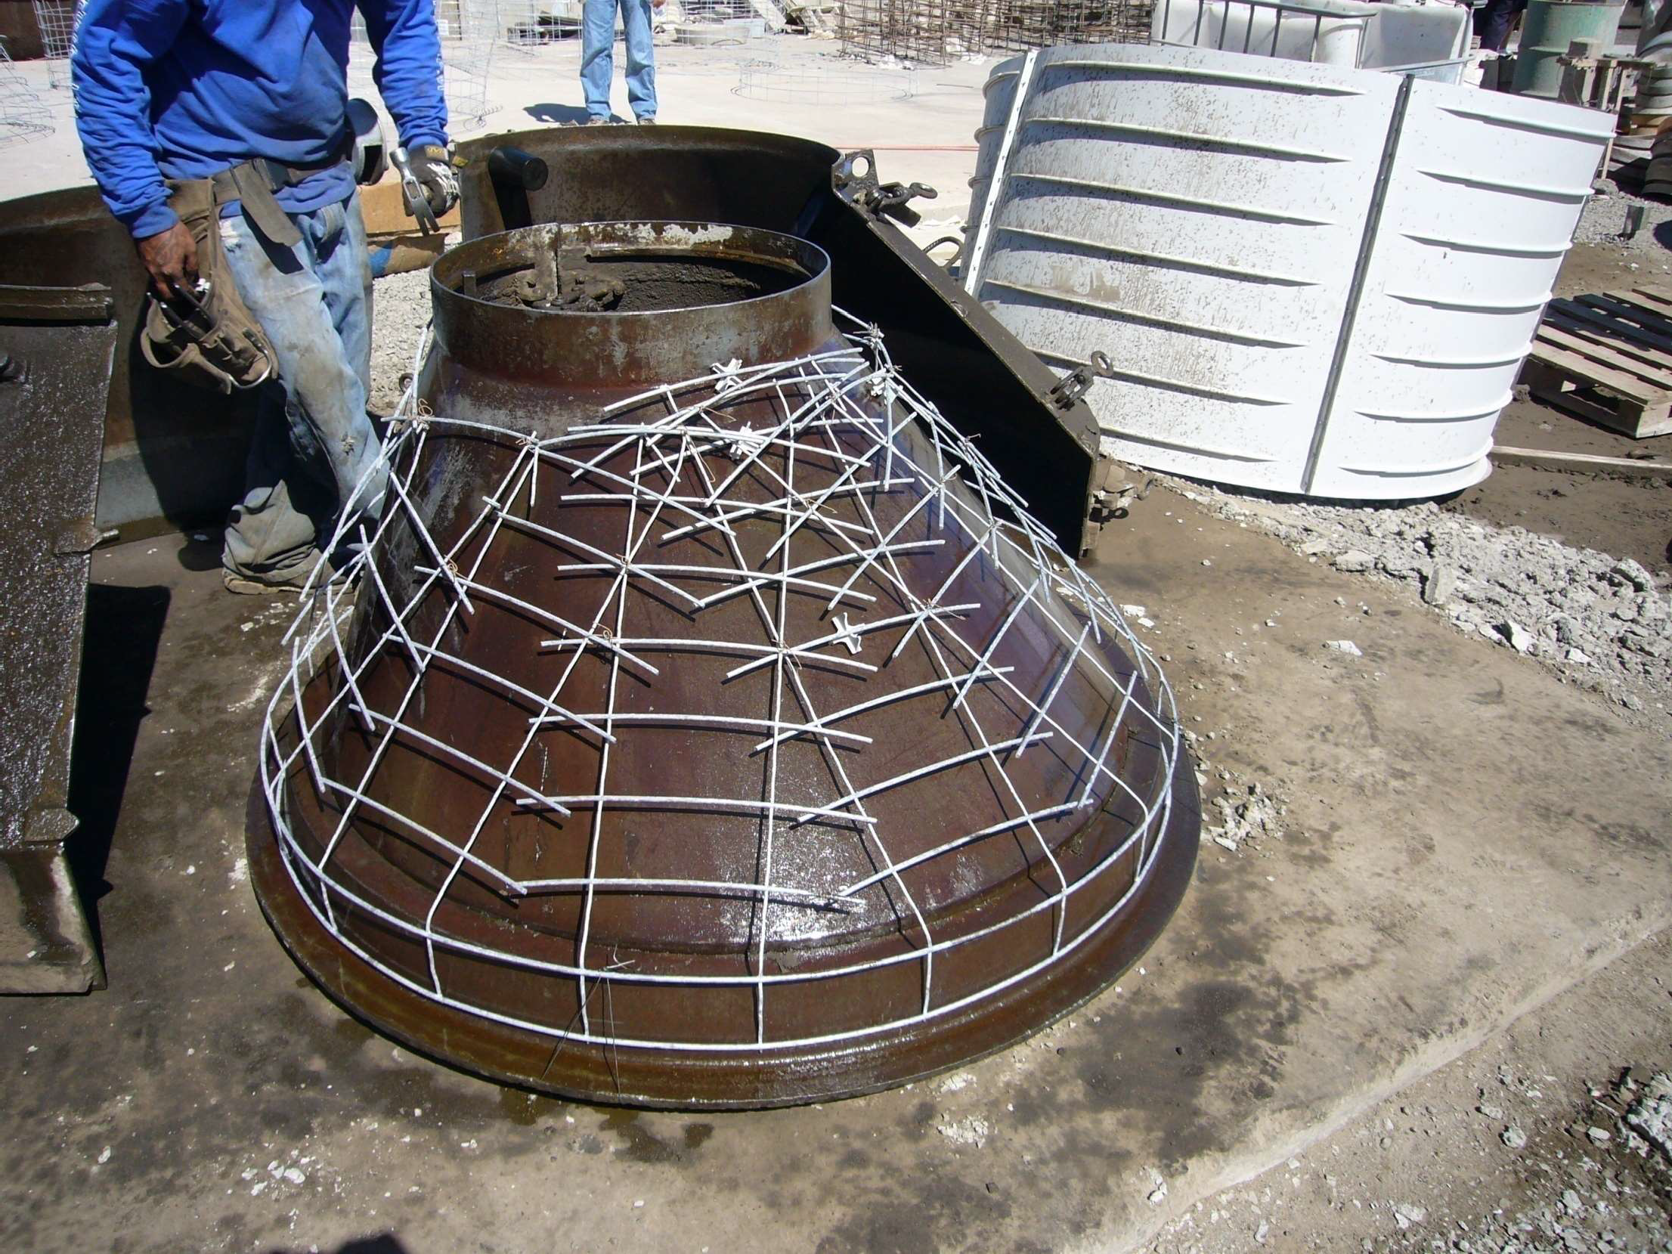

Slide 15
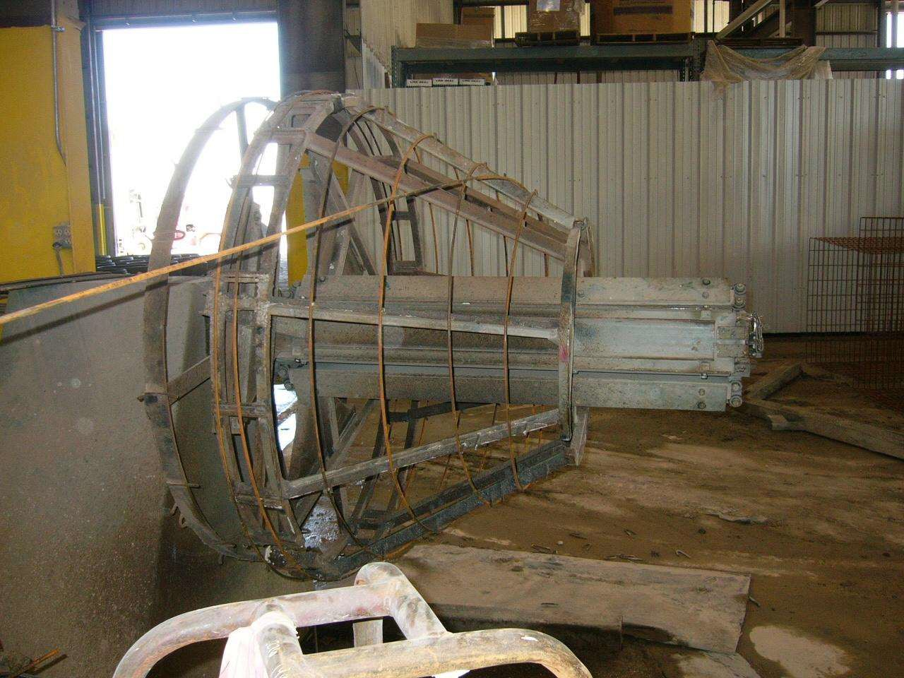

Slide 16
Welding
CONCRETEPIPE.ORG

Slide 17
Welding Requirements
Welding of reinforcement
Maintain product integrity
Two weldability limits
Max. Carbon content (0.30%) [AWS D1.4]
Carbon equivalent (CE)
ACI 318 And AWS D1.4, CE are:
For #6 And smaller - 0.55%
For #7 And larger - 0.45%
The lower The CE, The better The weldability
For larger CE values, The rebar must be preheated
CONCRETEPIPE.ORG

Slide 18
ASTM A615 Reinforcement
ASTM A615 rebar
Must be used with extreme caution
Generally not acceptable
Check CE = %C + %Mn / 6
CONCRETEPIPE.ORG

Slide 19
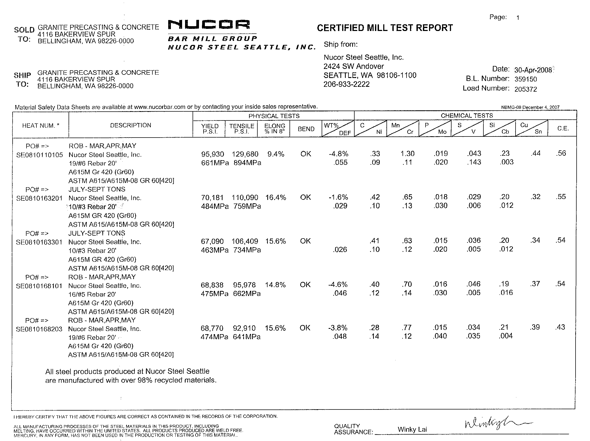

Slide 20
ASTM A706 Reinforcement
ASTM A706 rebar
Is a low-alloy weldable grade
Check CE =
%C + %Mn/6 + %Cu/40 + %Ni/20 + %Cr/10 - %Mo/50 - %V/10
CONCRETEPIPE.ORG

Slide 21
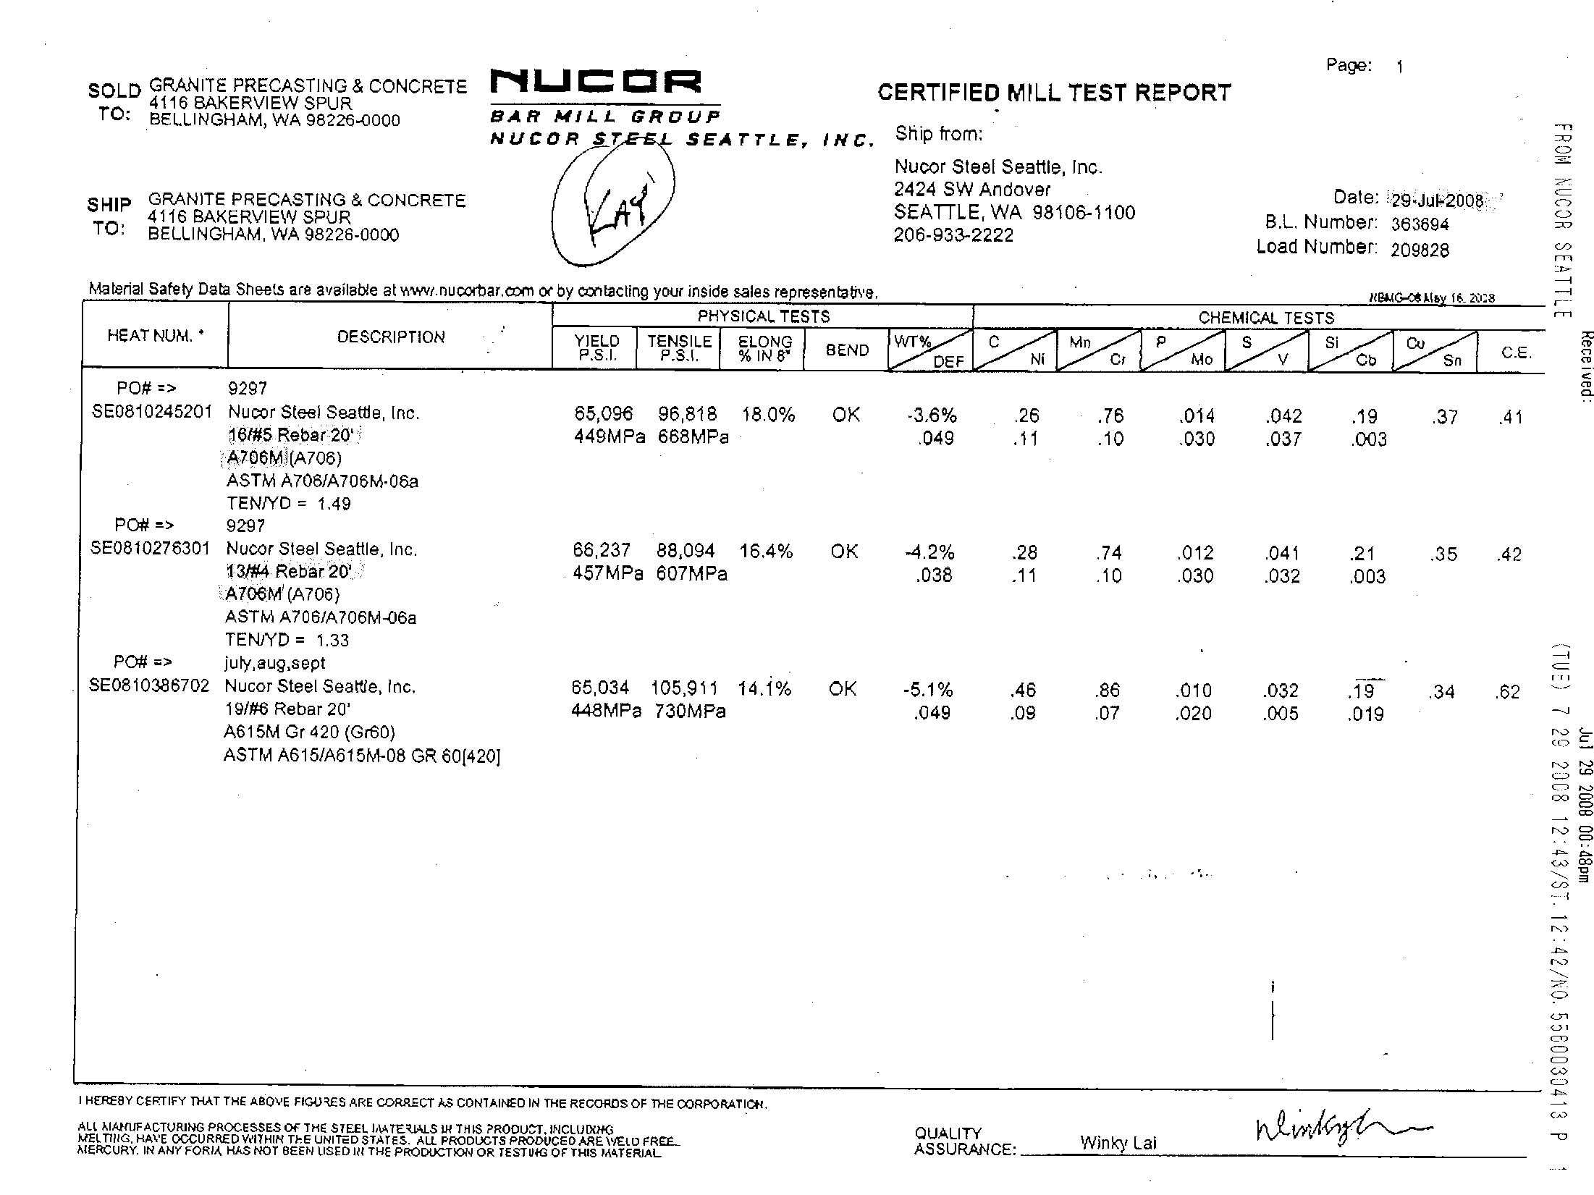

Slide 22
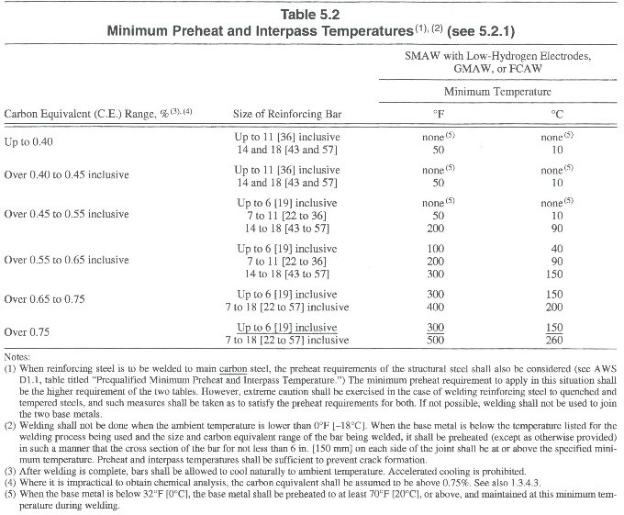
Arc Welding
AWS D1.4

Slide 23
Pre-Heating Guidelines
CONCRETEPIPE.ORG

Slide 24
Fabrication
CONCRETEPIPE.ORG

Slide 25
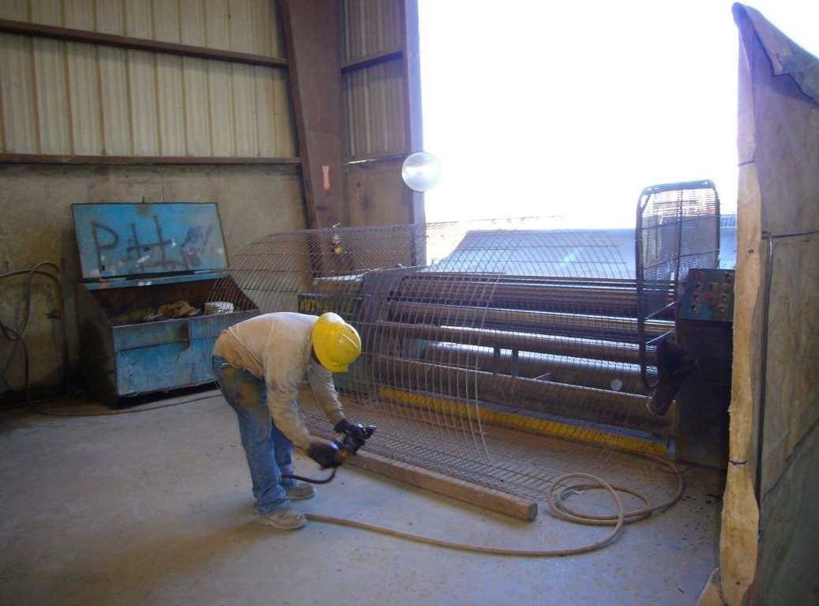

Slide 26
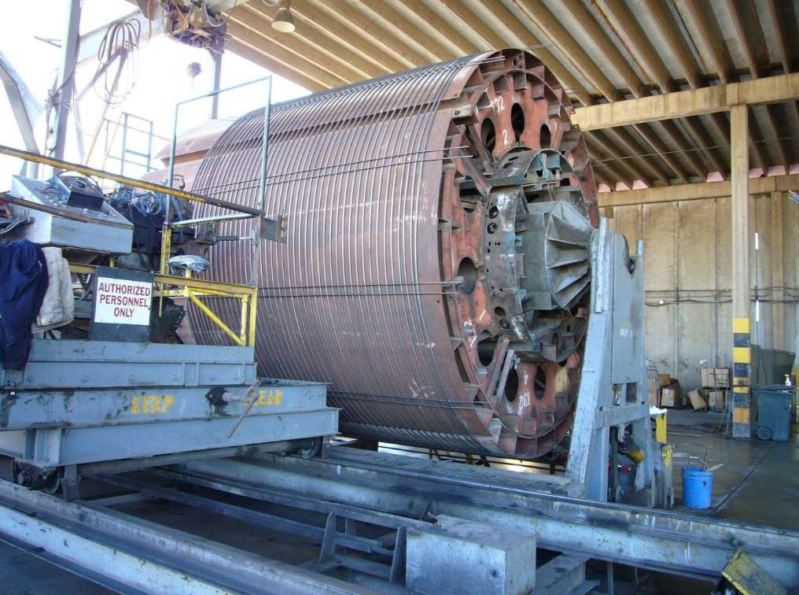

Slide 27
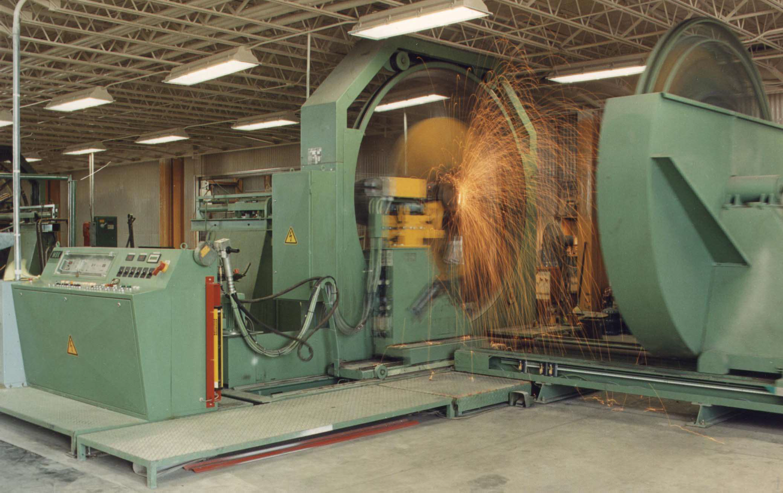

Slide 28
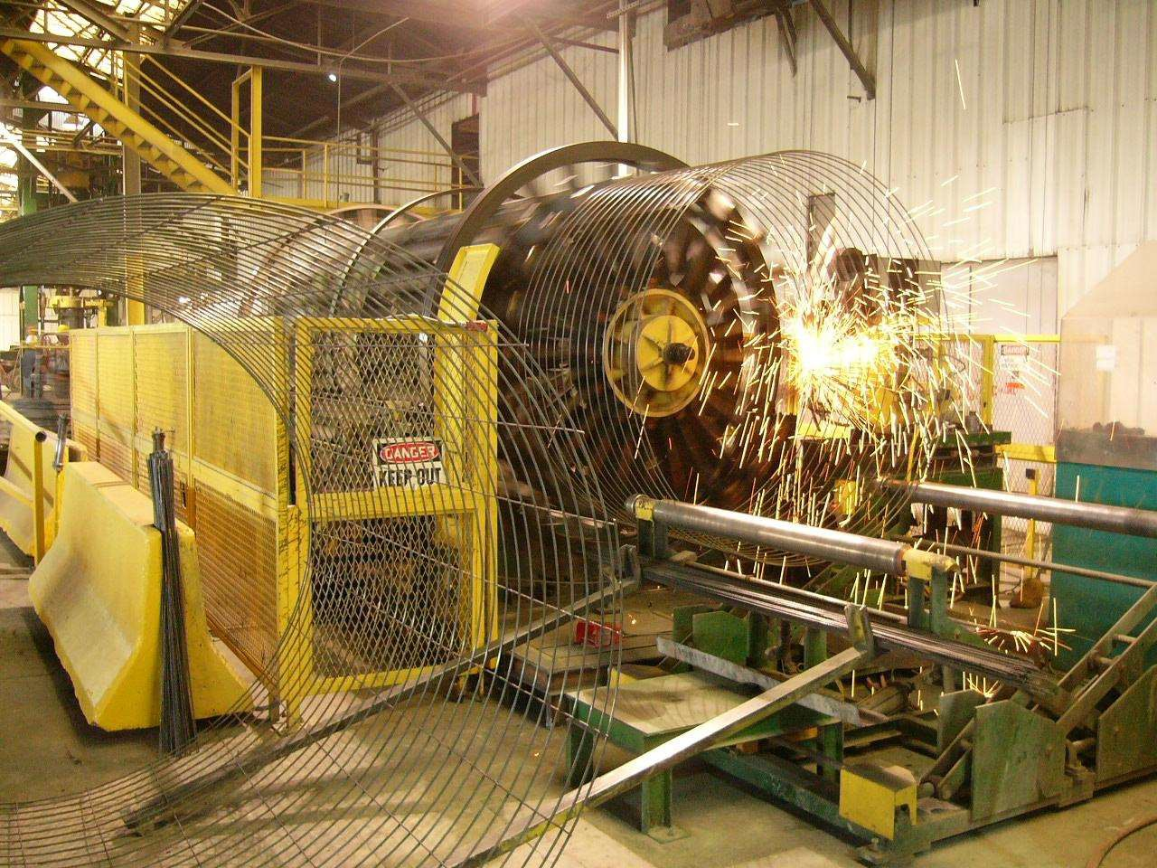

Slide 29
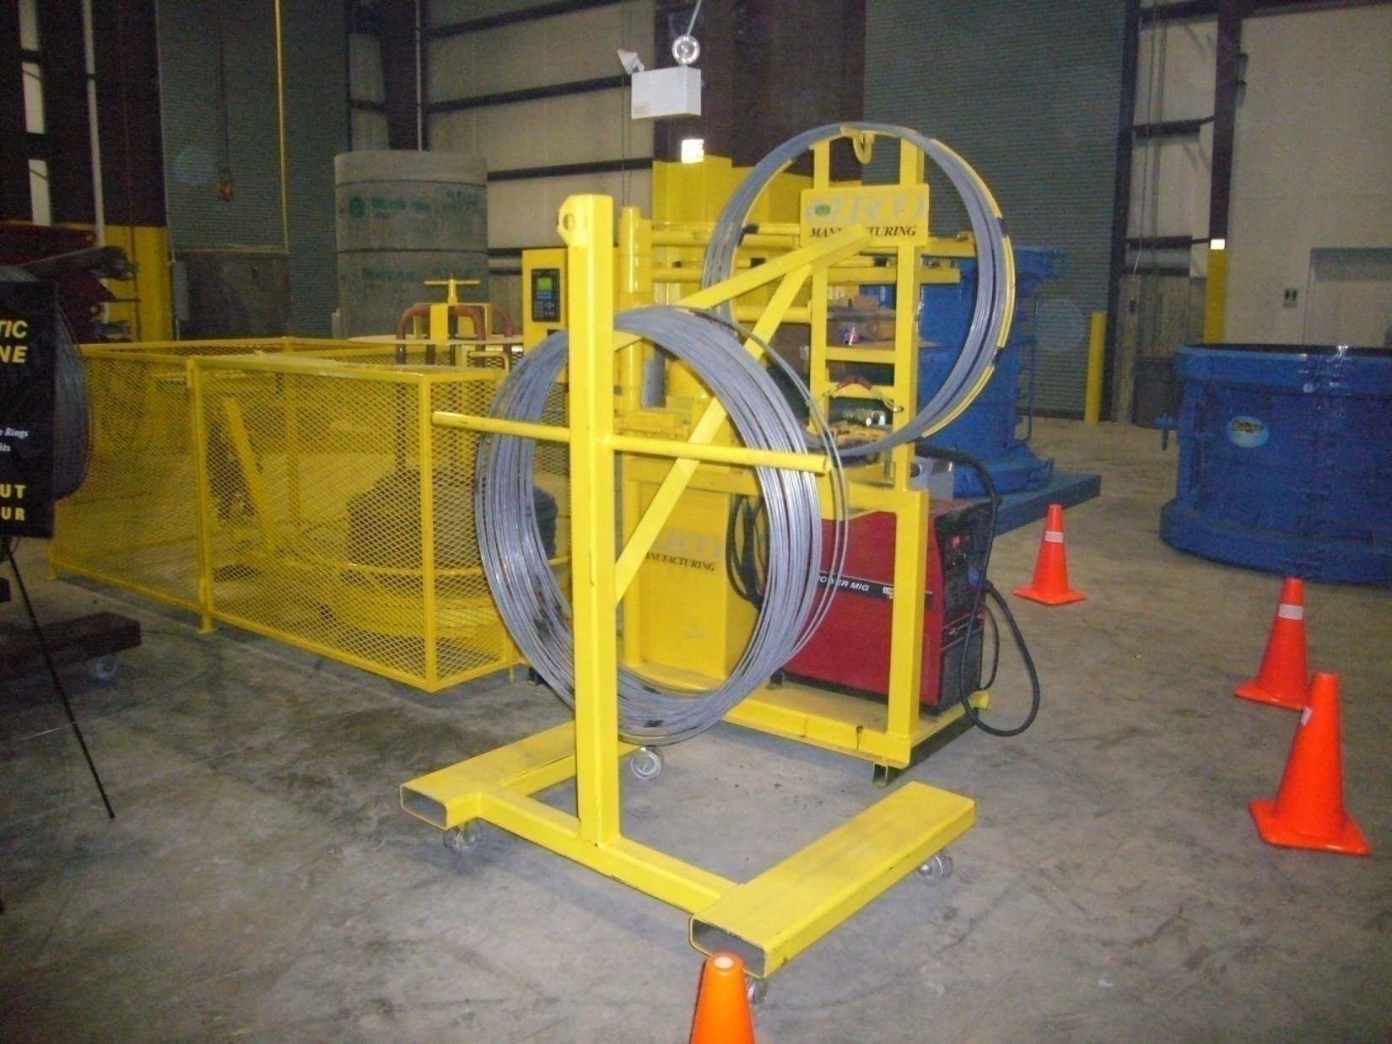

Slide 30
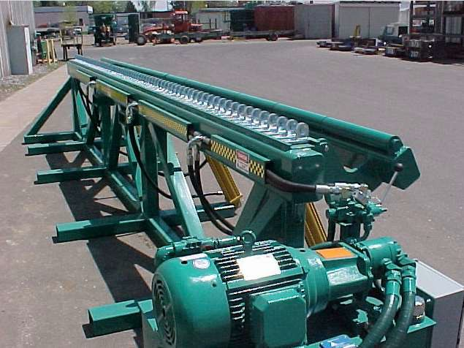

Slide 31
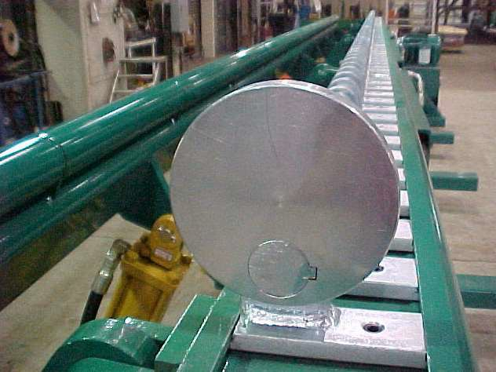

Slide 32
ACI 318 – Details of Reinforcement
Standard Hooks
Minimum Bend Diameters
CONCRETEPIPE.ORG

Slide 33
Minimum Bend Diameters – ACI 318
Bar Size Minimum Diameter
No.3 - No.8
No.9, No.10, No.11
No.14 and No.18
6d_{b} 8d_{b} 10d_{b}
d_{b} = diameter of the bar Not for Hooks or Stirrups
CONCRETEPIPE.ORG

Slide 34
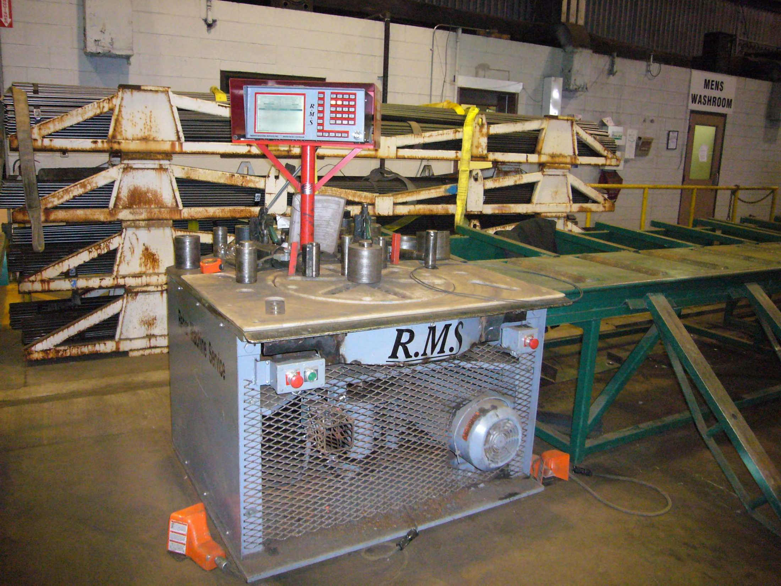

Slide 35
Minimum Bend Diameters – ASTM A1064
All bends described in terms of inside diameter
Factors affecting minimum bend diameters
Feasibility of bending without breaking
Avoidance of concrete crushing inside the bend
Welded wire fabric
W7 and smaller
Larger than W7
D6 and smaller
Larger than D6
1d_{b} 2d_{b} 2d_{b} 4d_{b}
CONCRETEPIPE.ORG

Slide 36
Plain Wire Splice Length – ACI 318
CONCRETEPIPE.ORG

Slide 37
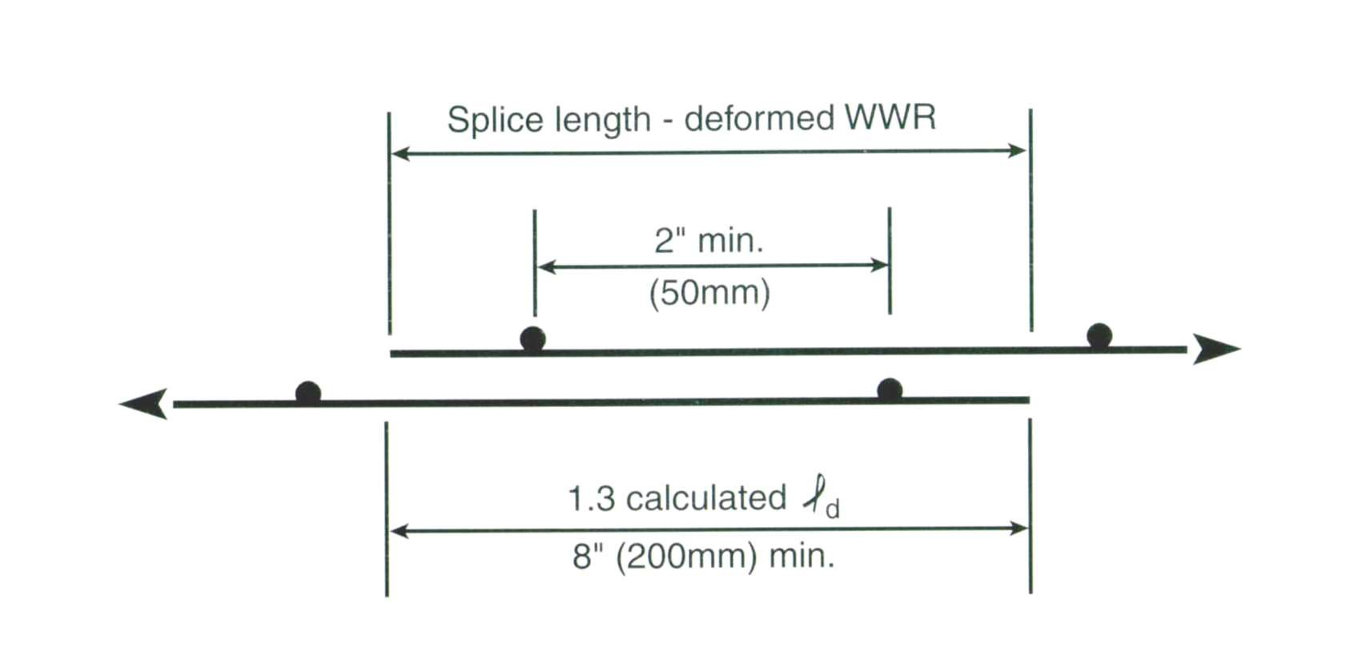
Deformed Wire Splice Length – ACI 318
CONCRETEPIPE.ORG

Slide 38
Specifications
CONCRETEPIPE.ORG

Slide 39
ASTM C76
Section 7.1 – Design Tables
Tables 1 – 5
Specify minimum required steel area
Section 7.2 – Modified/Special Designs
Permitted for situations not covered by the design tables
Submit proof of adequacy of the design
Must be approved by the owner
CONCRETEPIPE.ORG

Slide 40
ASTM C76
Section 8.1.5 – Circ. Wire Spacing
Based on wall thickness
4” Max for up to 4” wall thickness
Equal to wall thickness for 4” – 6” wall thickness
6” absolute maximum
What Is A Proper Number Of Longitudinals?
Section 8.2 – Longitudinals
Not specified , must contain sufficient longitudinal bars or members, to maintain the reinforcement in shape and in position within the form
CONCRETEPIPE.ORG

Slide 41
ASTM C76
Section 8.1
What Is A “Line” Of Reinforcement & What Is A “Layer” Of Reinforcement?
A “Line” may be made of a single Layer or multiple Layers
Two layers allowed for pipe wall less than 7”
Three layers allowed for pipe wall 7” or larger
Layers separated by maximum thickness of one longitudinal + 1/4”
CONCRETEPIPE.ORG

Slide 42
ASTM C76
Section 8.1.1 - Single Cage
Placed 35% - 50% of wall thickness from inside wall
Pipe with wall thickness <2 1/2”, Cover = 3/4”
Section 8.1.2 - Double Cage
Circular Cages - Concrete cover = 1”
Section 8.1.3 – Elliptical Cage
Elliptical Cages – Cover = 1” from wall in tension (3/4” for wall < 2 1/2”)
Section 8.1.4
Location of reinforcement subject to permissible variations of Section 12.5
CONCRETEPIPE.ORG

Slide 43
ASTM C76
Section 12.5 - Permissible Variations
Position of reinforcement, +/- 10% of wall thickness, or +/- 1/2” whichever is greater
If your cage is outside this permissible variation, is the pipe automatically rejected?
Variations exceeding those above shall be accepted if D-load passes
Must maintain minimum cover requirements (1/2” from any surface except: 1/4” from end of spigot, mating surfaces of nonrubber gasket joints or gasket groove)
CONCRETEPIPE.ORG

Slide 44
ASTM C76
Section 8.3 - Joint Reinforcement
Non-rubber gasket joint
For pipe 36” & larger, either the bell or spigot shall contain circumferential reinforcement
Rubber gasket joint
For pipe 12” & larger, the bell ends shall contain circumferential reinforcement
CONCRETEPIPE.ORG

Slide 45
ASTM C76
Section 8.1.8 - Splices
Welding
Lap = min 2”, and a weld of sufficient length that pull test = at least 50% of min specified tensile strength of the steel
butt-welded splices permitted only with helically wound cages, Strength = 75% of min specified strength of the steel
Lapping
Lap = 20/40 Bar Diameters (Deformed/Plain)
WWR lap must contain a longitudinal
CONCRETEPIPE.ORG

Slide 46
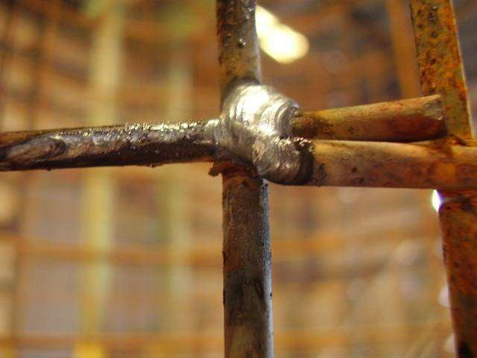

Slide 47
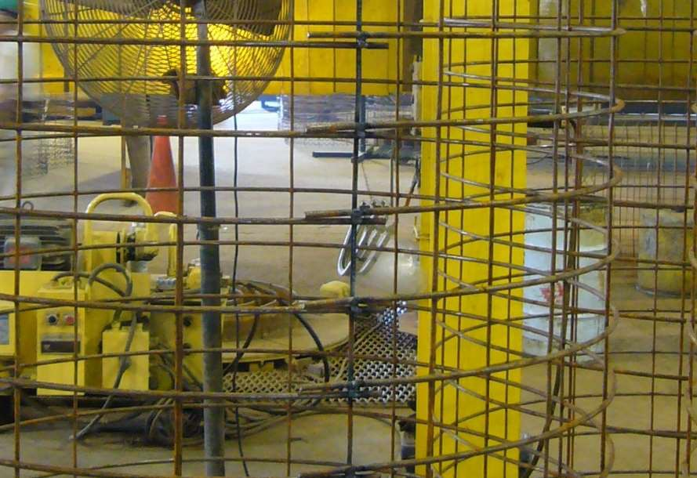

Slide 48
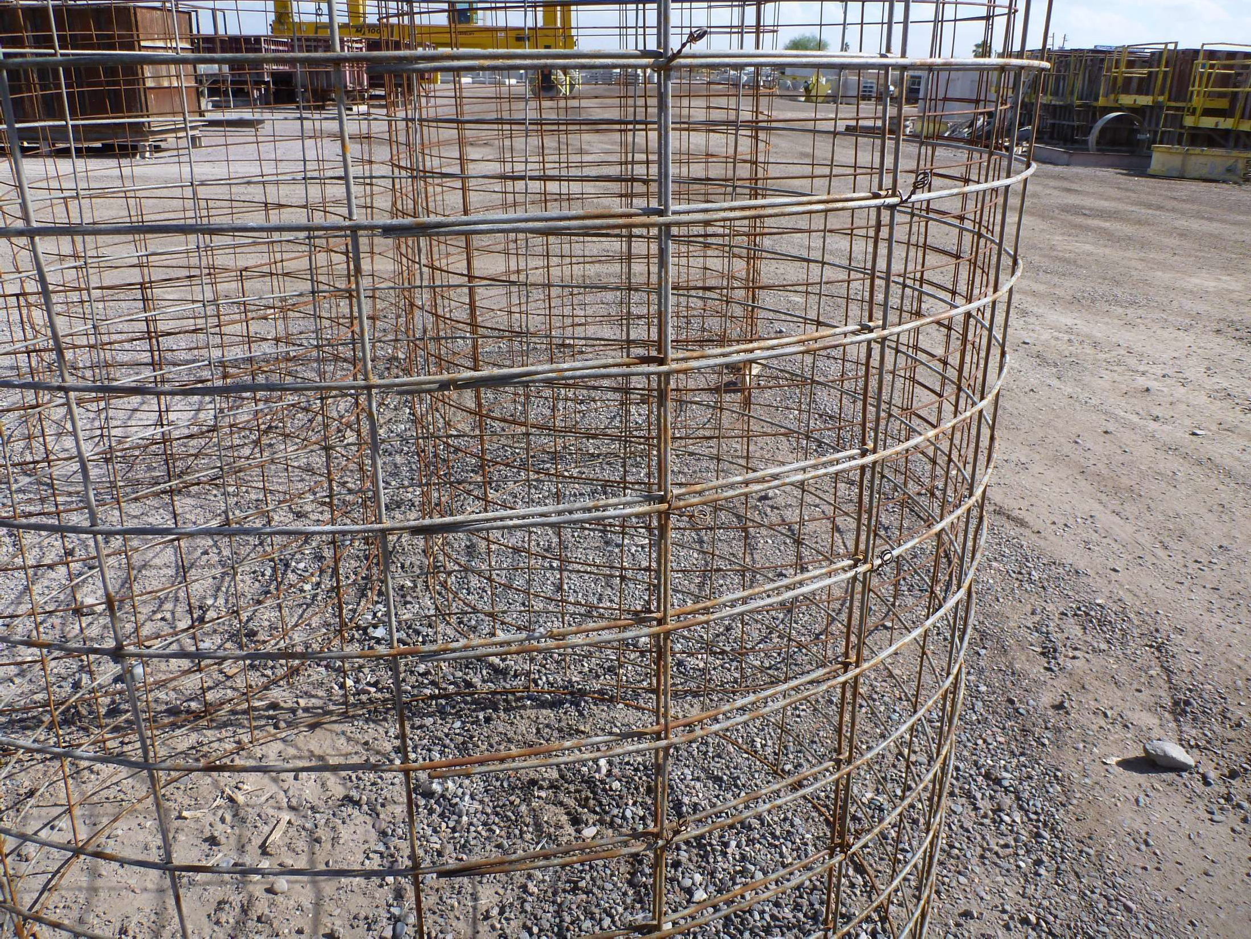

Slide 49
ASTM C478
Sections 6.4.1 and 6.4.2 contain the same wording as for Sections
8.1.8 and 8.1.8.1 of ASTM C76
CONCRETEPIPE.ORG

Slide 50
ASTM C76
Spacers & Chairs
How many spacers/chairs should you have & where should they be placed?
Section 8.2
The exposure of the ends of longitudinals, stirrups, or spacers that have been used to position the cages during the placement of the concrete shall not be a cause for rejection.
Use enough to maintain the cage in place!
CONCRETEPIPE.ORG

Slide 51
ASTM C1433/1577
Section 7 – Design
Design Tables
Modified/Special designs are allowed
Circ. Spacing = 2”–4”, Long spacing = 8” max
Section 7.3 – Placement of Reinforcement
Subject to permissible variations of Section 12
Section 7.4 – Laps & Welds
All splices made by lapping
Beware the Restricted Welding Zones!
CONCRETEPIPE.ORG

Slide 52
ASTM C1433/1577
Section 7.4 – Laps
The overlap measured between the outermost longitudinal wires of each fabric sheet shall not be less than the spacing of the longitudinal wires plus 2 in. but not less than 10 in.
CONCRETEPIPE.ORG

Slide 53
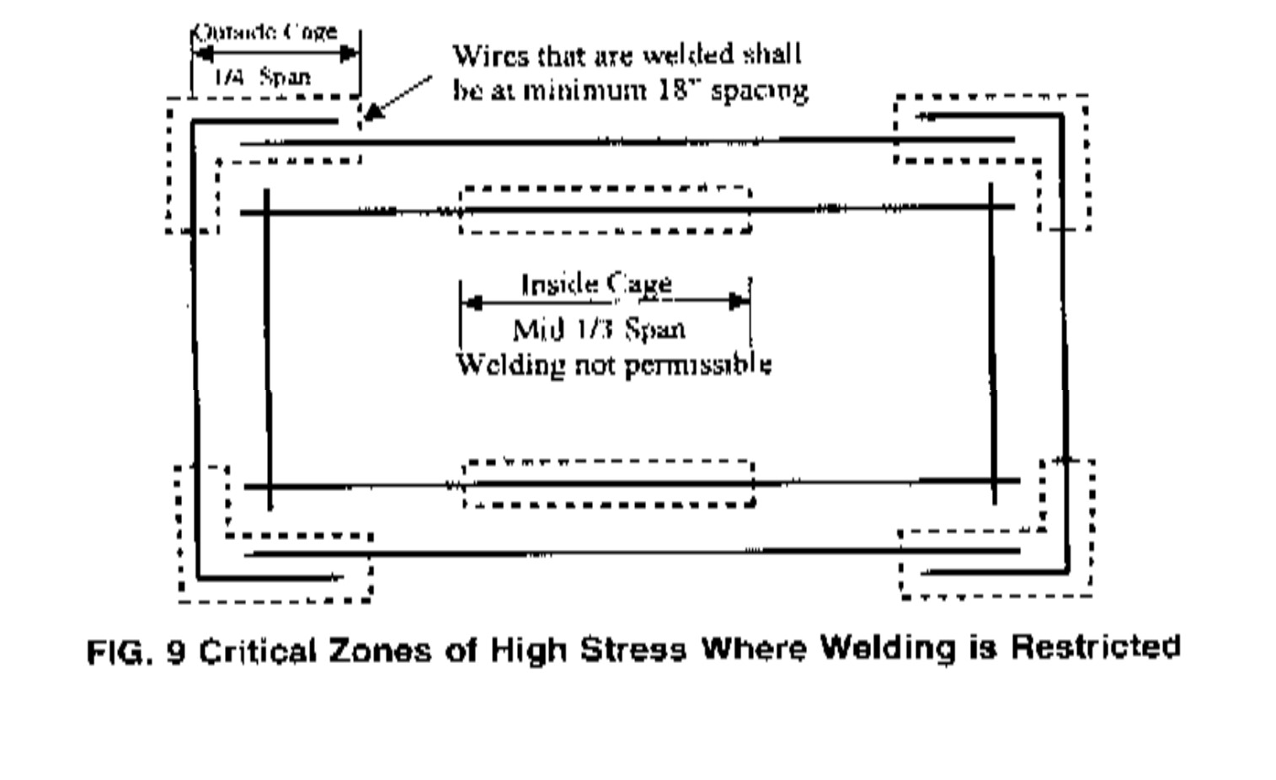
ASTM C1433/1577
Do you know the Restricted Welding Zones?
CONCRETEPIPE.ORG

Slide 54
What Makes a Good Cage?
Right Steel Areas (Circumferential & Longitudinal)
Correct Cage Dimensions
Proper Lap &/or Good Welds
Proper Spacers & Chairs
Meet Specifications
CONCRETEPIPE.ORG

Slide 55
Thank You
Jake Jyrkama, P.E. Jaakko.Jyrkama@RinkerPipe.com

